Slide 1
Biological experiment PoP experiment

Slide 2
ITRF PA2 work packages

Slide 3
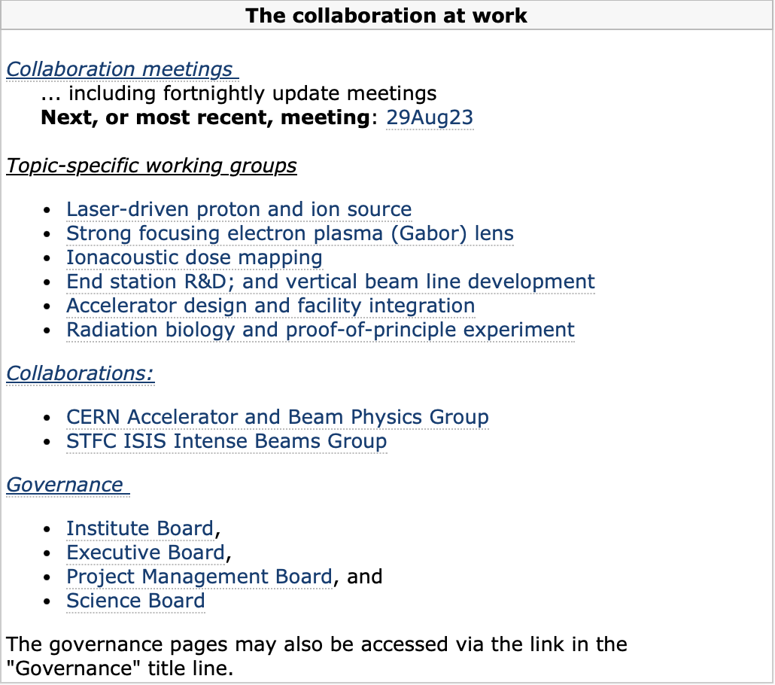
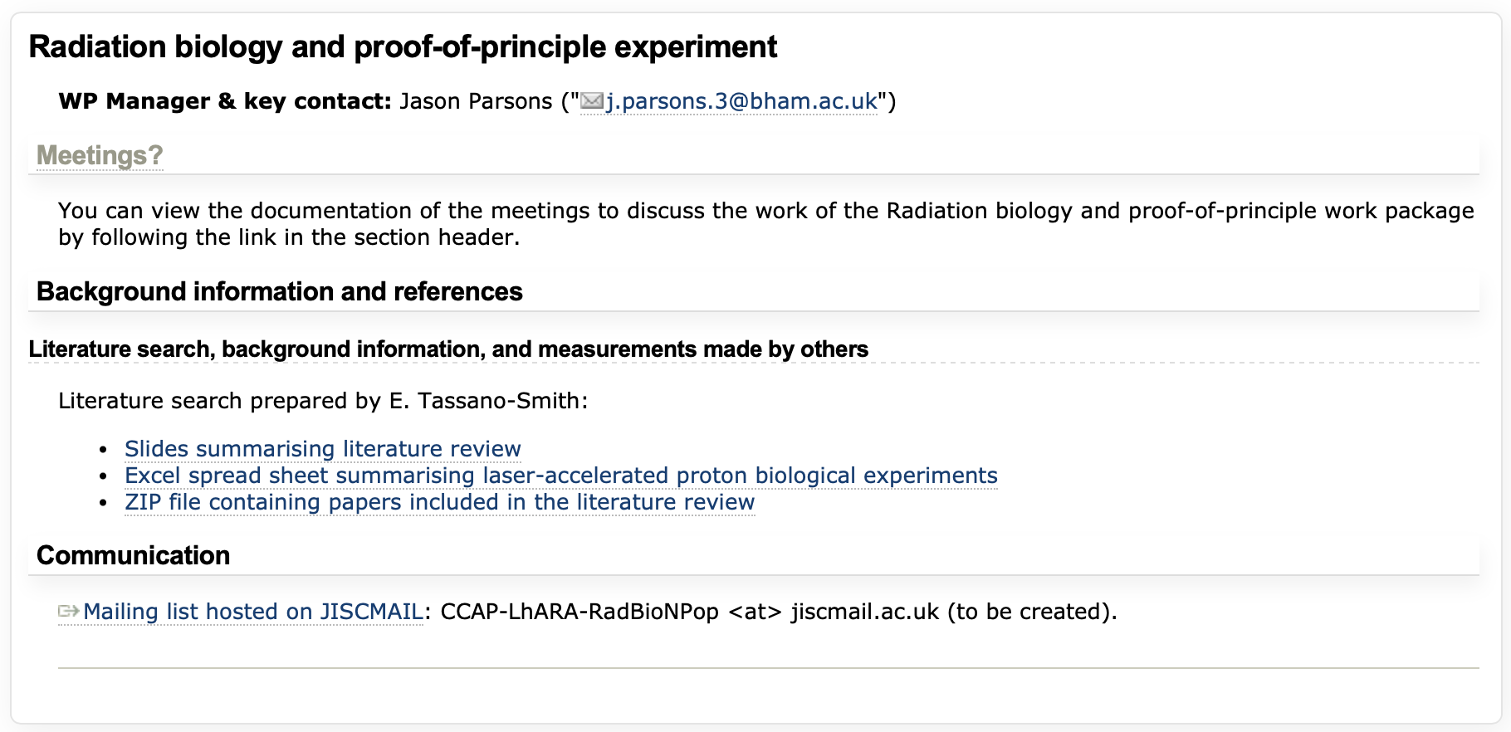

Slide 5
sdfv
Development of radiation biology programme:
  At existing facilities:
    Novel (e.g. laser driven)
    Conventional
Josie, Jason, Yolanda taking steps …
LhARA proof-of-principle experiment:
  CW: “… include as many of key LhARA elements as possible …”
Focus of today’s discussion

Slide 6
Review of radiobiology experiments using laser accelerated protons
E. Tassano-Smith

Slide 7
Paper Selection
Cellular Irradiations with laser driven carbon ions at ultra high dose rates. doi: 10.1088/1361-6560/aca387
A new platform for ultra high dose rate radiobiological Research using the BELLA PW Laser Proton Beamline. doi: 10.1038/s41598-022-05181-3
Tumour irradiation in mice with a laser-accelerated proton beam. doi: 10.1038/s41567-022-01520-3
Ultra-High Dose Rate FLASH Irradiation Induced Radio-Resistance of Normal Fibroblast Cells Can Be Enhanced by Hypoxia and Mitochondrial Dysfunction Resulting From Loss of Cytochrome C. doi: 10.3389/fcell.2021.672929
Spectral and spatial shaping of laser driven proton beams using a pulsed high field magnetic beamline. doi: 10.1038/s41598-020-65775-7
A feasibility study of zebrafish embryo irradiation with laser- accelerated protons. doi: 10.1063/5.0008512
Fast dose fractionation using ultra-short laser accelerated proton pulses can increase cancer cell mortality, which relies on functional PARP1 Protein. doi: 10.1038/s41598-019-46512-1
DNA DSB Repair Dynamics following Irradiation with Laser-Driven protons at Ultra-High Dose Rates. doi: 10/1038/s41598-019-40339-6
The radiobiology of laser-driven particle beams: focus on sub-lethal responses of normal human cells. doi: 10.1088/1748-0221/12/03/C03084
Ultra-short laser accelerated proton pulses have similar DNA-damaging effectiveness but produce less immediate nitroxidative stress than conventional proton beams. doi: 10.1038/srep3244
Dose controlled irradiation of cancer cells with laser-accelerated proton pulses. doi: 10.1007/s00340-012-5275-3
A laser driven nanosecond proton source for radiobiological studies. doi 10.1063/1.4769372
Biological effectiveness on live cells of laser driven protons at dose rates exceeding 10^9 Gy/s. doi: 10.1063/1.3699063
Dosimetry and spectral analysis of a radiobiological experiment using laser-driven proton beams. doi: 10.1088/0031-9155/56/21/013
Measurement of relative biological effectiveness of protons in human cancer cells using a laser driven quasimonoenergetic proton beamline. doi: 10.1063/1.3551623
Dose-dependent biological damage of tumour cells by laser-accelerated proton beams. doi: 10.1088/1367-2630/12/8/085003
Application of laser accelerated protons to the demonstration of DNA double strand breaks in human cancer cells. doi: 10.1063/1.3126452

Slide 8
Results Table
I reviewed each paper and took what I thought were the key pieces of information and laid it out in a table:
  Year of publication
  Laser Beamline
  Test Radiation (particle type, energy, dose)
  FLASH Specifications (MDR, IDR, dose/pulse, pulse count, rate and duration)
  Reference Radiation (particle type, energy, dose)
  Cell experiment (model, setup, outcomes)
  Comments

Slide 9
LASERs
ASTRA GEMINI at RAL
BELLA PW Laser Proton Beamline
DRACO PW Laser
CLAPA Laser
ATLAS 300 Laser at the LION Beamline
SAPHIR
PICO200
200 TW ARCTURUS
TARANIS
J-KAREN
ELIMAIA

Slide 10
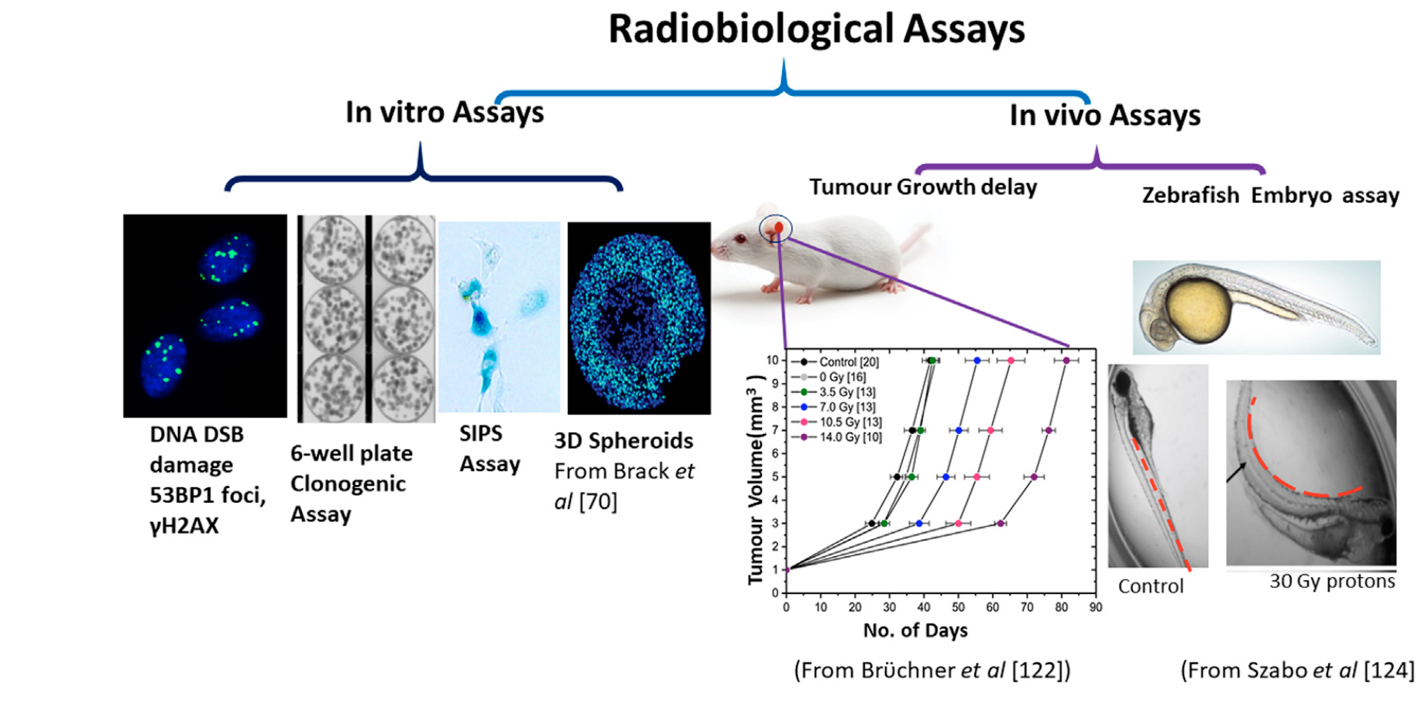
Radiobiology Experiments
Chaudhary P, Milluzzo G, Ahmed H, Odlozilik B et al. Radiobiology Experiments with Ultra-high Dose Rate Laser-Driven Protons: Methodolofy and State-of-the-Art. Frontiers in Physics. 2021;9

Slide 11
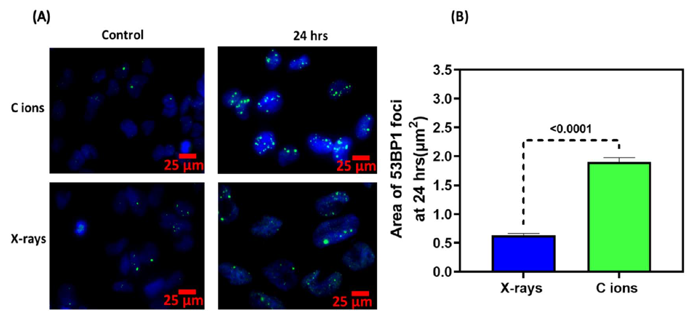
Examples
Cellular Irradiations with laser driven carbon ions at ultra high dose rates. doi: 10.1088/1361-6560/aca387
ASTRA GEMINI Laser Beamline
Foci Size post Irradiation

Slide 12
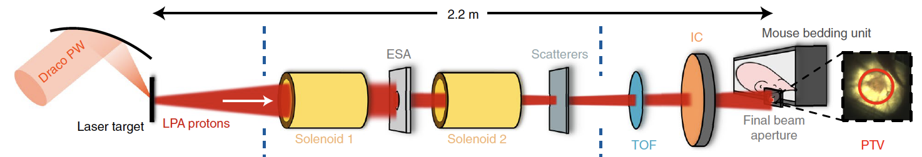
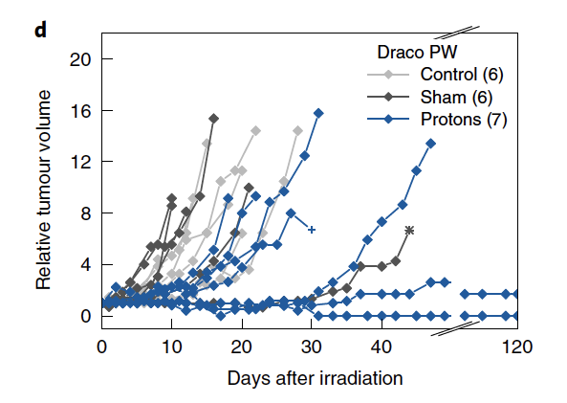
Example Set Ups
Tumour irradiation in mice with a laser-accelerated proton beam. doi: 10.1038/s41567-022-01520-3
DRACO PW Laser
Growth of Tumour Post Irradiation

Slide 13
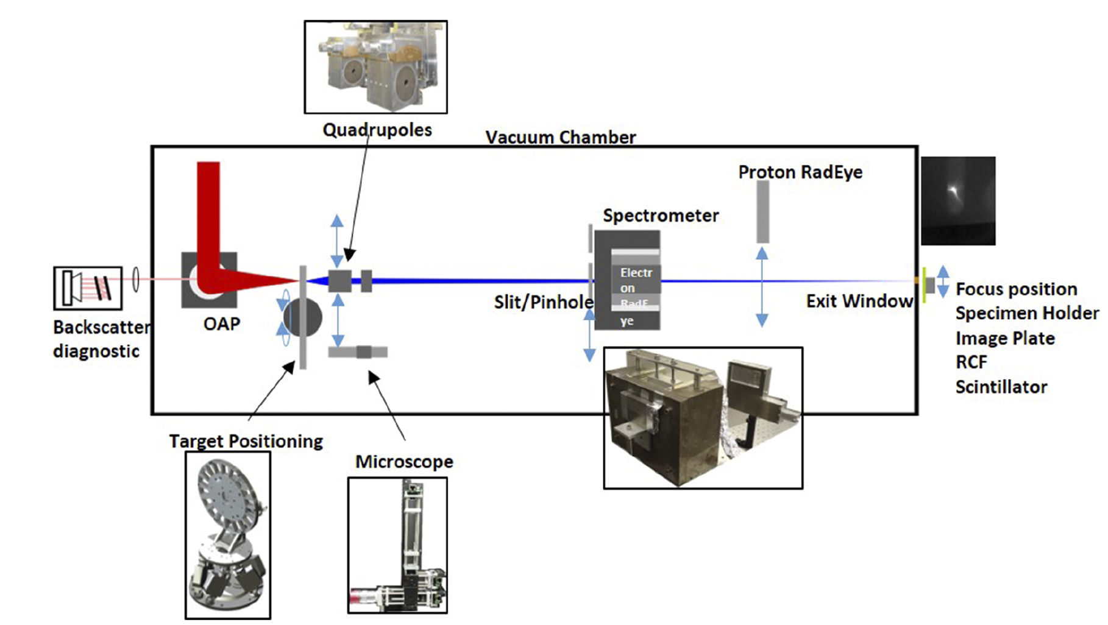
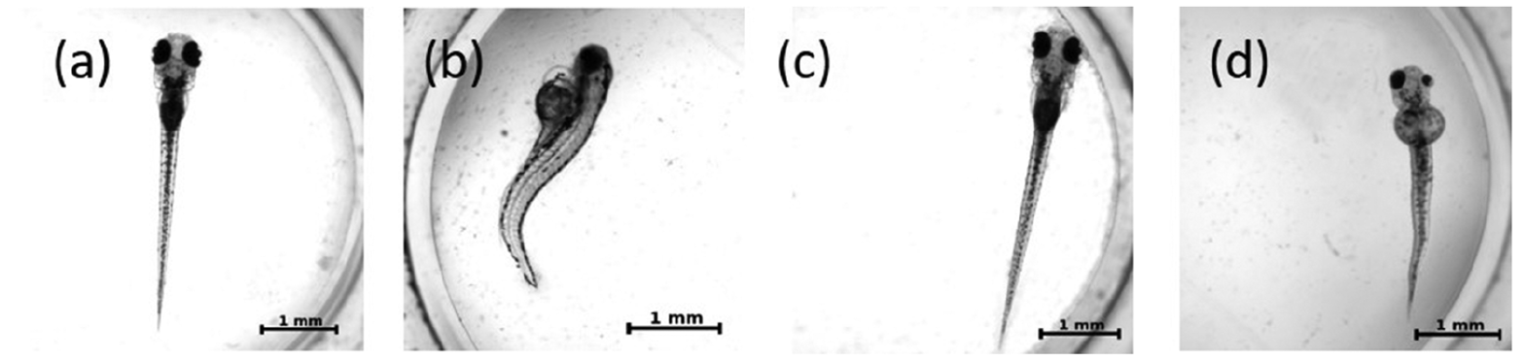
Example Set Ups
A feasibility study of zebrafish embryo irradiation with laser- accelerated protons. doi: 10.1063/5.0008512
ATLAS 300 Laser at the LION Beamline
Comparison of Irradiated versus Control Embryos

Slide 14
End of intro ...
LhARA (our) bio programme needs to be developed to culminate in exploitation of:
  PoP experiment … and …, ultimately, LhARA
Today discuss how we should define/specify the PoP experiment

