Slide 1
WP5 End-stations Update
12th March 2024
Tony Price on behalf of WP5

Slide 2
Consultation Meetings
Consultation Meeting 1
  Focus on Stage 1 in-vitro and stage 2 in-vivo
  London/Online
  December 2022
  Attended by > 50 people
  Agenda and presentations https://indico.stfc.ac.uk/event/668/
  Write up and recommendations https://www.overleaf.com/project/63fde3bc54032d1d77b71519
Consultation Meeting 2
  Focus on Stage 1 in-vitro
  Birmingham
  June 2023
  ~20 in person and online
  Agenda and presentations https://indico.stfc.ac.uk/event/780/
  Write up and recommendations https://www.overleaf.com/project/64cba6a69dc3f7ebdf52c346

Slide 3
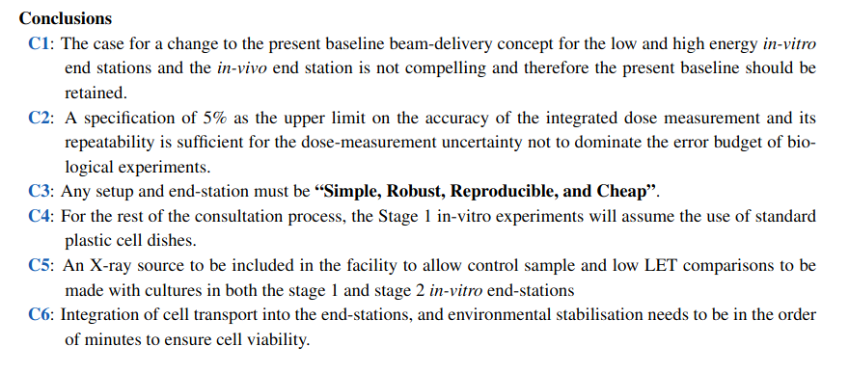
Conclusions and Recommendations

Slide 4
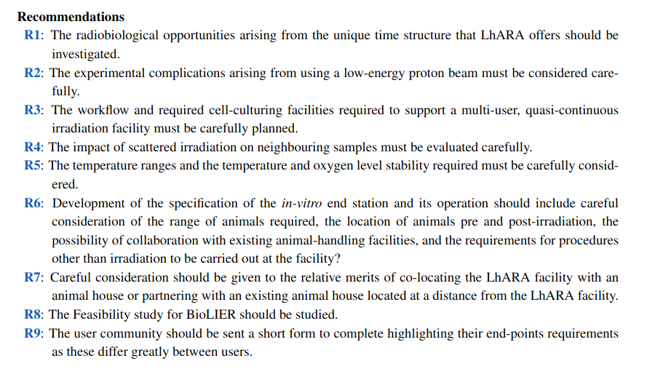
Conclusions and Recommendations

Slide 5
Conclusions and Recommendations
C2
covered by NK and MP as well as UoB Y4 student project
R2 and R4
Geant4 Simulation Developed and presented at Colab2
C6 and R5
being studied by Y4 UoB masters projects
R6 and R7
Consultation Meeting 3
R9
Questionaire sent out. Tony needs to chase and sort

Slide 6
Consultation Meetings
Consultation Meeting 3
  Focus on in-vivo
  Liverpool (thanks to Narender and Milaan)
  Jan 2024
  Attended by ~20 people and two invited speakers
    Martin Fray from Mary Lyons Institute
    Prof David Killick (Professor of Vetinary Oncology)
Primarily to discuss the legislations and implications on the whole facility of animal work, both experimental and companion animals
Agenda and Presentations https://indico.stfc.ac.uk/event/923/
Write up …. ongoing

Slide 7
Consultation Meeting 3 – Key Outcomes
Legislation required for animal work is different for vet studies and for experimental work on rodents. We must keep both of these in mind and some are complimentary, some contradictory for the work flow
For experimental animal work
  it is essential to have animal houses on site and it’s a "one way trip" for the animals. Can be reared and provided by other facilities but cannot go back there after irradiation.
  Facility must be close to animal source (where close was undetermined but <50km) for legislation
  Licenses - Establishment license (PEL), project license (PPL), individual license (PIL)
  PEL itself has 25 conditions which must be met
  Mary Lyons can work with us to ensure we cover legislation as we need it (beyond the scope of WP5 ATM)
  Controlled environments for avoid excess stress to animals 22 degrees C +/- 2, humidity 55% +/- 10%, controlled lighting
Companion Animals
  Needs consultants close by / in-house to protect animal welfare. Impact on location of ITRF
  Trials can be undertaken if vet believes there is a potential benefit to the animal
  Owners can provide consent to studies
  Animals generally home same day and require somewhere on site for owners to wait. This would be a new call on the building design.

Slide 8
UoB Masters Projects
Amber Jones and Eleanor Gaggs
Working on dosimetry
  GafChromic EBTXD
  0.4 cGy to 50 Gy -> Ideal for LhARA ranges
Silicon strip detectors
Beam alignment
Automation
Environmental box ideas
14 MeV onto sample beam tested at MC40

Slide 9
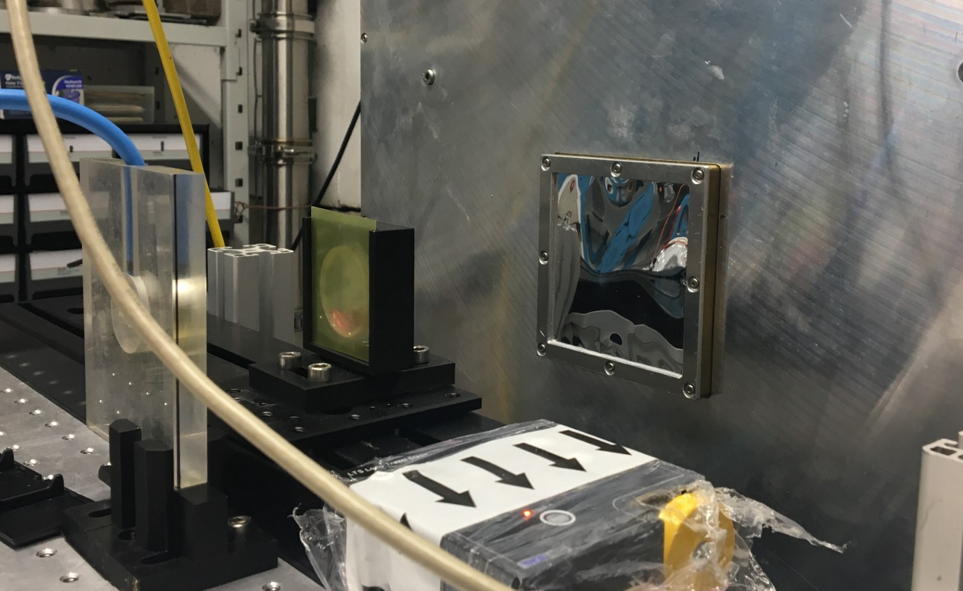
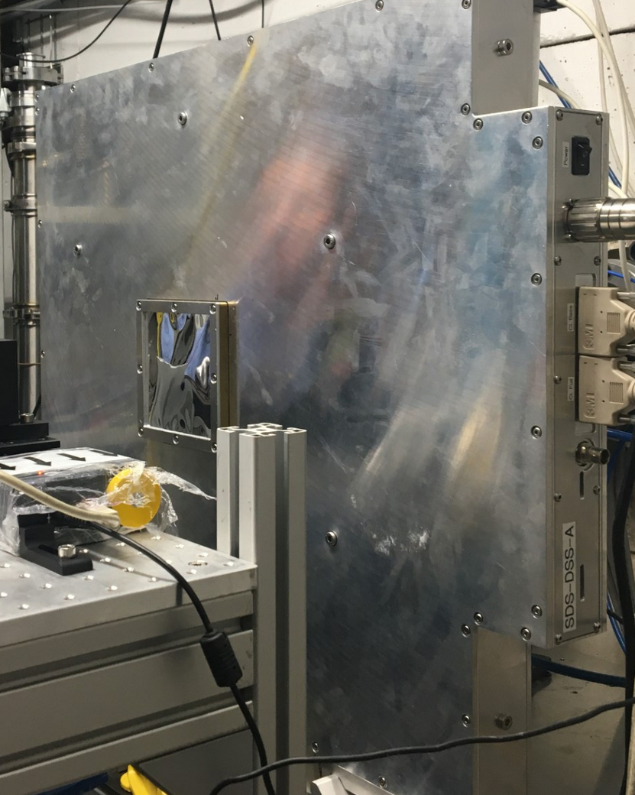
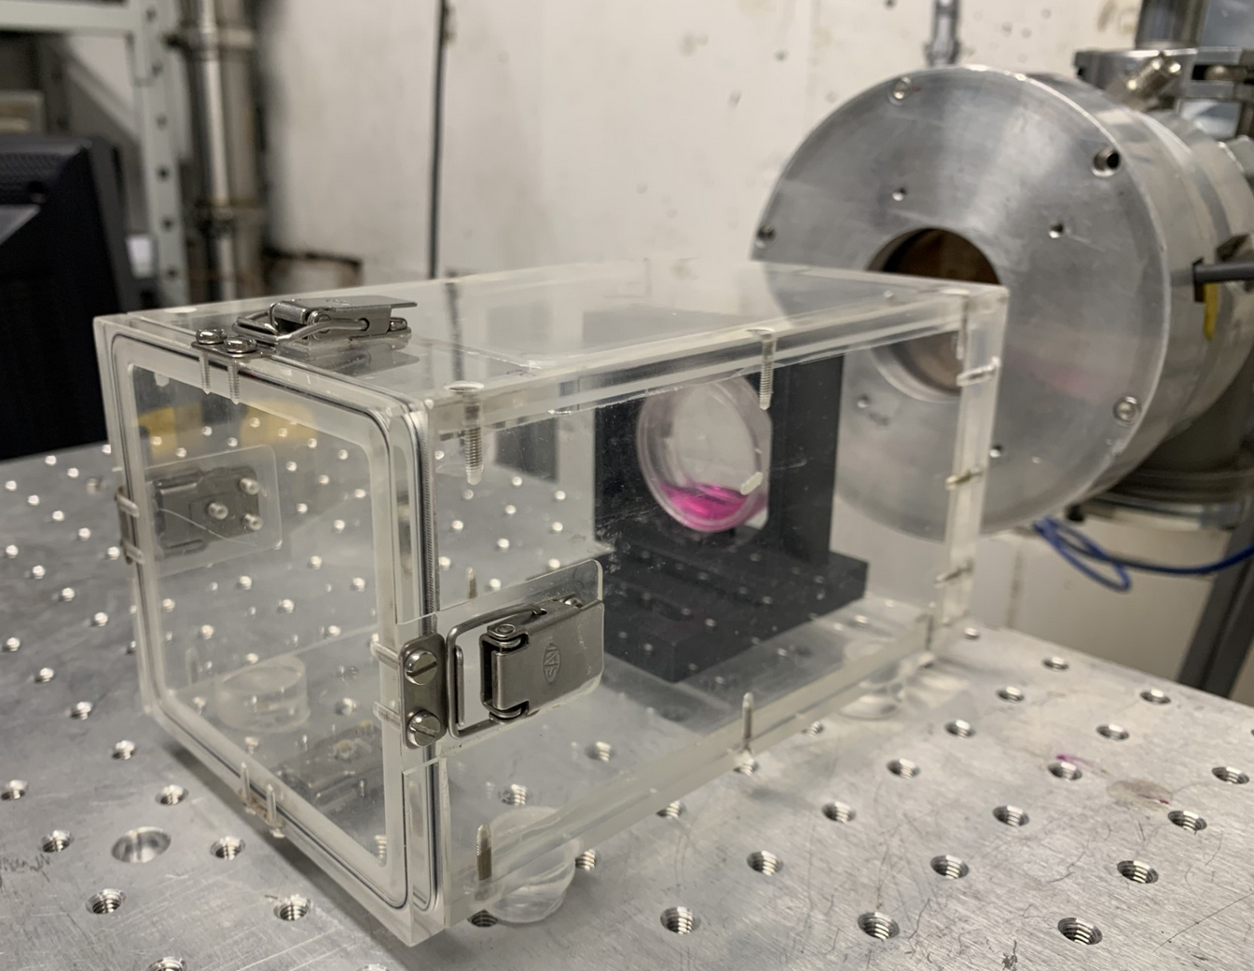
PRaVDA proton CT tracker operating in treatment mode
Three layers of 150um thick silicon
96um strip pitch
Frame rate of 10kHz
Three synchronised 1D profiles can be obtained

Slide 10
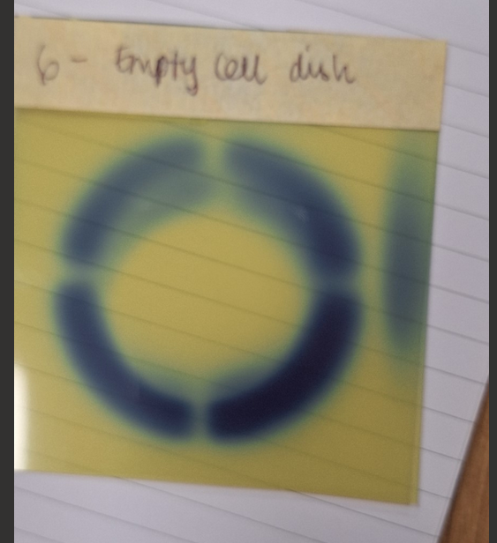
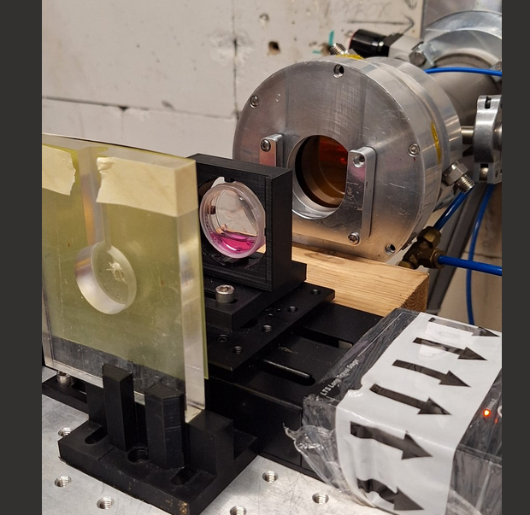
14 MeV beam onto 3D printed holding cell dish in place. Attached to 1D moving stage (for now)
EBTXD film behind the cell dish
Beam completely stopped by the cell dish and 3D holder.
Machine learning being developed to identify centre of cell dish relative to the beam
Could be extended to any detector system inside the env chamber and behind the cell dish to check alignment

Slide 11
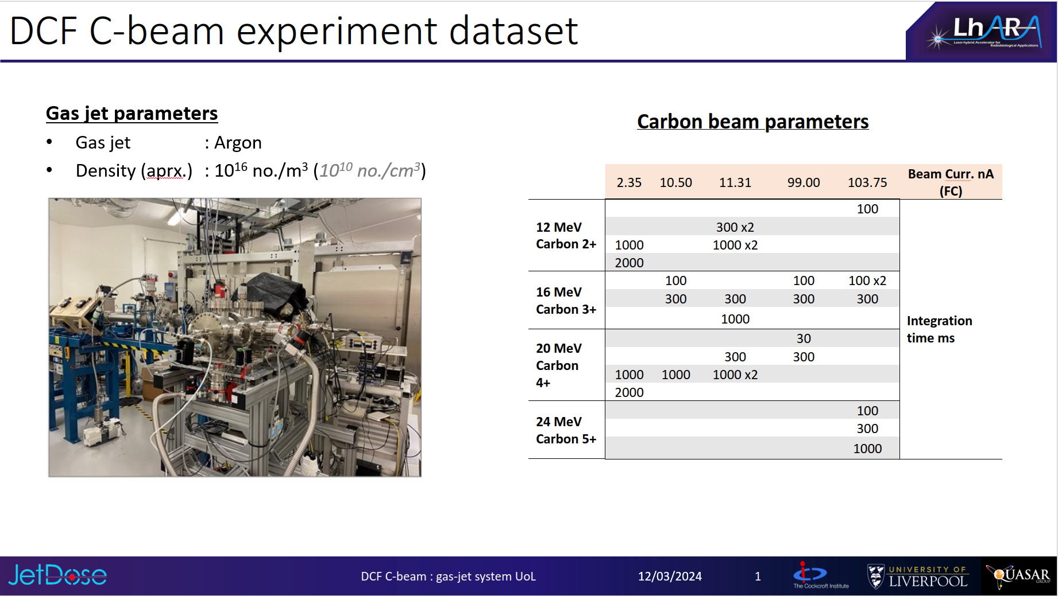

Slide 12
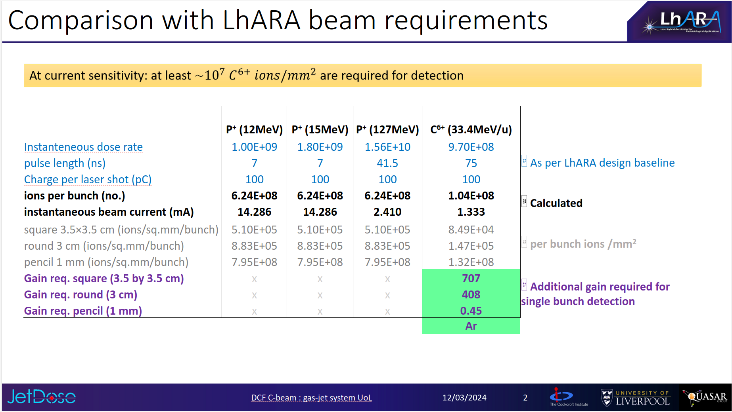

Slide 13
