Slide 1
News and update
K. Long
July 14, 2026

Slide 2
Apologies …
I will be on the road when the meeting starts, so can not join!

Slide 3
Continuing refresh
Urgent:
  Matt Periera
    Logo slide! – ready!
      Used on 21May26 and now for RS Summer Science Exhibition
      And on lhara.org
Not so urgent:
  Ongoing (also Matt):
    IB list update, not so urgent, but underway
      Stalled, need to restart
No progress!
Seek to pick up now that RS SSE is passed

Slide 4
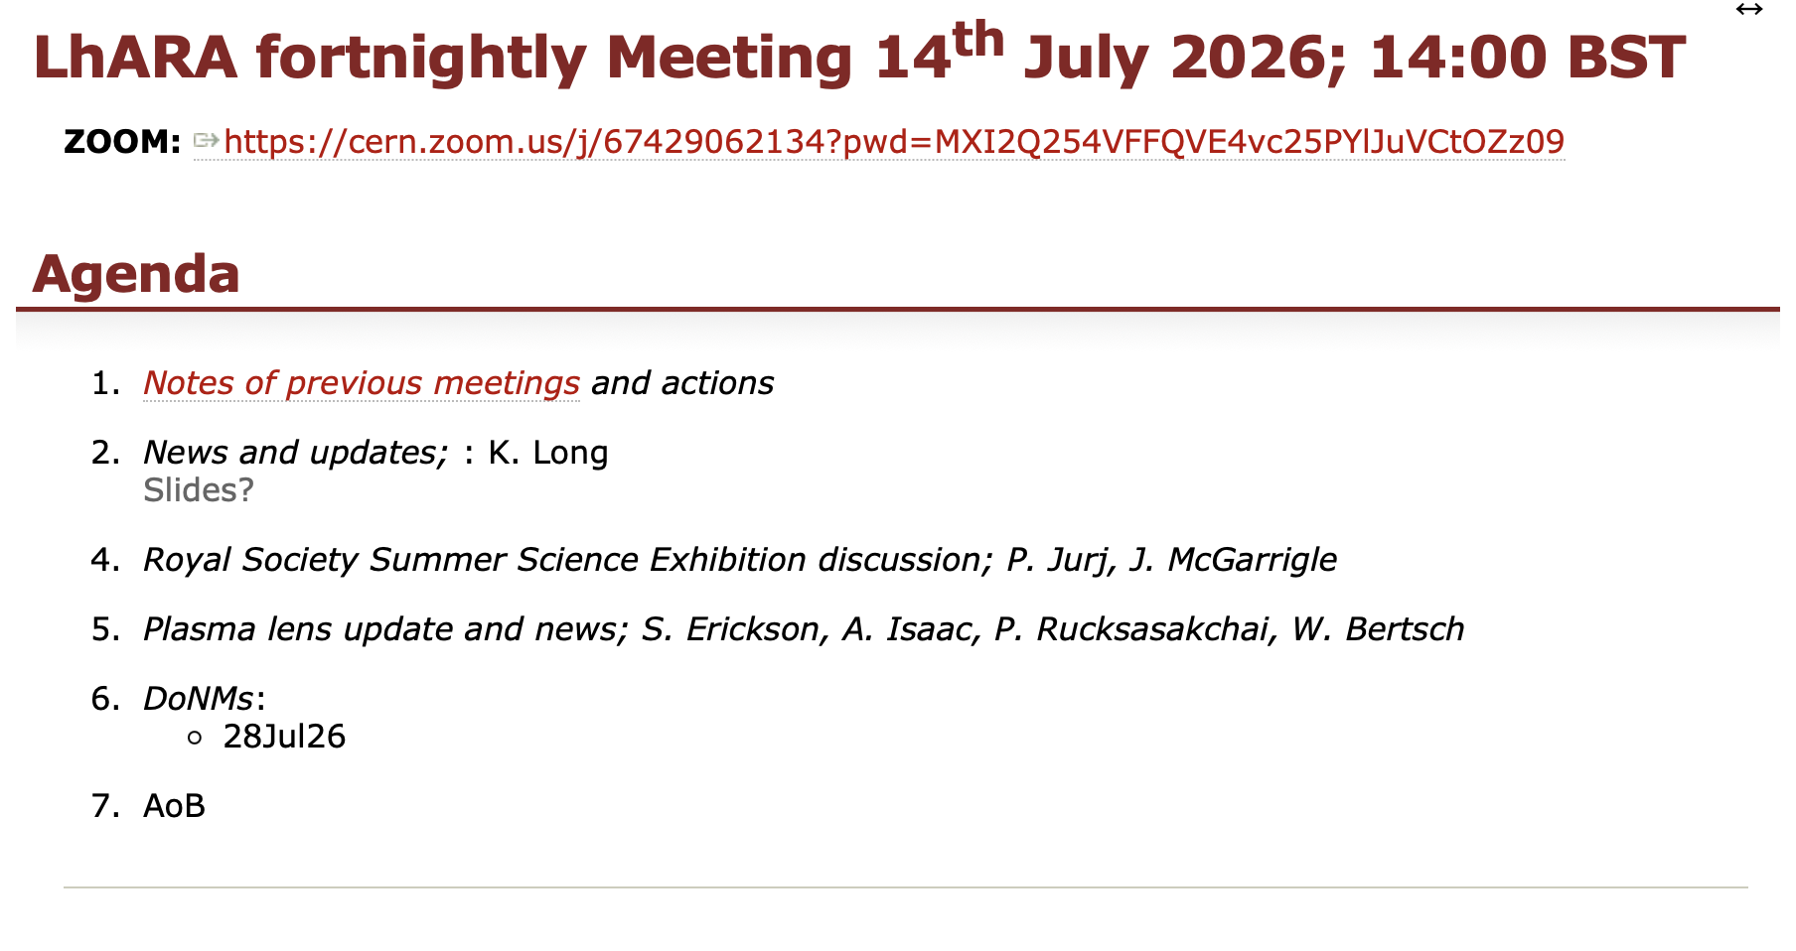
Main news

Slide 5
Updates:
Royal Society Summer Science Exhibition:
  Review impressions today
  Then take stock and follow-up on contacts and discussions
  Debrief last week:
    Consensus to engage with “Exhibition on Tour”;
      Support for this course of action?
Engagement with O. Glover, MP or Didcot and Wantage:
  Harwell Science and Innovation Campus in his constituency
    KL/PP working with STFC/RAL staff on OG visit to Harwell 21Jul26

Slide 6
Peer-group meeting series
Past:
  CP4CT w/s: International strategic workshop; what will be the unique advantages of laser driven charged particles
    https://indico.stfc.ac.uk/event/1703/
Coming up:
  Cylindrically-symmetric strong focusing of ion beams;
    11Sep26; IoP HQ in London
  Novel time-resolved, high-resolution imaging;
  Biology, measurement, simulation and interpretation of ion beams

Slide 7
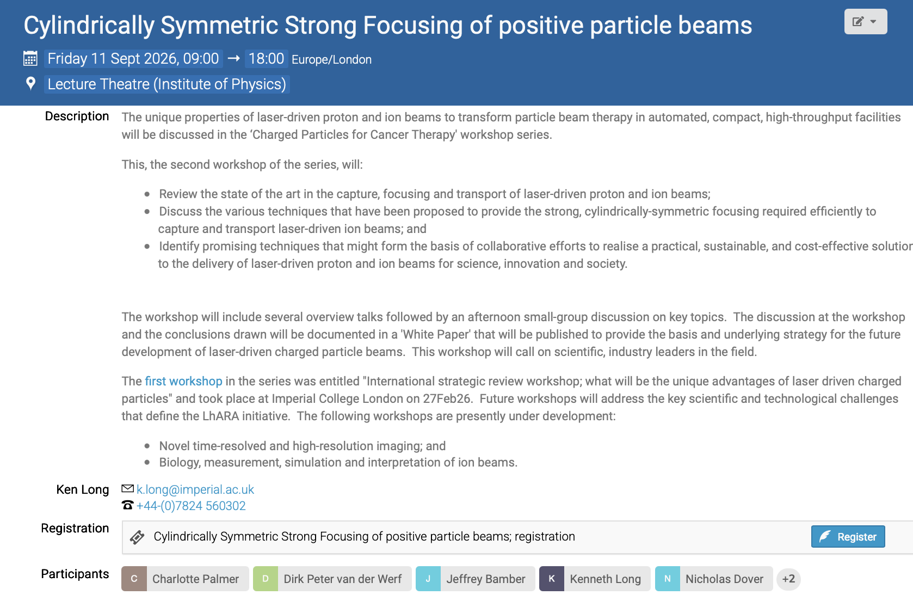
Please:
Register
Circulate

Slide 8
Going forward
Next fortnightly:
  28Jul26
Next collaboration meeting:
  Now likely Dec26; venue to be decided

