Slide 1
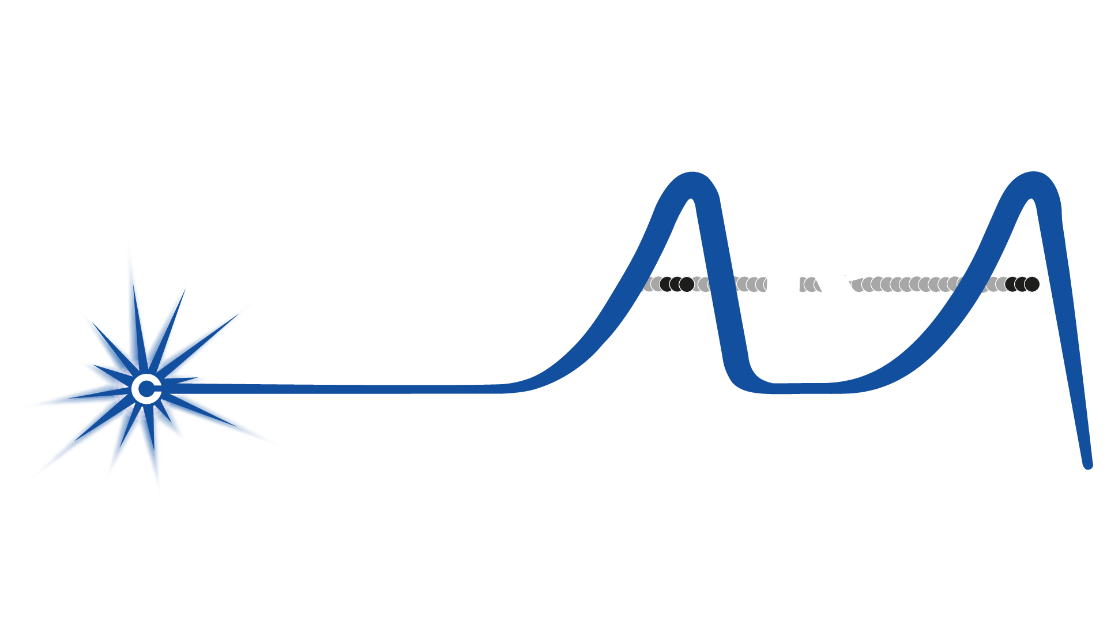
IMPERIAL
A global picture of
laser-driven radiobiology
Preliminary analysis of a 22-paper database
22/09/2026
Josie McGarrigle

Slide 2
Data selection process
PRISMA flow
32
27
22
22
Identified laser-driven studies by E. Tassano-Smith
5 excluded: no biological endpoint, beamline methodology only
5 excluded: radiobiological output does not include laser-driven, only conventional
Final number of publications
PICO framework
Population
Intervention
In-vitro cells, 3D spheroids, zebrafish embryos, small in-vivo animal models
Irradiation with a laser-driven proton or ion beam
Comparison
Outcome
Unirradiated control or relevant reference irradiation of the same dose
Biological response described or quantified, e.g. DNA damage, survival, tissue response or tumour response

Slide 3
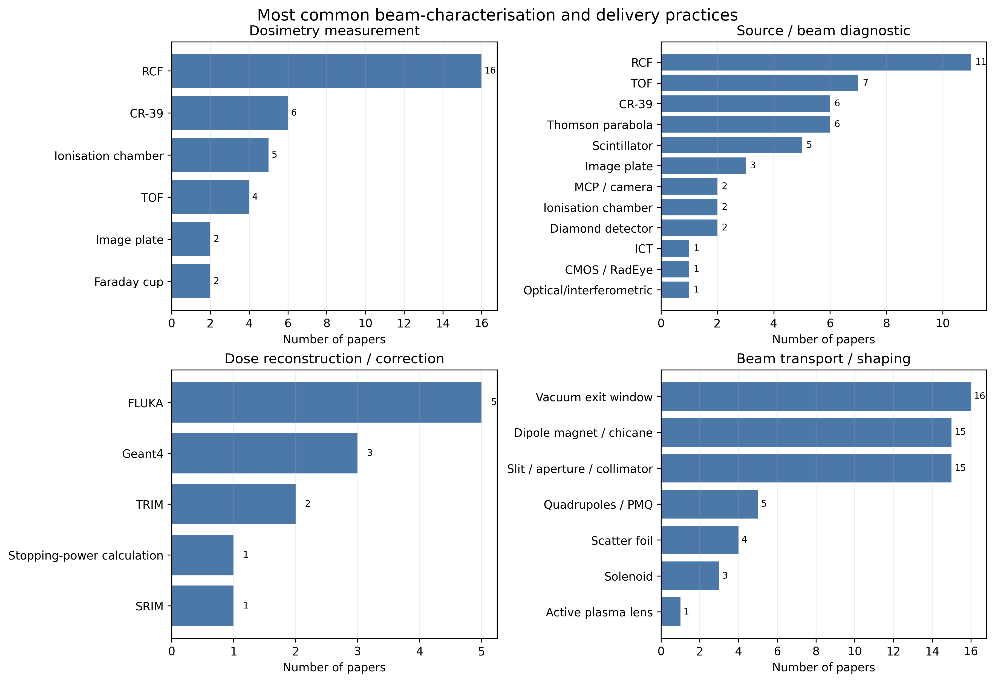
Global trends- Instrumentation
Dosimetry techniques:
16
5
of 22 selected publications used RCF in their measurements
Papers reported using FLUKA to reconstruct or correct the dose

Slide 4
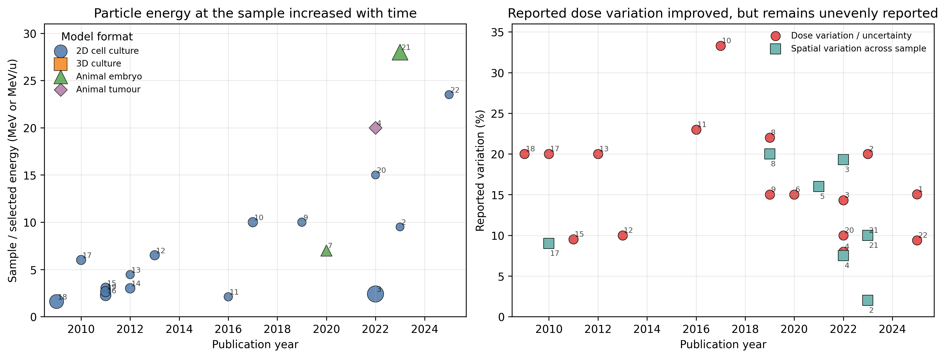
Global trends- Sample
Suggestion of progression in the field:
Energy at the biological sample is increasing with time
Dose variation (shot to shot and spatial) are decreasing with time
Preliminary data
Preliminary data

Slide 5
Global trends- Sample
Energy variation:
Preliminary data
10 MeV
max energy in
2009-2019
27.5 MeV
max energy in
2020-2026

Slide 6
Global trends- Sample
Dose variation:
20%
Preliminary data
median dose variation in
2009-2019
12.2%
median dose variation in
2020-2026

Slide 7
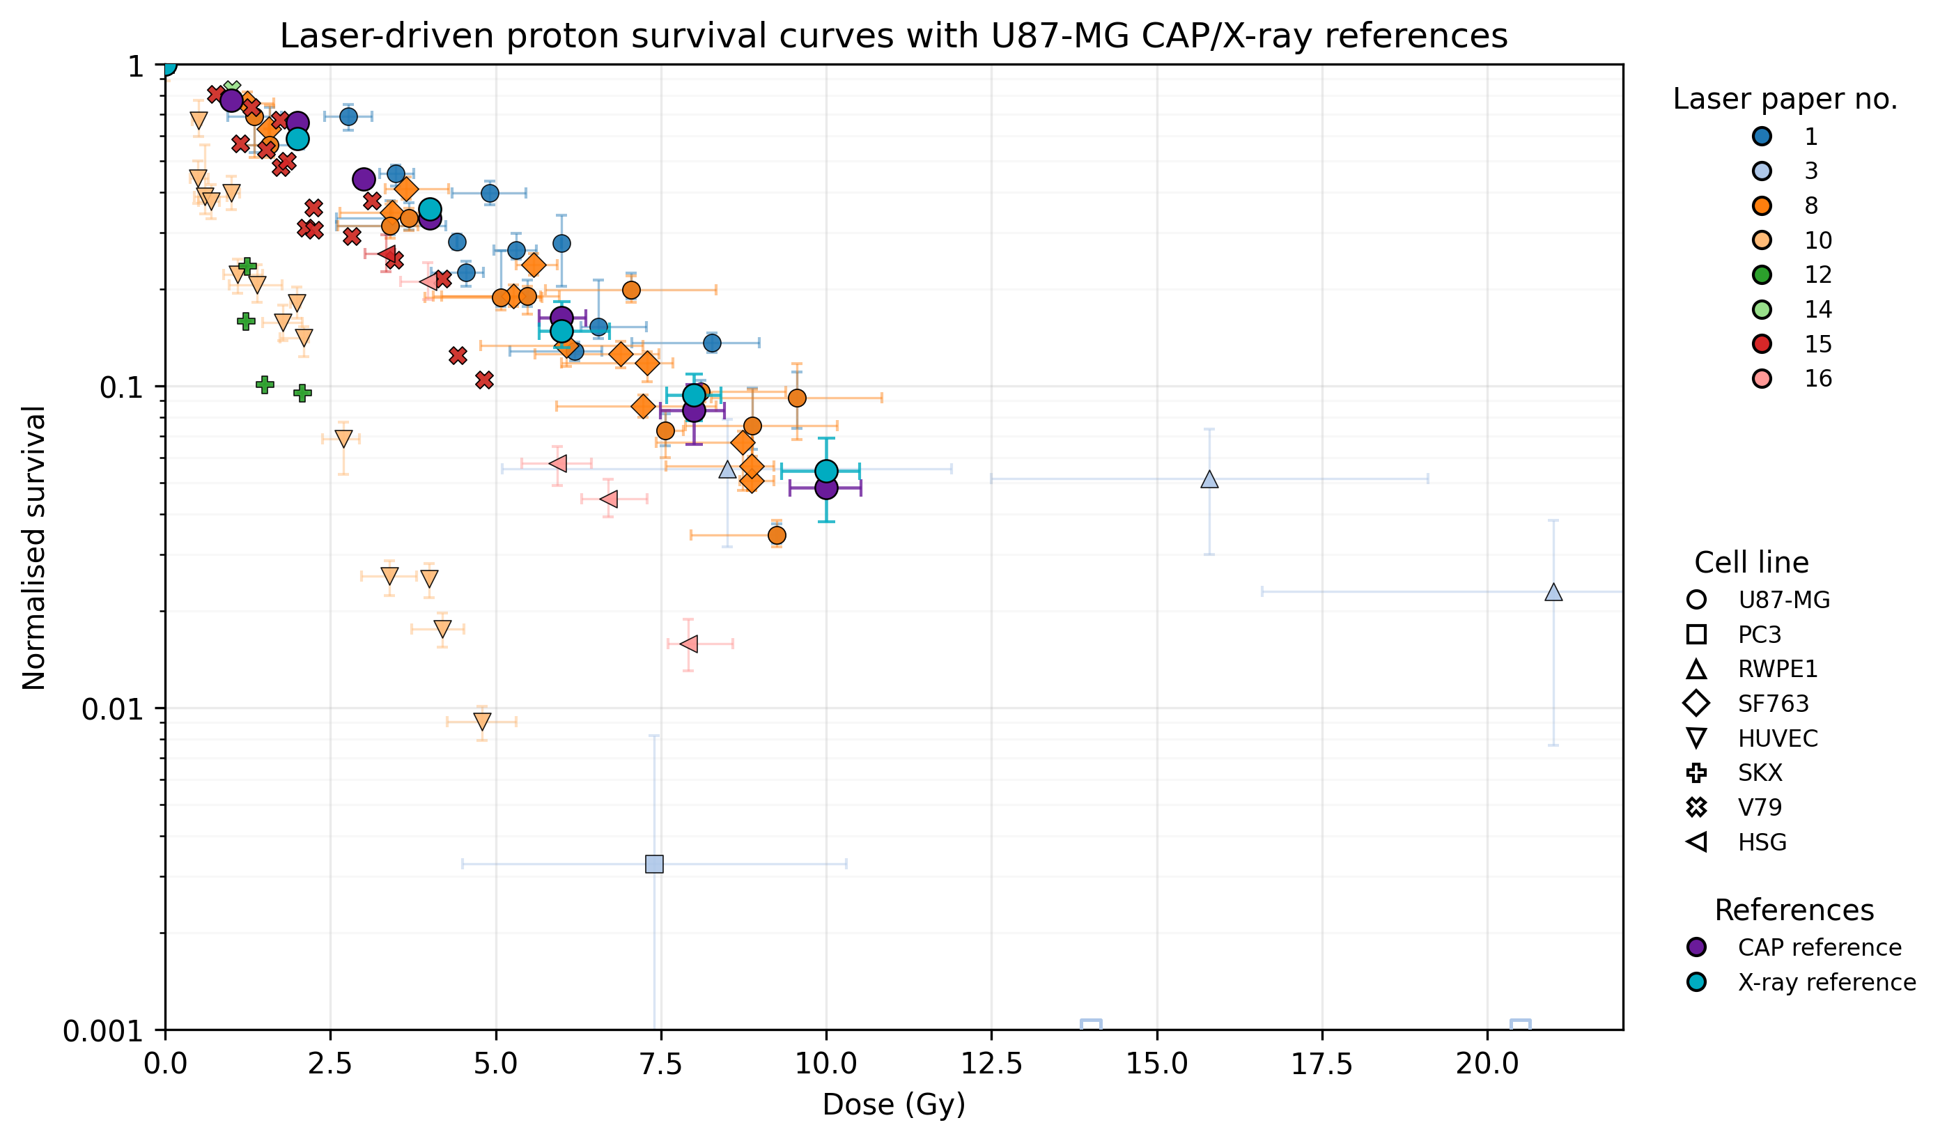
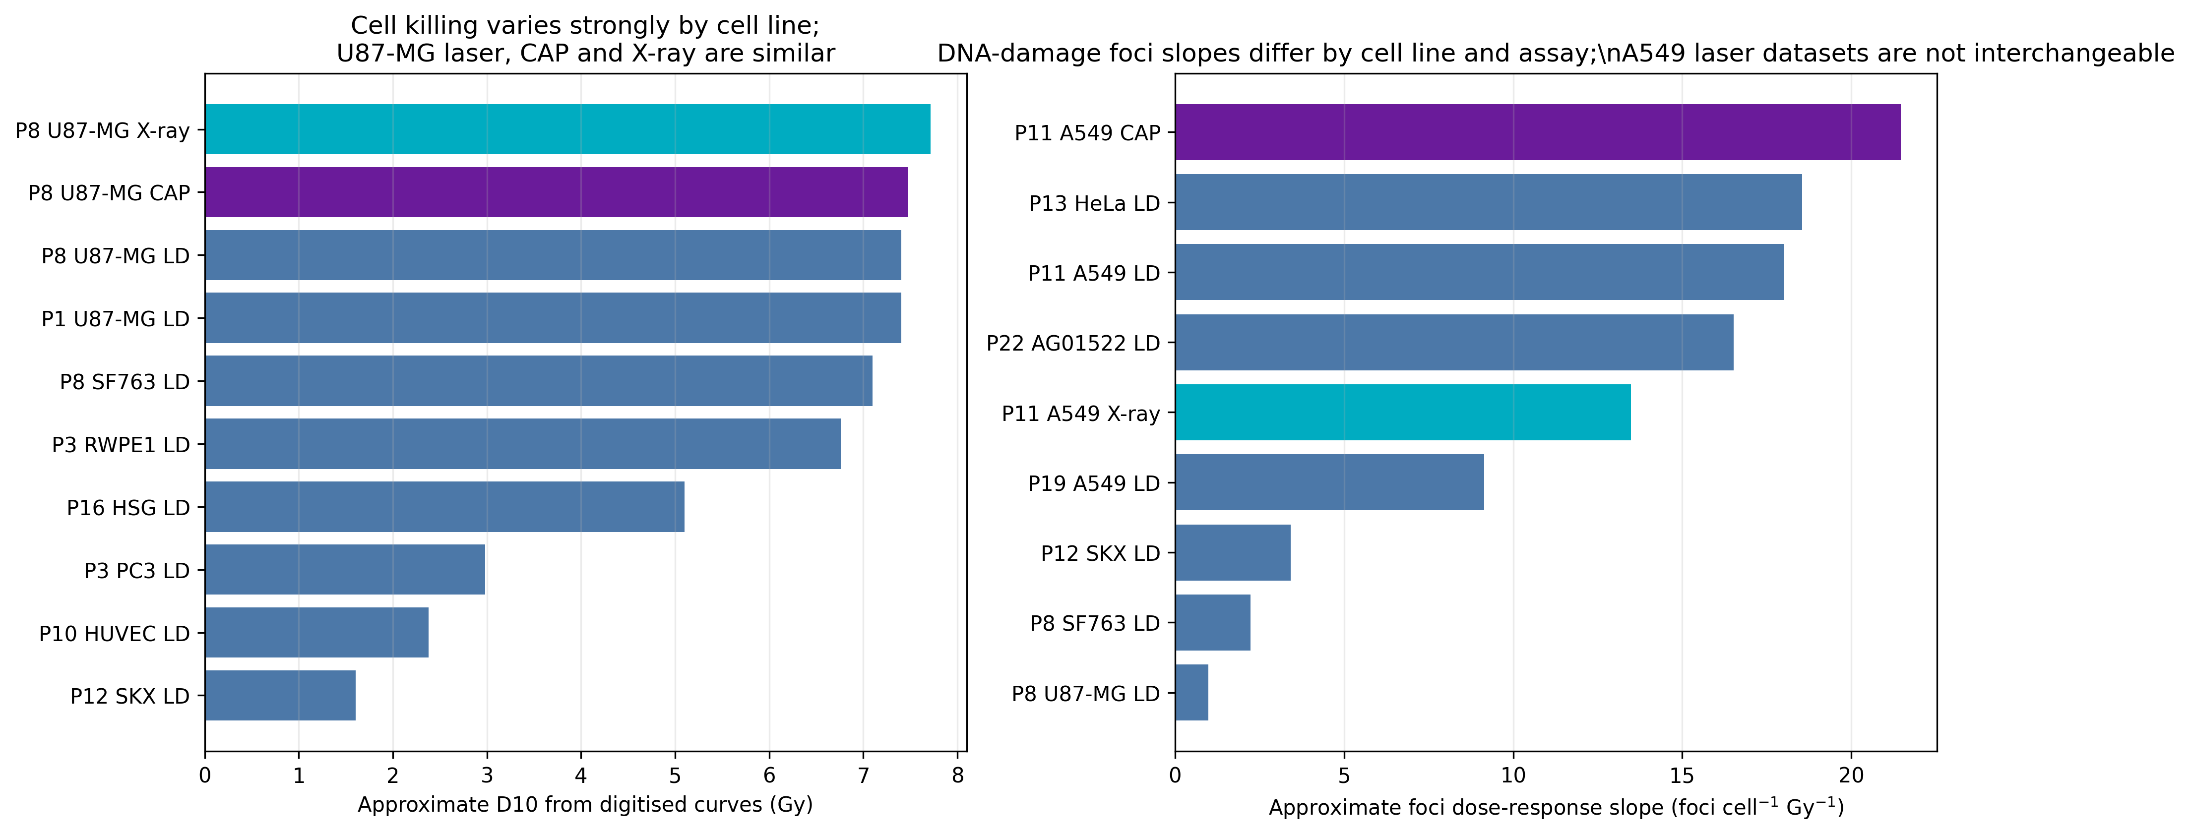
Global trends- Endpoint
Survival data:
U87-MG laser-driven curves from Papers 1 and 8 are very similar, SF763 from Paper 8 is also very similar- likely due to also being a glioblastoma cell line.
U87-MG CAP and X-ray references sit in the same broad response band as the laser-driven points.
Preliminary data

Slide 8
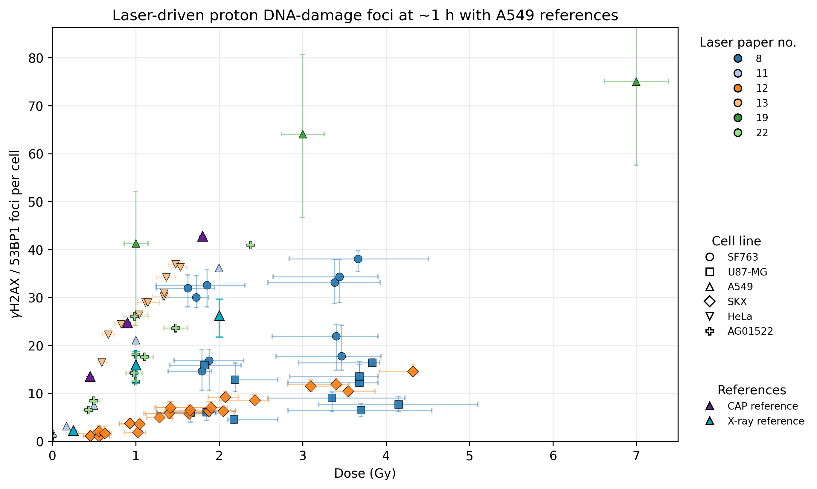
Global trends- Endpoint
DNA-damage data:
No global trend- Scoring time, marker, background, segmentation and irradiation geometry must be reported and standardised.
The two A549 laser-driven dataset give a very dose-response slope- same cell line does not guarantee comparability across studies.
Preliminary data

Slide 9
Next steps
Laser-params:
Explore links between laser parameters and dose variation
Explore links between laser parameters and energy
Sample:
Explore links between doses and dose variation
End point:
Compare survival between Paper 1 and 8, see how differing set up/ beam properties may have influenced differences in survival for the same cell line
Compare normal tissue results to tumour results explicitly

