Slide 1
LhARA Stage 1 Energy Selection
06/10/26

Slide 2
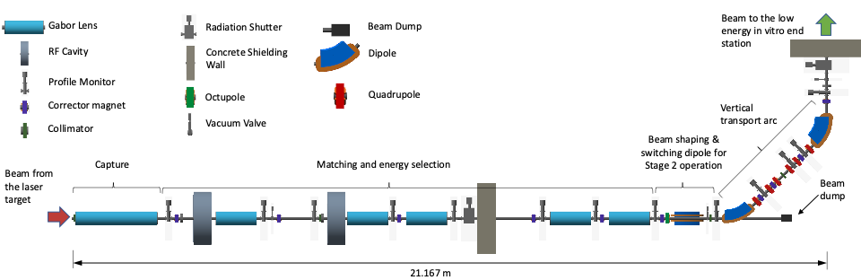
LhARA Stage 1 Start-to-End Tracking
Stage 1 Tracking So Far
Parametrised Source Beam – Representing the laser-driven beam in simulation
Source-Nozzle Tracking Workflow – Coupling the target room vacuum to the S1 beamline
Gabor Lens Optics Matching – Transporting the nominal energy band to the S1 End Station
Next Step – Energy Selection
Full Spectrum Tracking – What happens to the ‘off-energy particles’ naturally?
Energy Selection Performance – Squeezing more into the band, cleaning the rest away

Slide 3
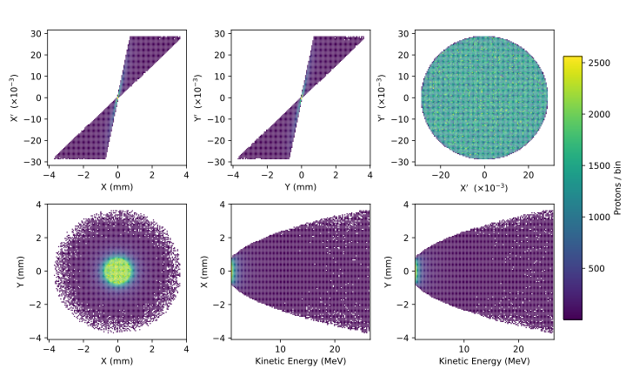
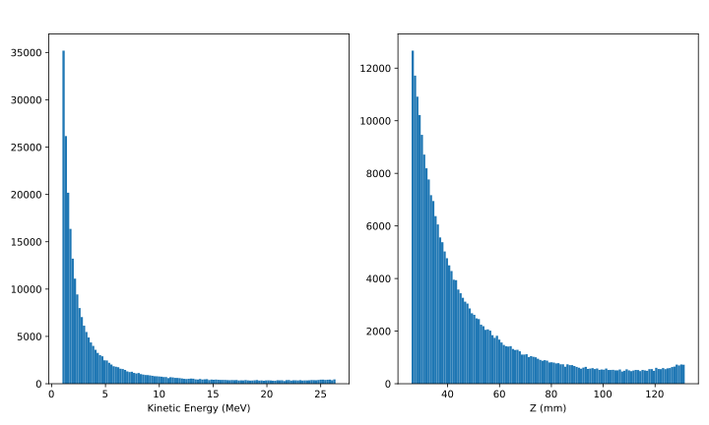
Stage 1 Full Spectrum Beam
Source parameters taken from LhARA CDR for LhARA Linear Optics TNSA beam generation.
Source-Nozzle region simulated in RF Track with space charge.
Particle coordinates at the nozzle exit as input to BDSIM tracking of the Stage 1 lattice
(Shown on this slide)
3M protons at source generation
~29,000 protons in 15±2% MeV band (~1% of total pop.)
250k protons survive the nozzle
~1220 protons in 15±2% MeV band (~0.5% of total pop.)

Slide 4
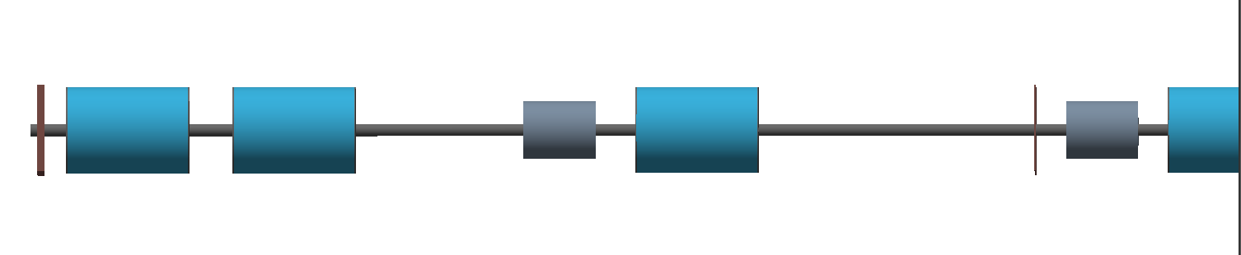
Stage 1 Energy Selection
LEL Drift 01
LEL Drift 03
Cavity 01
Cavity 02
TR Drift 04
LEL Drift 02
Collimator 01
TR Drift 02 + 03
TR Drift 05
Gabor Lens 3
Gabor Lens 4
Gabor Lens 1
Gabor Lens 2
TR Drift 01
Cavity 1 – Increase the population of the nominal energy band at Collimator 1
Gabor Lens 3 – Focus the nominal energy band to a hard focus at Collimator 1
Collimator 1 – Energy Cleaning at a hard focus
Cavity 2 – Longitudinal Phase Space rotation for bunch length compression

Slide 5
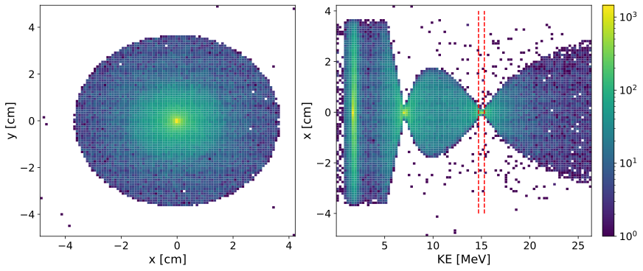
Full Spectrum Tracking at the Collimator
BDSIM Tracking
Physical aperture of 3.65cm
No RF or Collimation simulated
Three regions of transverse focusing due to the broadband nature of the beam through three chromatic lenses
94k protons at the collimator
~1220 protons in 15±2% MeV band
~63% total beam loss but in-band population is maintained from nozzle to collimator
Cavity 01
LEL Drift 02
LEL Drift 03
Collimator 01
TR Drift 04
LEL Drift 00 + 01
TR Drift 02 + 03
TR Drift 05
Gabor Lens 3
Gabor Lens 1
Gabor Lens 2
TR Drift 01

Slide 6

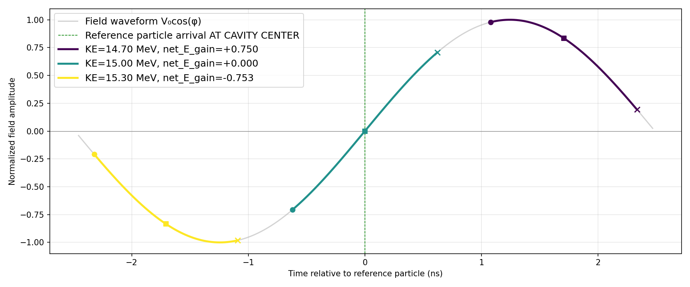
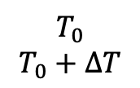
Stage 1 Energy Selection – RF Cavity Frequency
LEL Drift 01
LEL Drift 03
Cavity 01
Cavity 02
TR Drift 04
LEL Drift 02
Collimator 01
TR Drift 02 + 03
TR Drift 05
Gabor Lens 3
Gabor Lens 4
$$T_{0}$$
$$T_{0}+∆T$$
Gabor Lens 1
Gabor Lens 2
TR Drift 01
Fixed Parameters
Cavity 1
Frequency - ?? MHz
Length – 0.26 m
Gabor Lens 3
Length – 0.857 m
Collimator 1
Length – 1 cm
Material - Iron
201 MHz

Slide 7
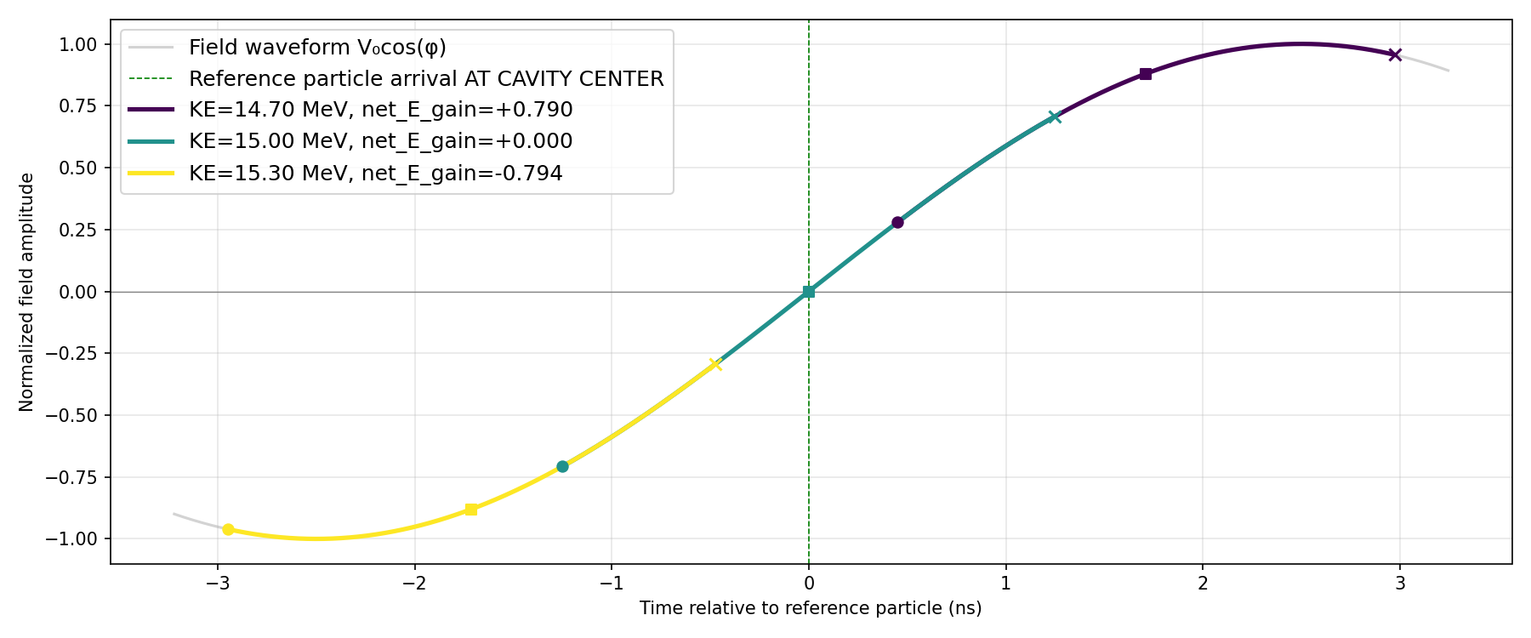
Stage 1 Energy Selection – RF Cavity Frequency
LEL Drift 01
LEL Drift 03
Cavity 01
Cavity 02
TR Drift 04
LEL Drift 02
Collimator 01
TR Drift 02 + 03
TR Drift 05
Gabor Lens 3
Gabor Lens 4
$$T_{0}$$
$$T_{0}+∆T$$
Gabor Lens 1
Gabor Lens 2
TR Drift 01
Fixed Parameters
Cavity 1
Frequency - ?? MHz
Length – 0.26 m
Gabor Lens 3
Length – 0.857 m
Collimator 1
Length – 1 cm
Material - Iron
100 MHz

Slide 8
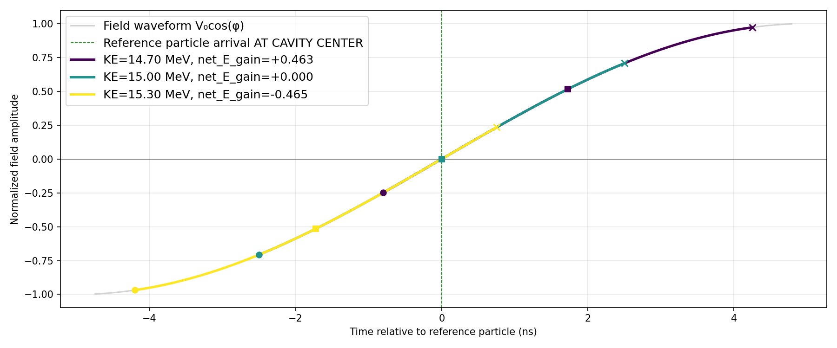
Stage 1 Energy Selection – RF Cavity Frequency
LEL Drift 01
LEL Drift 03
Cavity 01
Cavity 02
TR Drift 04
LEL Drift 02
Collimator 01
TR Drift 02 + 03
TR Drift 05
Gabor Lens 3
Gabor Lens 4
$$T_{0}$$
$$T_{0}+∆T$$
Gabor Lens 1
Gabor Lens 2
TR Drift 01
Fixed Parameters
Cavity 1
Frequency - 50 MHz
Length – 0.26 m
Gabor Lens 3
Length – 0.857 m
Collimator 1
Length – 1 cm
Material - Iron
50 MHz

Slide 9
Stage 1 Energy Selection
LEL Drift 01
LEL Drift 03
Cavity 01
Cavity 02
TR Drift 04
LEL Drift 02
Collimator 01
TR Drift 02 + 03
TR Drift 05
Gabor Lens 3
Gabor Lens 4
Gabor Lens 1
Gabor Lens 2
TR Drift 01
Fixed Parameters
Cavity 1
Frequency - 50 MHz
Length – 0.26 m
Gabor Lens 3
Length – 0.857 m
Collimator 1
Length – 1 cm
Material - Iron
Free Parameters
Cavity 1
Voltage [MV]
Gabor Lens 3
Field [T equiv.]
Collimator 1
Aperture Radius [mm]
Objectives
Yield
% increase of the population of the nominal energy band
Purity
% of total beam population that is in-band

Slide 10
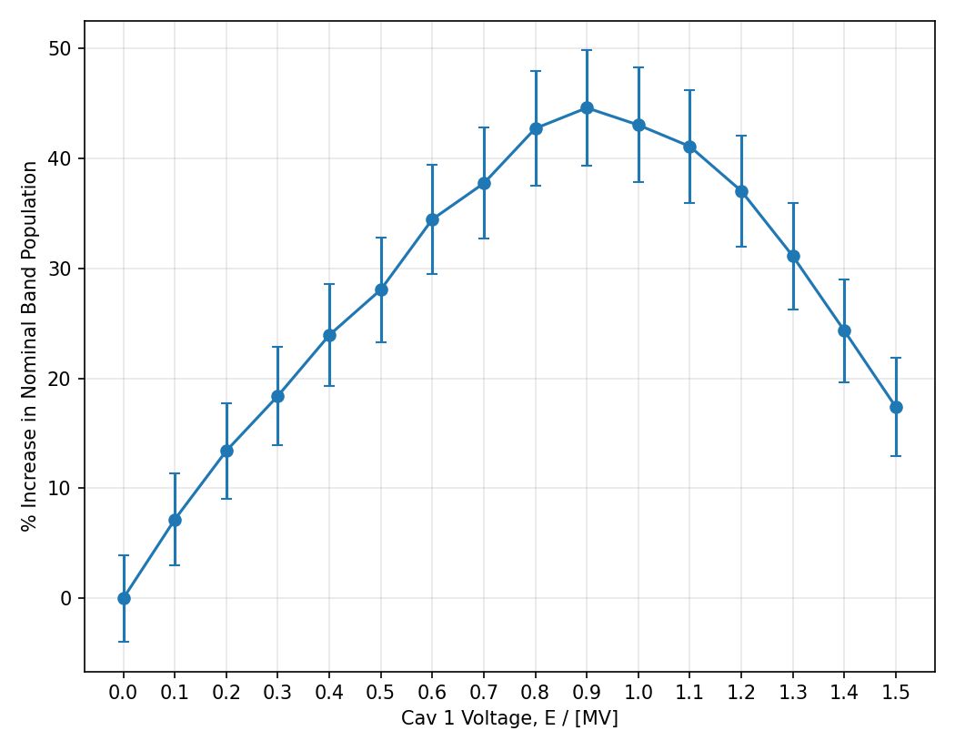
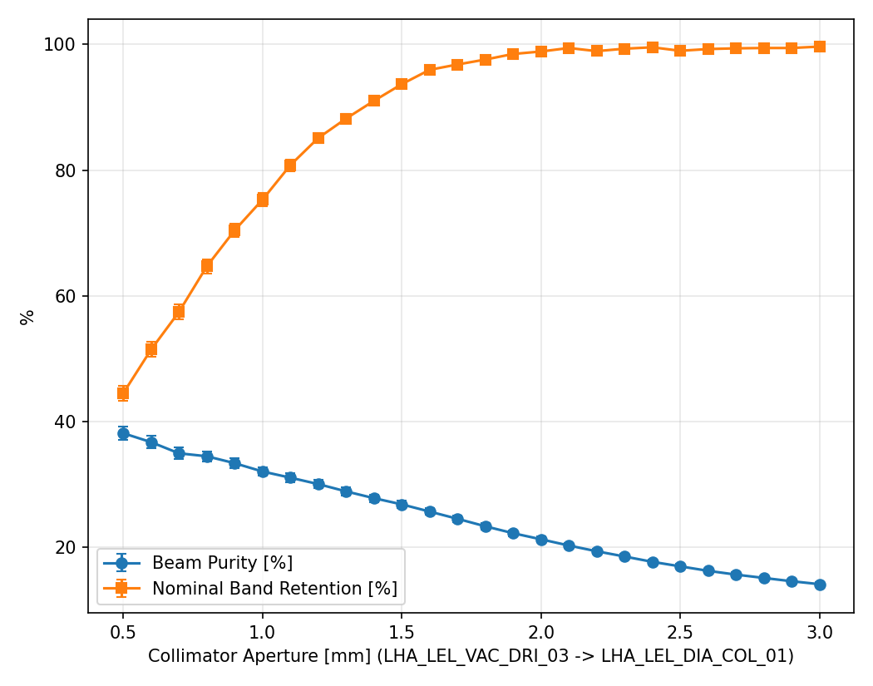
Sequential Grid Scans
Optimising one parameter at a time:
Cavity 1 voltage -> Gabor Lens 3 field strength -> Collimator 1 radial aperture
Achieved a 37% increase in the nominal band population with a beam purity of 21% (Sampled after Cavity 2)
Cavity Voltage – 0.9 MV, GL3 Field – 0.84 T equivalent, Collimator Aperture – 2.0 mm radius
Gap – Sequential scans do not see interaction effects between parameters

Slide 11
Holistic Optimisation
Rather than scanning for optima element-by-element, Multi Objective Bayesian Optimisation (MOBO)
Initial bounds are the same as the sequential scans for comparisons of runtime and convergence.
All optimisation runs begin with 24 quasi-randomly sampled points (SOBOL)
Random samples are followed by batches of 12 points.
Free Parameters – {Bounds}
RF Voltage – {0.5, 1.5} MV
Gabor Lens 3 Field – {0.1, 1.4} T Equiv.
Collimator Aperture – {0.5, 3.0} mm
Objectives – [Bounds]
Yield – [0, 1]
Purity – [0, 1]

Slide 12
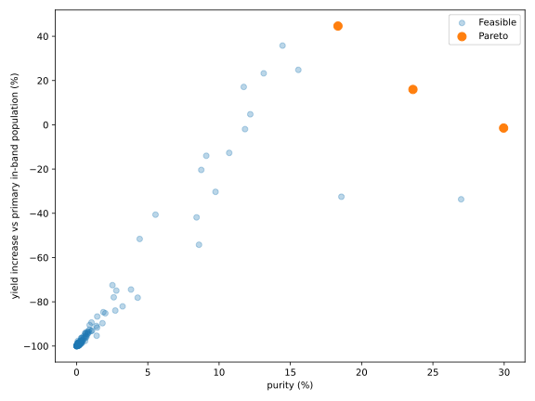
MOBO – Wide Search
44-minute Run – 12 Core Machine
3 Point Pareto Front
We can see the Yield vs Purity trade-off
Need more than 3 points to characterise the behaviour
RF Voltage (MV) | GL3 Field (T Equiv.) | COL Aper. (mm) |  | Purity (%) | Yield (%)
0.934 | 0.831 | 0.969 |  | 30% | -1.4%
0.787 | 0.852 | 1.44 |  | 24% | +16%
0.912 | 0.849 | 2.30 |  | 18% | +45%

Slide 13
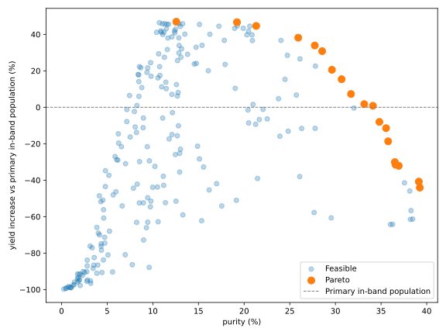
MOBO – Finer Search
Tighter Bounds
RF Voltage – {0.65, 1.05} MV
GL3B – {0.75, 0.92}
COL Aper. – {0.3, 4} mm
1 hr 44 min – 12 Core Machine
19 Point Pareto Front
Prominent trade-off curve
Needed Constraint
Any point with an in-band yield lower than the primary beam should be discarded.
Better

Slide 14
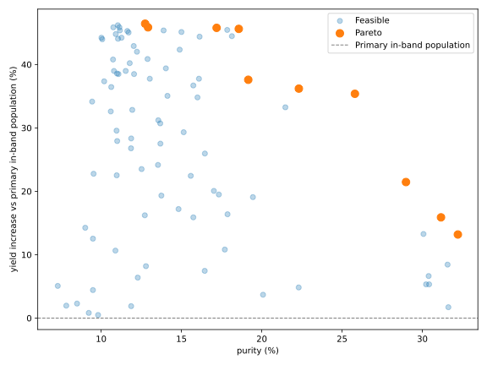
MOBO – Finer Search – Constrained
Same Tighter Bounds
RF Voltage – {0.65, 1.05} MV
GL3B – {0.75, 0.92}
COL Aper. – {0.3, 4} mm
10 Point Front - 3 Highlights
Yield Favoured (A)
  13% purity, 45% yield increase
  0.975 MV, 0.853 T, 3.3 mm
Balanced (B)
  26% purity, 35% yield increase
  0.70 MV, 0.835 T, 1.57 mm
Purity Favoured (C)
  32% purity, 12% yield increase
  0.978 MV,0.8420 T, 1.02 mm
GL3 Field converges to 0.83 – 0.86 T equiv. across all pareto points.
Much tighter than other parameters.
(A)
(B)
(C)

Slide 15
Summary and Next Steps
Summary
Full spectrum tracking without energy selection elements
Holistic optimisation of S1 energy selection
Produced a 10-point front showing the trade-off between yield and purity
Next Steps
Inspect longitudinal phase-space of pareto points for correct behaviour
Sensitivity scans around the pareto points to fill out the front
Introducing Cavity 2 for bunch length compression
Study of momentum selection collimation in the vertical arc

