Slide 1
News and update
K. Long
October 20, 2026

Slide 2
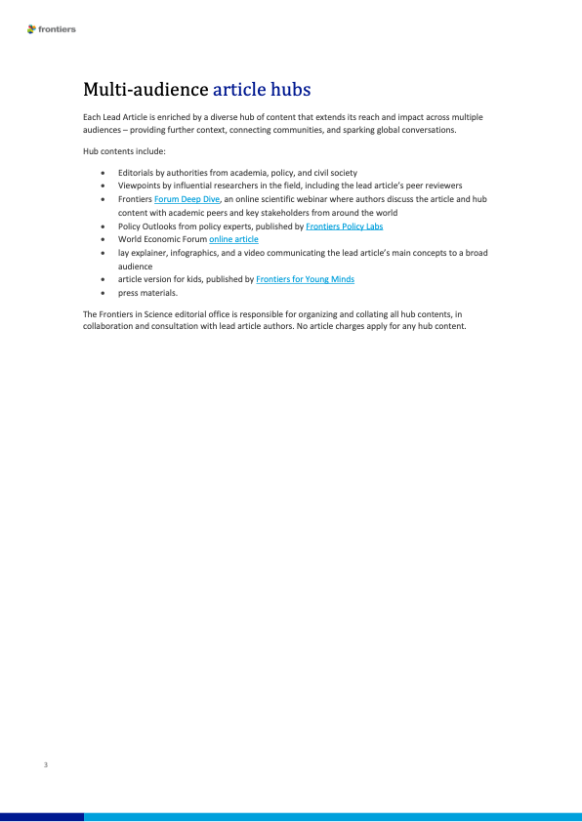
Updates:
Frontiers in science
  Now underway:
    Initial drafting team
    KL, Y. Prezado, J. Parsons, R. Amos, T. Underwood, C. Whyte
    On behalf of the collaboration
    Will reach out … aiming for Q1 27
    Publishing CDR:
    Exchange with Editor:
    Editor proposes vehicles by which CDR contributions can be published together
    Clear that they want the lead article before further discussion…

Slide 3
Updates:
4-nation …
Aled Isaac, Stefan Eriksson, Mike Charlton, Richard Hugtenburg, Colin Whyte, Marie Boyd, Bob Bingham, Marco Borghesi, Tim Greenshaw, Richard Amos
Will meet, Friday 23Oct26
Programme grant …
Writing committee;
Too many names! First task 2-pager for EPSRC Programme Manager
Met 16Oct26: next slide …
EU MCSA DN …
Getting started;
Initial discussion held with CNRS/Strassbourg
Meeting with Katia Parodi and Yolanda Prezado 16Nov26

Slide 4
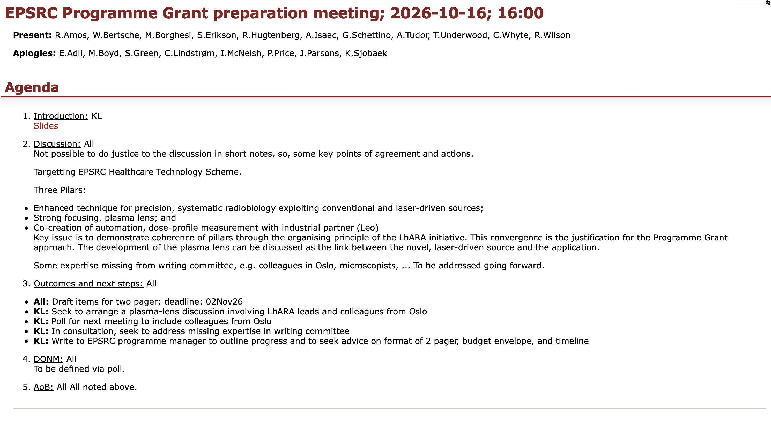
Programme grant; first discussion
Proposal development page created from PMB page on wiki:
  Programme grant development page will be used to share information and document progress.
https://ccap.hep.ph.ic.ac.uk/trac/wiki/Research/LhARA/ProjectManagementBoard/ProposalDevelopment/EPSRCprogrammeGRANT2026/2026-10-16
Selected slides follow …

Slide 5

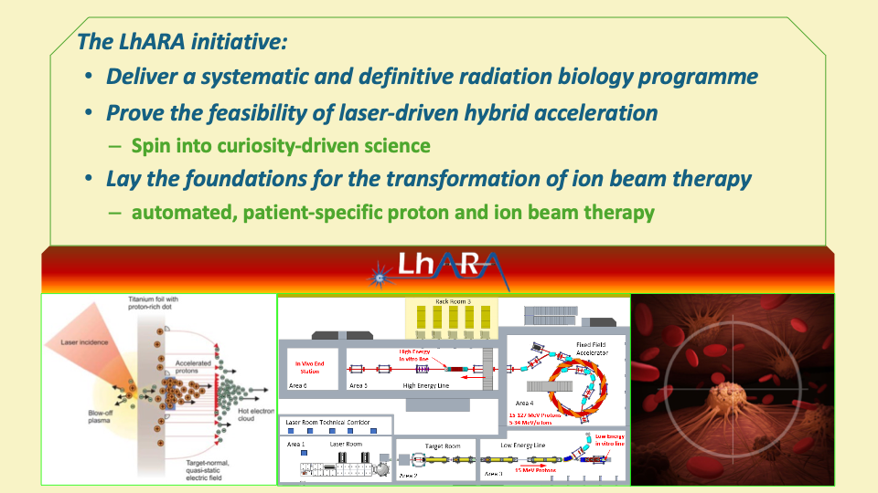
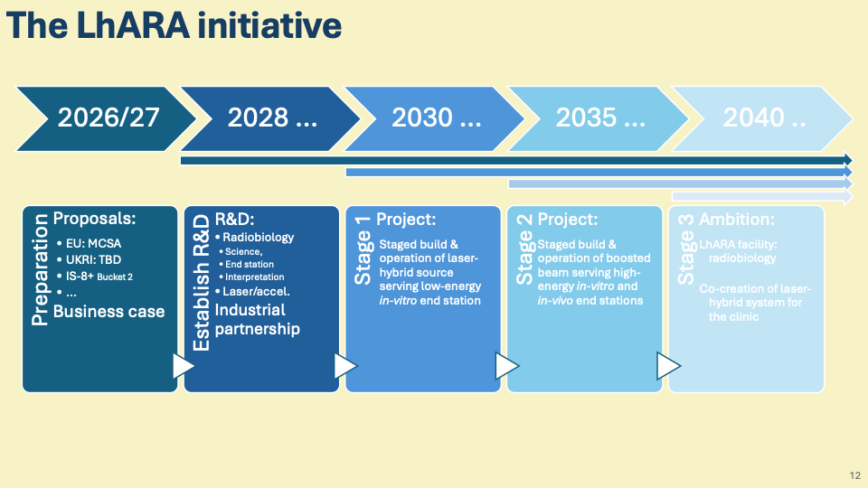
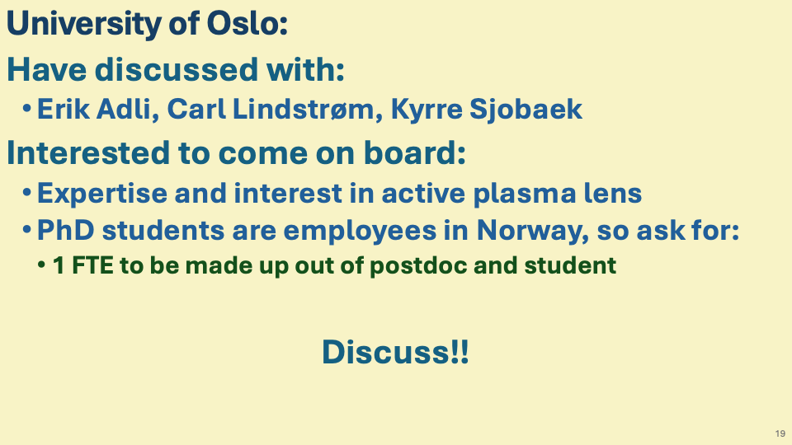
EPSRC Programme Grant introduction to discussion (16Oct26)

Slide 6
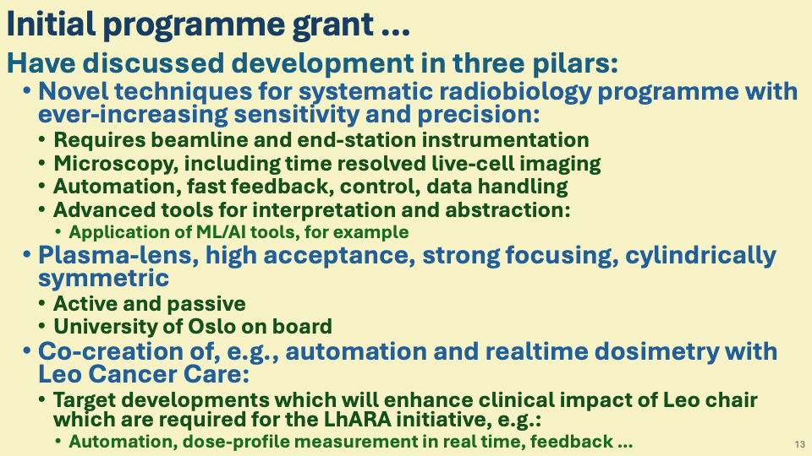
EPSRC Programme Grant introduction to discussion (16Oct26)

Slide 7
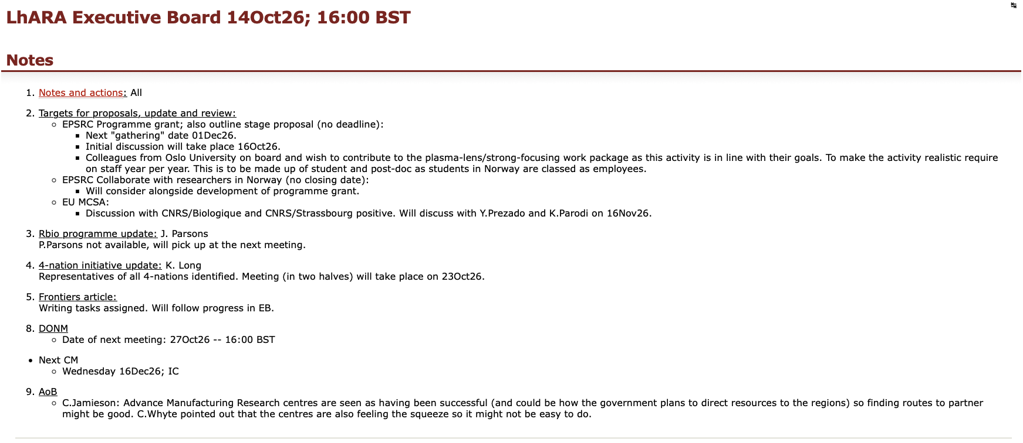
Update from EB:
EB page linked from Governance on wiki:
https://ccap.hep.ph.ic.ac.uk/trac/wiki/Research/LhARA/Governance/ExecutiveBoard/Meetings/2026/2026-10-14

Slide 8
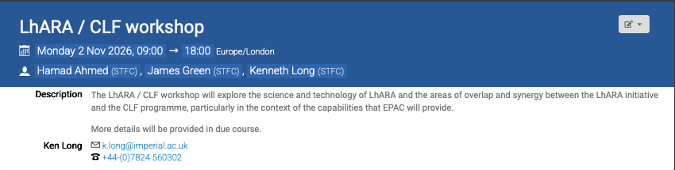
Updates:
CLF/EPAC & LhARA …
https://indico.stfc.ac.uk/event/1997/
More details will follow!

Slide 9
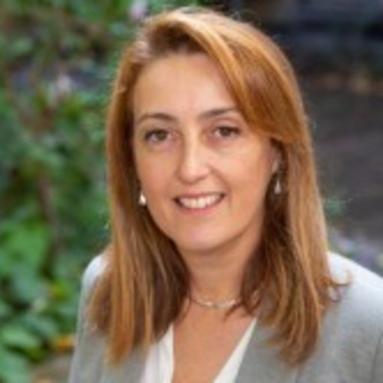
Updates:
LhARA radiobiology teach-ins and discussion
Many thanks to Emma, Josie, and Roshine who have agreed to organise presentations of radiobiology to allow discussion of LhARA radiobiology programme, its development, and to define the USPs.
Vision is one fortnightly per month devoted to rbio presentations … propose to record them and to post alongside slides for the record.
Start second half of October 2026.
Tuesday 20 October 2026: Kick off; overview and vision
Yolanda Prezado

Slide 10
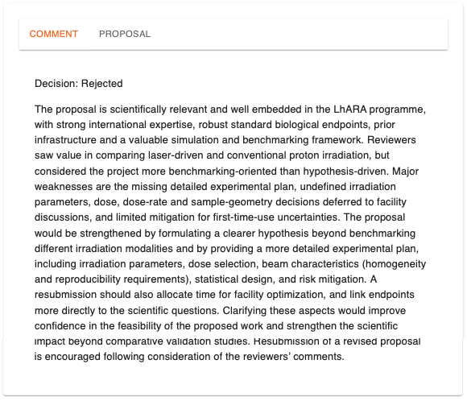
Updates:
ELIMED proposal feedback …
Prepare technical note addressing issues raised and share with instrument scientist at ELIMED
Now underway: review
progress at Thursday rbio
meetings

Slide 11
Raising resource
IAA:
  Impact analysis, benefits map as input to business case (? via UKRI IAA at Imperial)
  Bio-programme development
  Need to consider support for D.Laird comms.
STFC SPARK (25Aug26):
  RS SSE on tour, our regional outreach, D.Laird comms, schools outreach; in progress, Katia Smith (PPD)
STFC PPRP (27Aug26):
  "Talk to programme manager before submitting", conversation worthwhile, Will speak to S.Verth, 07Sep26
STFC/EPSRC KTP (no closing date):
  Worth discussing?
EPSRC Collaborate with researchers in Norway (no closing date):
  Plasma lens; discuss after 11Sep26 meeting?
EPSRC Programme grant; also outline stage proposal (no deadline): assembling writing panel
  Next "gathering" date 01Dec26.
  Worth doing to bring together our programme.
  Focus on development of bio and med-tech aspects?
  Potential also to bring forward a proposal on plasma lens post 11Sep26 meeting.
EU MCSA: forced to start now for 2027 submission
  Restarted!

Slide 12
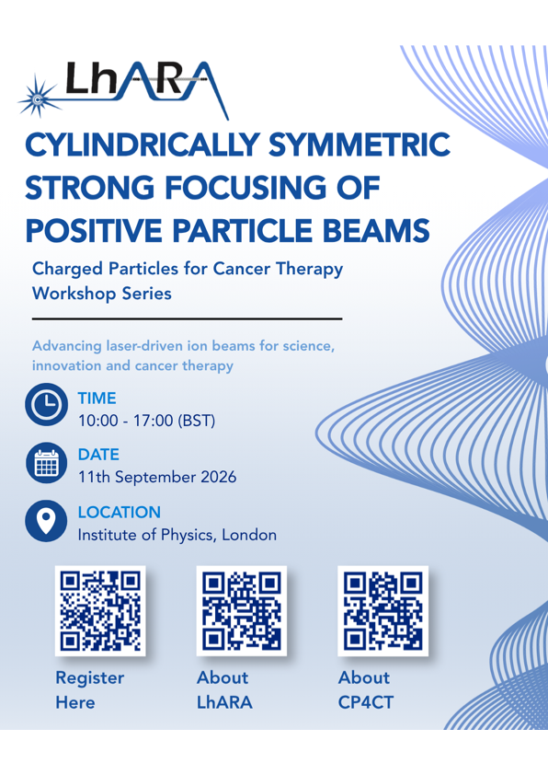
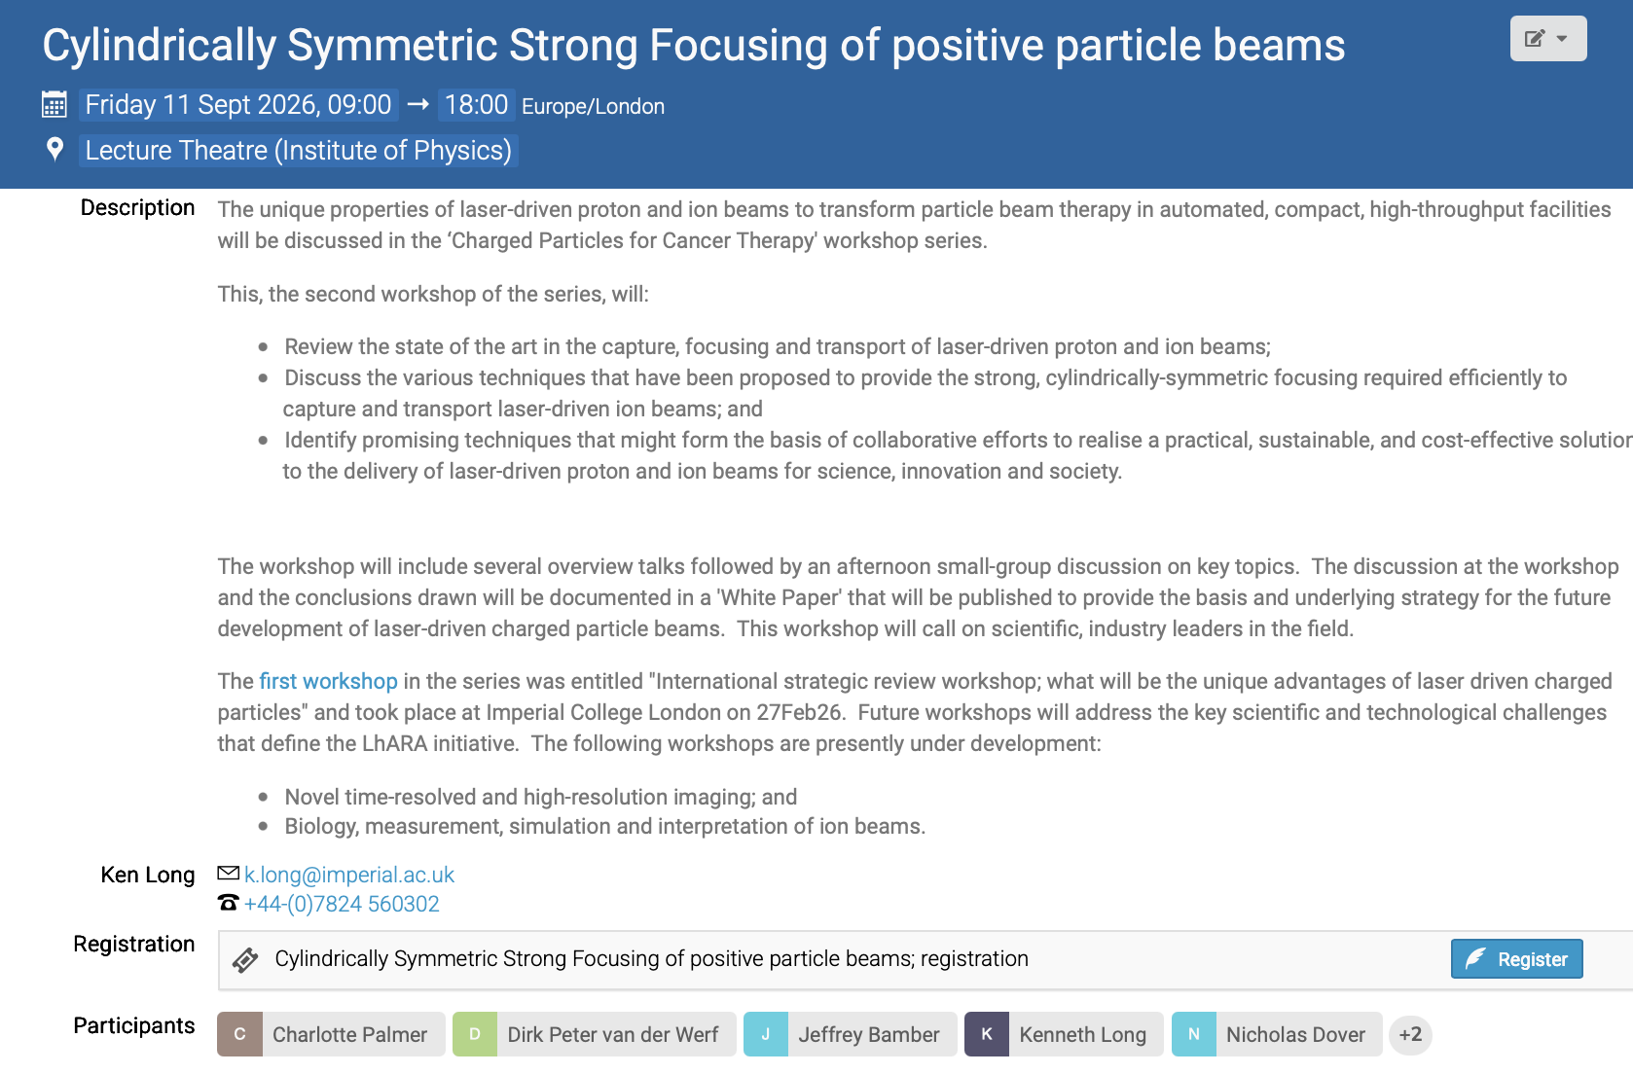
Please:
Register
Circulate
Now taking initial steps in organisation of third in series:
Novel time-resolved and high-resolution imaging

Slide 13
Peer-group meeting series
Past:
  CP4CT w/s: International strategic workshop; what will be the unique advantages of laser driven charged particles
    https://indico.stfc.ac.uk/event/1703/
  Cylindrically-symmetric strong focusing of ion beams;
    https://indico.stfc.ac.uk/event/1956/
Coming up:
  Novel time-resolved, high-resolution imaging:
    Tbd; 2027; Started assembling organisers:
    C.Dunsby, K.Parodi, Y.Prezado, …
  Biology, measurement, simulation and interpretation of ion beams

Slide 14
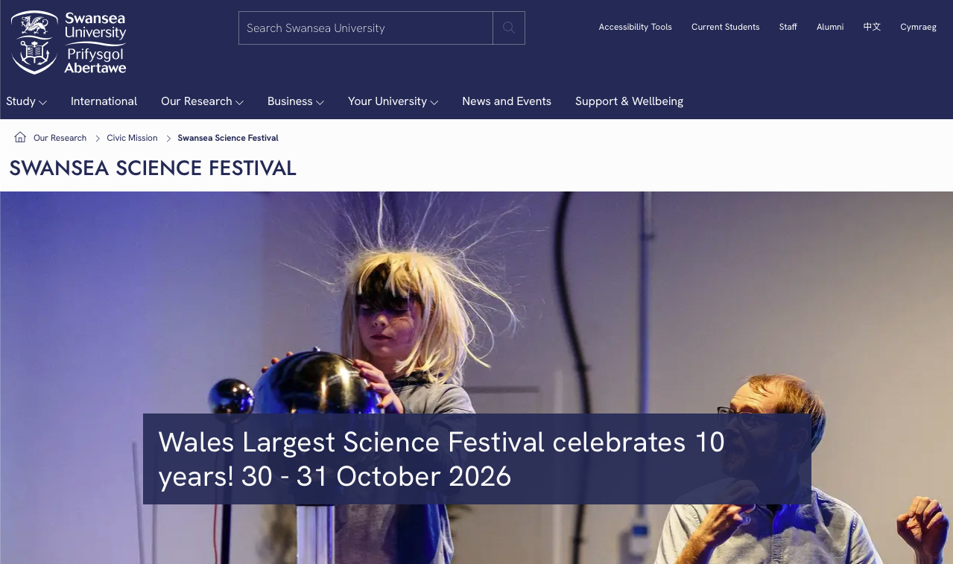

Slide 15
Going forward
Next fortnightly:
  03Nov26
Next collaboration meeting:
  16Dec26; Imperial’s Blackett Laboratory; South Kensington

