Slide 1
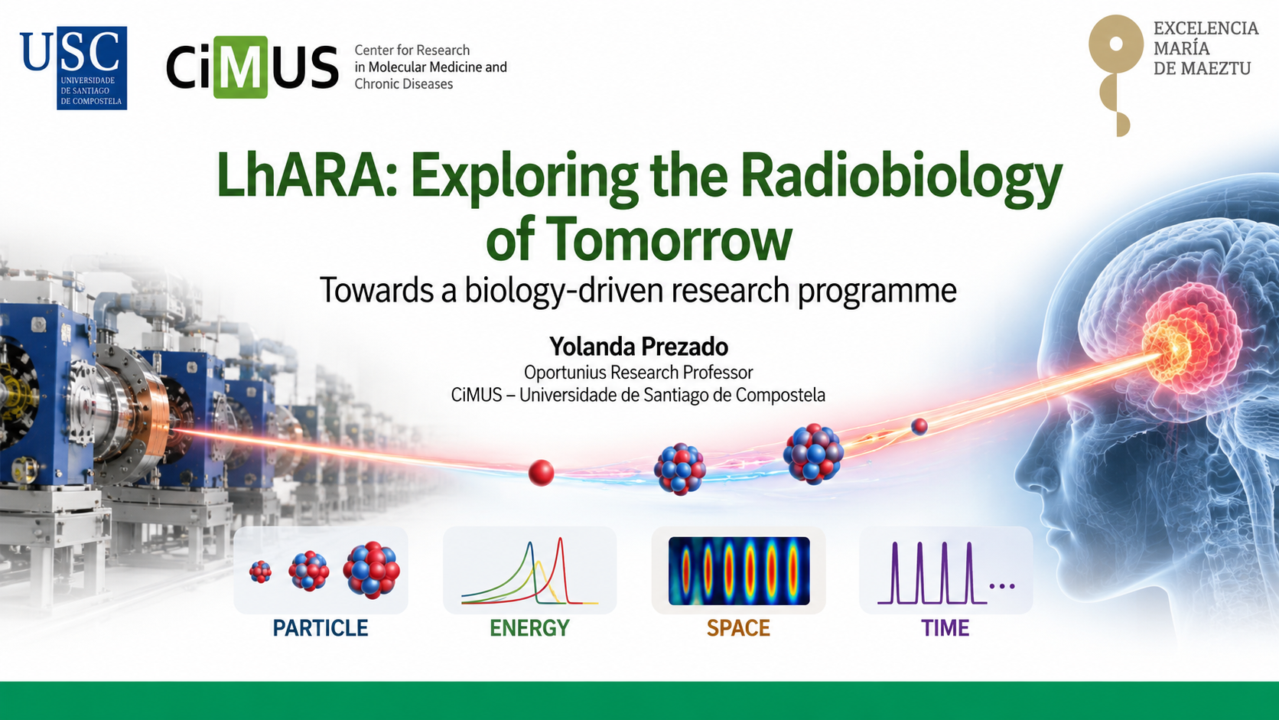

Slide 2
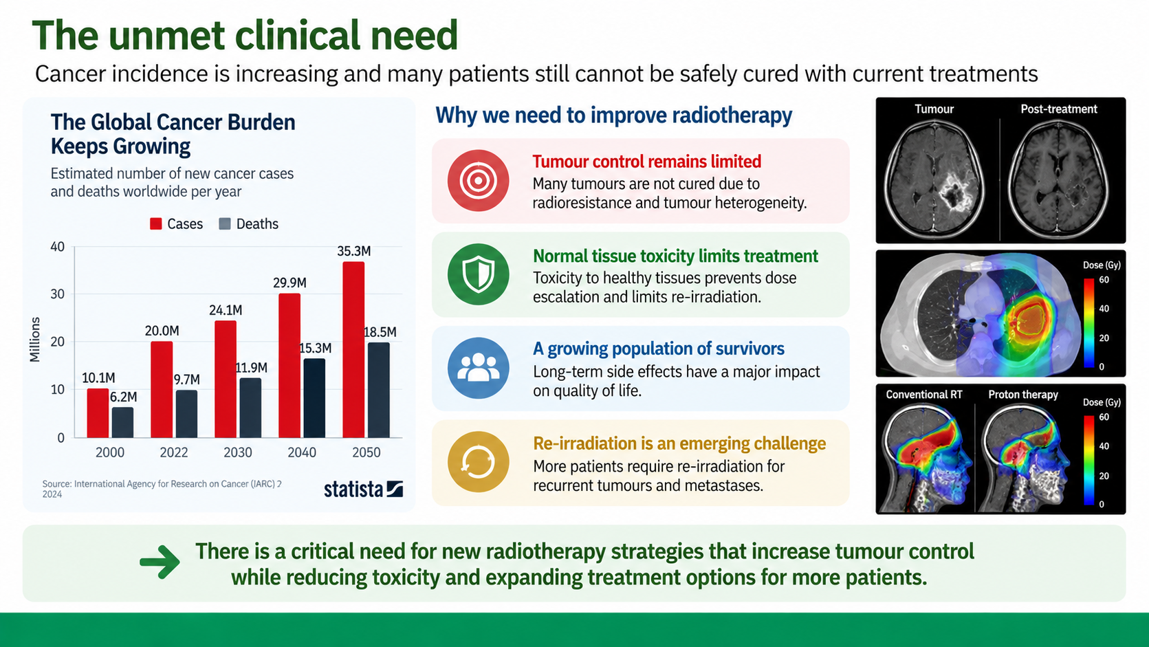

Slide 3
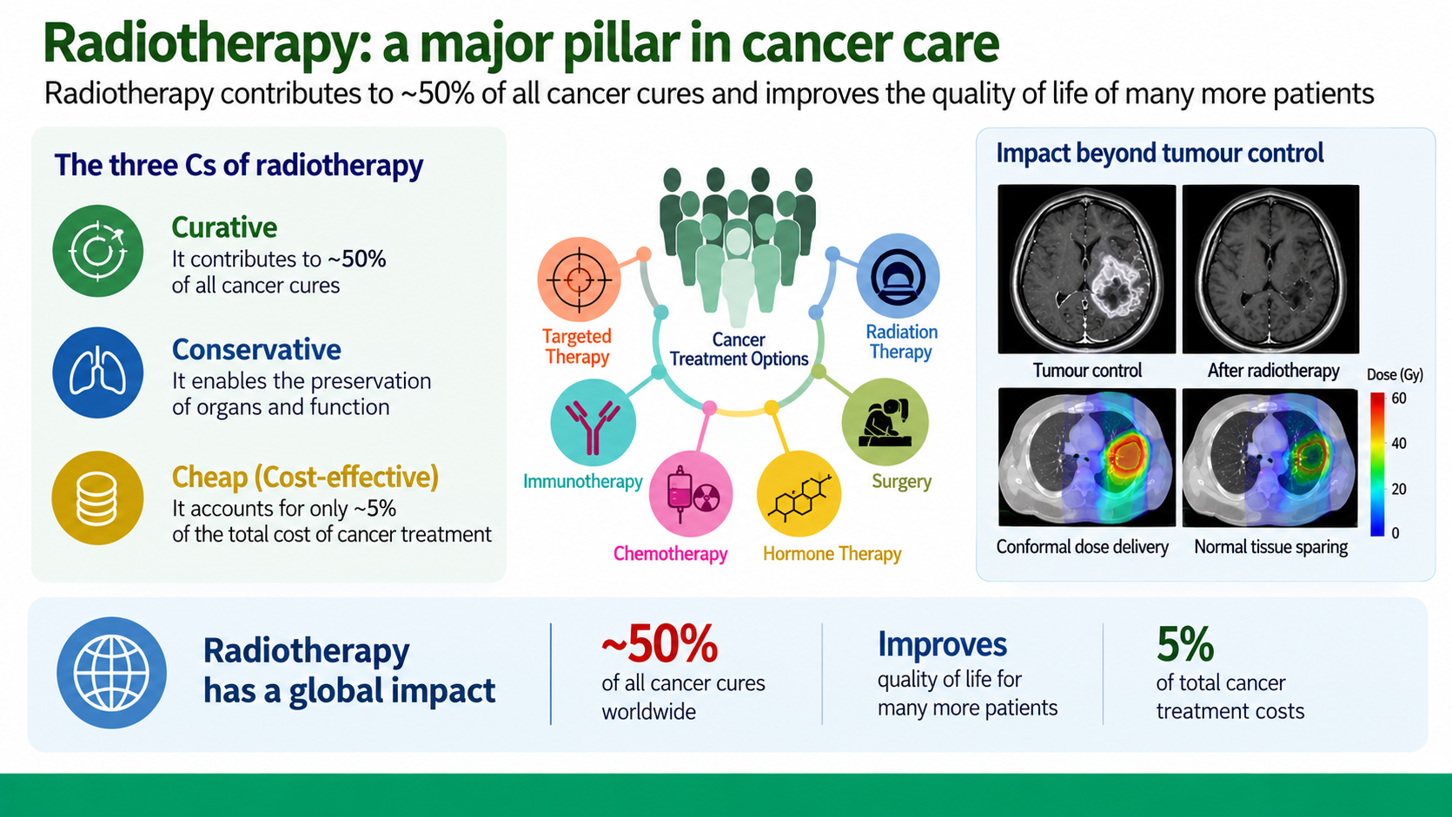

Slide 4
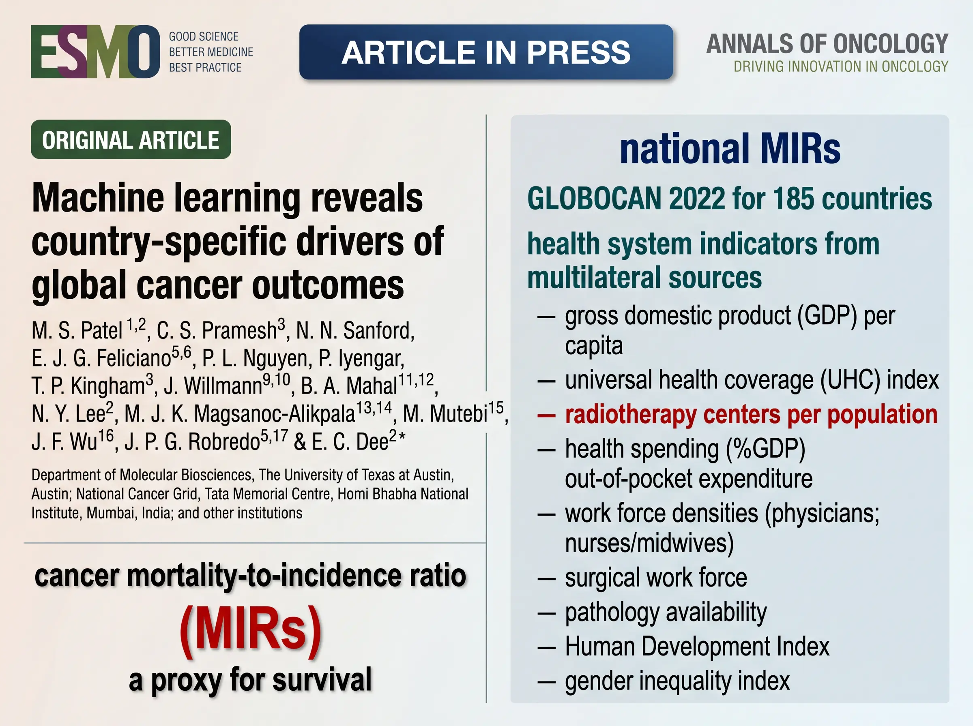


Slide 5
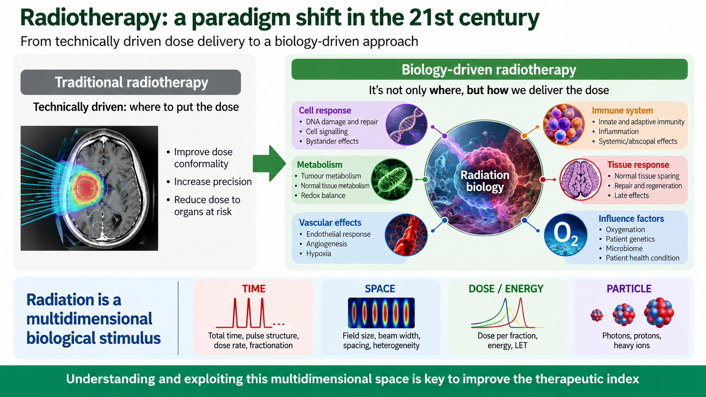

Slide 6
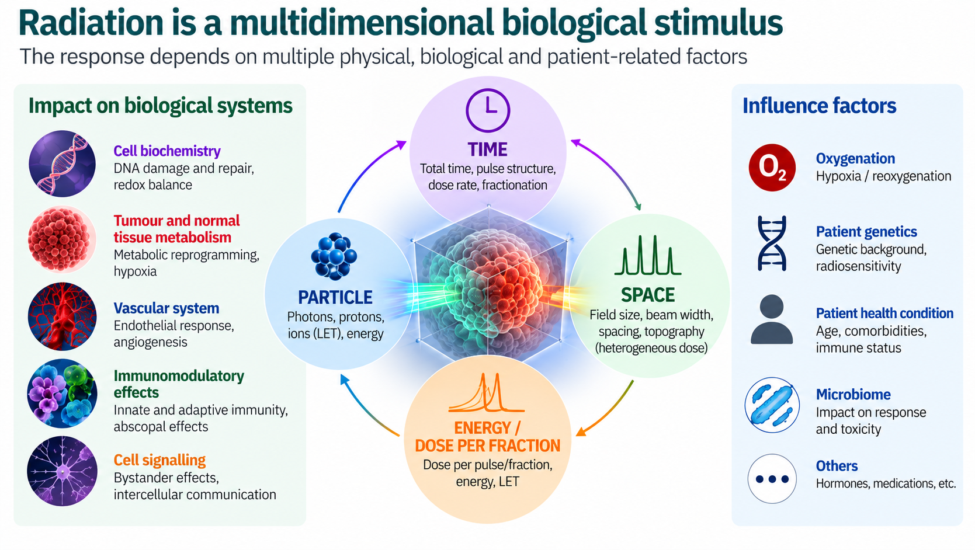

Slide 7
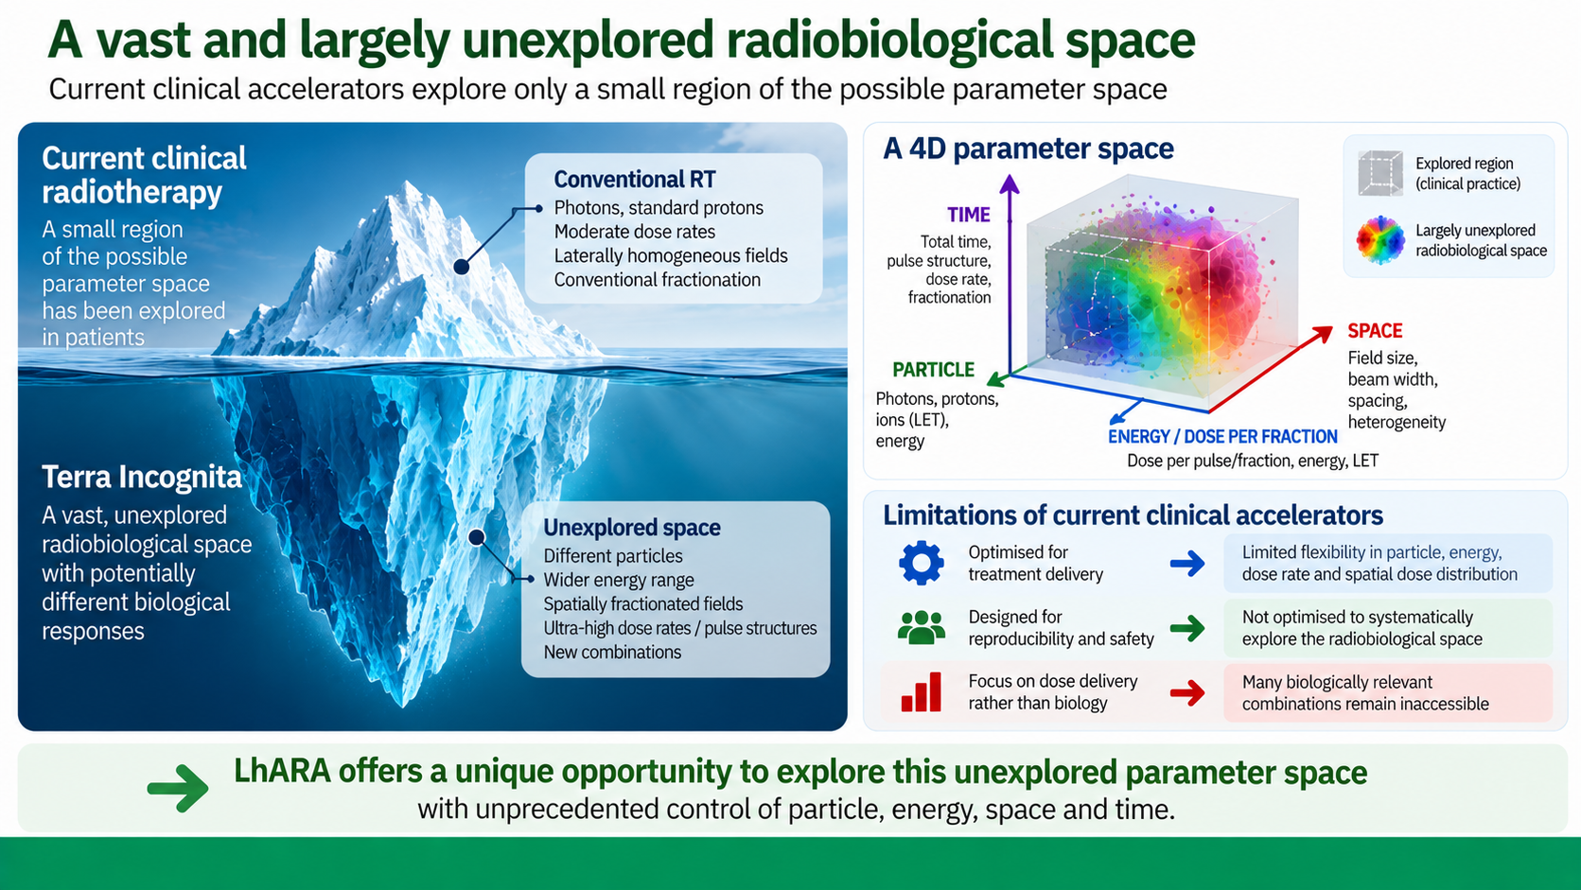

Slide 8
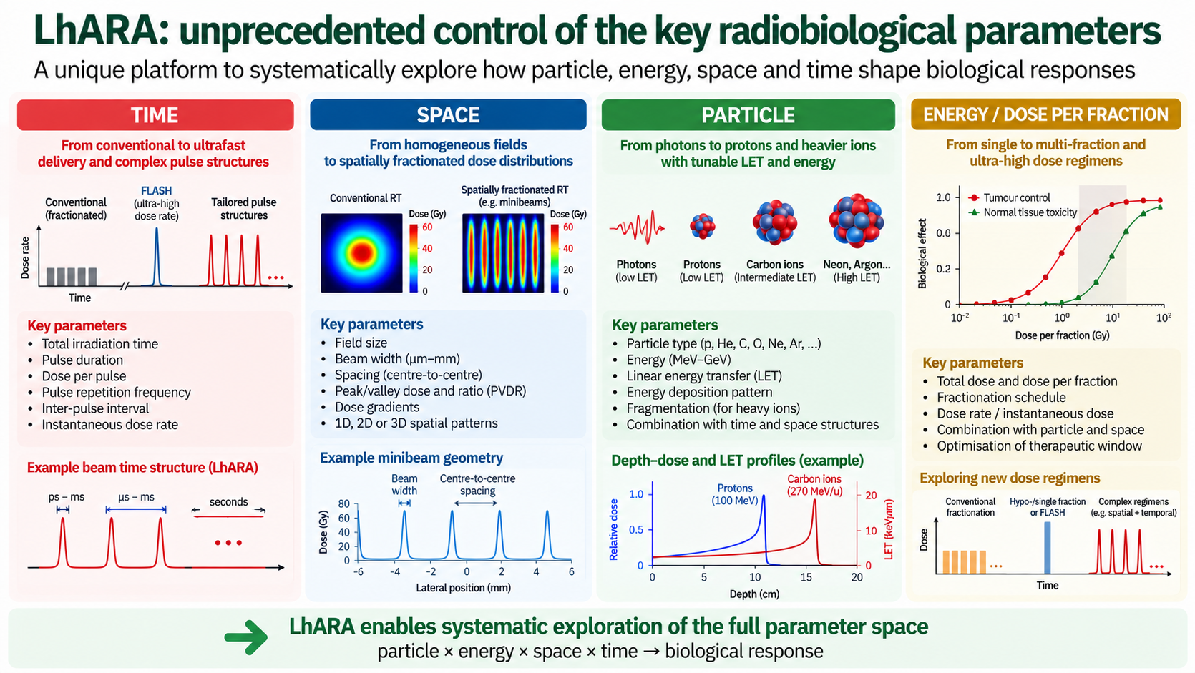

Slide 9
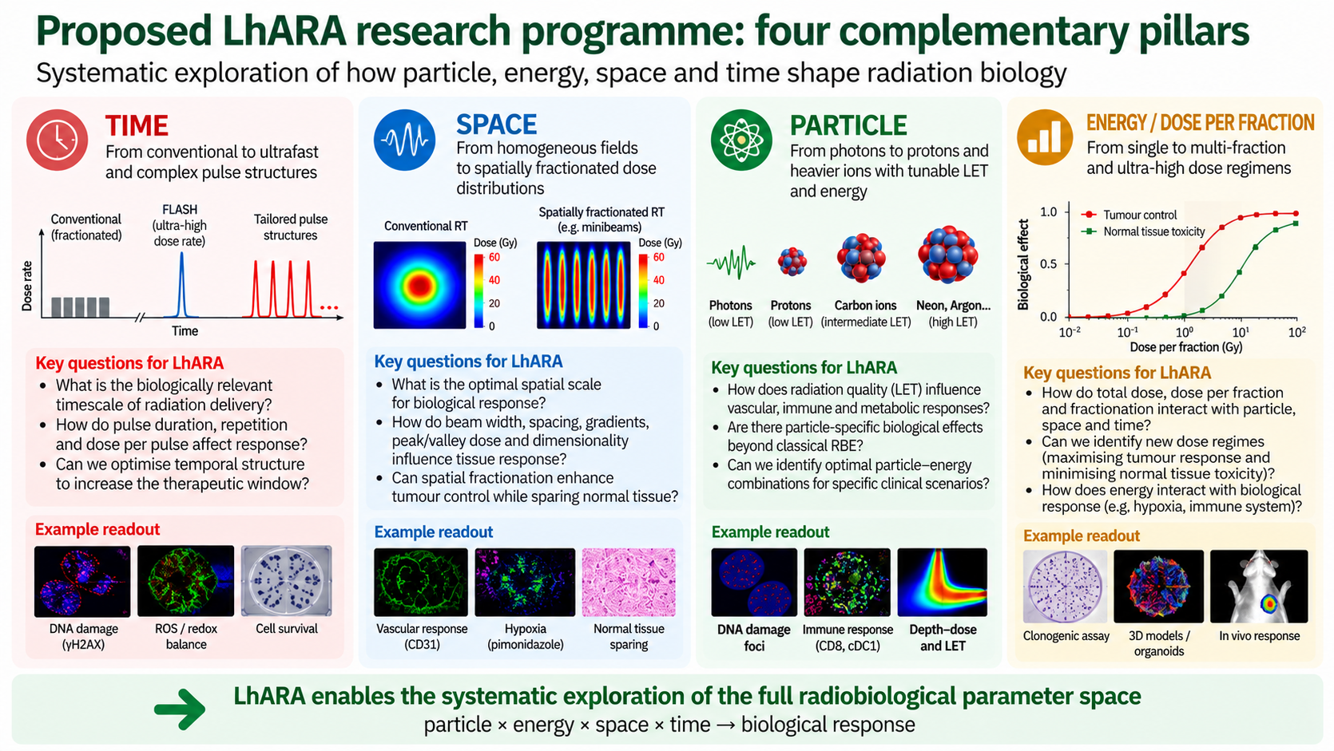

Slide 10

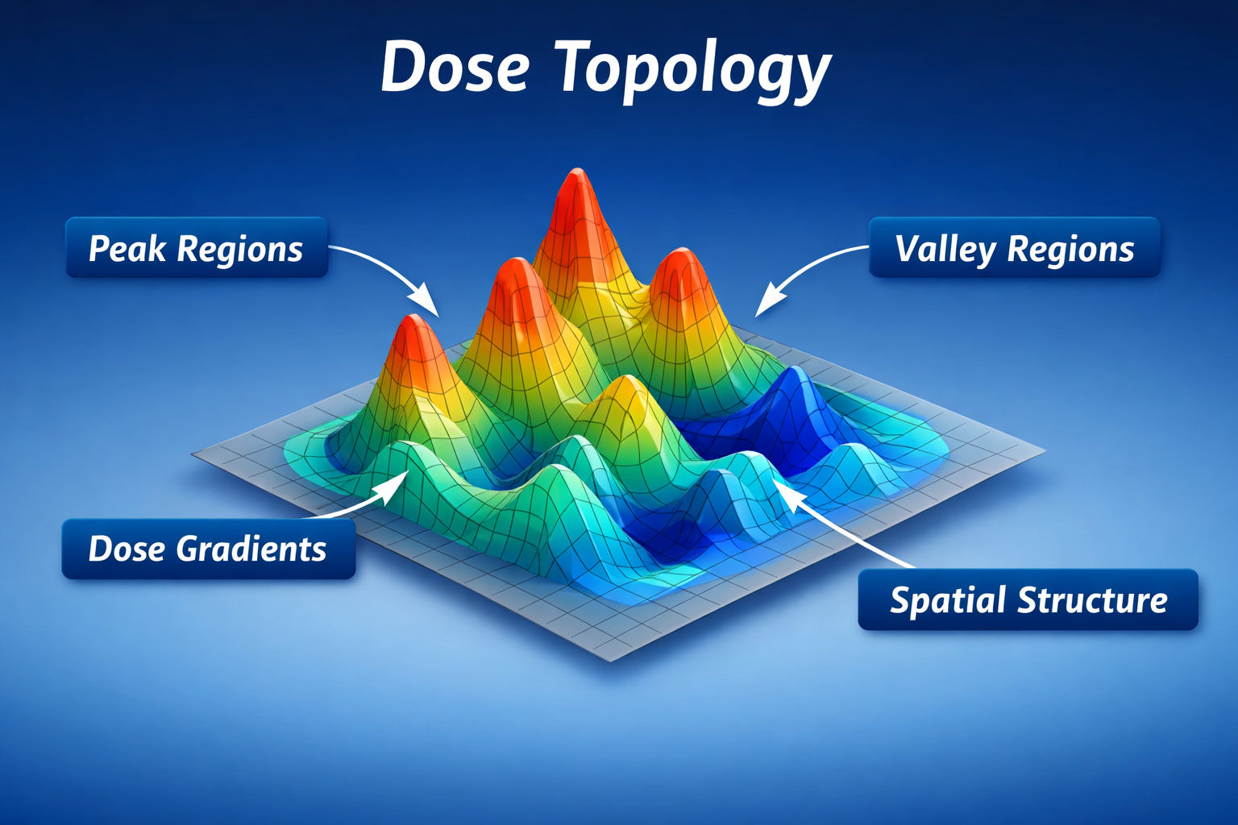
Rethinking RT: It’s not just the dose, it’s how it’s delivered

Slide 11
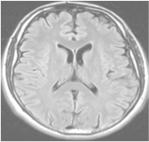
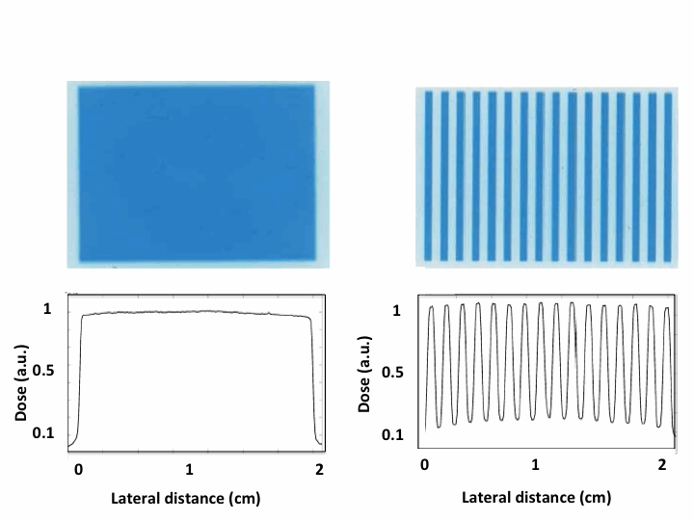
Spatially Fractionated Radiation Therapy (SFRT)
large fields (≥ 1 cm)
laterally homogeneous dose distributions
field composed of smaller beamlets
laterally heterogeneous dose distributions
(peaks and valleys)
➜ increase of normal
tissue tolerance
Standard RT
≥ 1 cm
beamlet
peak valley
SFRT

Slide 12
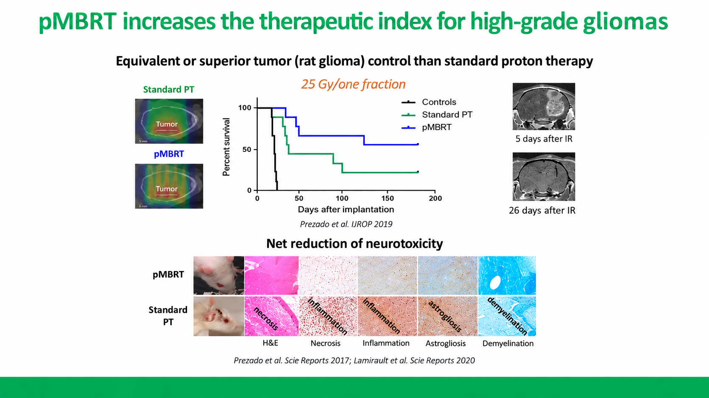

Slide 13
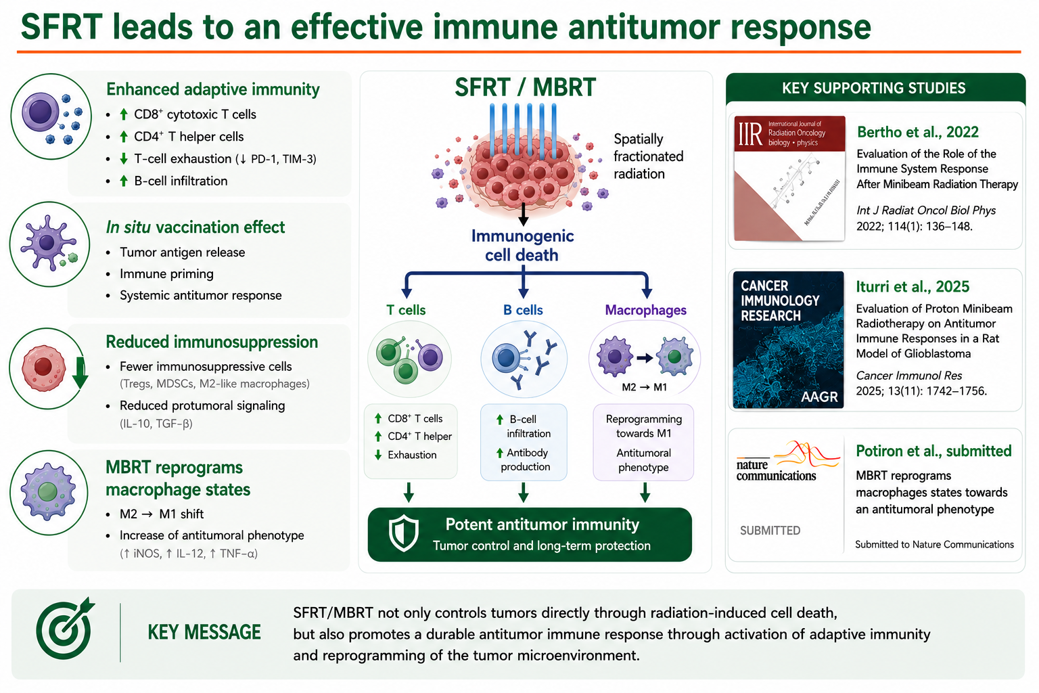
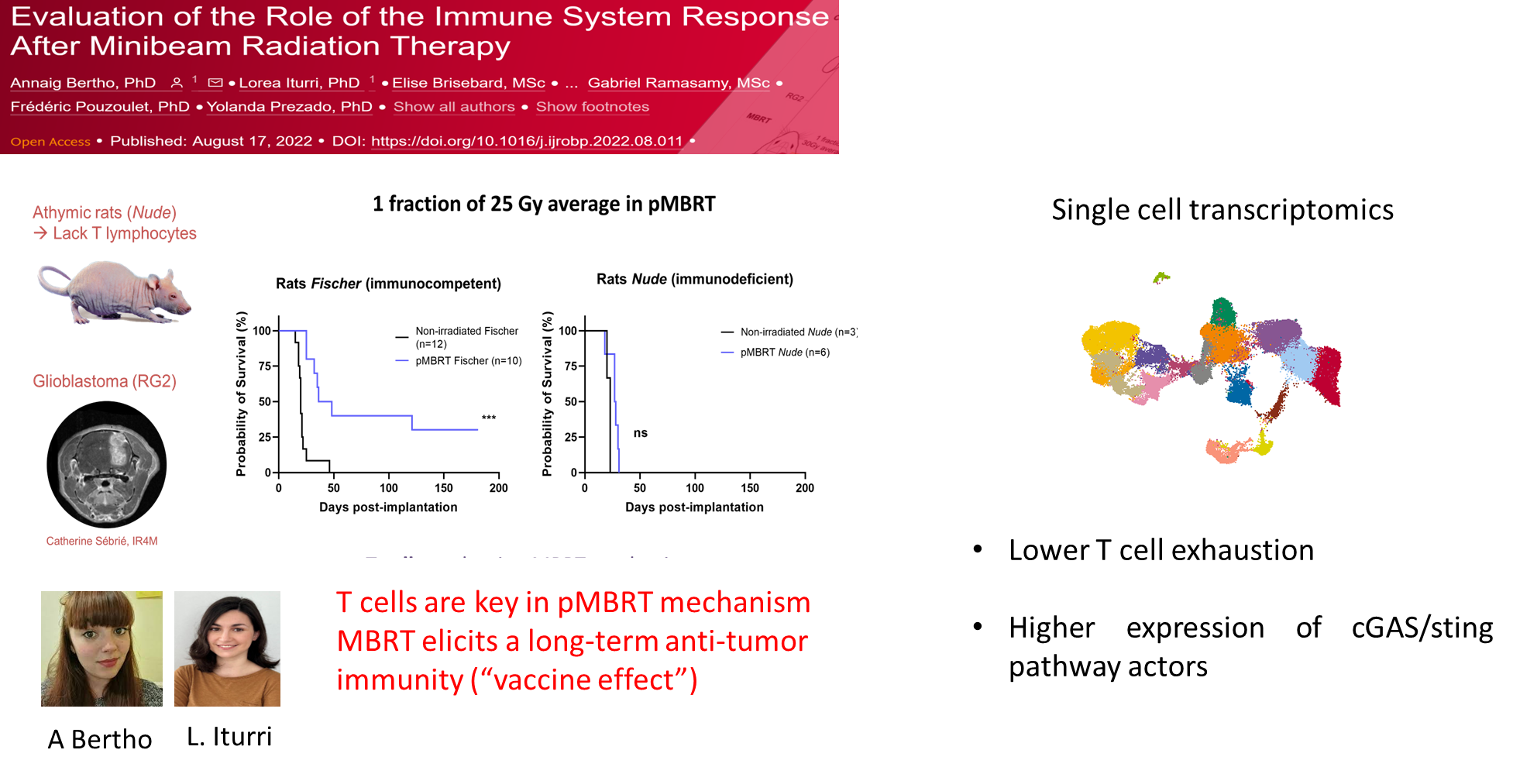
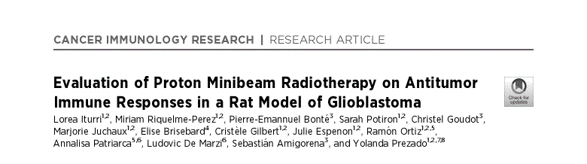
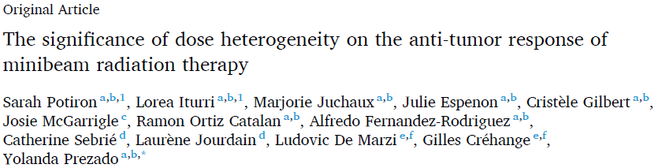
SFRT leads to an effective immune antitumor response
Increase of T cell infiltration
notably cytotoxic T cells, T helpers
Lower T cell exhaustion
Increase of B cell infiltration
In situ vaccination
Reduced number of immunosupressive cells
MBRT rewires macrophages states towards antitumoral phenotype
Potiron et al. submitted to Nat Comm.

Slide 14
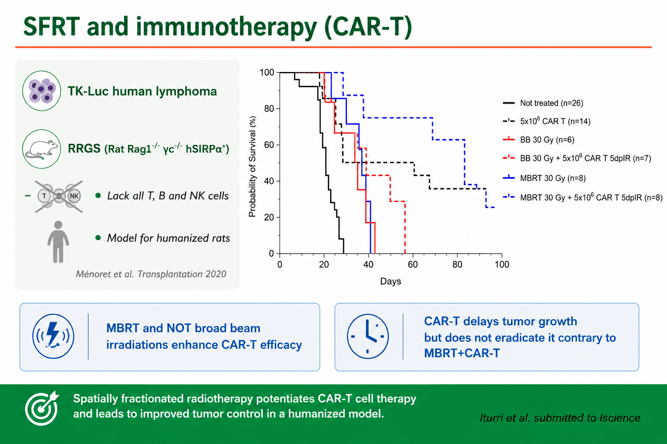
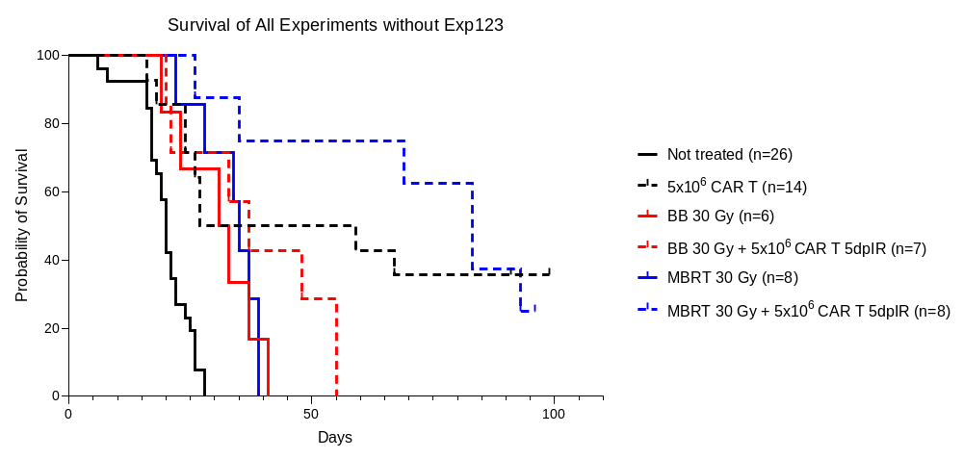
SFRT and immunotherapy (CAR-T)
TK-Luc human lymphoma
RRGS (Rat Rag1^{-/-} γc^{-/-} hSIRPα⁺)
lack all T, B and NK cells
Model for humanized rats
Ménoret et al. Transplantation 2020
MBRT and NOT broad beam irradiations enhance CAR-T efficacy
CAR-T delays tumor growth but does not eradicate it contrary to MBRT+CAR-T
Iturri et al. submitted to Iscience
Notes:
Mejorar la grafica!

Slide 15
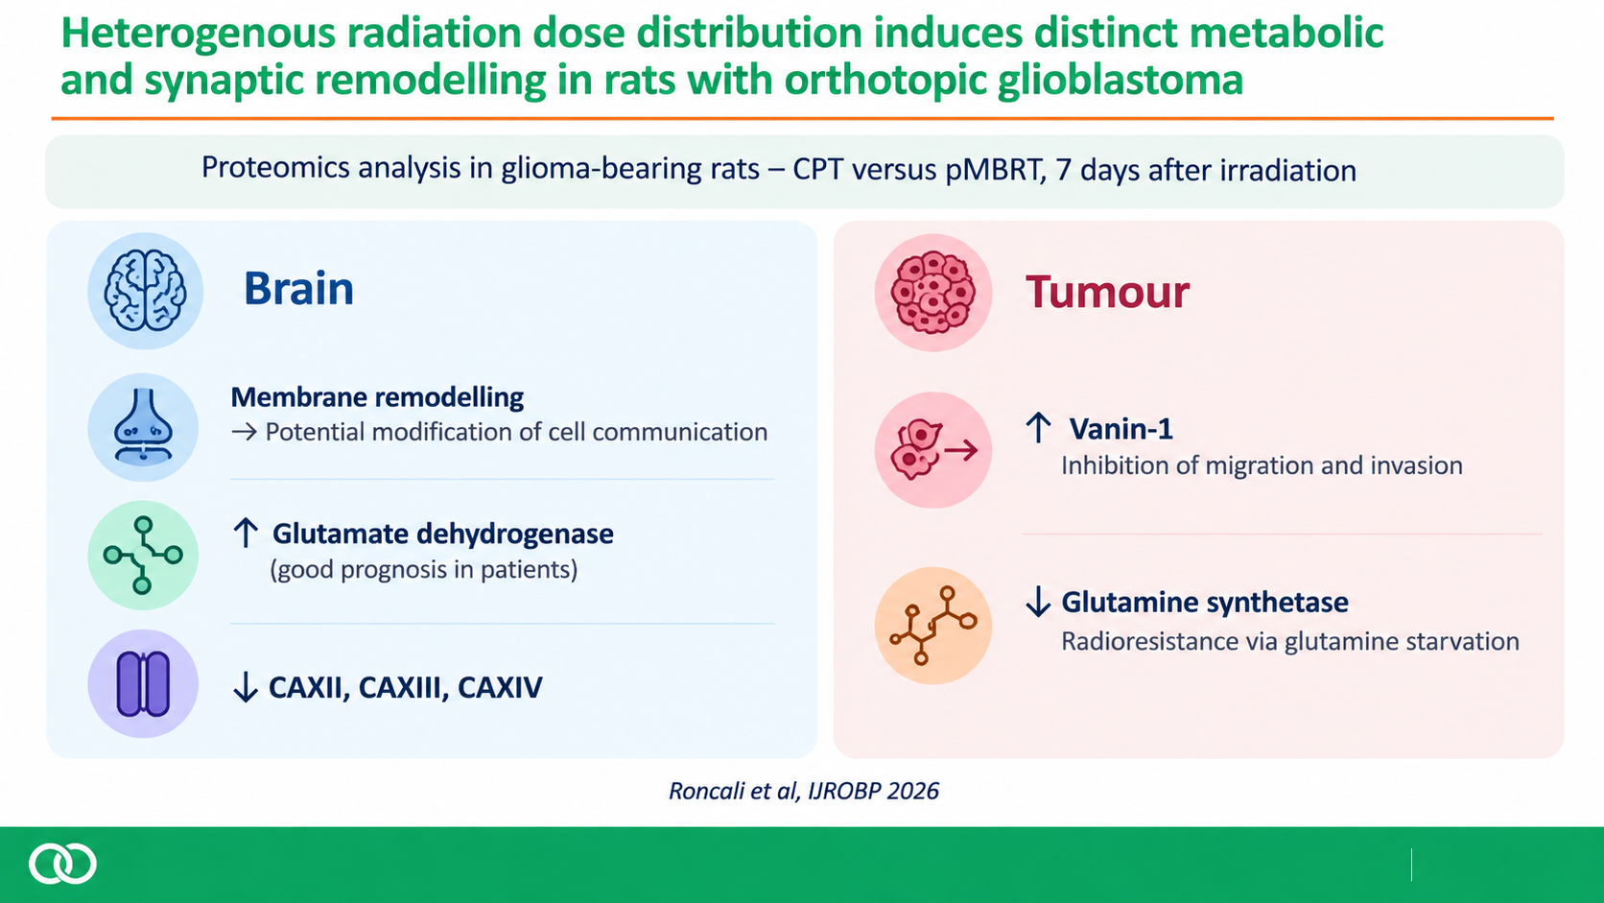
Heterogenous radiation dose distribution induces distinct metabolic and
synaptic remodelling in rats with orthotopic glioblastoma
Proteomics analysis in glioma-bearing rats CPT versus pMBRT, 7 days after irradiation
Brain
Tumour
Membrane remodelling
Potential modification of cell communication
↑ Glutamate dehydrogenase (good prognosis in patients)
↓ CAXII, CAXIII, CAXIV
↑ Vanin-1 : inhibition of migration and invasion
↓ Glutamine synthetase : radioresistance via glutamine starvation
Roncali et al, IJROBP 2026
13
Notes:
Glutamate is the primary excitatory neurotransmitter of the brain. Cellular homeostasis of glutamate is of paramount importance for normal brain function and relies on an intricate metabolic collaboration between neurons and astrocytes. Glutamate is extensively recycled between neurons and astrocytes in a process known as the glutamate-glutamine cycle. The recycling of glutamate is closely linked to brain energy metabolism and is essential to sustain glutamatergic

Slide 16
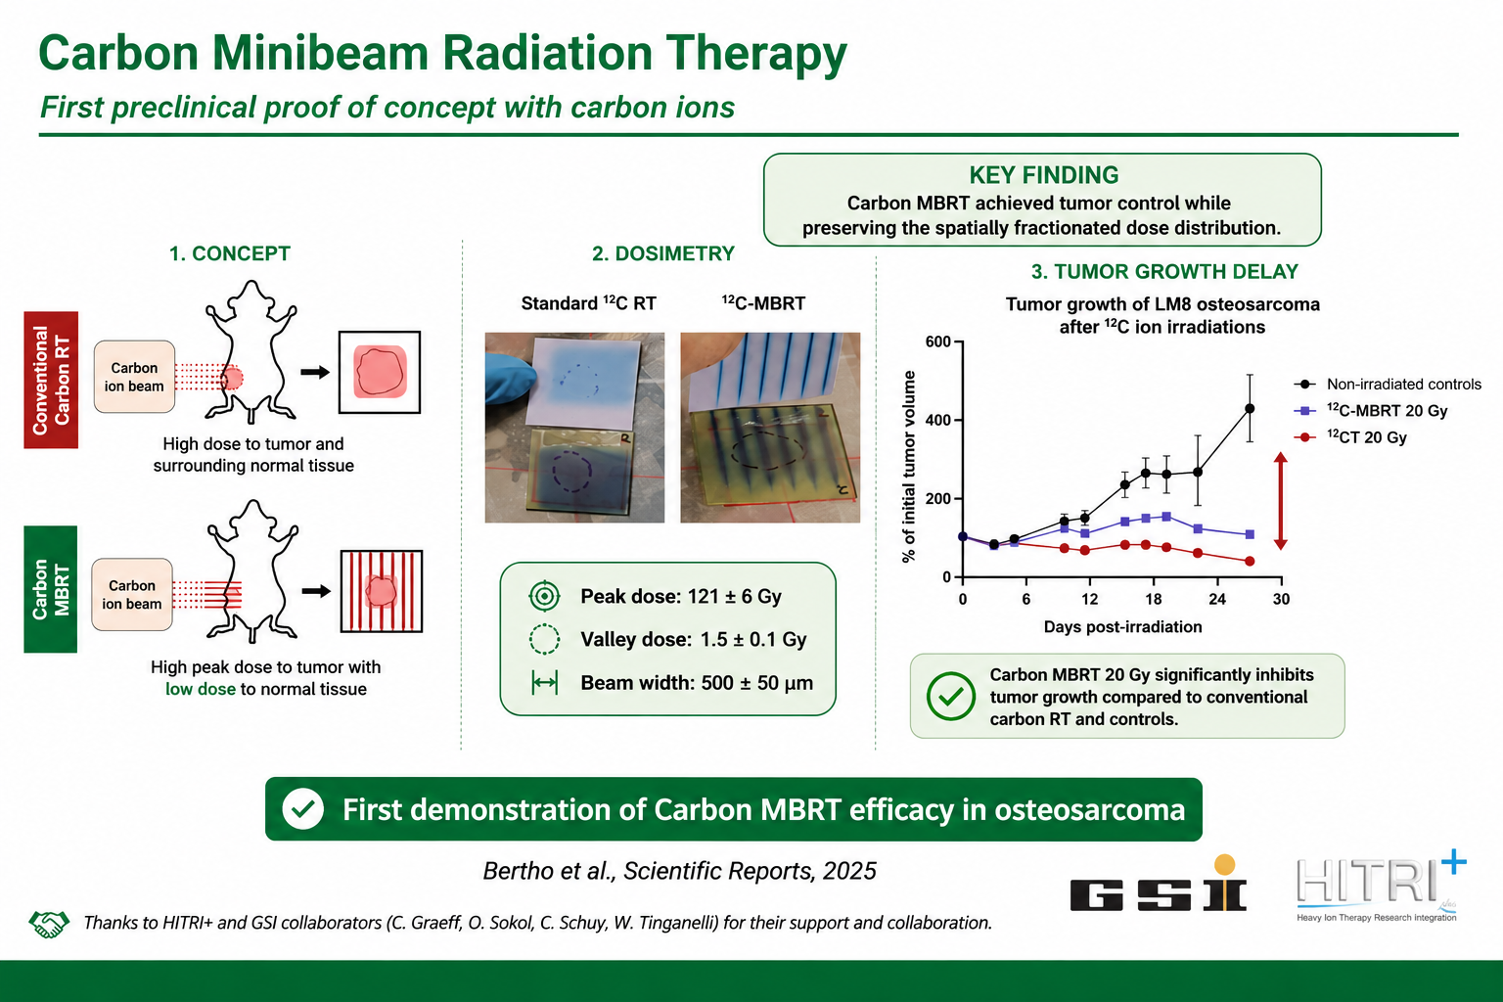

Slide 17
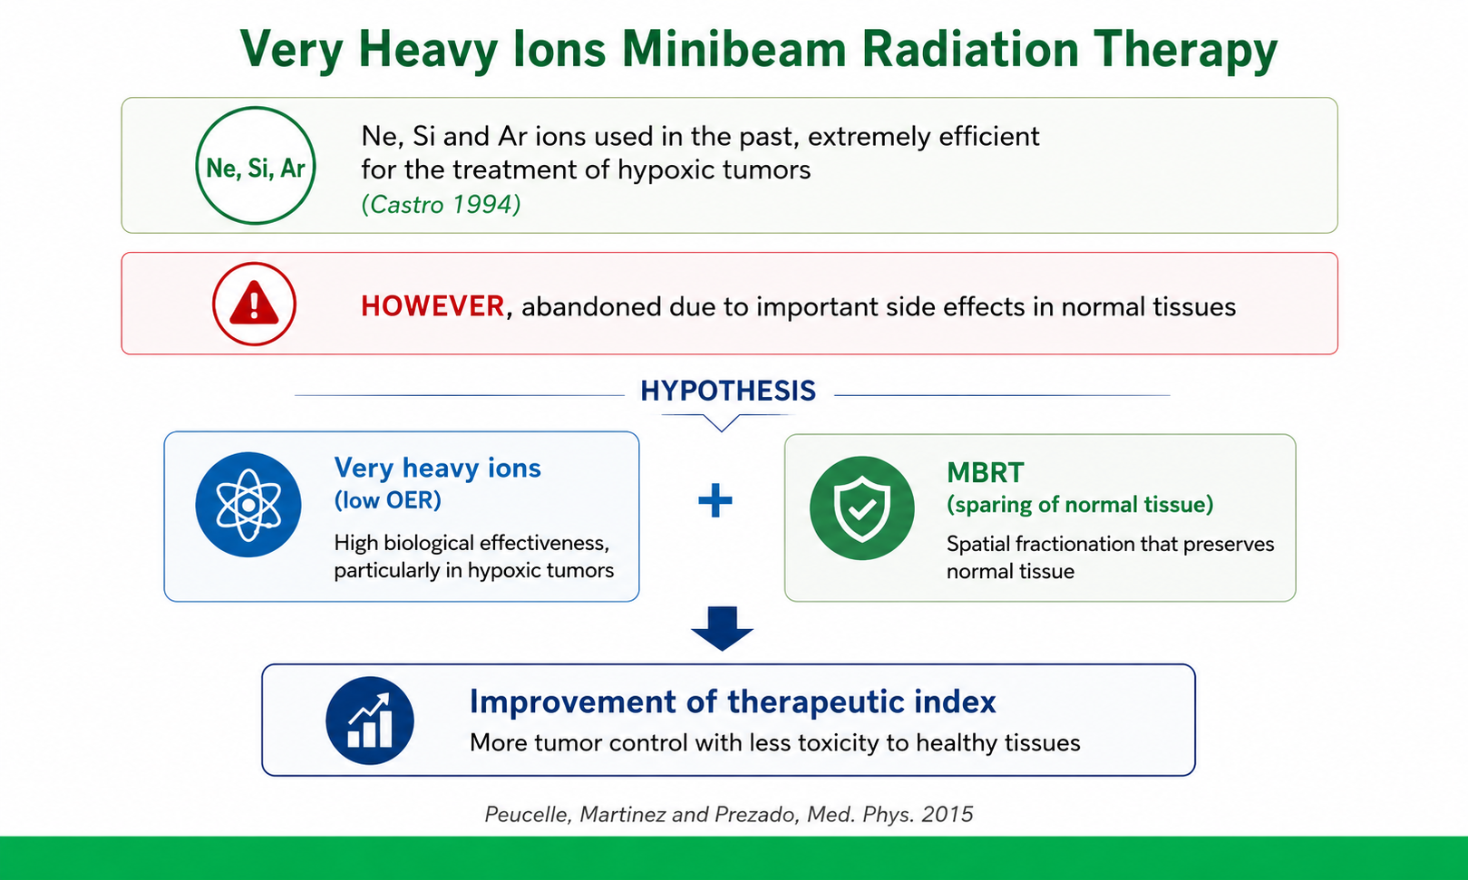

Slide 18
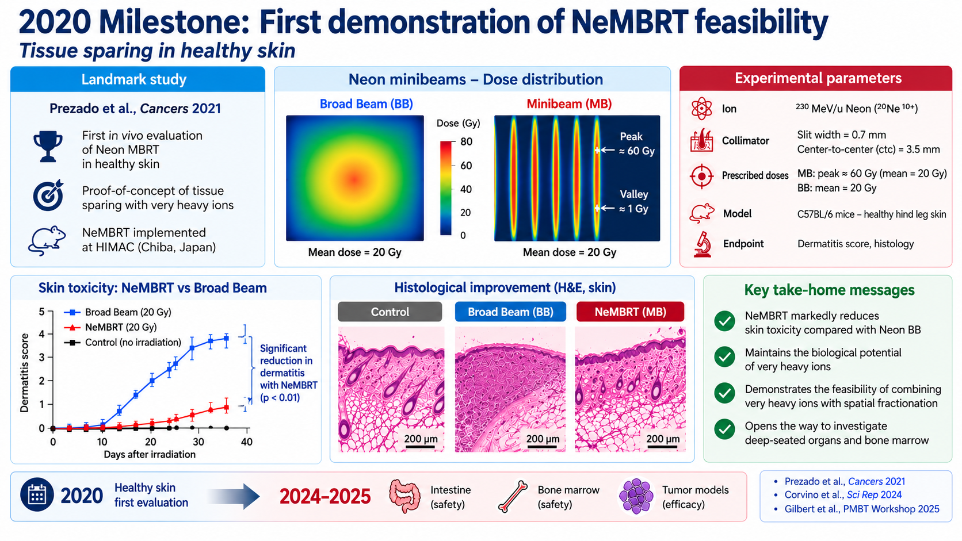

Slide 19
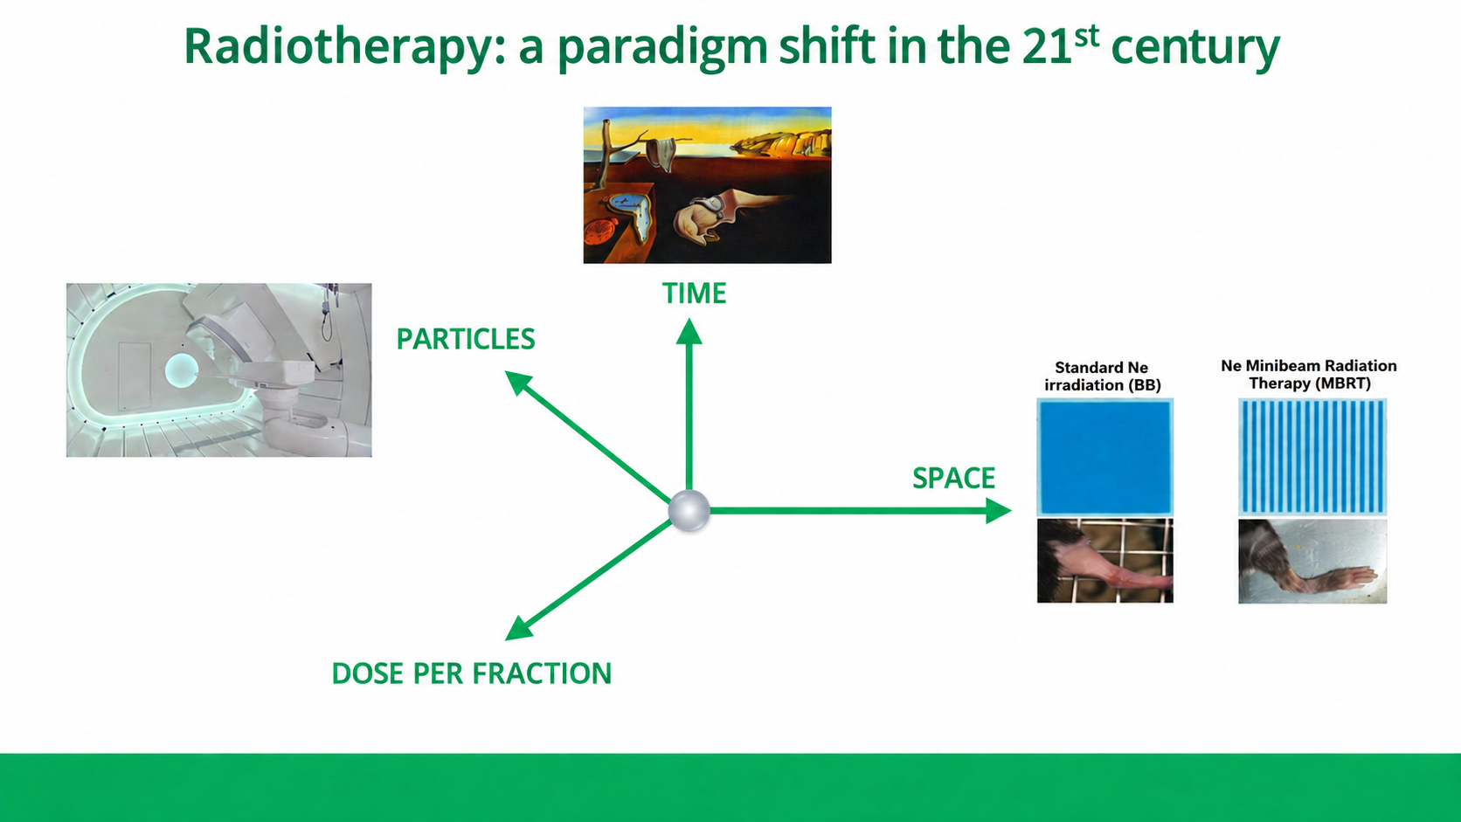

Slide 20
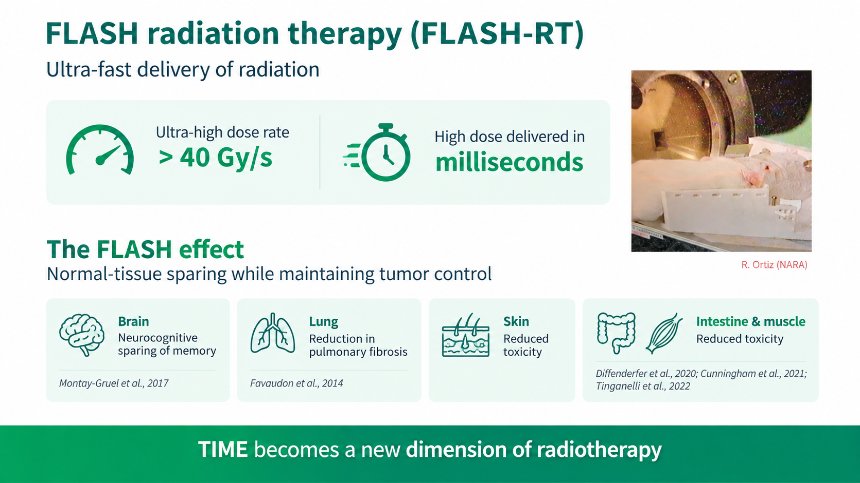

Slide 21
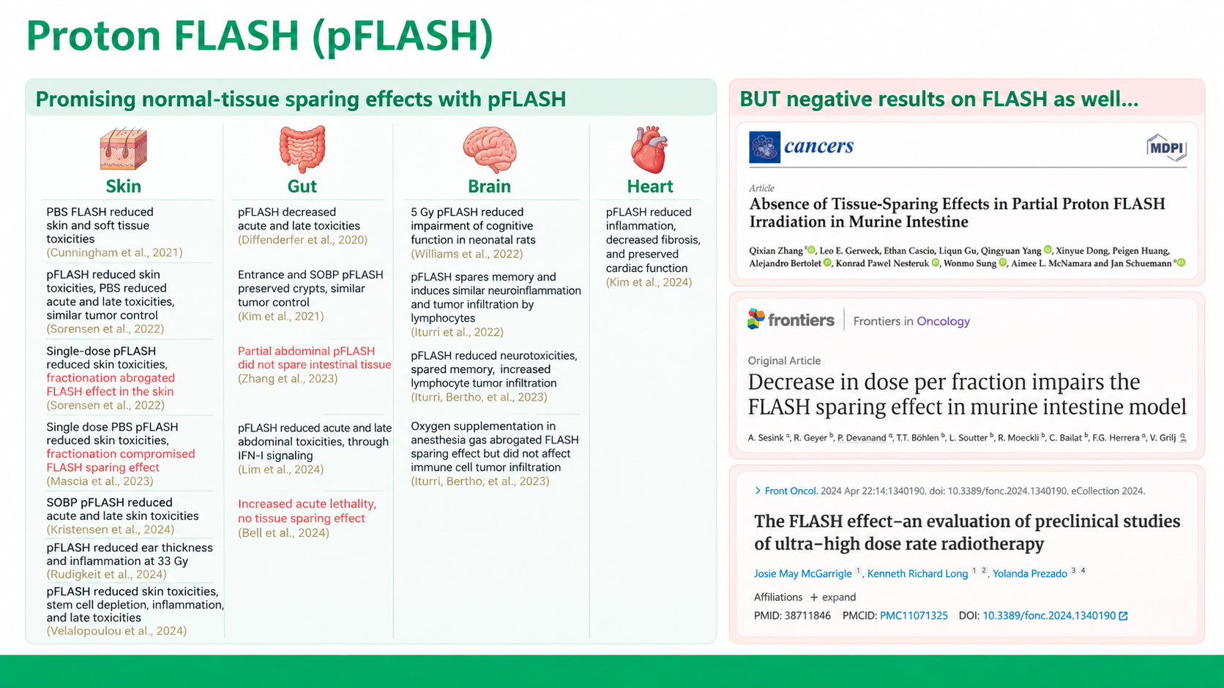

Slide 22
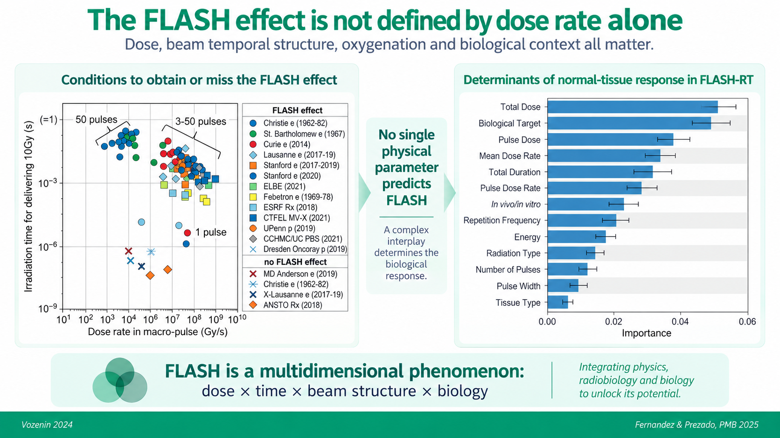

Slide 23
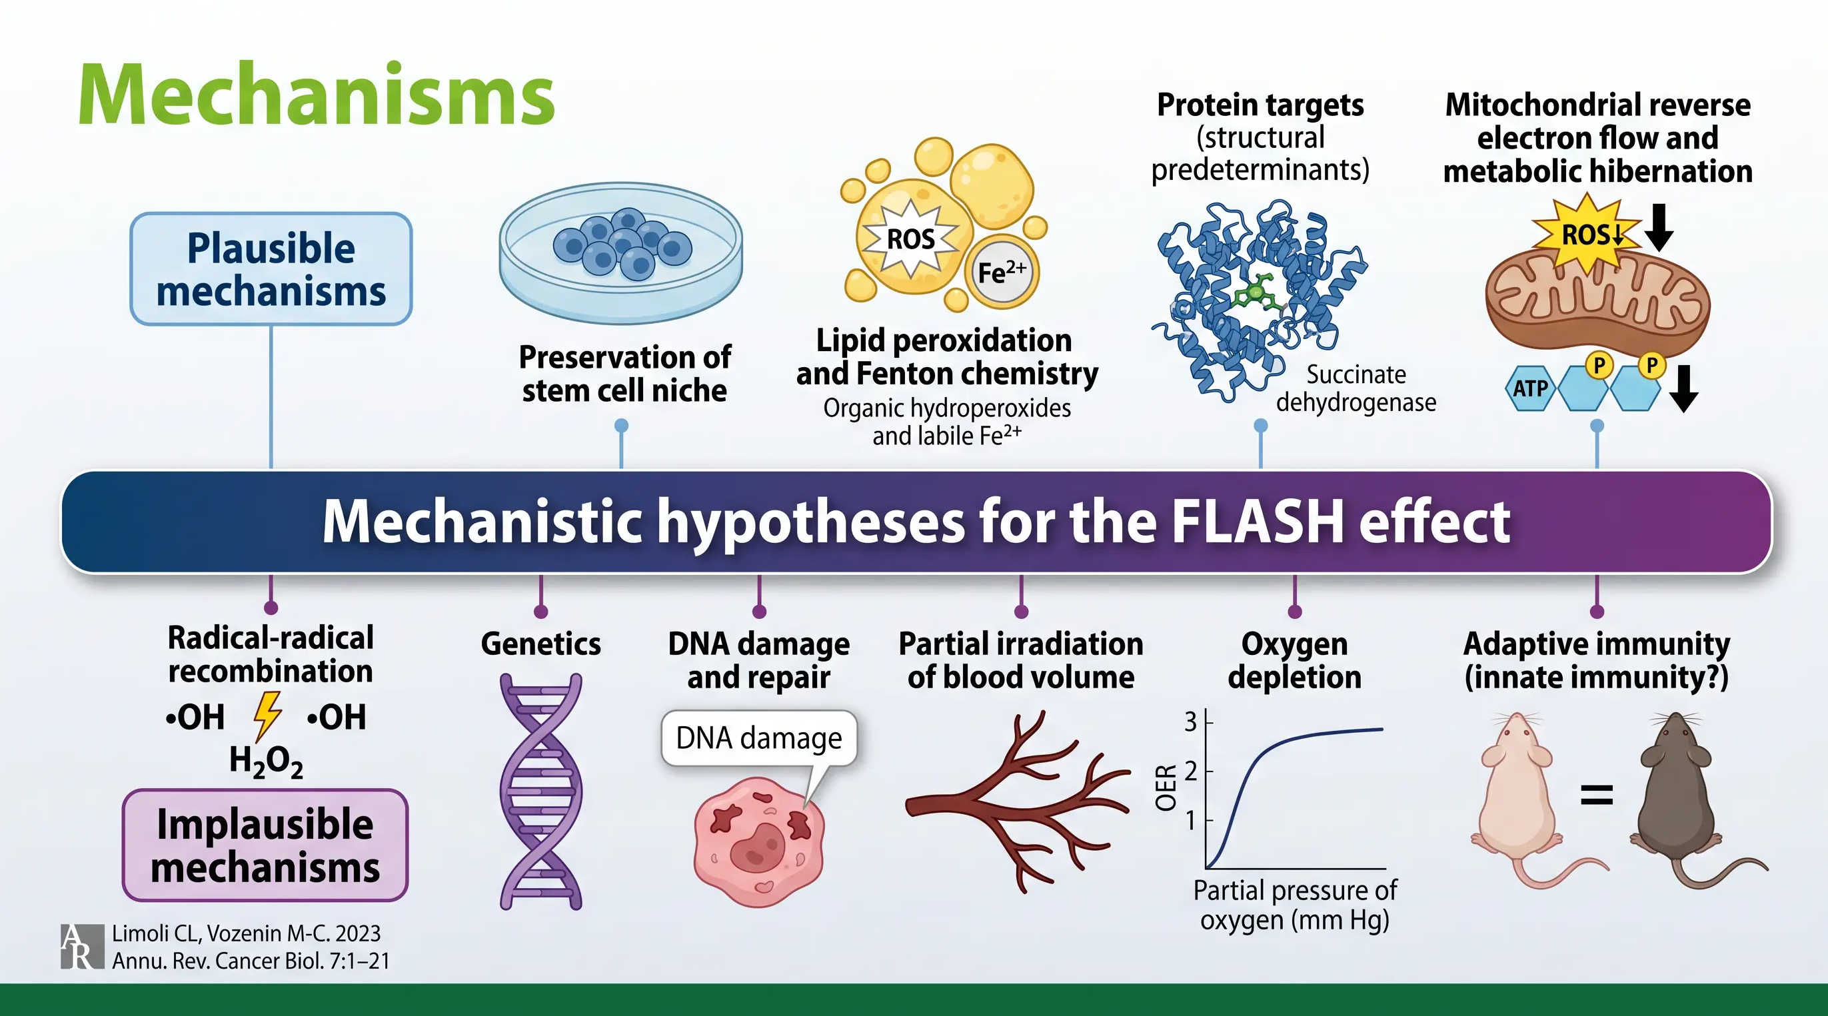

Slide 24
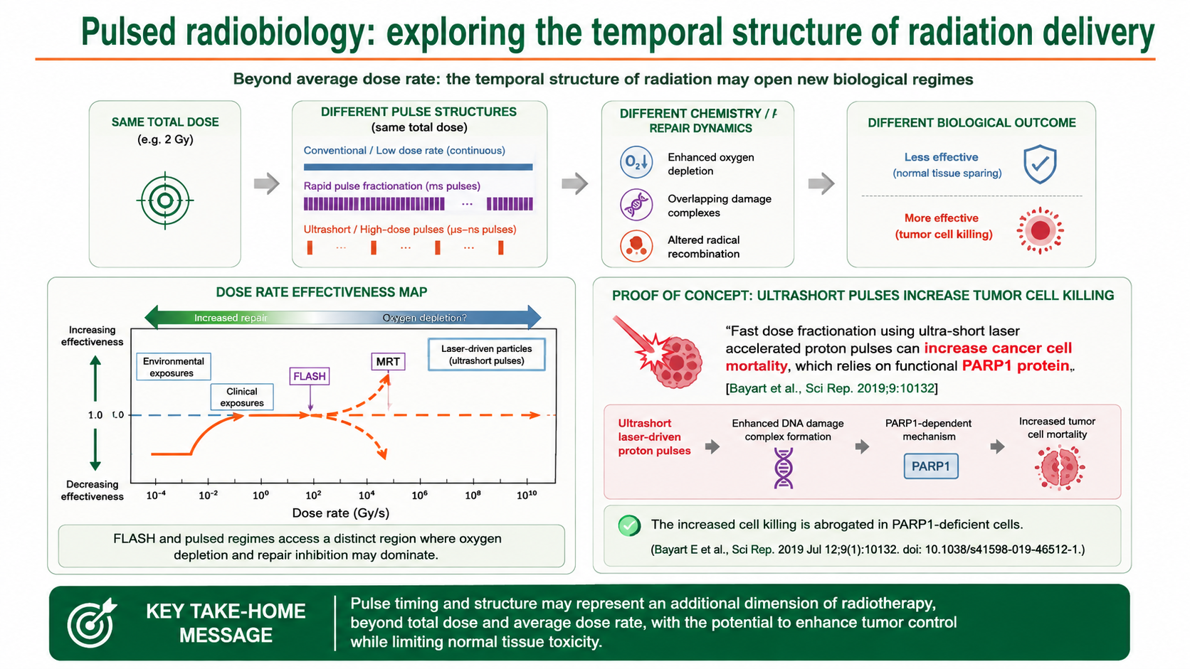
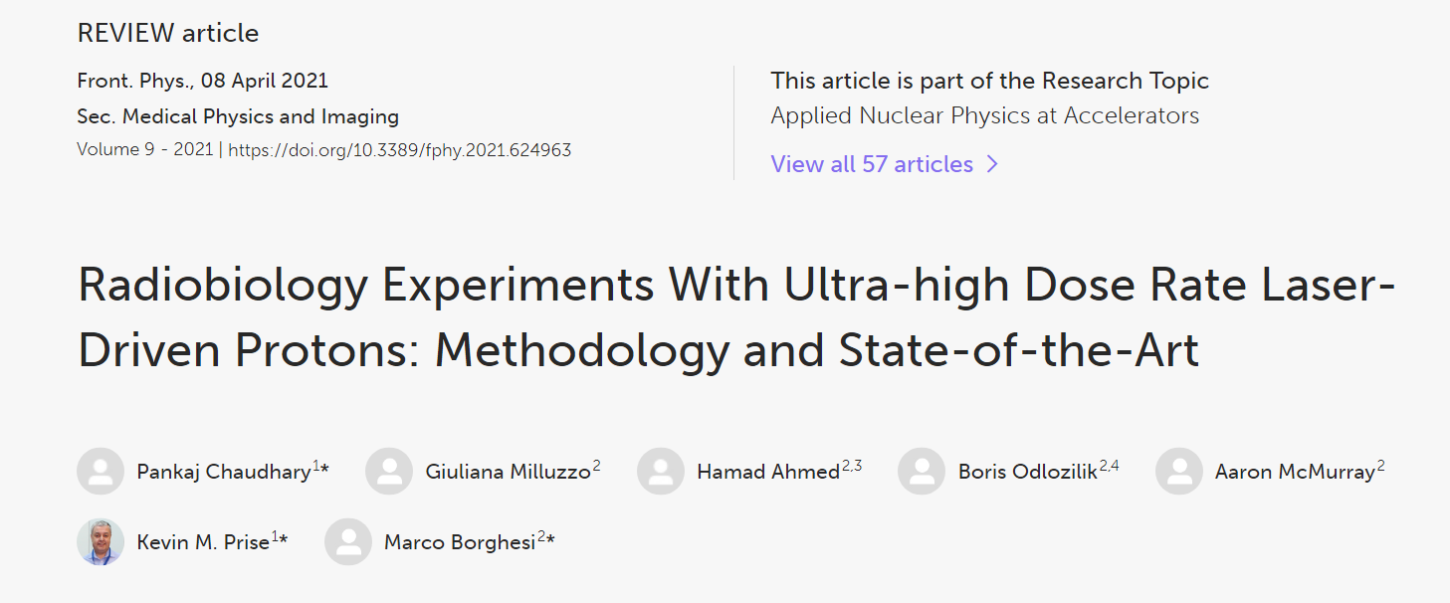
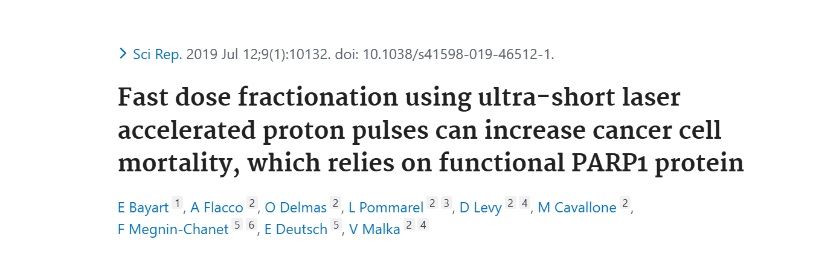
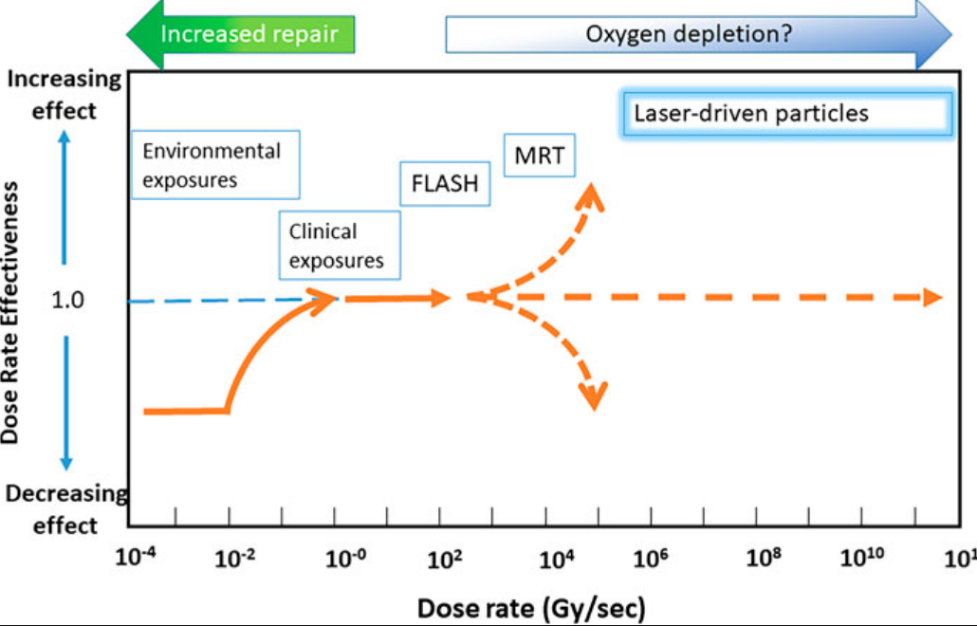
Pulsed radiobiology: new untested regimes in the femtochemistry domain

Slide 25
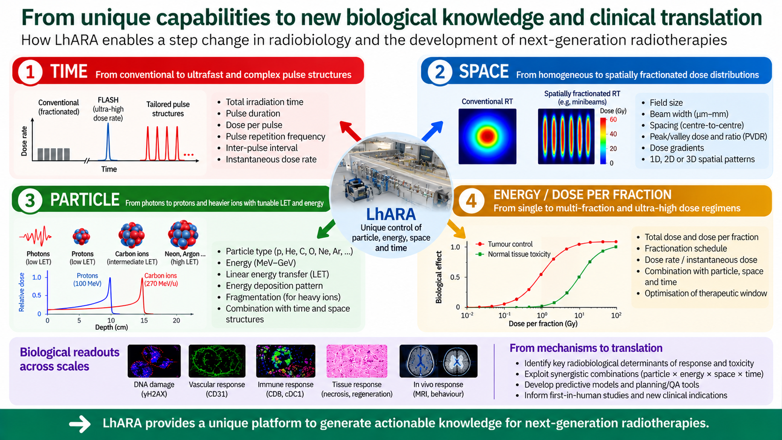

Slide 26
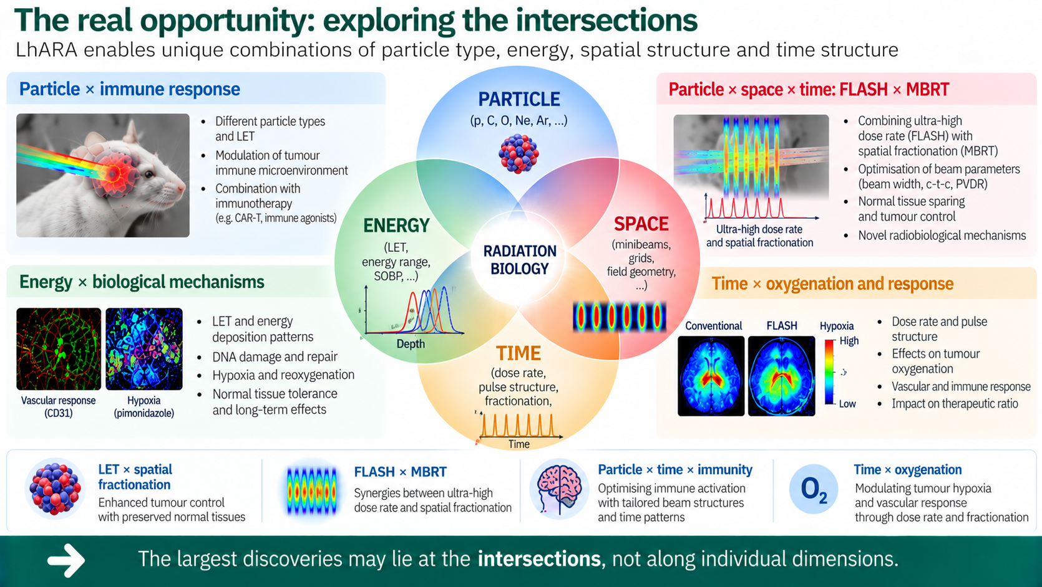

Slide 27
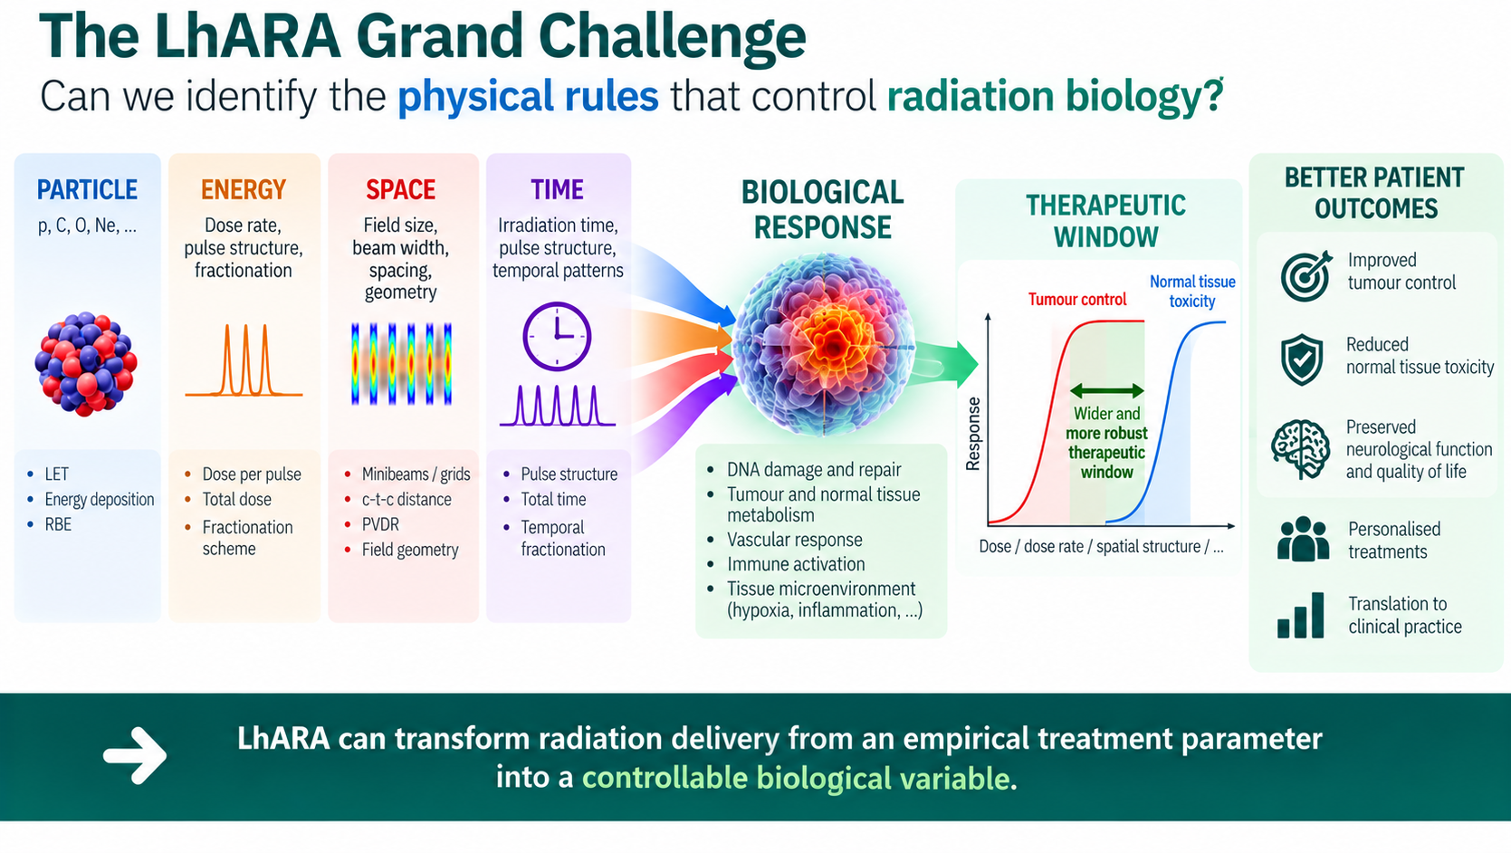

Slide 28


