Slide 1
News and update
K. Long
November 3, 2026

Slide 2
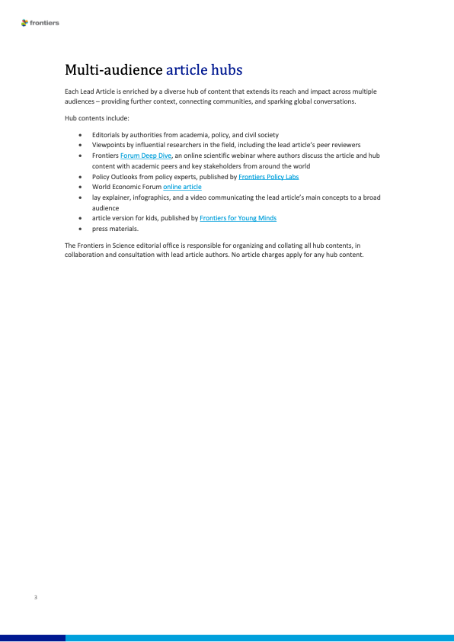
Updates:
Frontiers in science
  Now underway:
    Initial drafting team
    KL, Y. Prezado, J. Parsons, R. Amos, T. Underwood, C. Whyte
    On behalf of the collaboration
    Will reach out … aiming for Q1 27
    Publishing CDR:
    Exchange with Editor:
    Editor proposes vehicles by which CDR contributions can be published together
    Clear that they want the lead article before further discussion…

Slide 3
Updates:
4-nation …
Aled Isaac, Stefan Eriksson, Mike Charlton, Richard Hugtenburg, Colin Whyte, Marie Boyd, Bob Bingham, Marco Borghesi, Tim Greenshaw, Richard Amos
…
Programme grant …
Writing committee;
Too many names! First task 2-pager for EPSRC Programme Manager
Met 16Oct26: ongoing
EU MCSA DN …
Getting started;
Initial discussion held with CNRS/Strassbourg
Meeting with Katia Parodi and Yolanda Prezado 16Nov26

Slide 4
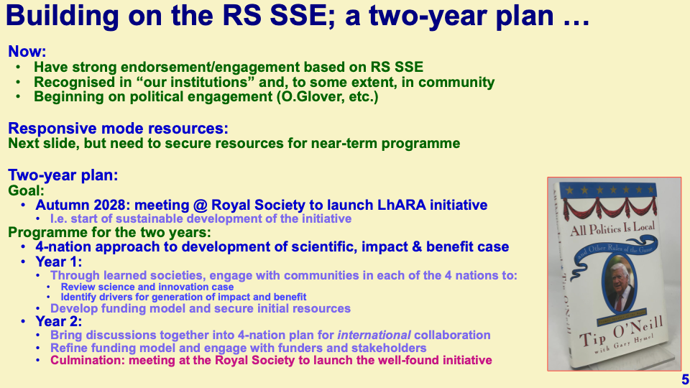
Updates:
4-nation initiative
(https://ccap.hep.ph.ic.ac.uk/trac/wiki/Research/LhARA/Governance/ExecutiveBoard/4Nation)
28Jul26

Slide 5
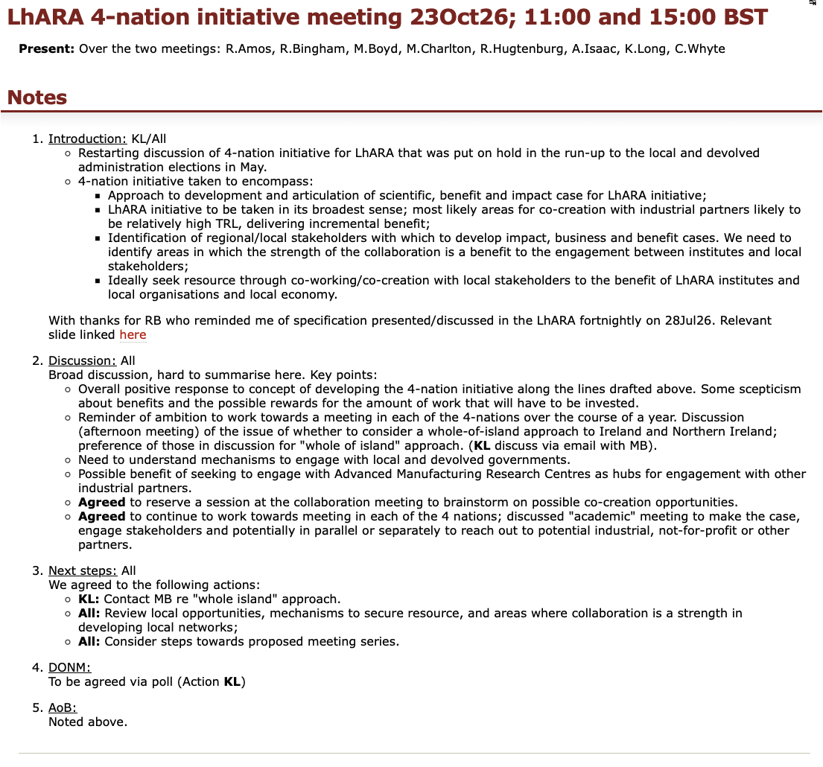
Updates:
4-nation initiative
(https://ccap.hep.ph.ic.ac.uk/trac/wiki/Research/LhARA/Governance/ExecutiveBoard/4Nation)
Discussion:
    Agreed to pursue initiative to use common LhARA vision to:
      Promote local/national engagement
      Seek resources through co-creation
    Concrete steps:
      Initial investigation of opportunities for co-creation
      Consideration of proposed 4-nation meeting series
      Initiated engagement in “whole-island” approach to NI/Ireland

Slide 6
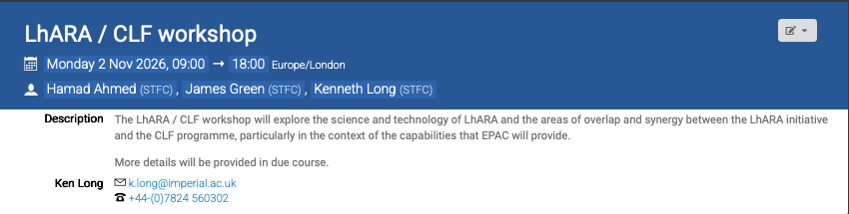
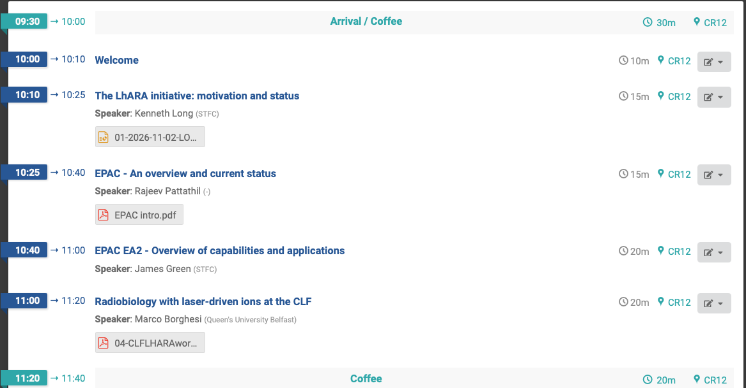
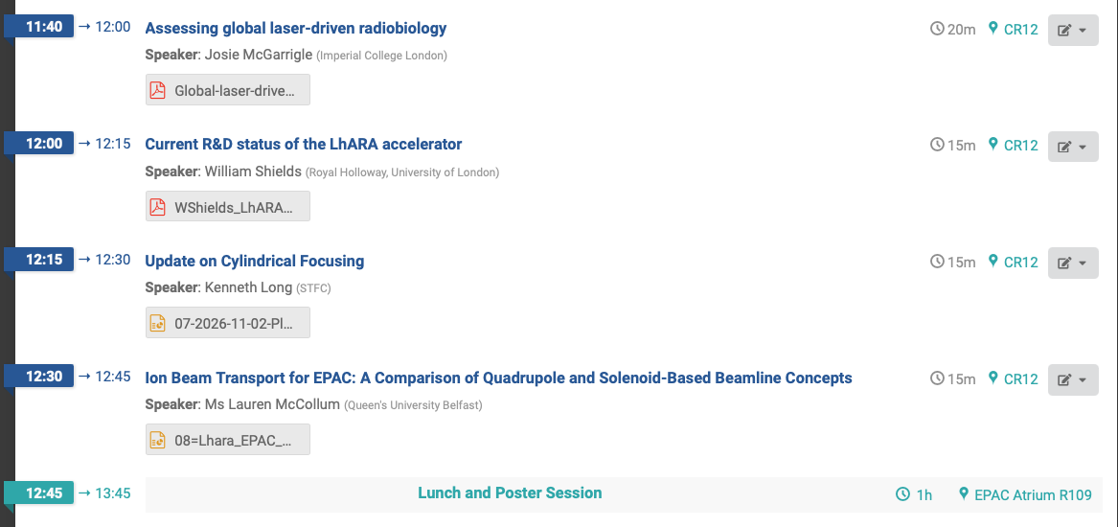
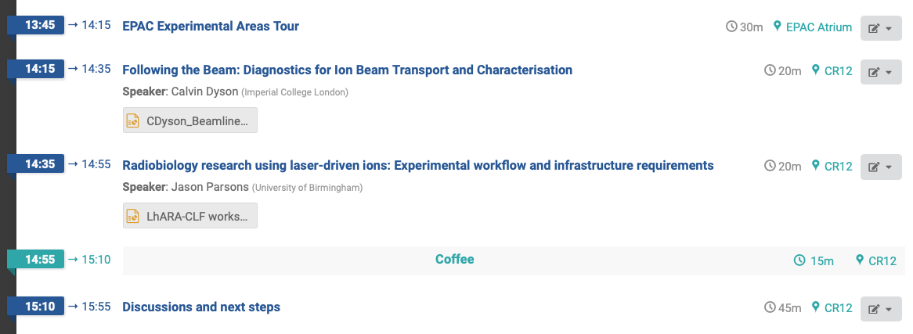
Updates:
https://indico.stfc.ac.uk/event/1997/
CLF/EPAC & LhARA …
Excellent meeting!
Discuss later, but:
    Positive!
    Agreed to follow-up with second meeting in ~6 months

Slide 7
Raising resource
IAA:
  Impact analysis, benefits map as input to business case (? via UKRI IAA at Imperial)
  Bio-programme development
  Need to consider support for D.Laird comms.
STFC SPARK (25Aug26):
  RS SSE on tour, our regional outreach, D.Laird comms, schools outreach; in progress, Katia Smith (PPD)
STFC PPRP (27Aug26):
  "Talk to programme manager before submitting", conversation worthwhile, Will speak to S.Verth, 07Sep26
STFC/EPSRC KTP (no closing date):
  Worth discussing?
EPSRC Collaborate with researchers in Norway (no closing date):
  Plasma lens; discuss after 11Sep26 meeting?
EPSRC Programme grant; also outline stage proposal (no deadline): assembling writing panel
  Next "gathering" date 01Dec26.
  Worth doing to bring together our programme.
  Focus on development of bio and med-tech aspects?
  Potential also to bring forward a proposal on plasma lens post 11Sep26 meeting.
EU MCSA: forced to start now for 2027 submission
  Restarted!

Slide 8
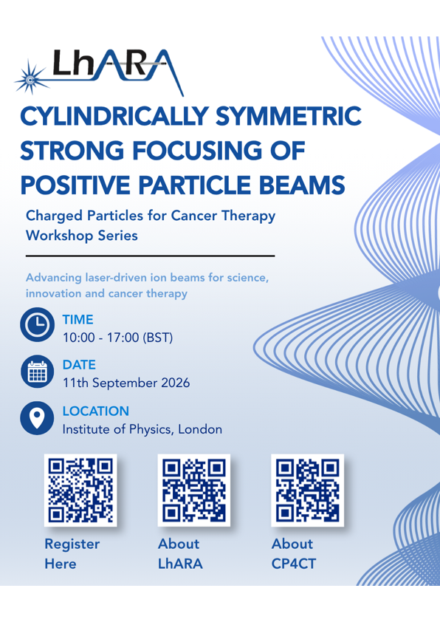
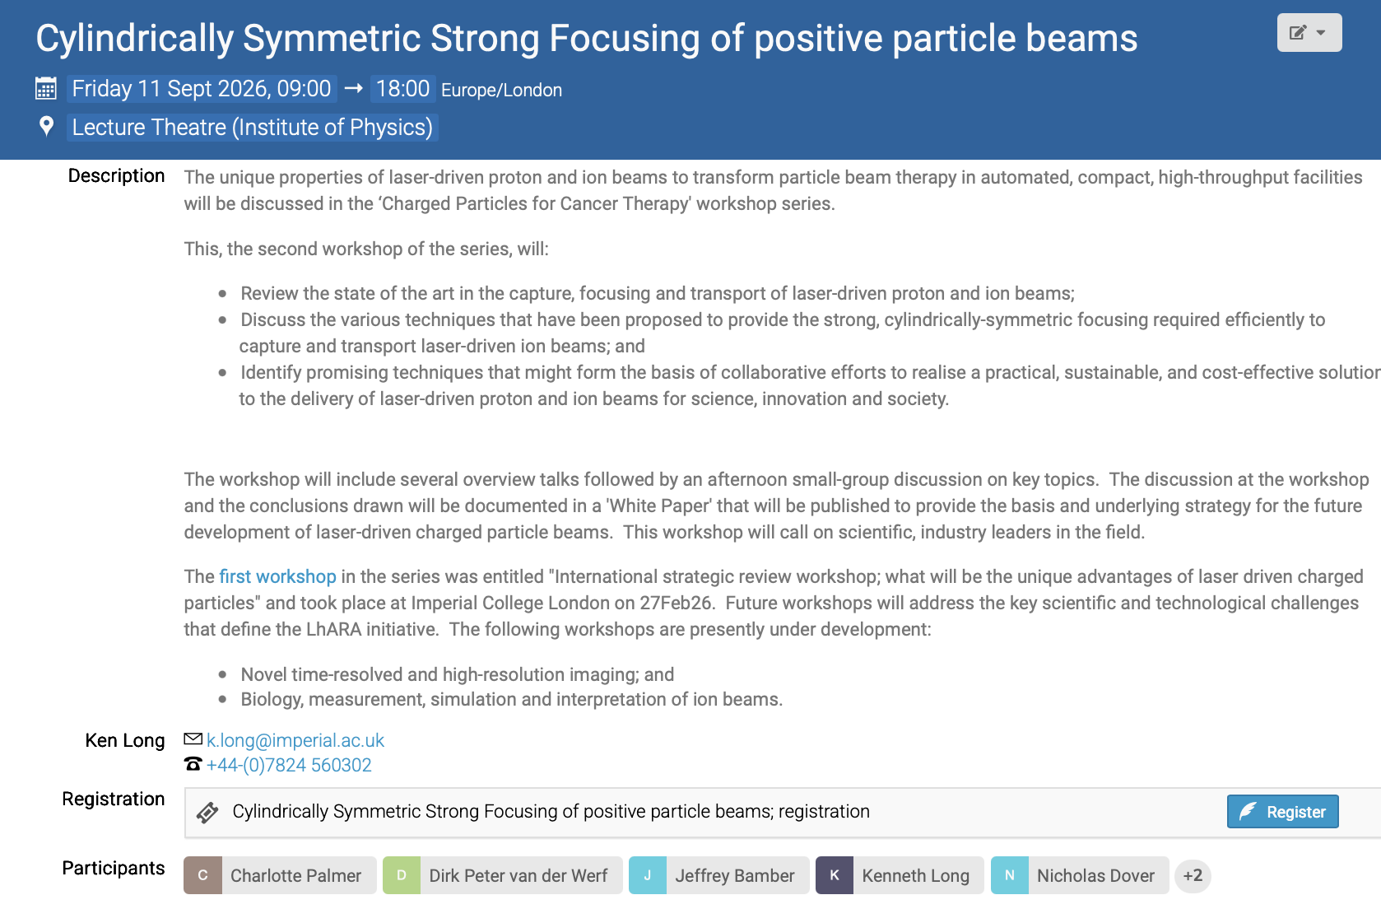
Please:
Register
Circulate
Now taking initial steps in organisation of third in series:
Novel time-resolved and high-resolution imaging

Slide 9
Peer-group meeting series
Past:
  CP4CT w/s: International strategic workshop; what will be the unique advantages of laser driven charged particles
    https://indico.stfc.ac.uk/event/1703/
  Cylindrically-symmetric strong focusing of ion beams;
    https://indico.stfc.ac.uk/event/1956/
Coming up:
  Novel time-resolved, high-resolution imaging:
    Tbd; 2027; Started assembling organisers:
    C.Dunsby, K.Parodi, Y.Prezado, …
  Biology, measurement, simulation and interpretation of ion beams

Slide 10
Going forward
Next fortnightly:
  20Oct26
Next collaboration meeting:
  16Dec26; Imperial’s Blackett Laboratory; South Kensington
  Start organization now!

