Slide 1
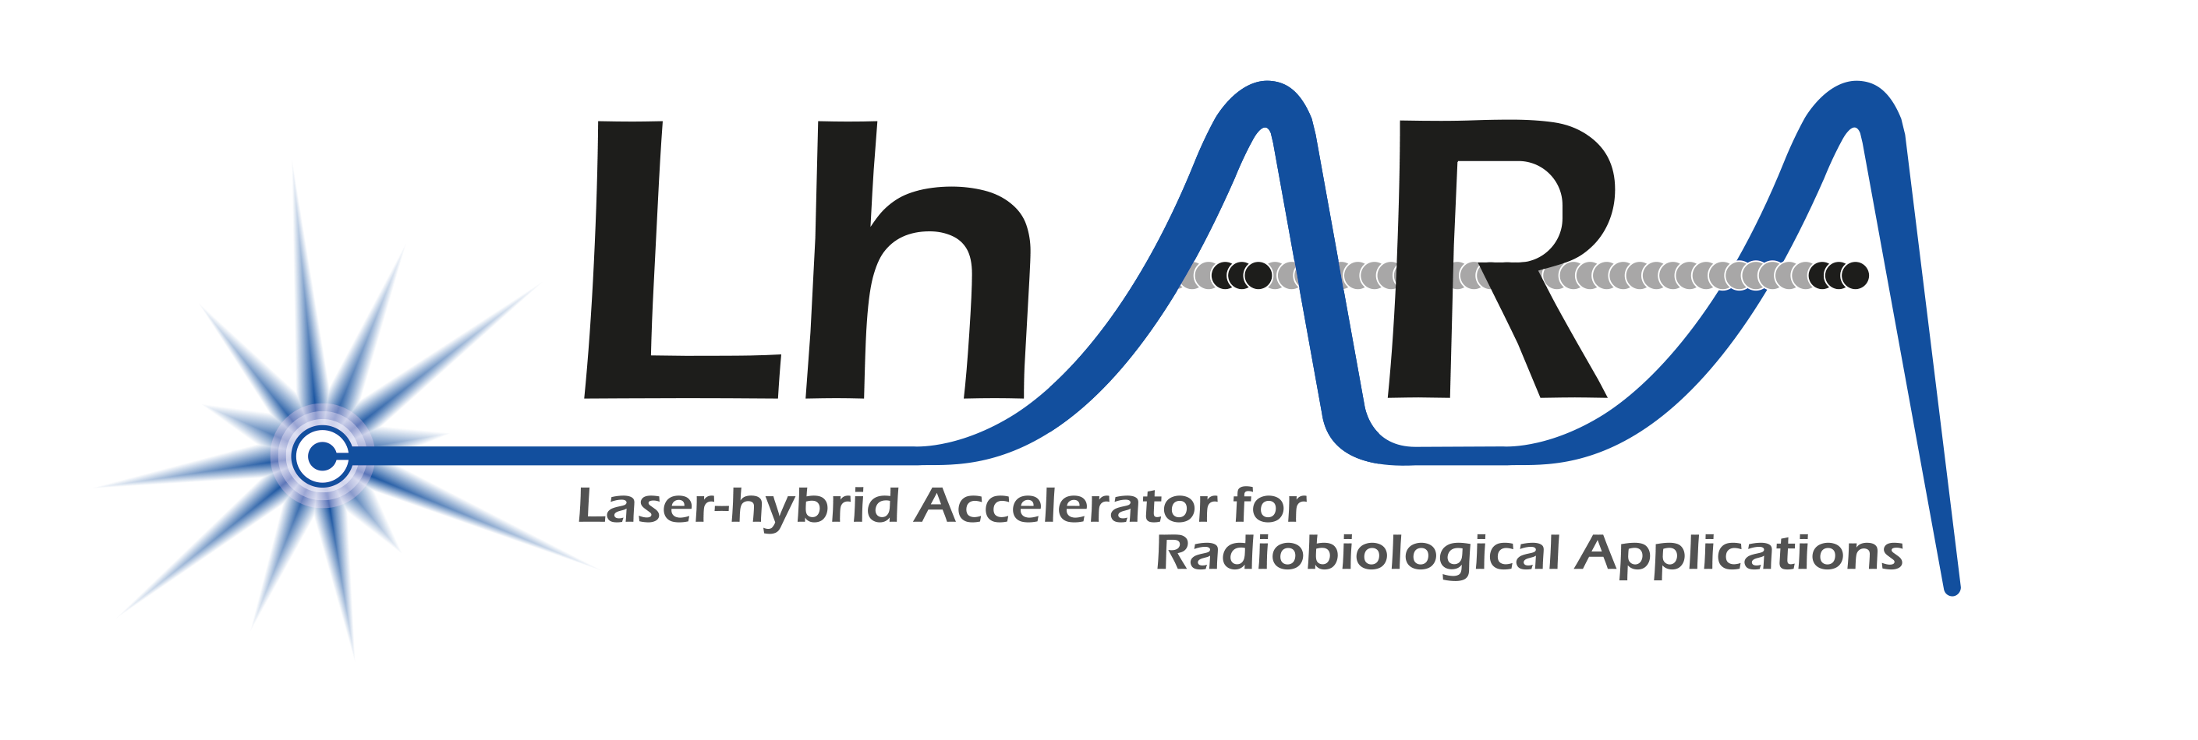
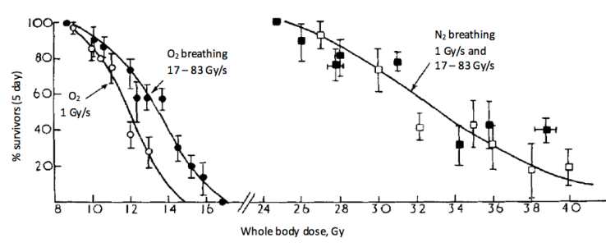
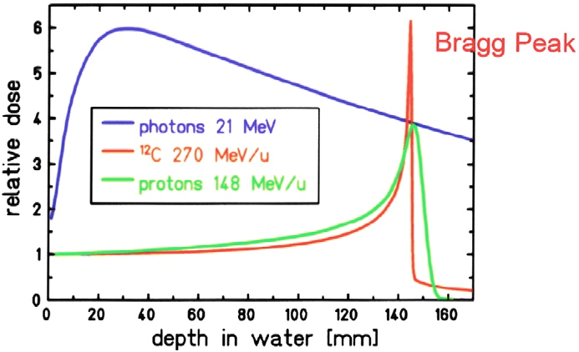
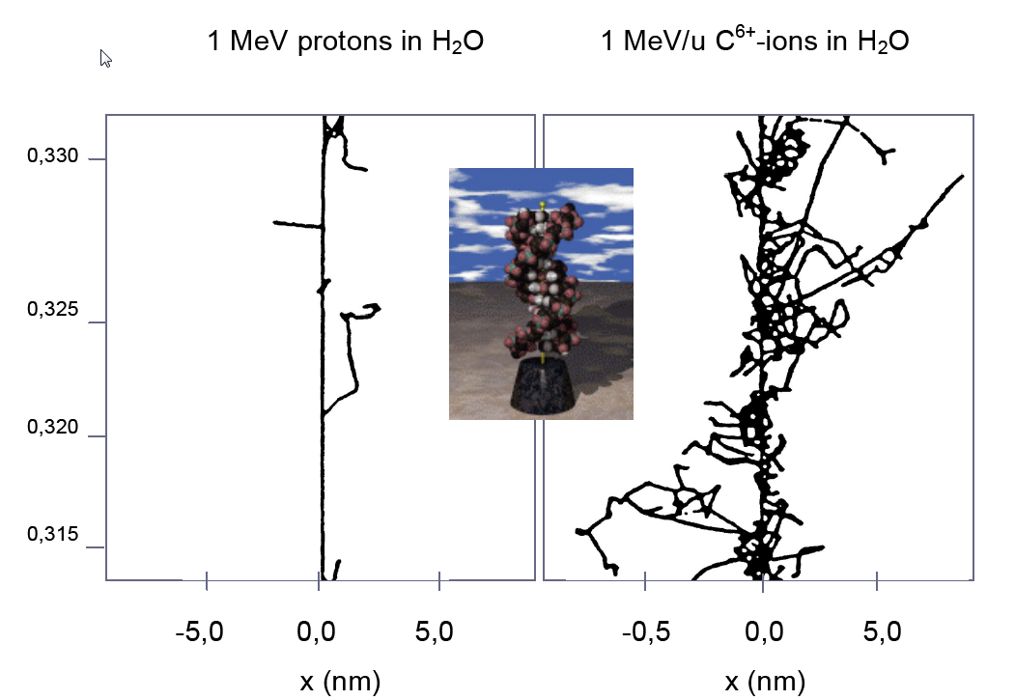
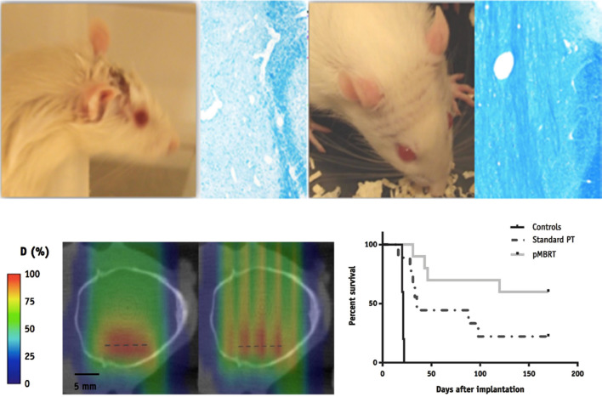
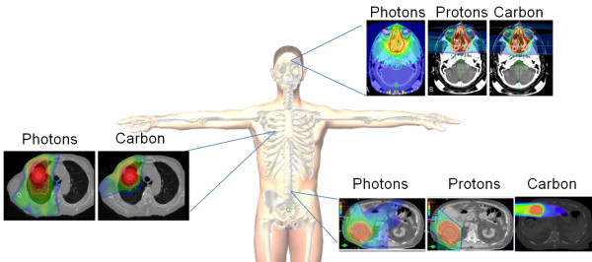
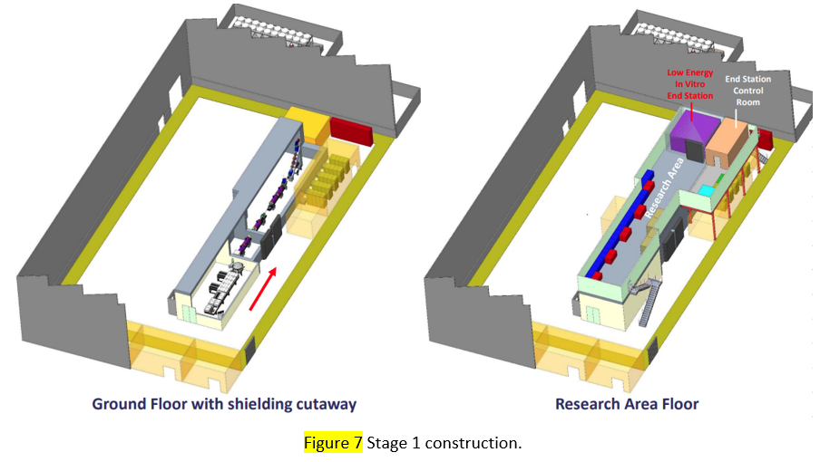
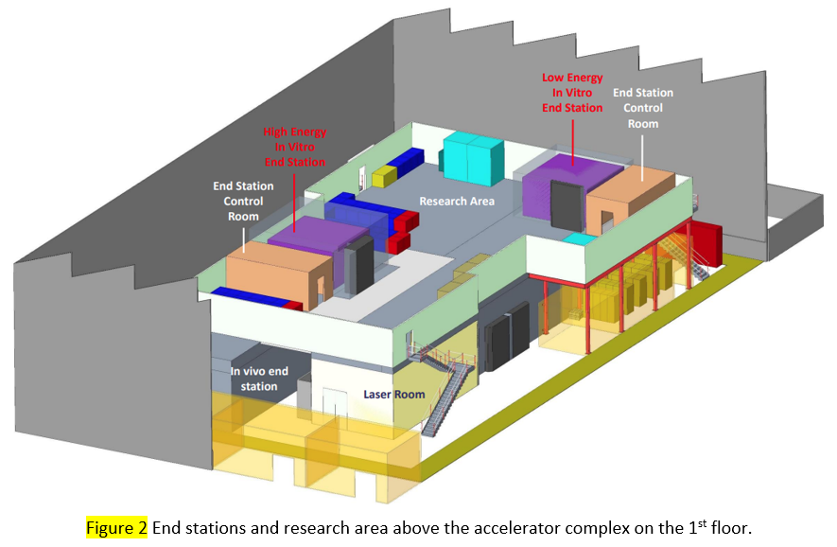
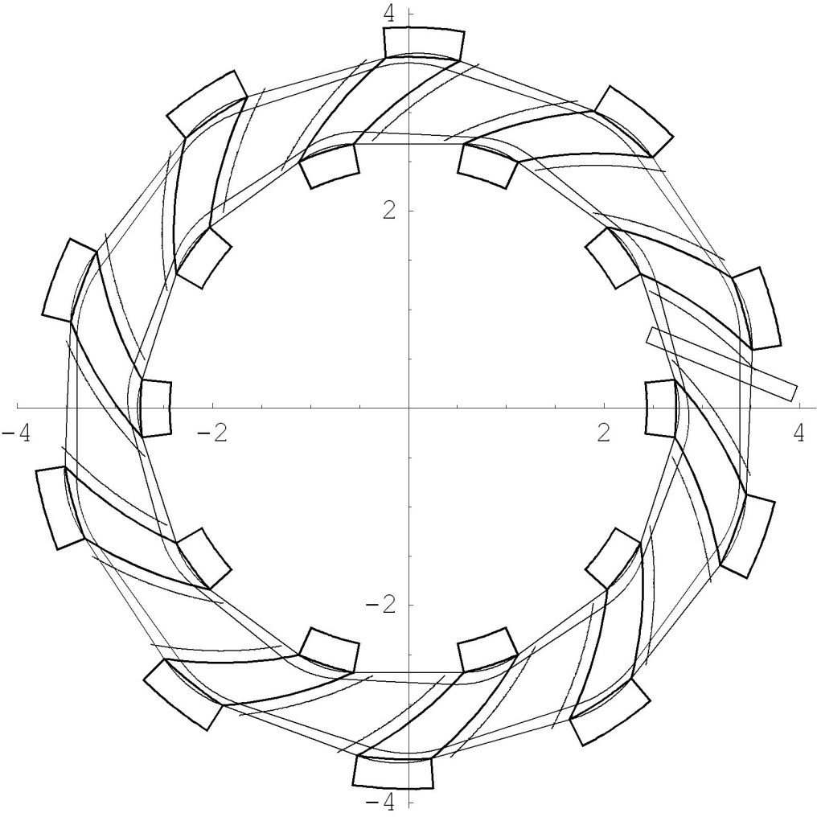
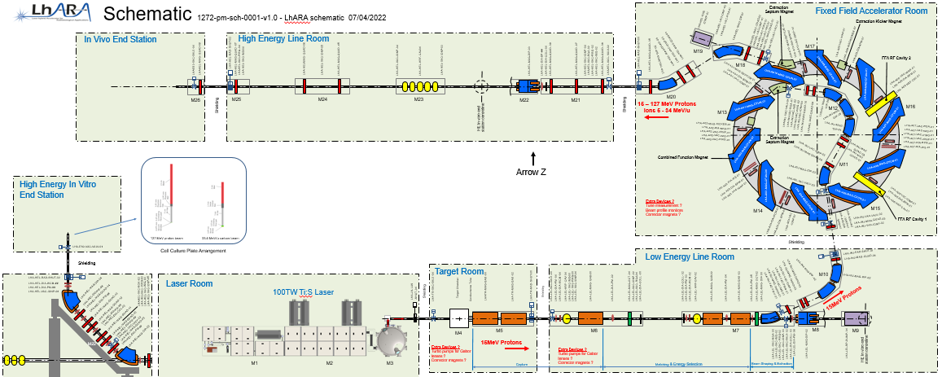
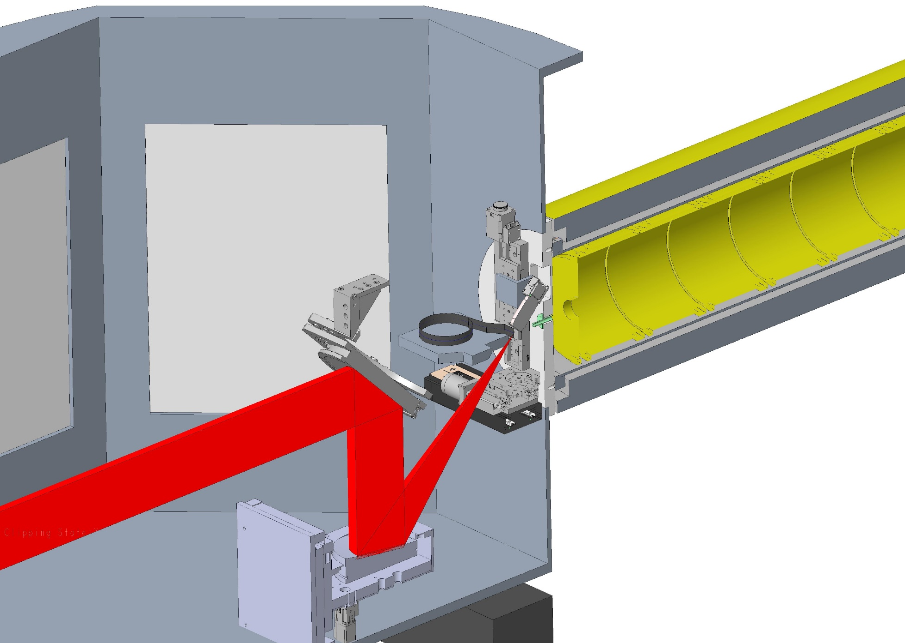
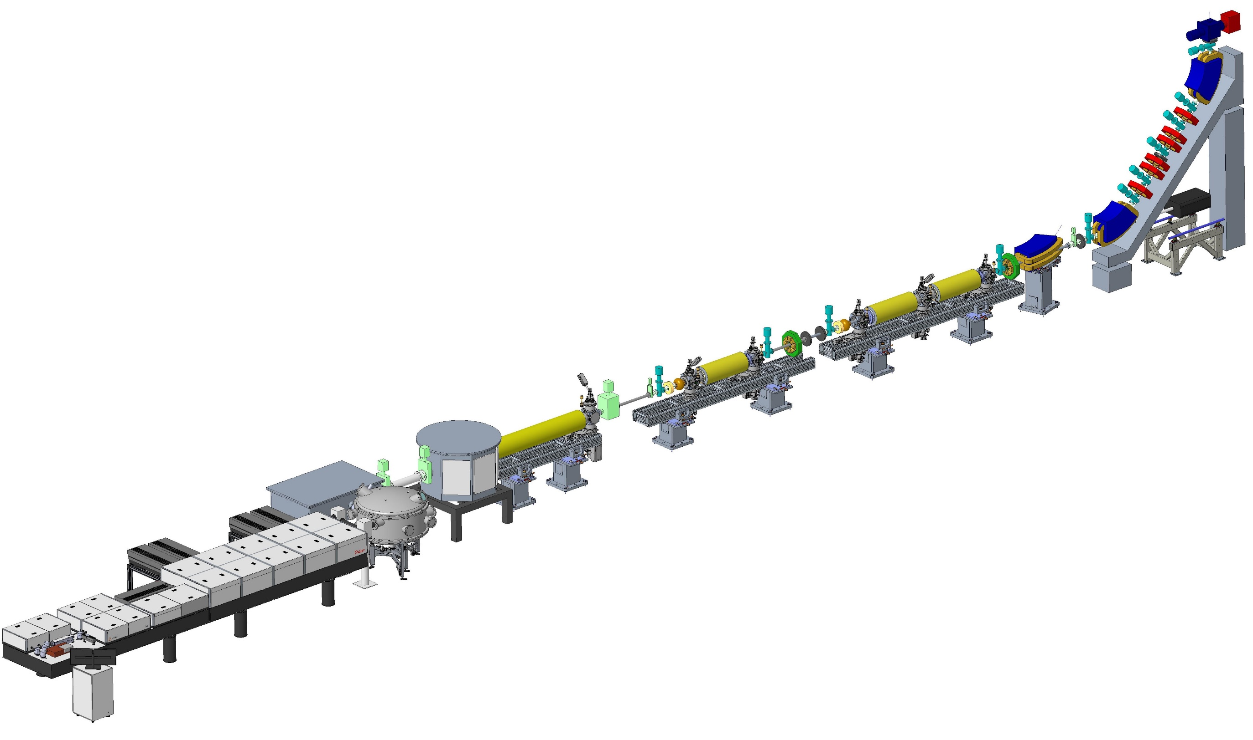
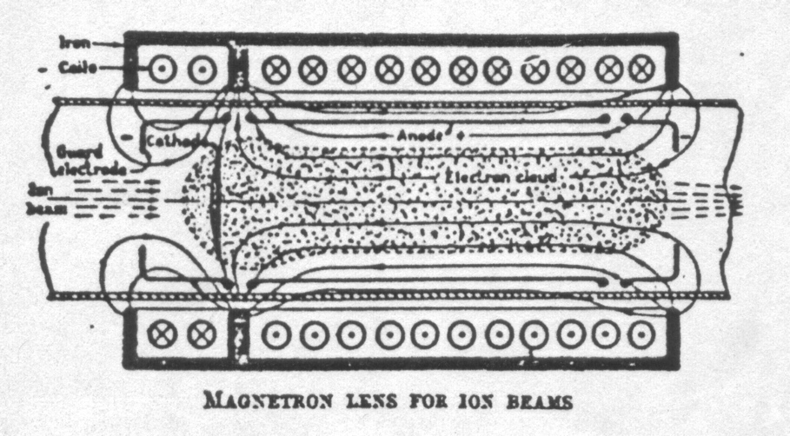
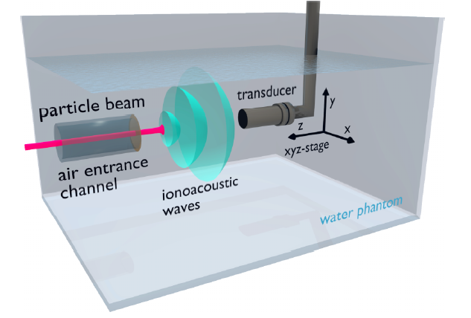
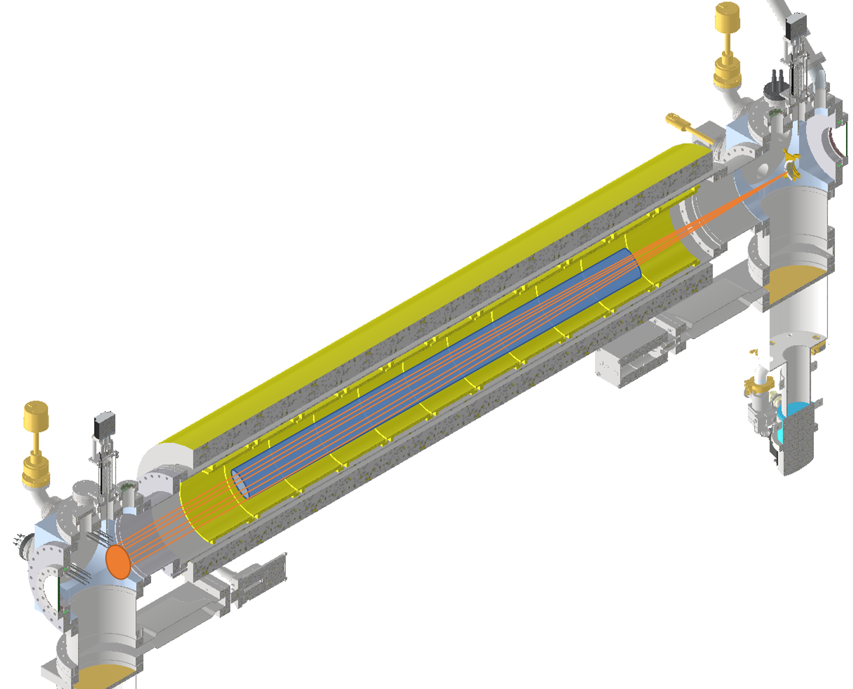
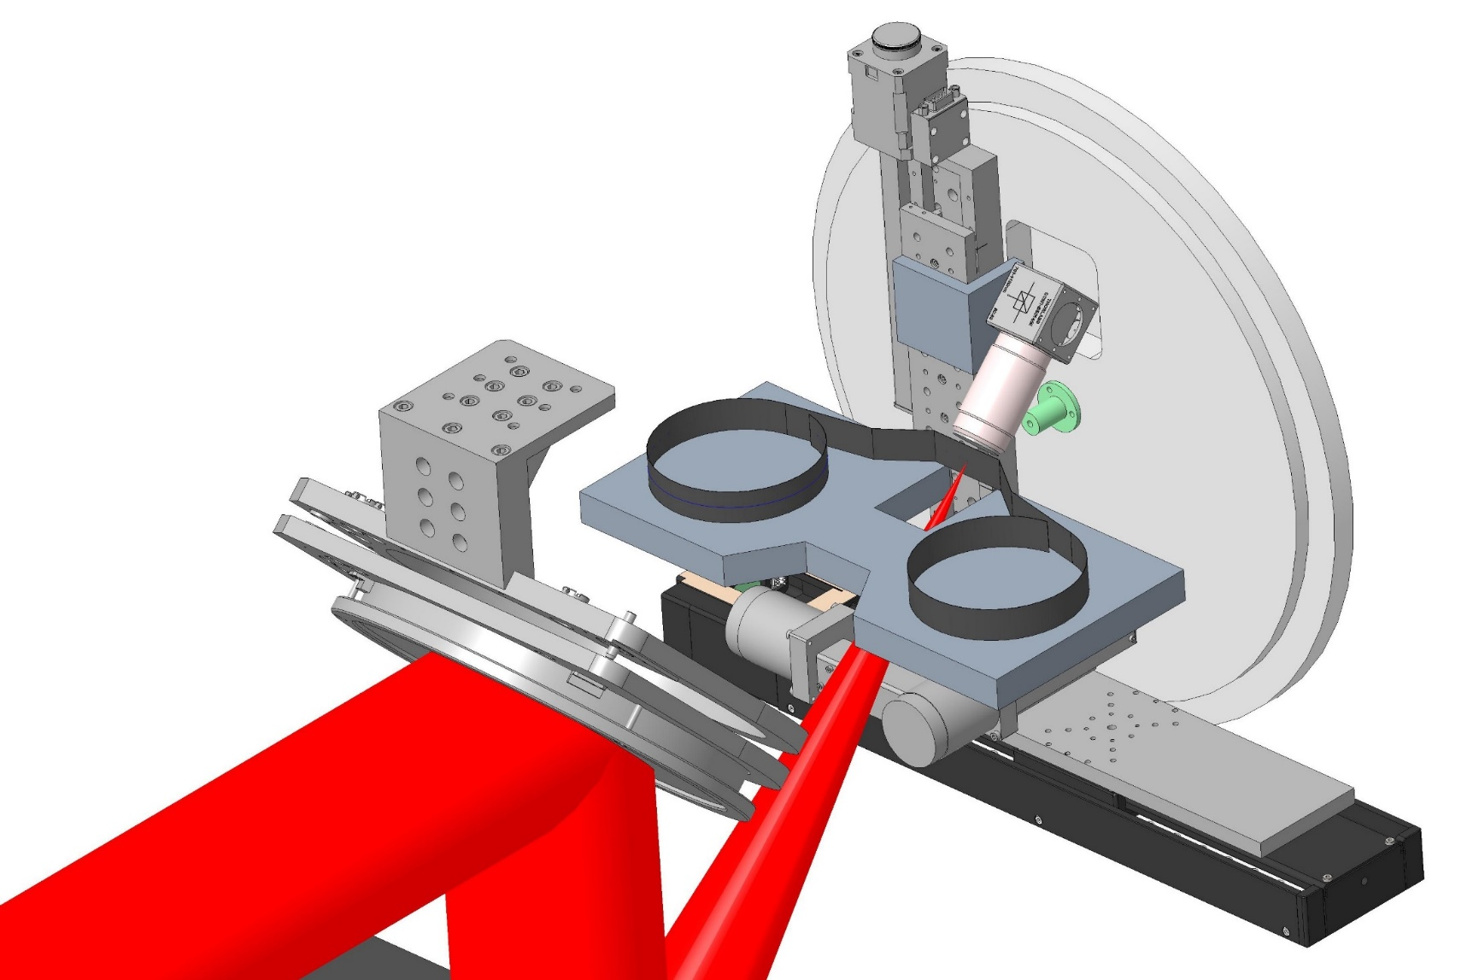
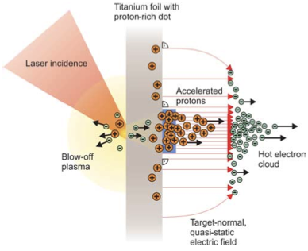
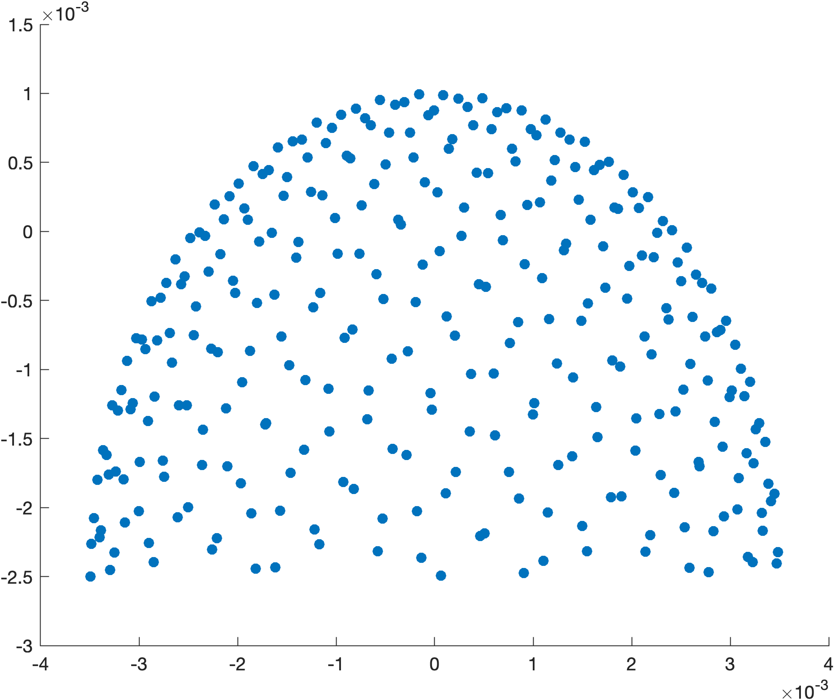
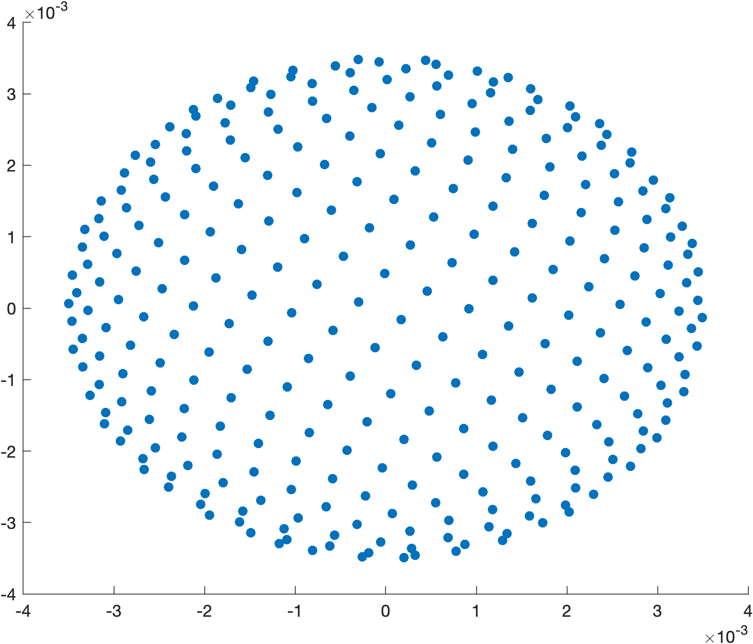
Therapy
Rationale for clinical benefit
The Origins of FLASH Radiotherapy
Proton
  Deliver a higher, targeted radiation dose with decreased toxicity to surrounding tissue compared with photon therapy, especially near critical structures
Ion Therapy
Carbon
  Further increase target tissue damage with decreased secondary tissue affected compared with proton
  Specific potential benefit with intractable radio-resistant tumors
Superior Dose Depth
Distribution & Physical
Beam Characteristics
-Higher LET
-Superior RBE
-Low OER
-Narrow penumbra
Engineering
Gantry
Miniaturisation
Physics
Beam Characteristic
Beam Heterogeneity
Materials Science
Target production
Shielding
Radiobiological Research
-Radioprotectors
-Carbon ion interactions
-Metabolism
-Microenvironment
Clinical Biology Research
-Dose limitations, Toxicity
-Which tumor histologies benefit most
-Tumor microenvironment
-Development of new clinical trial design
Multi-disciplinary
UK Lhara Ion Therapy
Program
Clinical Physics Research
-Treatment planning
-Development of IMCT
-Absorbed Dose Calcs
-Modeling RBE
Increased Biological Effectiveness:
Relative Biological Effectiveness is 3x protons
  Reduces # fractionations by ~ 2
  Countermands radio-resistance
Positrons permit active monitoring using PET
Radiology
-Ionacoustic Imaging
-Positron imaging
-Dose distribution
Patient Experience
-New Lhara Ion therapy
-Less toxicity
-Given in short period of time
-Cost effectiveness research
STFC/UKRI/ITRF
-Accelerator miniaturization
-Active and Passive Beam Shaping
-Beam Production
-Beam Delivery
LhARA Facility Design and Engineering
Stage 2
LhARA: Stage 2 FFA
Radiobiological Research
-Radioprotectors
-Carbon ion interactions
-Metabolism
-Microenvironment
-CSCs
LhARA FFA
10 cells
2 MA loaded
RF cavities
Sourec
Capture – Gabor lens
45° Dipole Magnets (2)
Ion-acoustic Imaging
Ion-acoustic Imaging
Quadrupole Magnets (6)
Octopole Magnet
Dipole Switching Magnet to FFA
FFA
RF Cavities (2)
Target Chamber
Gabor lenses (5)
1 double, 3 single
Abort line Beam Dump
TW Laser
Compressor Chamber
Support & Alignment modules
Large aperture
non-neutral plasma
Low magnetic field req.
Stability, hold time, density
Source TNSA laser solid
End Station Design
Vertical beamlines for both low and high energy
Horizontal beamline for high energy only
4 consultations.
High throughput
Integrated diagnostics

