Slide 1




Linear Optics
updates
Josie McGarrigle

Slide 2
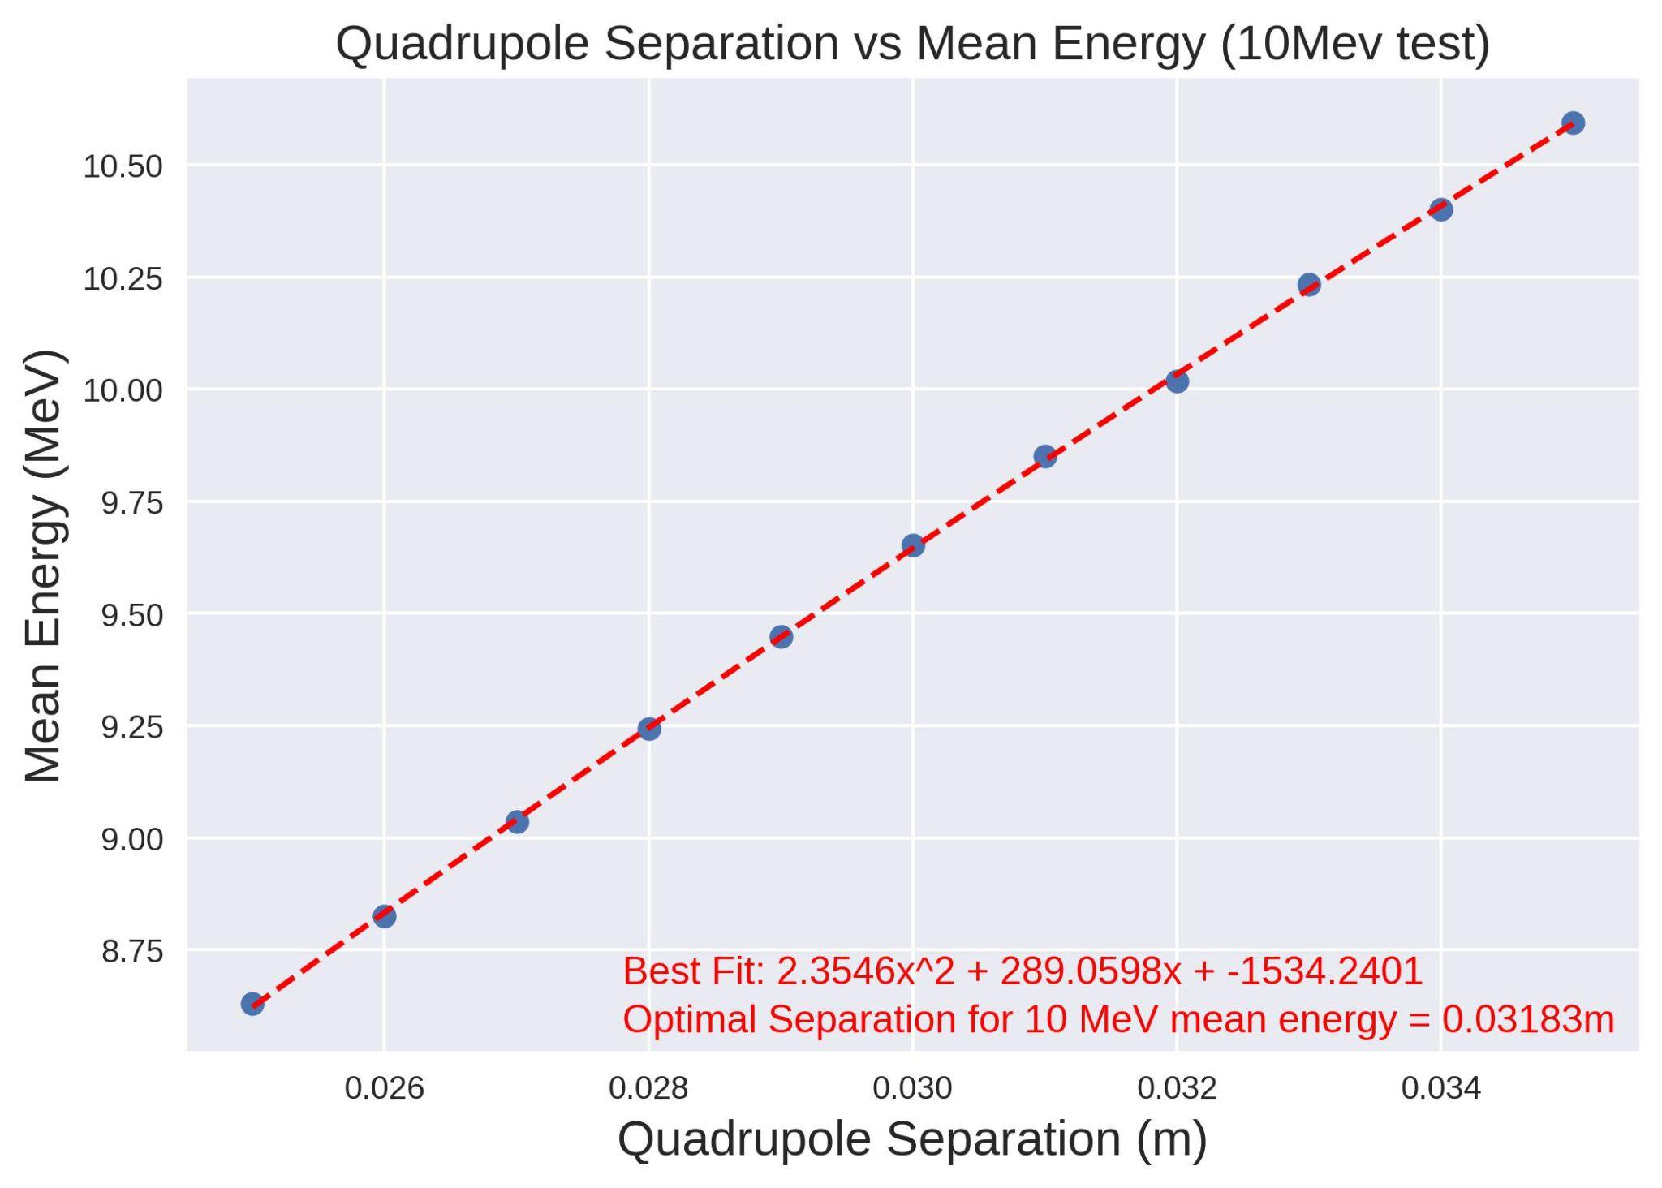
Quadrupole Separation for 10MeV (Mean)
Quadrupole 1 fixed at 0.04m

Slide 3
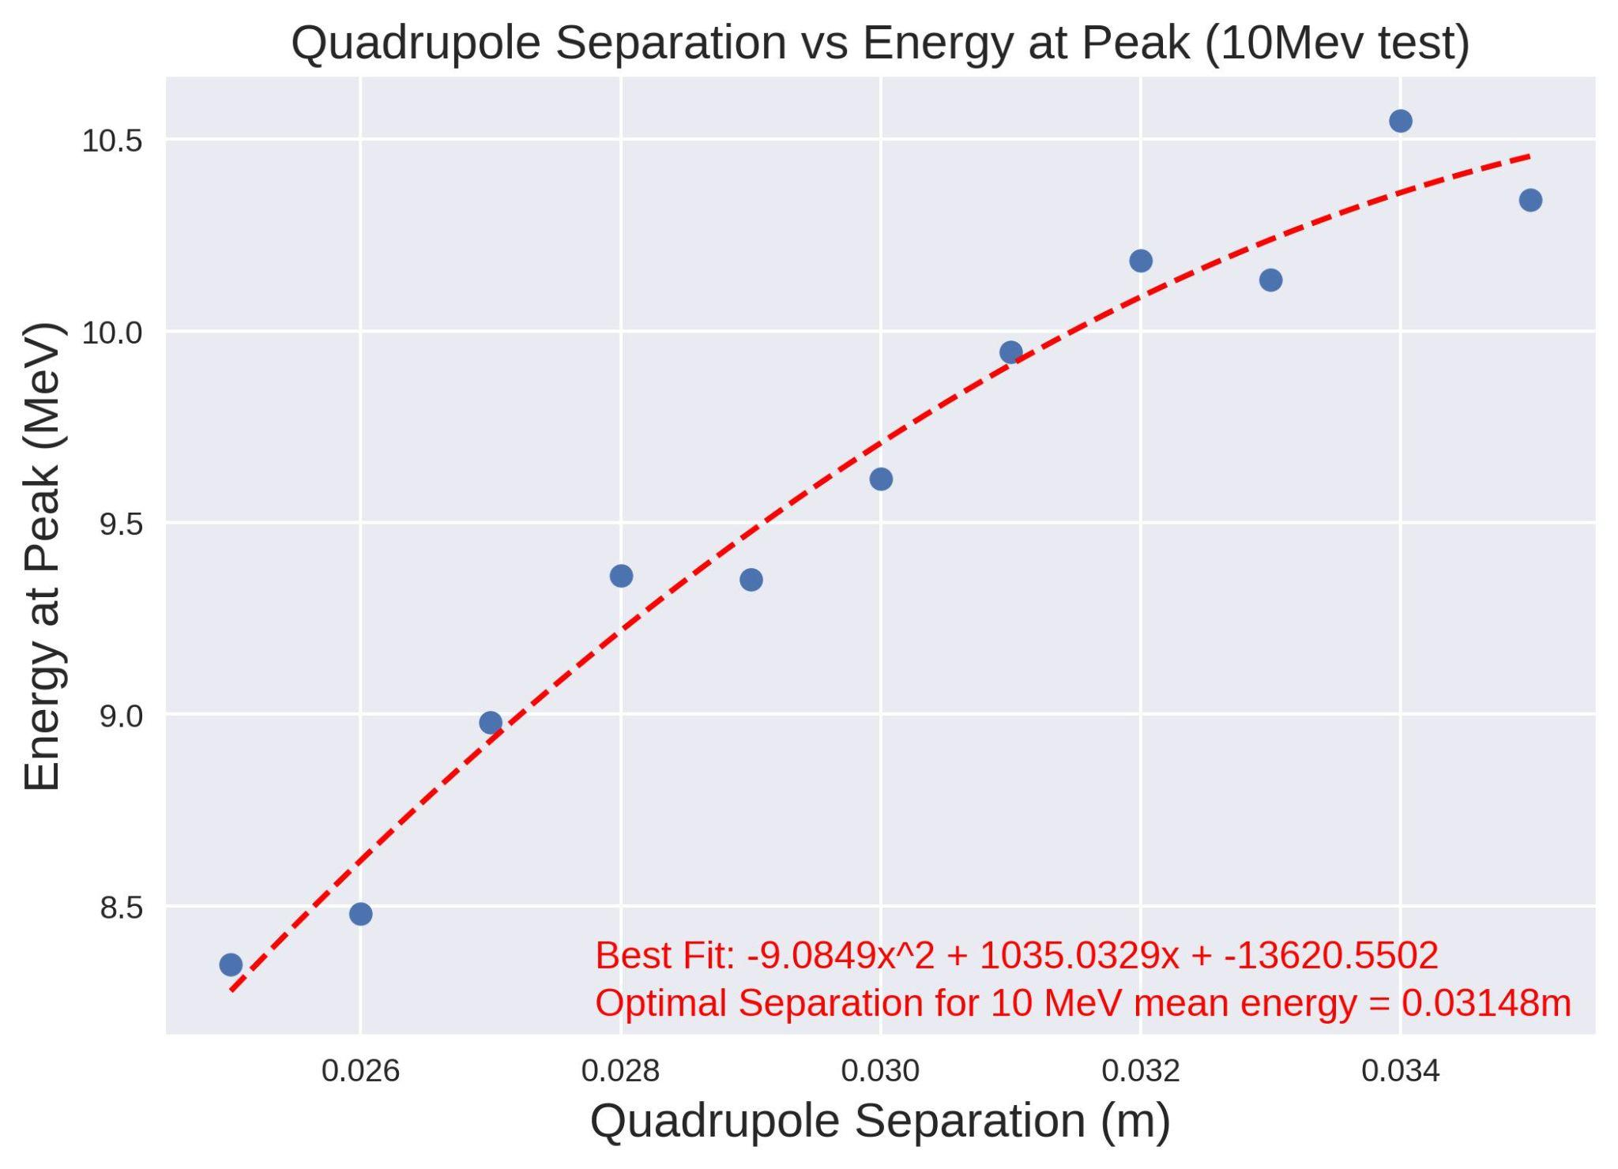
Quadrupole Separation for 10MeV (Peak)
Quadrupole 1 fixed at 0.04m

Slide 4
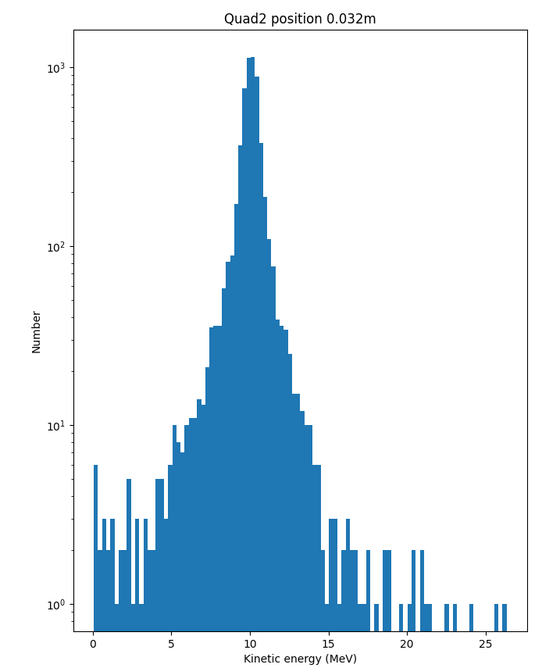
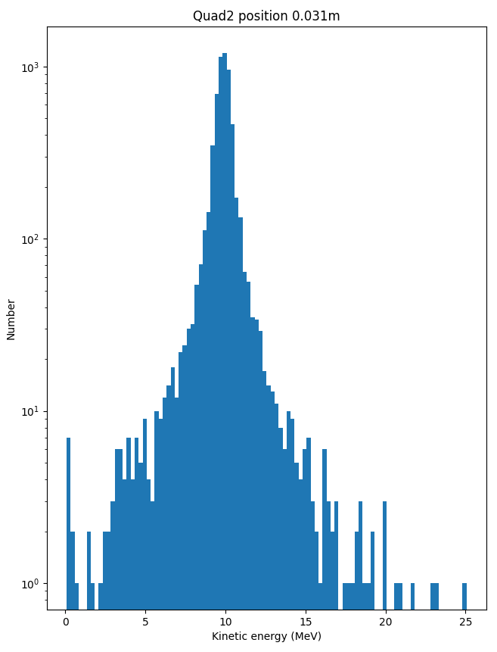
Distribution for 10MeV
Based on Mean
Based on Peak

Slide 5
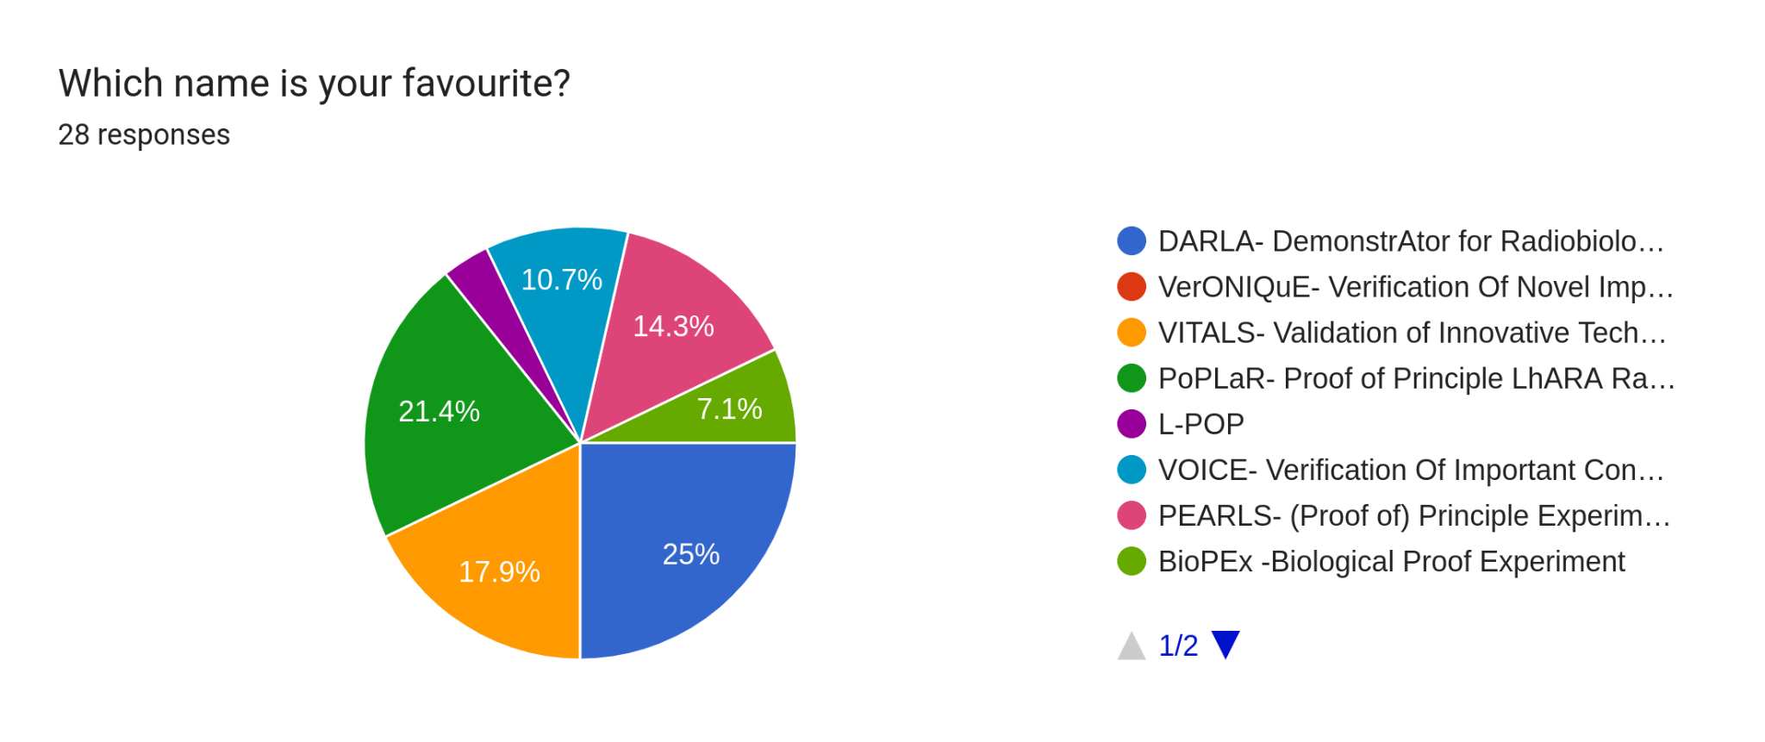
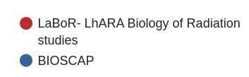
Naming competition

Slide 6
Naming competition
DARLA- DemonstrAtor for Radiobiology in Laser Accelerators
PoPLaR- Proof of Principle LhARA Radiobiology (experiments)
VITALS- Validation of Innovative Techniques Advancing LhARA & SCAPA
PEARLS- (Proof of) Principle Experimental Area for Radiobiology, LhARA and SCAPA
VOICE- Verification Of Important Concepts Experiment
BioPEx -Biological Proof Experiment
L-POP

