Slide 1
Intro to LhARA

Slide 2
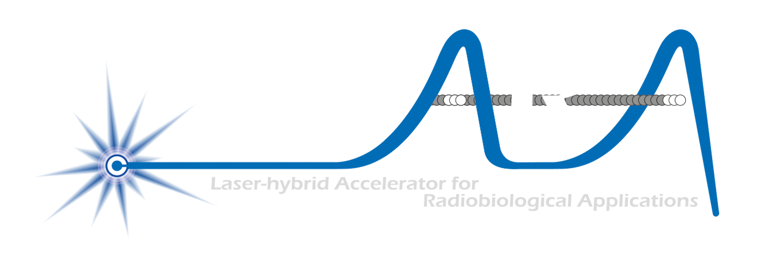
Our mission is to:
Deliver a systematic and definitive radiation biology programme
Prove the feasibility of laser-driven hybrid acceleration
Lay the technological foundations for the transformation of PBT
  automated, patient-specific proton and ion beam therapy

Slide 3
What is LhARA?
A novel, hybrid, approach:
Laser-driven, high-flux proton/ion source
  Overcome instantaneous dose-rate limitation
    Capture at >10 MeV
  Delivers protons or ions in very short pulses
    Bunches as short as 10—40 ns
  Triggerable; arbitrary pulse structure
Novel “electron-plasma-lens” capture & focusing
  Strong focusing (short focal length) without the use of high-field solenoid
Fast, flexible, fixed-field post acceleration
  Variable energy
    Protons: 15—127 MeV
    Ions: 5—34 MeV/u
Front. Phys., 29 September 2020; DOI: 10.3389/fphy.2020.567738

Slide 4
LhARA to serve the ITRF

Slide 6
Also:
  QMUL:
    Physics (hope to talk to biomedical colleagues in autumn)
  UCL Medical Physics (& Bio Eng)
  BELLA (don’t want their logo on the masthead until they have some money!)

Slide 7
Development of radiation biology programme:
  At existing facilities:
    Novel (e.g. laser driven)
    Conventional
LhARA proof-of-principle experiment:
  CW: “… include as many of key LhARA elements as possible …”

