Slide 1


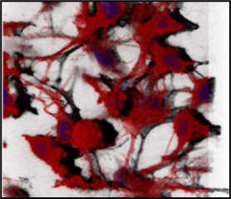
LhARA PoPLaR meeting
Laser-hybrid Accelerator for Radiobiological Applications
Radiobiology contribution
21 May 2024
Dr Natividad Gomez-Roman, PhD

Slide 2
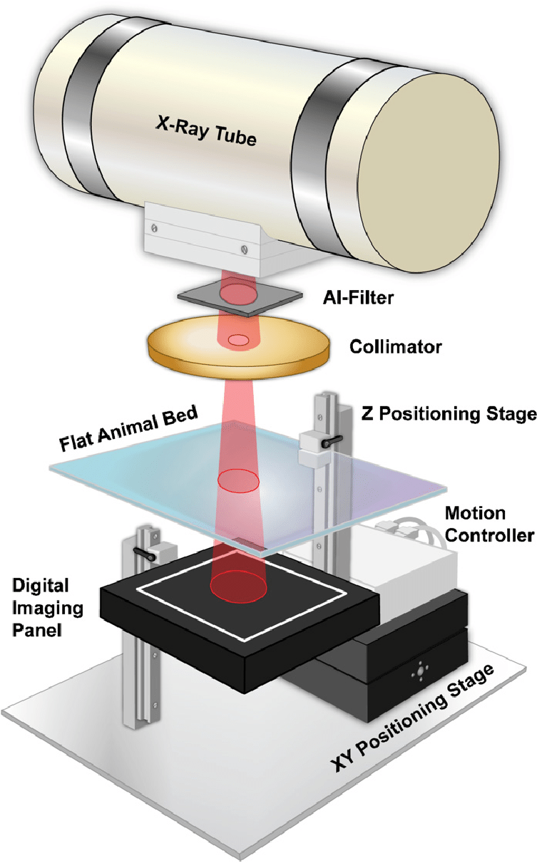
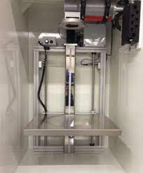
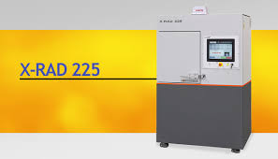

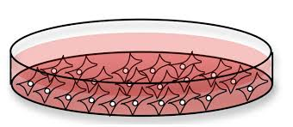
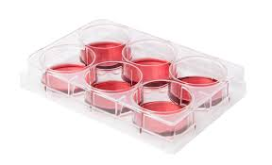
Current X-Ray Facilities in SIPBS
Dose Rate of 2.3 Gy/min @ 50 cm height
X-Rays delivered with an X-RAD 225
Device Maximum Voltage 225 kV; Device Maximum Amperage 13 mA
Notes:
Water phantoms required to get the absolute dosimetry.
Tissue mimicking phantoms (water, hydrogel, non-water polymers)

Slide 3
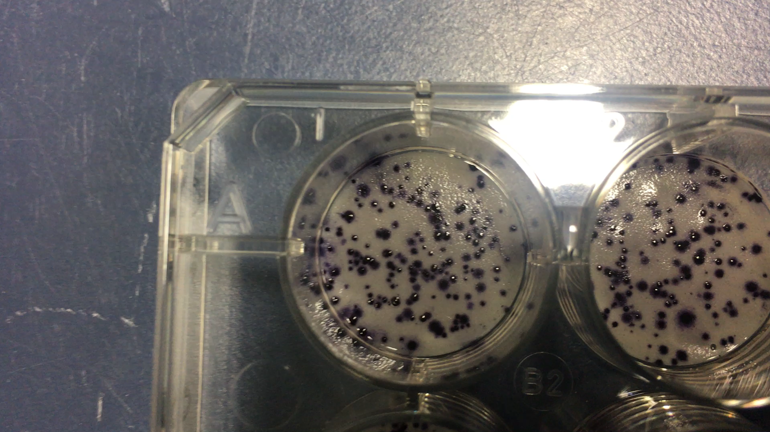
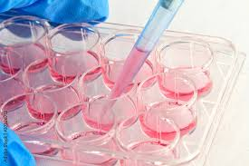
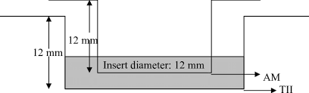
Clonogenic Survival Assay in 3D – Alvetex Scaffolds
Comparing the response to different treatment modalities will require clonogenic survival assays
Radiation is standard care of treatment for GBM
Clonogenic survival assay is the gold-standard assay to assess cellular radiosensitisation
Clonogenic survival assay readout is cell reproductive death
12 well plate dimensions:
Length: 127.76 +/- 0.15 mm width: 85.48 +/- 0.15 mm
Depth: 20 mm (10 mm covered in liquid media)
Polystyrene scaffolds
6. Gomez-Roman n et al. (2017). A novel 3D human glioblastoma cell culture system for modeling drug and radiation responses. Neuro-Oncology, 19(2):229-241.
Notes:
Since radiation is standard of care for the treatment of glioblastoma, we are invested in identifying novel radiosensitisers for glioblastoma in the laboratory. To do that, we developed a clonogenic survival assay using the 3D-Alvetex scaffold model, which is the gold-standard assay to assess cellular radiosensitisation, with a readout of cell reproductive death/capacity. As you can see from the video, the system is amenable for clonogenic survival assays, showing improved colony morphology compared to 2D conditions.

Slide 4
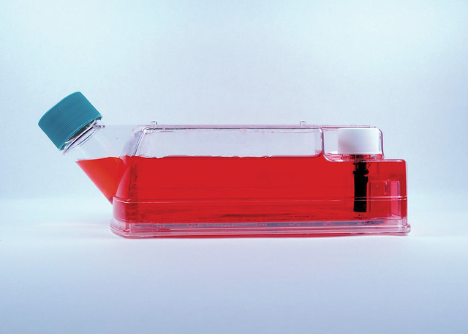
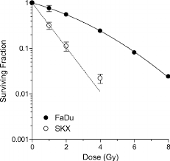

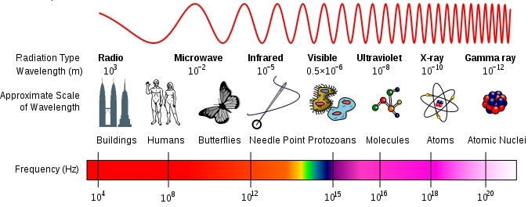


Clonogenic Survival Assay
Cell culture
+ enzymatic digestion (cell membrane proteins)
Seed dishes
Cell suspension
No. cells seeded:
250
250
750
1250
0 Gy
2 Gy
4 Gy
6 Gy
X-Ray dose
Incubate 2-3 weeks
$$Plating efficiency=\frac{Number of colonies}{Number of cells seeded} x 100$$
No. colonies counted: 40 32 36 25
Plating efficiency: 40%
Surviving fraction: 0.4 0.11 0.04
$$Surviving fraction=\frac{Colonies counted}{Cells seeded x (\frac{PE}{100})}$$
6. Gomez-Roman n et al. (2017). A novel 3D human glioblastoma cell culture system for modeling drug and radiation responses. Neuro-Oncology, 19(2):229-241.
Notes:
However, identification of radiosensitizers in vitro is best achieved using the gold-standard clonogenic survival assay (CSA), but this is currently labour-intensive and time-consuming.

Slide 5
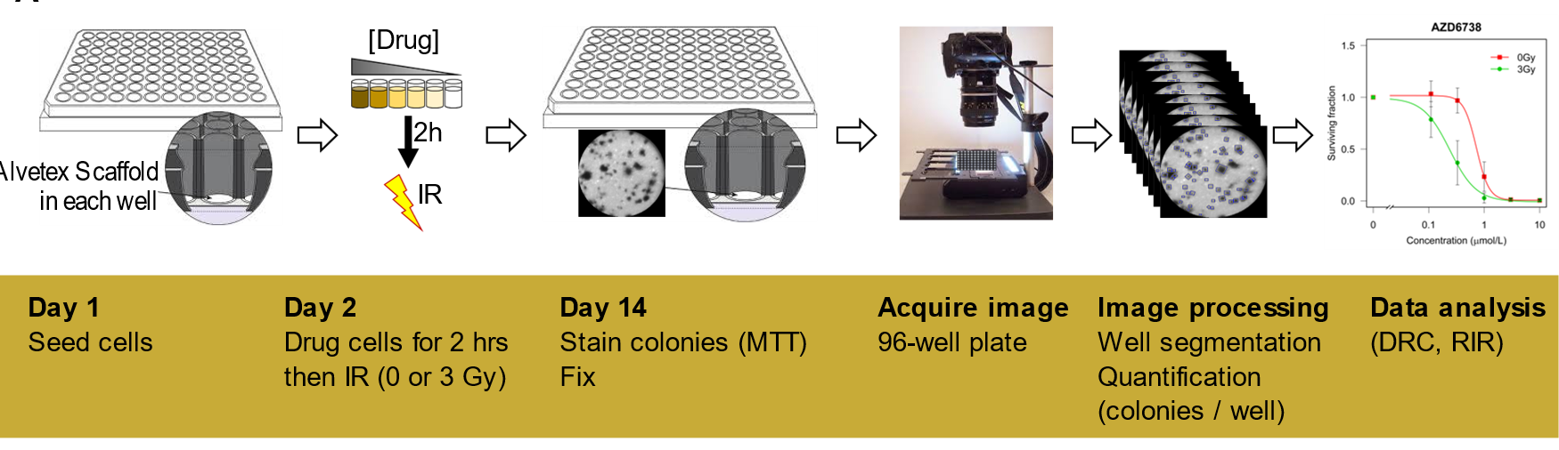
ClonoScreen3D platform for screening drug-IR combinations
96 well plate dimensions:
127.76 mm width: 85.48 mm
The 3D model provides much greater surface area in 96 well plate than 2D
Dr Mark Jackson
Dr Nati Gomez-Roman
Notes:
Using this 3D model, we have further investigated its utility as a screening platform of novel radiation-drug combinations using gold-standard clonogenic survival as readout.

Slide 6



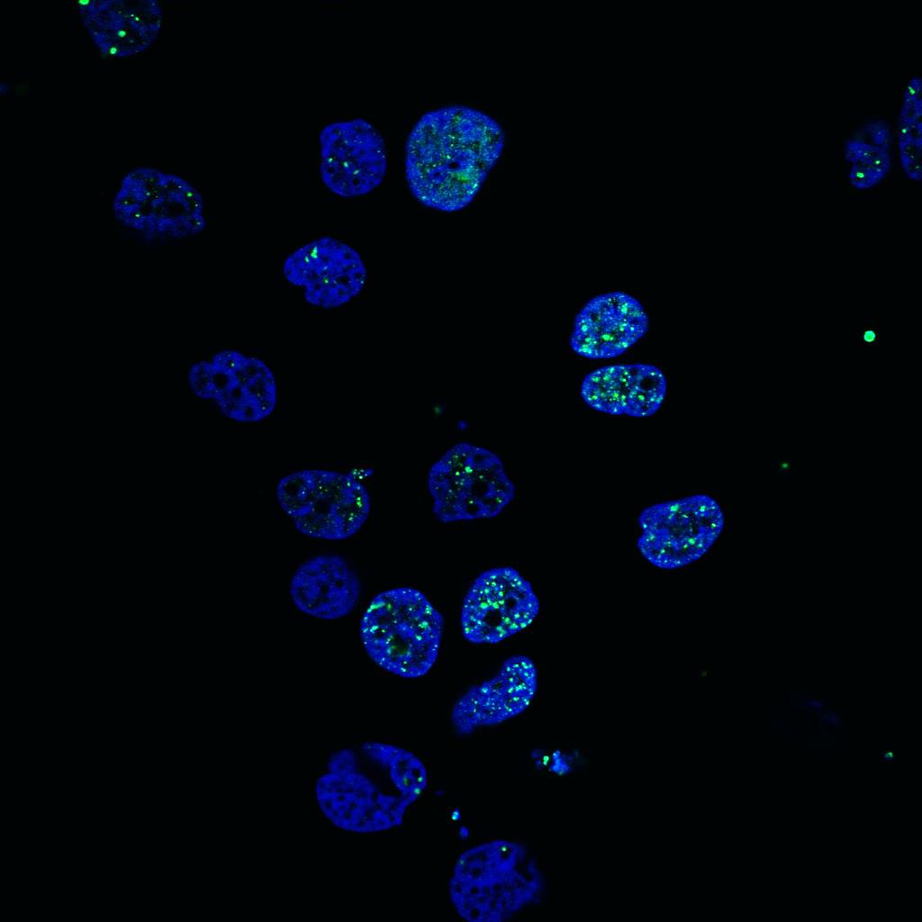
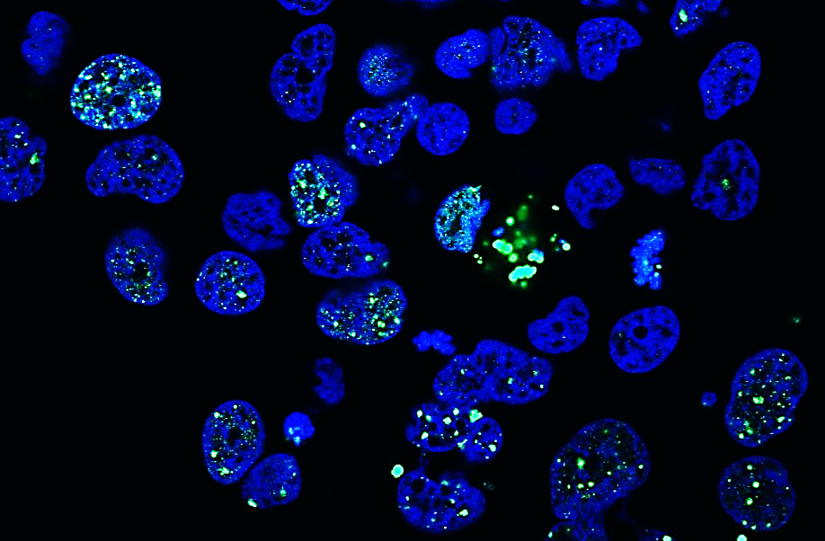
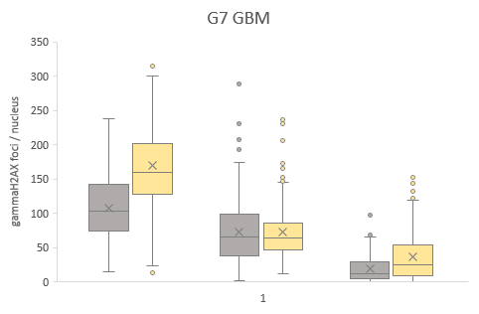
Characterisation of radiation response
2 Gy
2 Gy + Pitavastatin
Time (days)
24 hours
1
Seed cells
3
Treat cells
3-4
Stop exp @ at diff time points
5-6
Stain and image cells
7-14
Analyse acquired images
Nucleus / γH2AX foci
Cell death via mitotic catastrophe
*
2 Gy
2 Gy + Pitavastatin
*
1 h
3 h
24 h
Quantification of DNA double strand breaks (DSB) using H2AX phosphorylation (γH2AX) as a DSB marker
Quantification of cell death via mitotic catastrophe

Slide 7
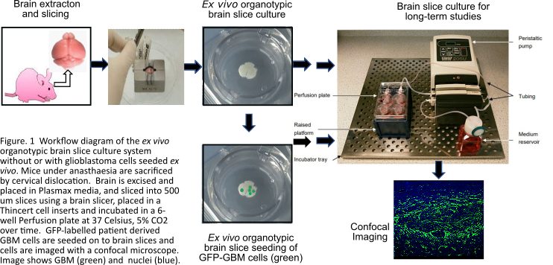
Ex Vivo Organotypic Brain Slice Culture System for Long-term healthy tissue and brain tumour (glioblastoma) Studies

Slide 8
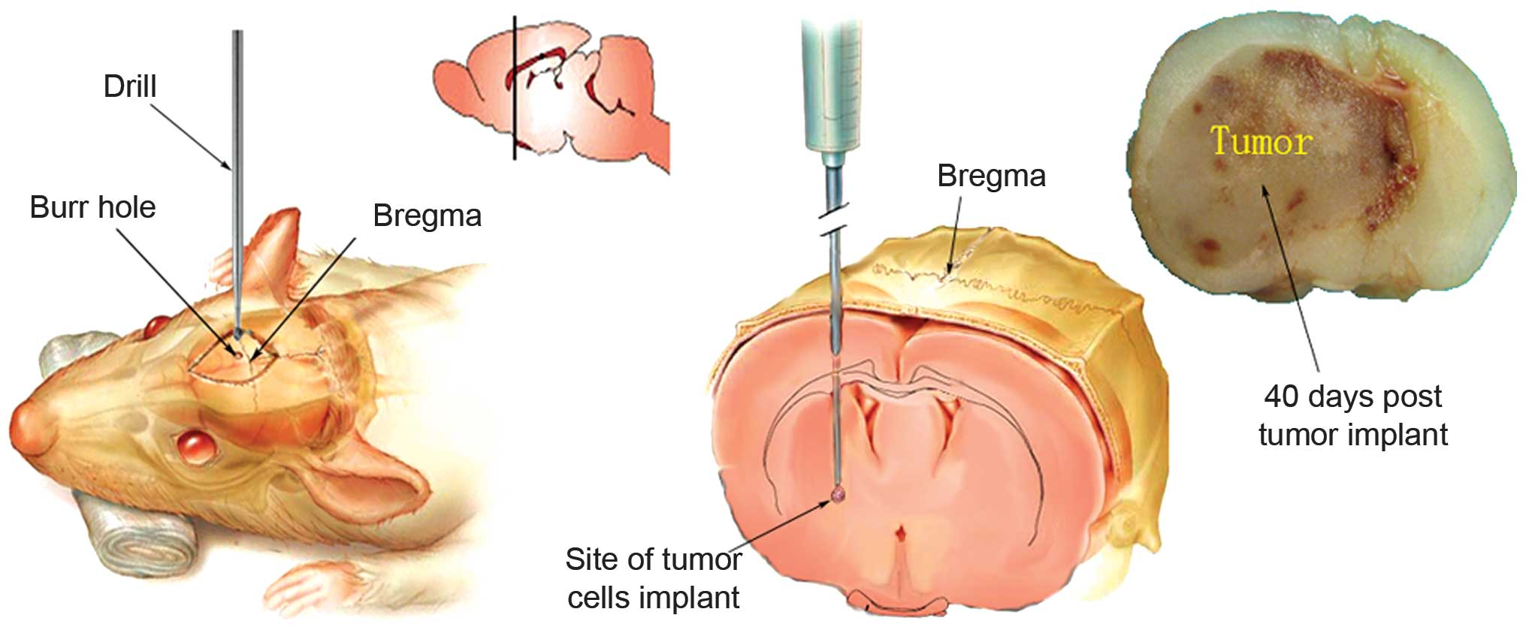
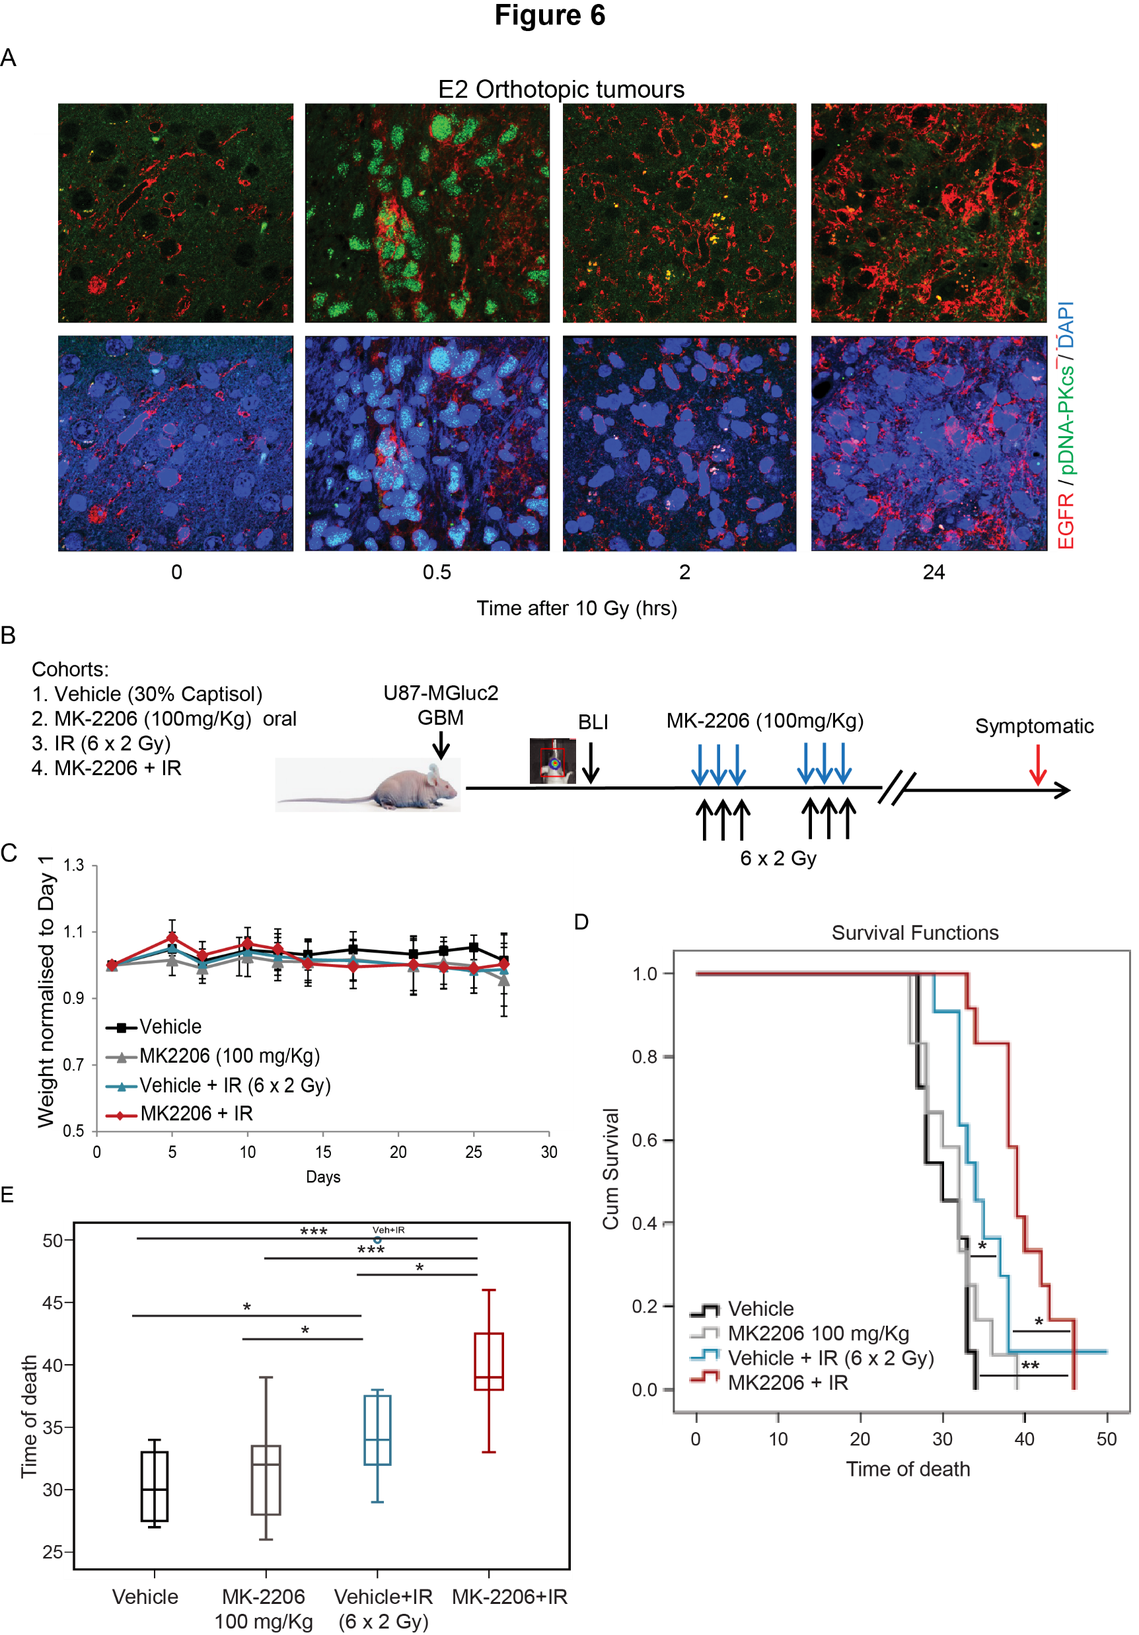
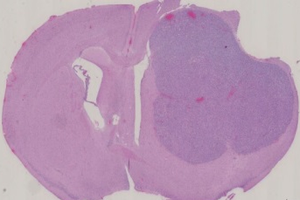
Validating in vitro results in vivo:
GLIOBLASTOMA INTRACRANIAL MODEL
Intracranial injection in CD1 nude mice
Experiments range from 4 weeks (U87) to 12-20 weeks (patient derived cell lines)
Drug
0 6 18 Days
Ionising radiation
Non-Invasive
Invasive
Highly invasive
U87-MGLuc2

Slide 9
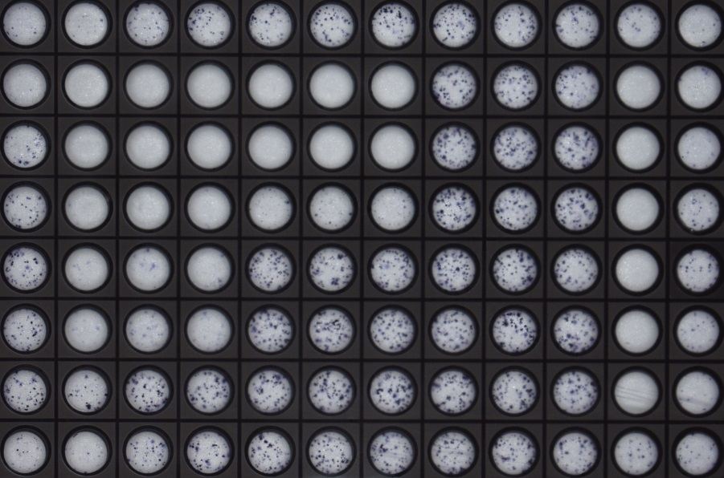
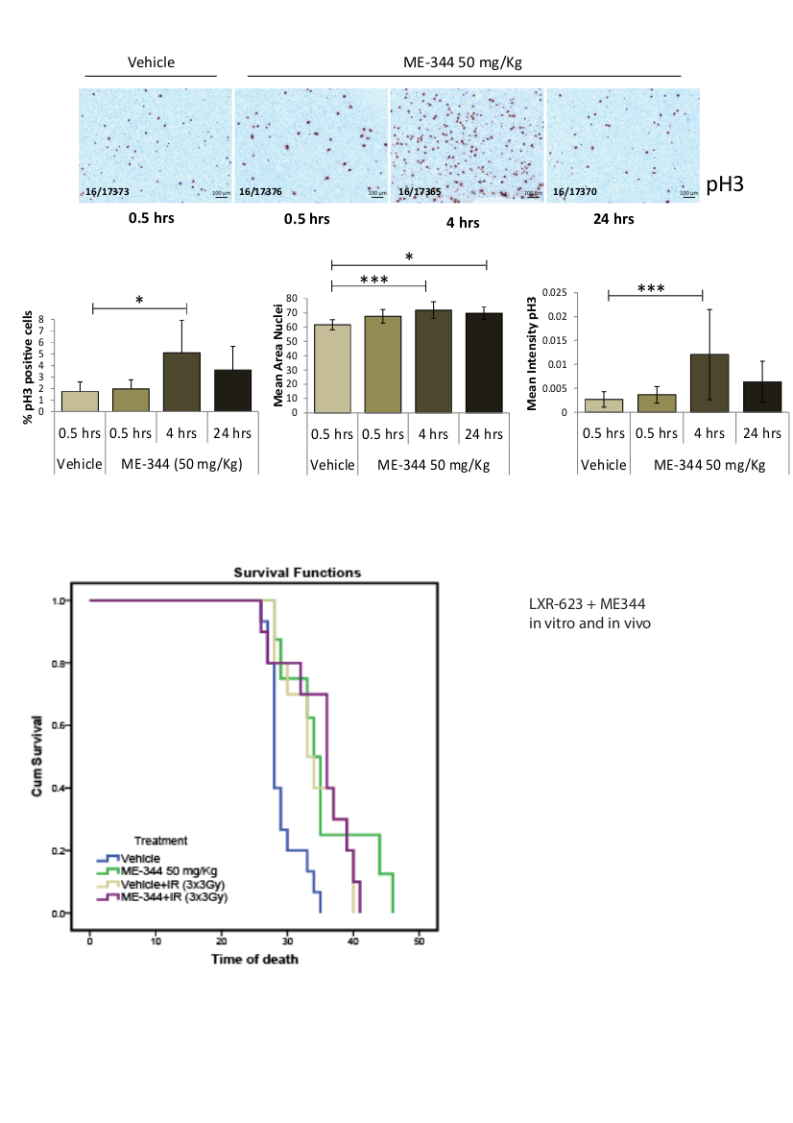
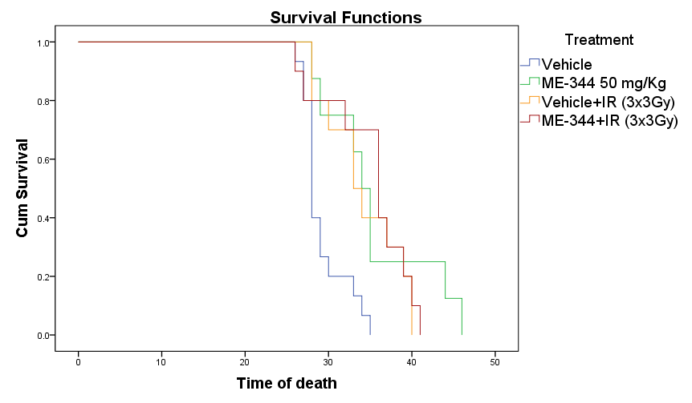
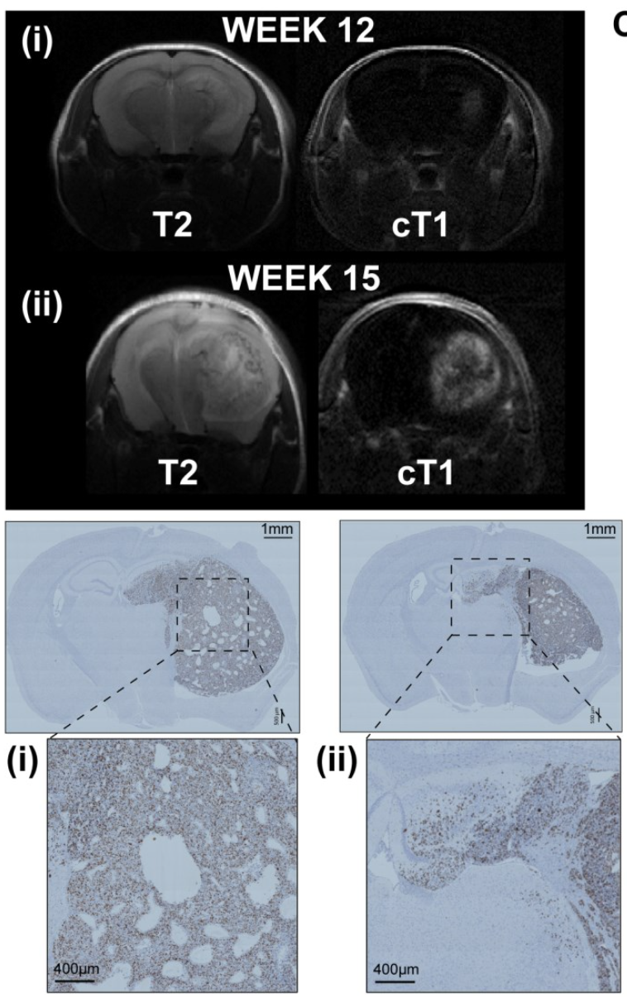
GLIOBLASTOMA INTRACRANIAL MODEL – Preclinical Pipeline
Hit(s) selected from Omics screen
Single agent or drug/IR combination activity
3D assay +/- IR
Phase I trial with PK/PD
Mitotic cells
*
*
*
In vivo PK/PD
In vivo efficacy

Slide 10
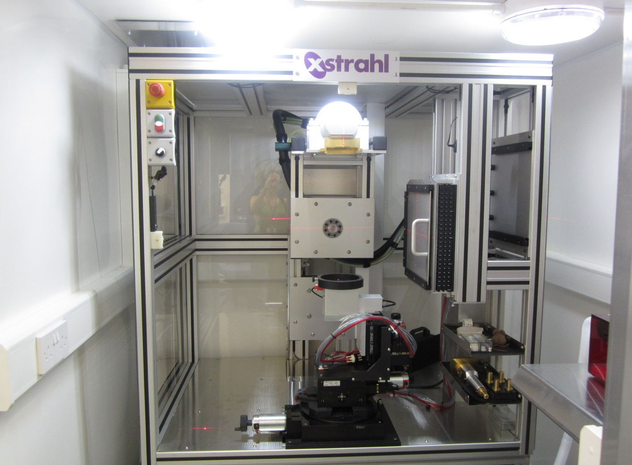

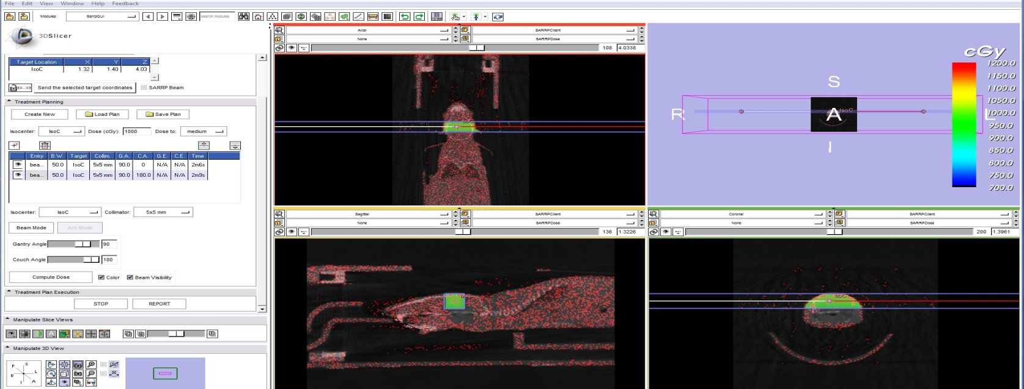
SMALL ANIMAL RADIOTHERAPY RESEARCH PLATFORM – SARRP
Beatson Institute for Cancer Sciences
University of Glasgow
CT scan
3D image guided micro irradiator
image acquisition, reconstruction, and treatment planning
target localization
dose validation
targeted radiation treatment
Dose rate 4.8 Gy/min
220 kV (peak) X-Ray beams, parallel opposed
5 x 5 mm collimator

Slide 11
Conclusions
Comparison between current standard of care therapies using X-ray vs proton and ion will require extensive assessment using clonogenic survival assays
Characterisation of response to treatment will require in vitro assays including:
  DNA damage and repair assays (γH2AX foci, mitotic catastrophe, Comet assay, etc)
  Cell cycle distribution (cell cycle distribution)
  DNA repair pathways analysis (activation of DNA repair pathways via immunofluorescence, protein analysis, etc)
In vivo validation of the findings will need to be performed in animal cancer models

Slide 12
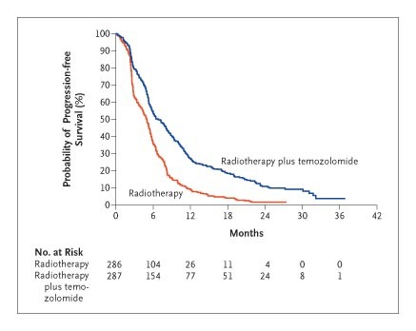
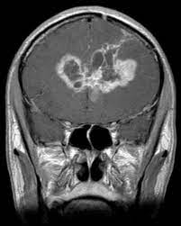
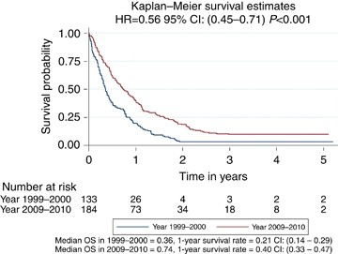
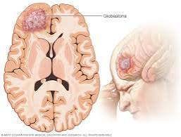
Glioblastoma
Stupp, et al. N Engl J Med 2005
deSouza, et al. Br J Cancer, 2016
Tumours are very resistant to treatment and inevitably recur
Novel treatments are urgently required!
Notes:
Most common and most malignant primary brain tumour
Modest improvement in survival has been achieved with formal multidisciplinary teams
Tumours are resistant to treatment and inevitably recur
Very poor prognosis remains: <5% of patients surviving after 5 years

Slide 13
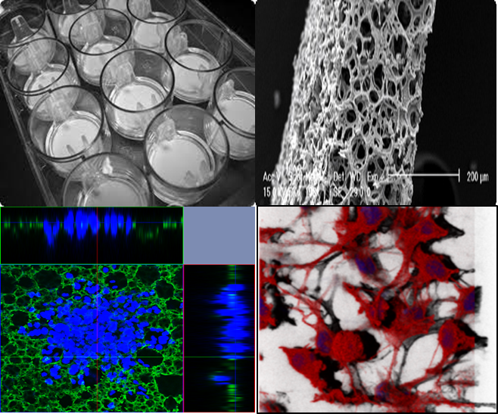
Three Dimensional Preclinical Models: 3D-Alvetex Scaffolds
Patient-derived
Using the 3D AlvetexTM model with patient-derived GSCs
⚈
REC ref: 11/YH/0319
Polystyrene scaffolds
Tissue-like structure growth enabling physiologically relevant conditions
Tumour bulk
core & edge
Clinicopathological correlation & pairing with 100,000 Genomes:
Patient lines: G1, G7, E2, S2, Ox cell lines
(Courtesy Prof. Colin Watts, Prof. Anthony Chalmers, Mr Ola Rominiyi, Dr Spencer Collis)
Cancer stem cell enriched
⚈
⚈
⚈
⚈
⚈
⚈
⚈
⚈
⚈
⚈
⚈
⚈
⚈
⚈
⚈
Inherently treatment resistant subpopulation
Upregulated DNA damage response (Bao et al.⁵)
Maintained in vitro using serurm-free conditions with stem cell supplements inc: hEGF, hFGF, N2, B27
Cells retain their natural spherical shape, similar to their in vivo morphology
5. Bao S et al. (2006). Glioma stem cells promote radioresistance by preferential activation of the DNA damage response. Nature, 444(7120), 756-760.
6. Gomez-Roman n et al. (2017). A novel 3D human glioblastoma cell culture system for modeling drug and radiation responses. Neuro-Oncology, 19(2):229-241.
Notes:
3D-Alvetex scaffolds, which are highly porous plastic scaffolds engineered into a 200 um thick membrane providing 3D spaces into which cells can invade, proliferate and grow.

Slide 14

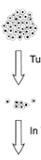
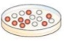
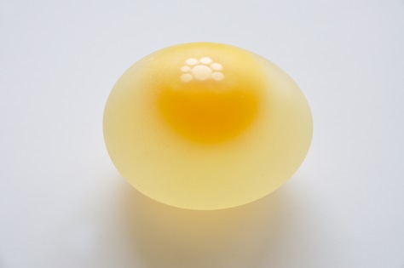

Glioblastoma experimental models in vitro
Tumour
Specimen
3D
2D
Tumour Disaggregation
Single cells
Failed to predict treatment response
Better clinical prediction and translation
3D cell
in vitro
Different responses to molecular targeted agents?
2D cell
Notes:
However, preclinical studies of novel targeted therapies that have shown activity on GBM cell lines, have failed to achieve clinical efficacy. One explanation for the discrepancy between preclinical and clinical data may be the sparsity of preclinical models that faithfully recapitulate the in vivo situation. The use of established cancer cell lines typically cultured in simplified two-dimensional (2D) in vitro systems, in which cells undergo profound phenotypical changes and exhibit markedly different responses to cytotoxic treatments might explain clinical failure. To improve clinical outcomes, the molecular mechanisms underlying radio- and chemoresistance must be elucidated and targeted in in vitro models that represent the clinical scenario.
14

Slide 15
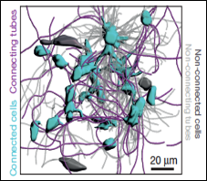
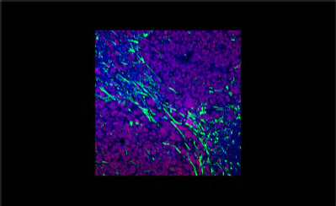
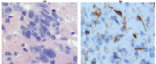
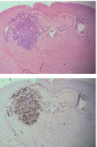
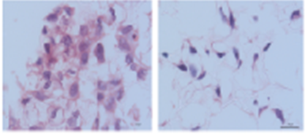
Growth
Tumour microtubes
Tumourigenicity
Clinical Response to Treatment
Heterogeneity
3D model recapitulates glioblastoma tumour features and clinical response
Orthotopic xenografts
GBM-G7 cells injected from cells grown in 3D-Scaffolds
GFAP/
Sox2/
DAPI
Nestin/
Cleaved Notch/
DAPI
G7
E2
Osswald, et al, Nature, 2019
3D-Scaffolds
H&E
GBM patient-derived cell lines
G7
E2
Ki67
GFAP/
Sox2/
DAPI
Nestin/
Cleaved Notch/
DAPI
3D-scaffold GBM cells retain tumour heterogeneity and growth phenotype
Microtube formation in 3D-Scaffold GBM cells than in 2D
Retain tumourigenic activity (100% Penetrance)
Higher translational power than 2D or spheroids
Gomez-Roman N, Stevenson K, Gilmour L and Chalmers AJ. Neuro Oncol. 2017 Feb 1;19(2):229-241.
Caragher S, Chalmers AJ, Gomez-Roman N. Cancers. 2019, 11(1), 44. Review.
Gomez-Roman N, Chong M, Jackson M, Carrager S, Chahal S, Stevenson K, Chalmers JA. Mol Can Therapeutics. 2020
Notes:
This 3D glioblastoma model has been extensively characterized in terms of, heterogeneity, retaining the heterogeneity, cell growth replicating that observed in vivo, cell morphology, depicting tumour microtubes identified in tumours, mRNA and protein expression, tumourigenic potential and response to therapies including radiation, chemotherapy (temozolomide) and replicating molecular targeted agents clinical responses including that observed for erlotinib.

Slide 16


GLIOBLASTOMA INTRACRANIAL MODEL – Preclinical Pipeline
Hit(s) selected from Omics screen
Single agent or combination activity
SIPBS capability
3D assay +/- IR
Phase I trial with PK/PD
Mitotic cells
*
*
*
In vivo PK/PD
In vivo efficacy

Slide 17
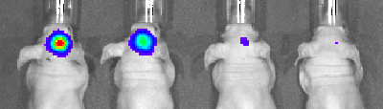
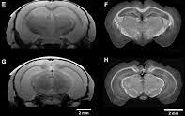

GLIOBLASTOMA INTRACRANIAL MODEL - IMAGING
Bioluminescence - IVIS
SIPBS capability
U87-MGLuc2
MRI
MRI
CT

Slide 18
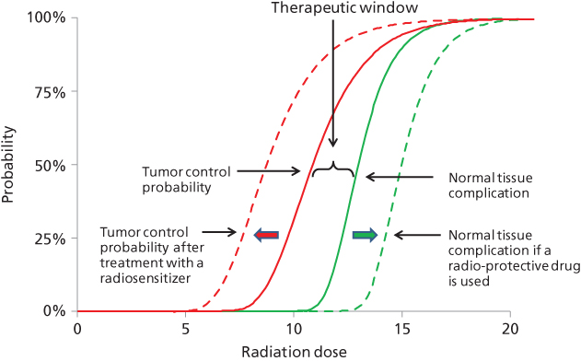
The Goal:
Improve treatment response to SOC leading to better patient outcomes
How: Combining drug(s) and RT to achieve tumour radiosensitisation
TCP = Tumour control probability
NTCT = Normal tissue complication probability
https://oncohemakey.com/principles-of-radiation-oncology-2/
Notes:
The dose of radiation is often chosen that will provide the highest chance of local control at an acceptable level of toxicity to surrounding normal structures. Rarely is local control achieved in all patients with this approach. The use of a radiosensitizer makes logical sense if local control is limited with the current standard approach or if the current standard approach results in excessive toxicity. If the radiosensitizer is selective to tumour tissue, the combination would increase the effective dose of radiation while minimizing the increased risk to adjacent normal tissues, favourably altering the therapeutic ratio. The sensitizer should have a clear preference for tumour tissue and the expected composite toxicity of the reduced dose radiation and the investigational agent should not exceed that of the standard dose radiation.

