Slide 1



An investigation into the potential of laser wakefield accelerated electrons to very high energies
for cancer therapy
What we did- how we did it and how we can do it this time
SIPBS: Dr. Annette Sorensen and Dr. Marie Boyd
ALPHA-X: Prof. Dino Jaroszynski and team
Notes:
1
Unlike the previous speaker and most other people at this conference I am not going to talk about laser accelerated protons but rather lwfa of electrons to energies in the range of 150-250MeV and their potential as a treatment modality in radiotherapy.
1

Slide 2
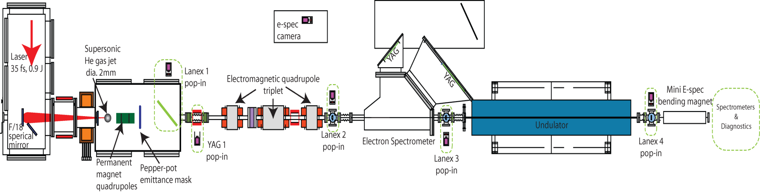
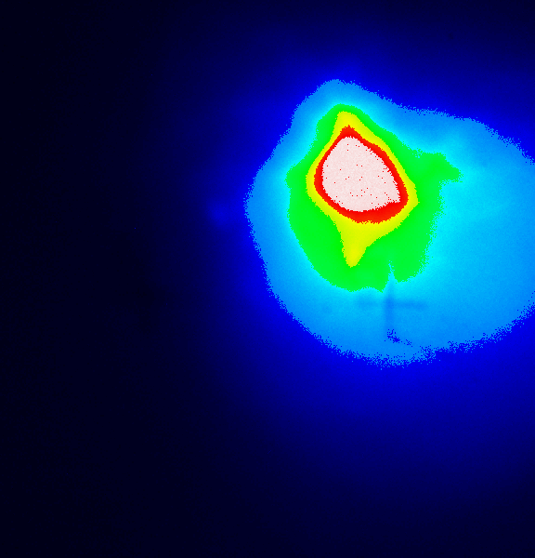
Experimental set up – ALPHA-X beamline
Ti:Sapphire laser pulse (800 nm, 35 fs, 0.9 J)
spot size of 40μm
maximum peak intensity I=2×10¹⁸Wcm−2
2 mm diameter pulsed supersonic helium gas jet
Electron energy measured by electron spectrometer
Electrons are delivered
in femtosecond duration electron bunches one every 2-3 second

Slide 3
Radiobiology
Aim: To interrogate the biological effect of LWFA VHEE on cancer cells to provide the biological evidence to encourage future clinical translation of this form of radiotherapy
Does LWFA VHEE kill cancer cells?
Does LWFA VHEE cause DNA damage and repair to cancer cells
Dpth penetration?

Slide 4
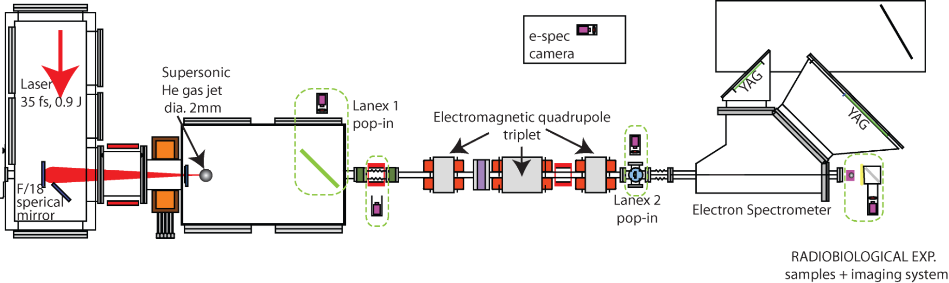
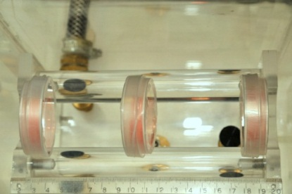
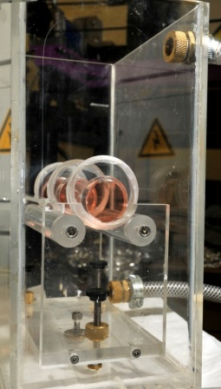
Radiobiological experiment –
cell monolayers – vertical beams a challenge
Monolayers of Human lung cancer lines (A549) in 30mm petridishes
Cells placed in water bath along the beamline at depths of 0, 3.5 and 10cm from the radiation source
Cells irradiated with 0.3, 0.7 and 1.5Gy
24h after cells were seeded for a clonogenic assay
Average electron energy measured before and after every cell irradiation (162 ± 25 MeV)
Electron charge measured before and after every cell irradiation using image plates and used in Monte Carlo simulations to determine delivered dose

Slide 5
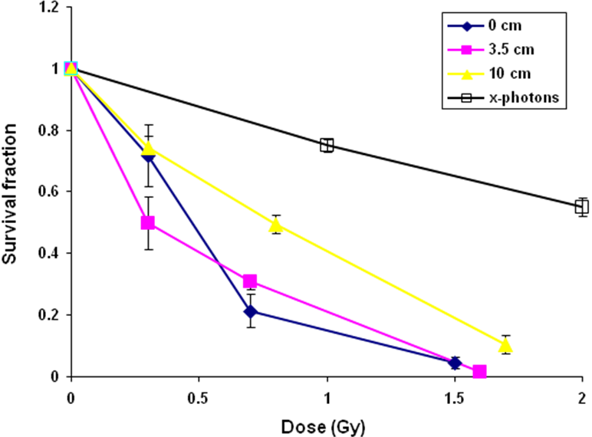
Clonogenic survival following LWFA VHEE irradiation of cells in monolayer
Dose dependent decrease in survival of cells at each individual depth
Survival curves at depths of 0 and 3.5cm show similar pattern of survival at all doses
At 10cm depth survival is greater over the dose range compared to 0 and 3.5cm

Slide 6
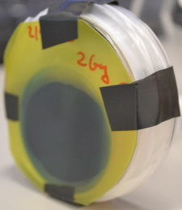
Electron beam travels 3m without any guidance
Bending magnets confirm photon contamination
Image plates have different sensitivities to different radiation types
Therefore impossible to obtain reliable charge measurements
Delivered dose underestimated

Slide 7
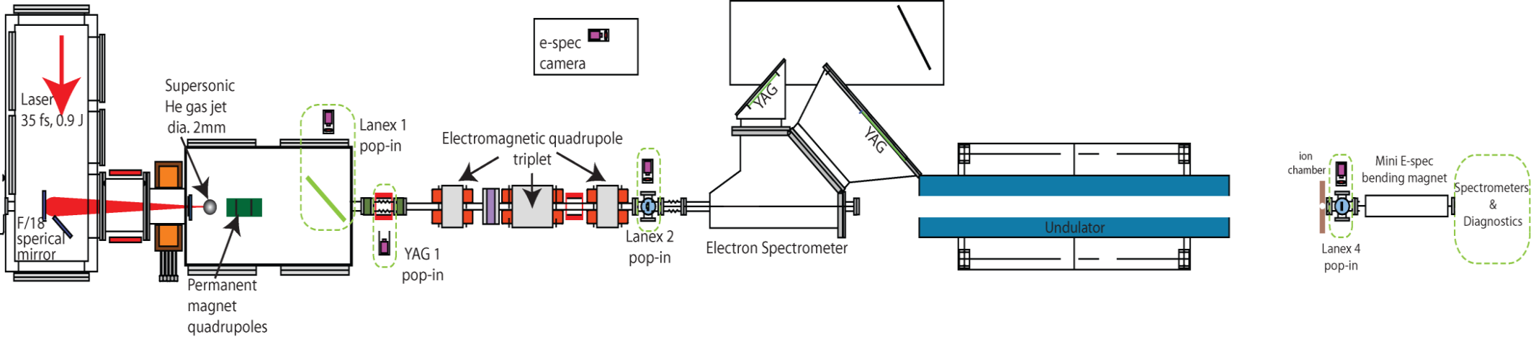
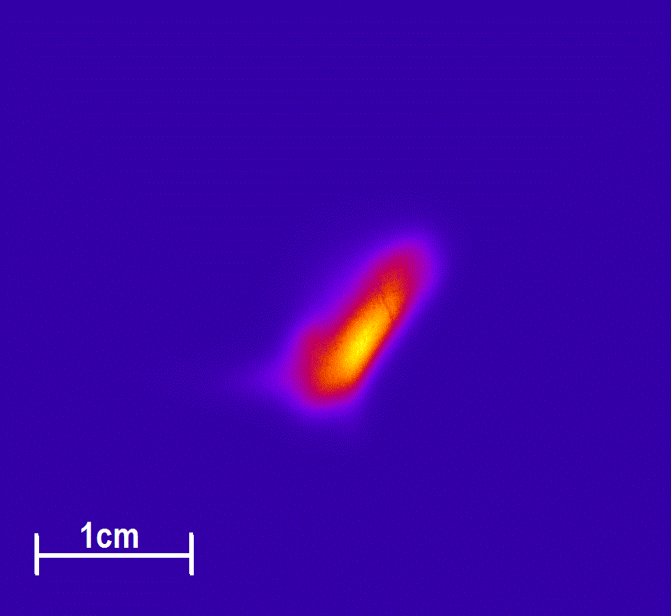
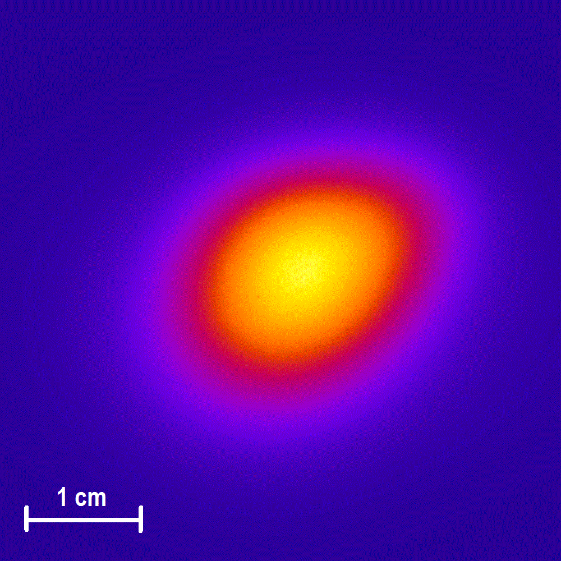
Radiobiological experiment – cell pellet
Extra 185 cm of propagation in air
Beam monitoring:
Electron spectra
IPs
EBT2 Gafchromic films
Ionization chamber
5 consecutive shots on FUJI BAS SR image plate
20 consecutive shots on FUJI BAS SR image plate
Notes:
7

Slide 8
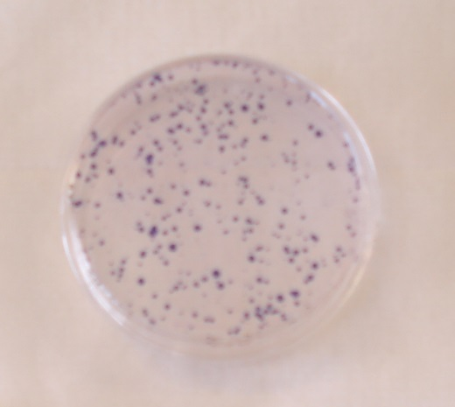
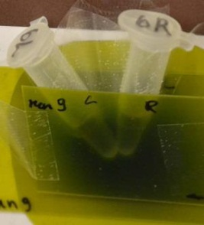
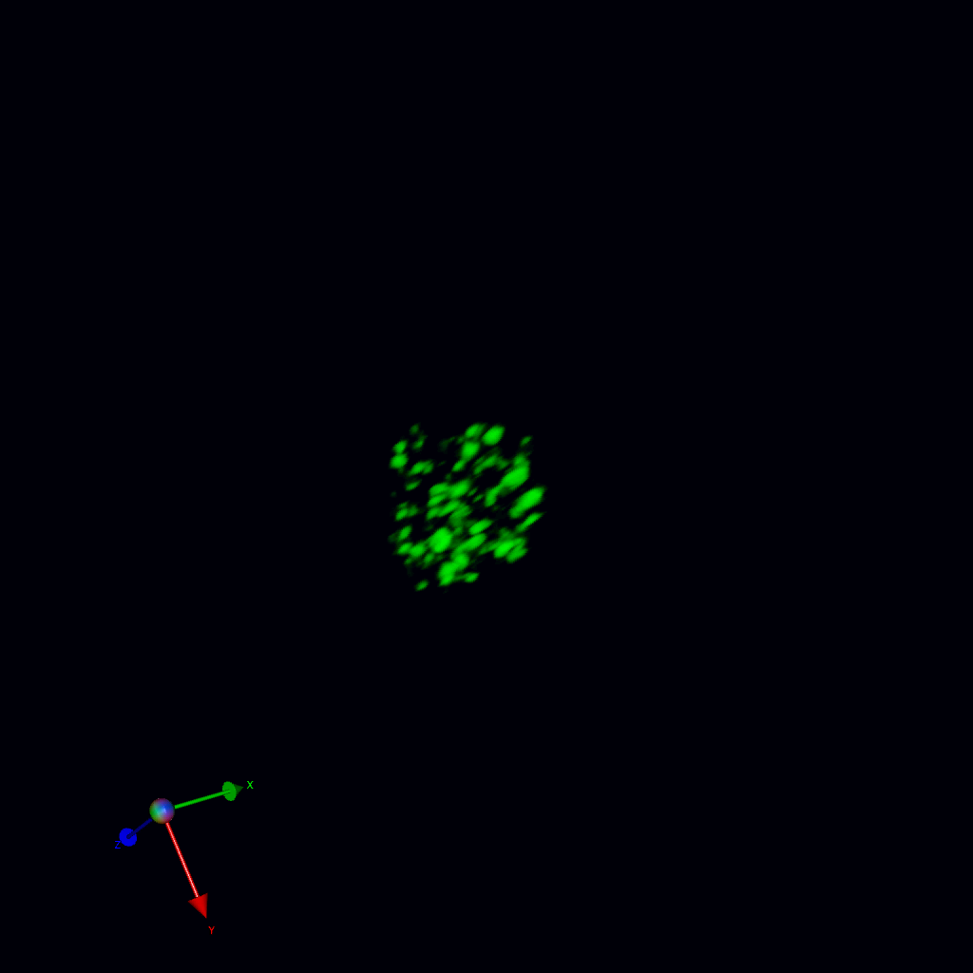
Radiobiology experiments-cell pellet
Clonogenic assay
5x10⁵
γ-H2AX foci
Cell pellet

Slide 9
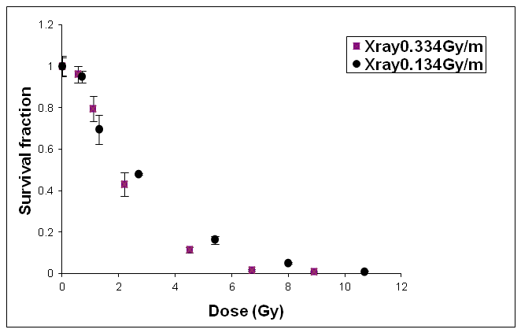
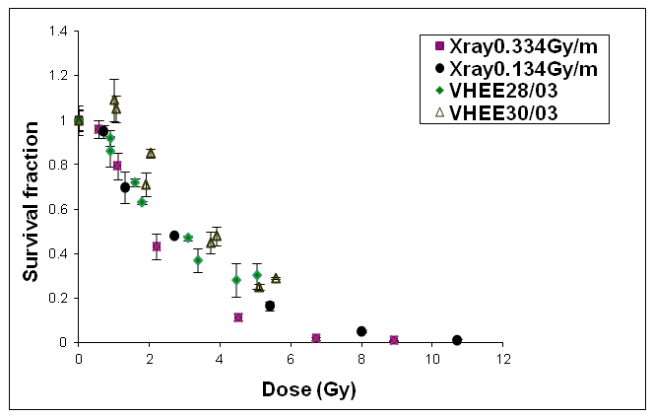
Clonogenic capacity of H460cells following irradiation
Clonogenic capacity decreases with an increase in dose of LWFA VHEE

Slide 10
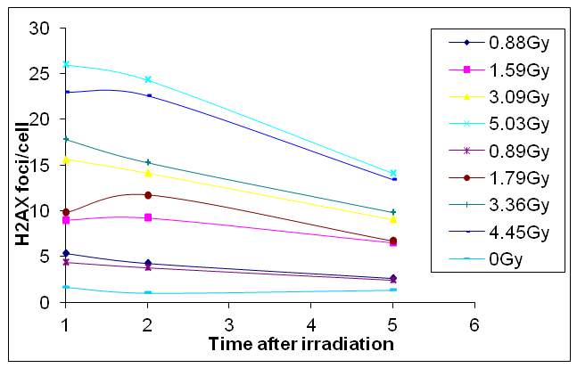
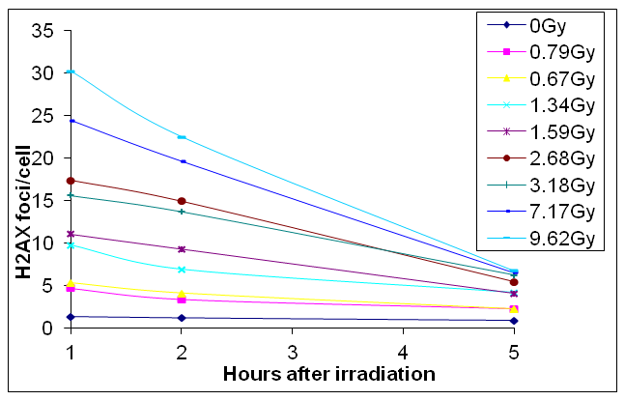
Dynamics of ʏH2AX following irradiation with LWFA VHEE
A549
H460

Slide 11
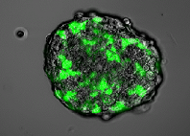
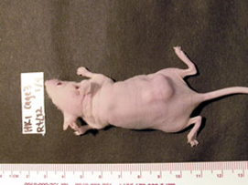
Other models we can use:
3D tumour spheroids- kill, IHC, section, image
About 500-800 microns
Still in medium and plastic
nude mice xenografts- could be used
Need Home office Licence

Slide 12
The issue with our new proposed experiments is the penetration
Of the beams through plastics/medium:
Without medium the cells will dry out and die or produce damage that’s
Not related to the beam
How can we overcome this with current low energy penetration power of the beam
Also wont go through plastic- how do we hold the cells?
Questions:
What will the beam penetrate
Can we design a system that the beam will penetrate through?
What are others doing- QUB had a film???

Slide 13
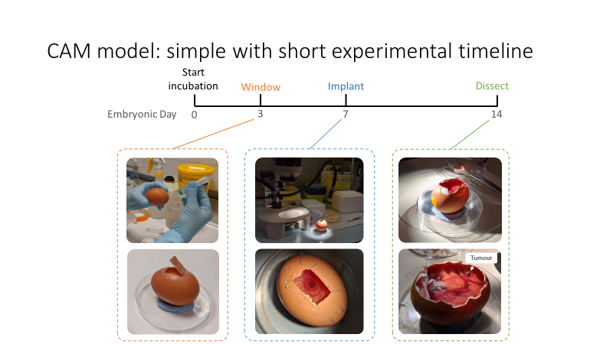
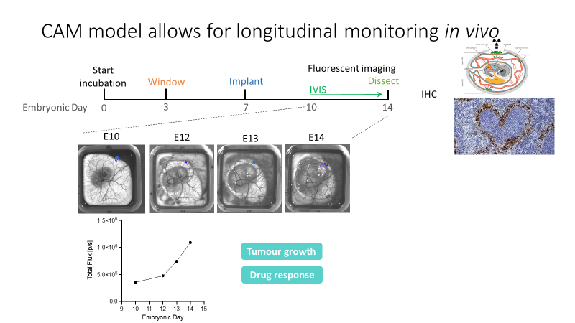
May overcome the need for medium and plastic covering
May be able to be used with a horizontal beam

