Slide 1
Sci-Fi

Slide 2
Concept
Sparse sci-fi
Credit card size, cheep as chips
250 micron fibre, centre-to-centre 3—4mm?

Slide 3
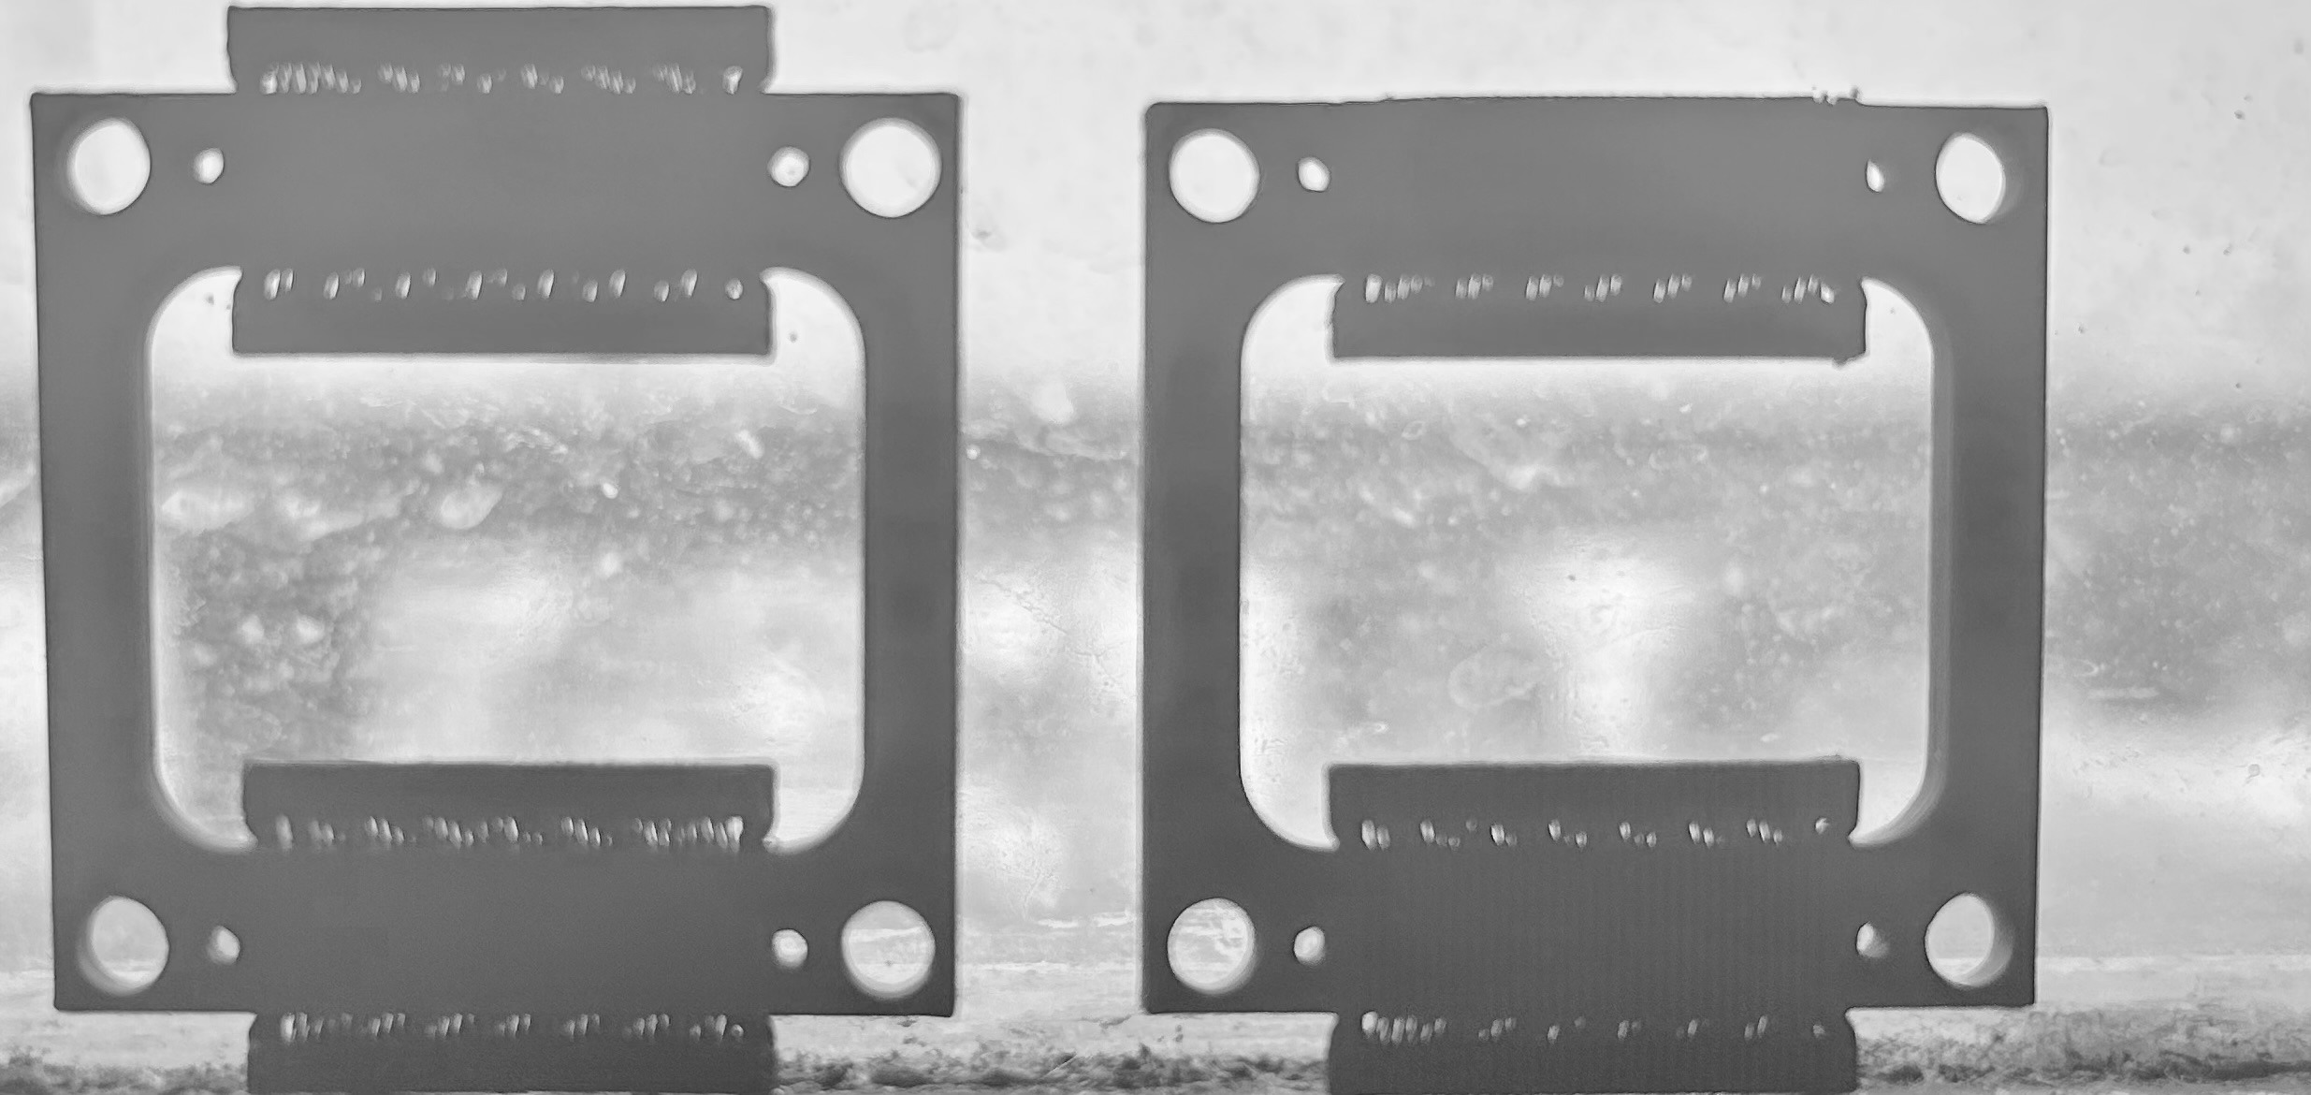
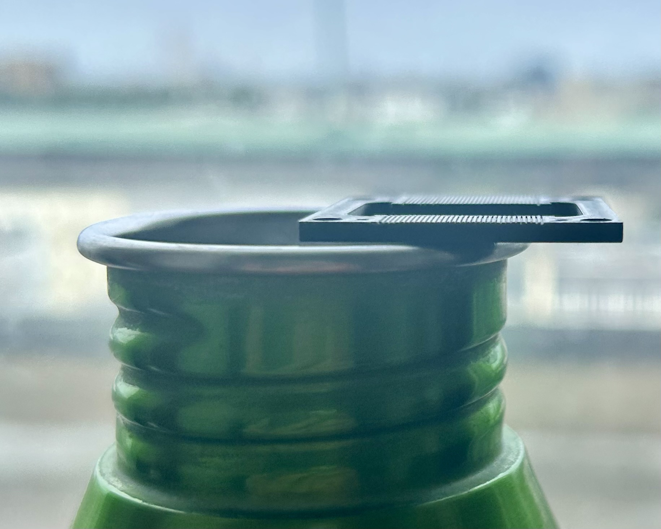
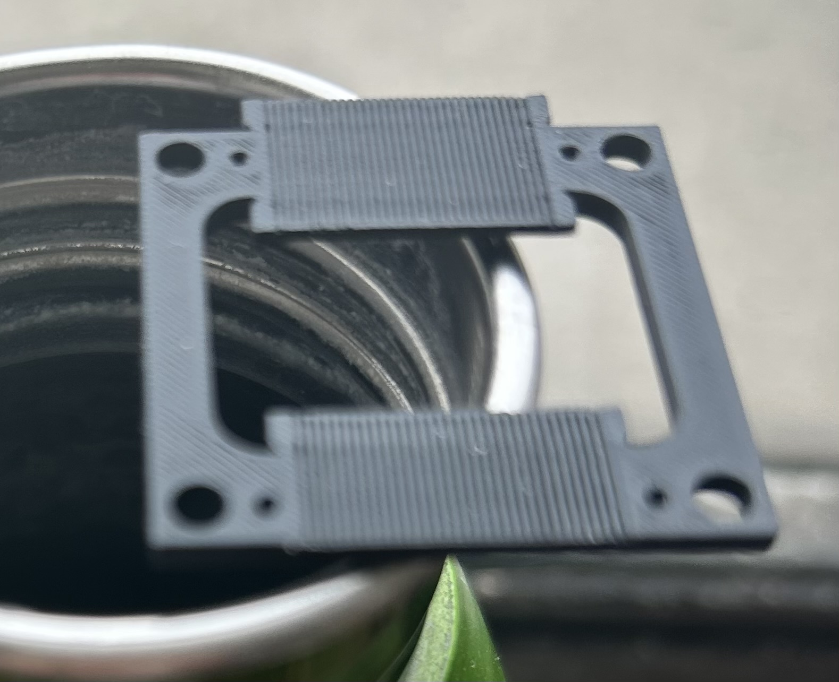
Frame

Slide 4
Plan
Spoke to Chris Armstrong at RAL
Agreed we make next prototype at Imperial with fibre we have
Then seek resources through Lab as CLF/PPD project
Let’s see …

