Slide 1
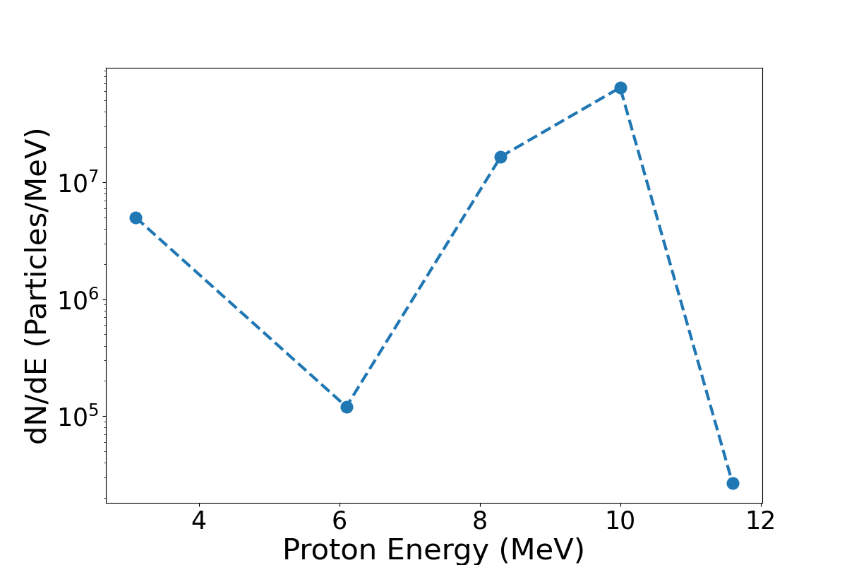
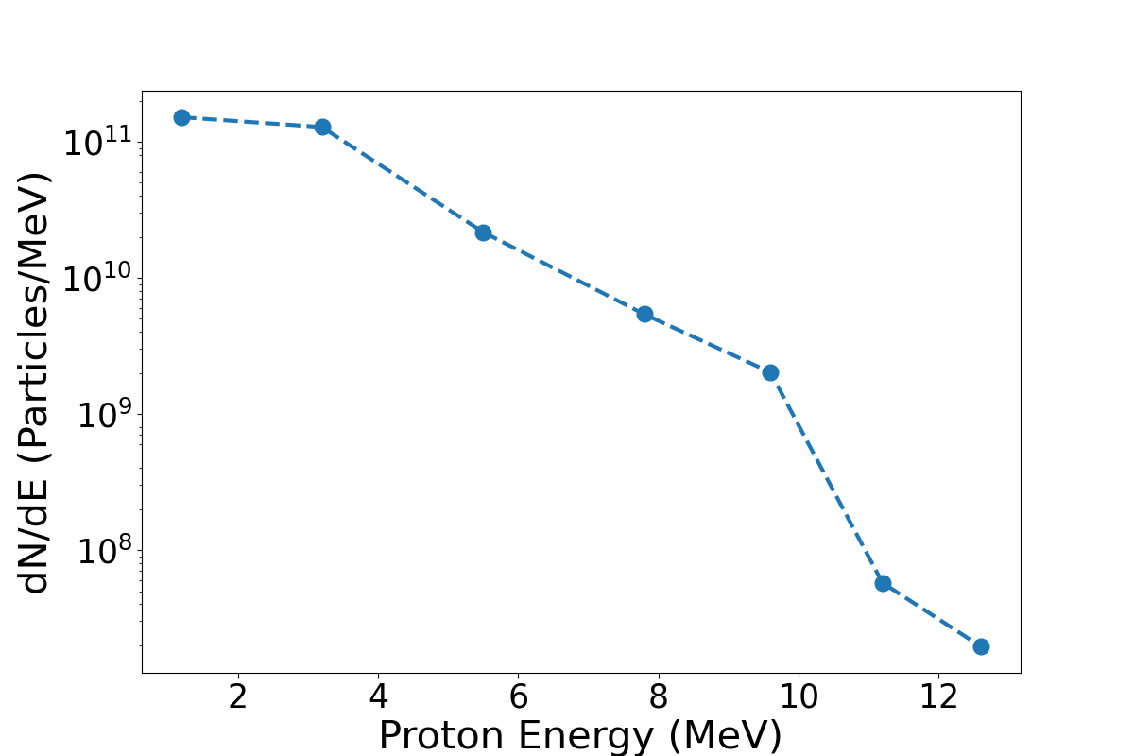
Focused Proton Beam RCF
Output proton beam from PMQs
Input proton beam to PMQs
PMQs
X THE UNIVERSITY OF STRATHCLYDE
1
Notes:
This is a CAD model of said experiment.
We plan to install a capture beamline to guide the proton source to a cell irradiation station
This will involve a permanent magnet quadrapole system as seen on left, and a cell irradiation end station which will sit at target normal in the TP line.
Very exciting application experiment for Bunker B

Slide 2
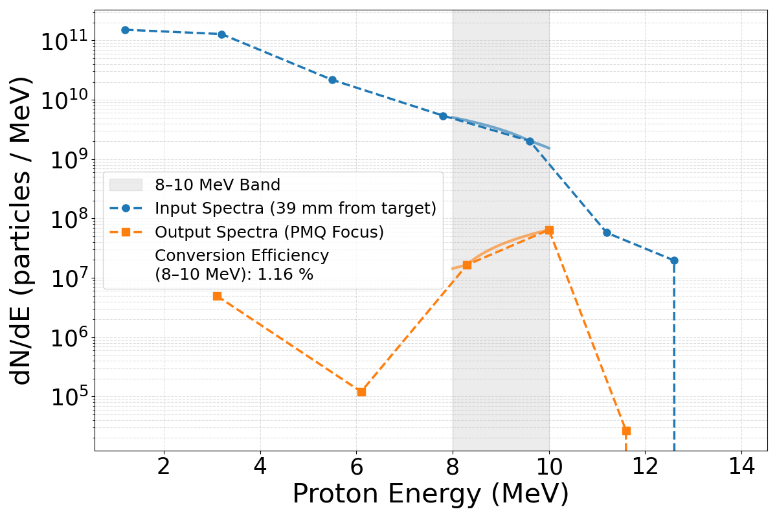
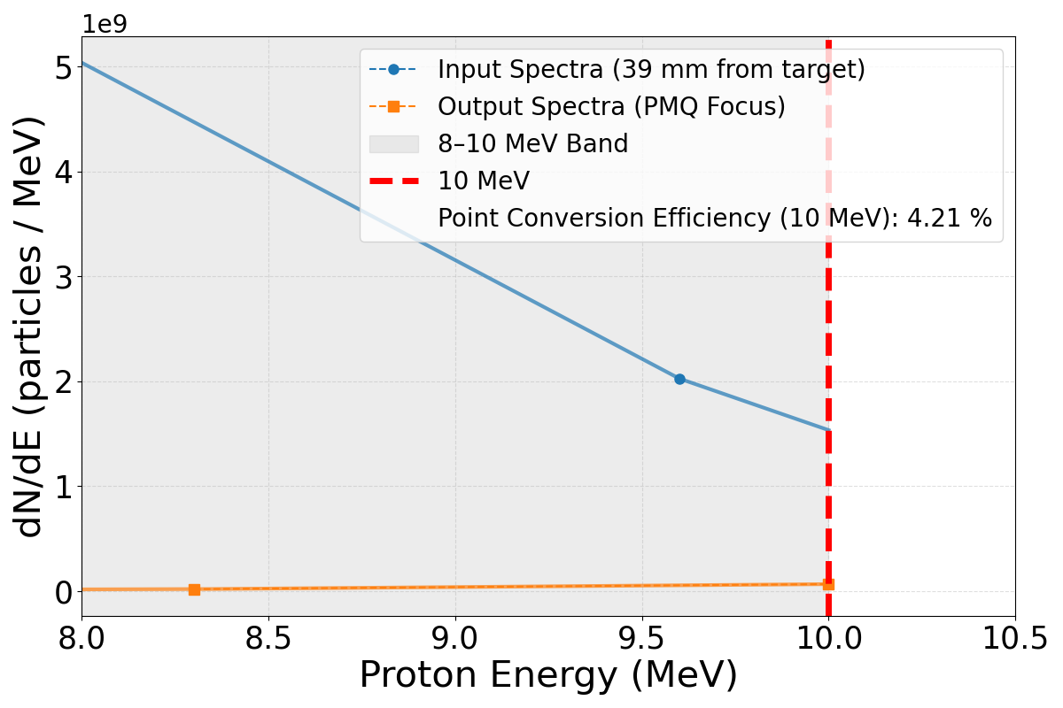
Focused Proton Beam RCF
Comparing the input spectra to the output we see a conversion efficiency of the proton capture at 8-10 MeV of 1.16 %.
PMQs
X THE UNIVERSITY OF STRATHCLYDE
Zooming in to 10 MeV, we see a conversion efficiency of 4.21 %
2
Notes:
This is a CAD model of said experiment.
We plan to install a capture beamline to guide the proton source to a cell irradiation station
This will involve a permanent magnet quadrapole system as seen on left, and a cell irradiation end station which will sit at target normal in the TP line.
Very exciting application experiment for Bunker B

