Slide 1
Comparing best transmission quad positions

Slide 2
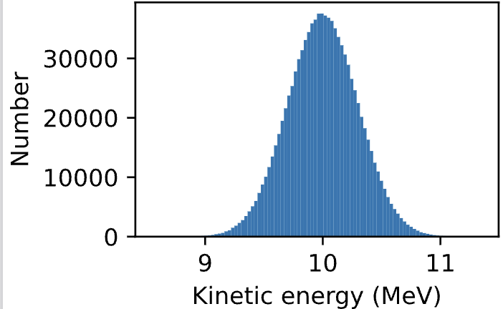
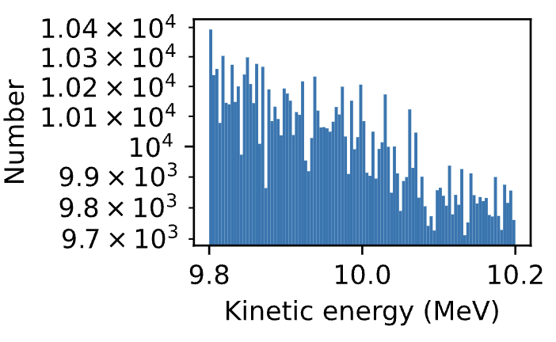
10MeV
Gaussian
LsrDrvn

Slide 3
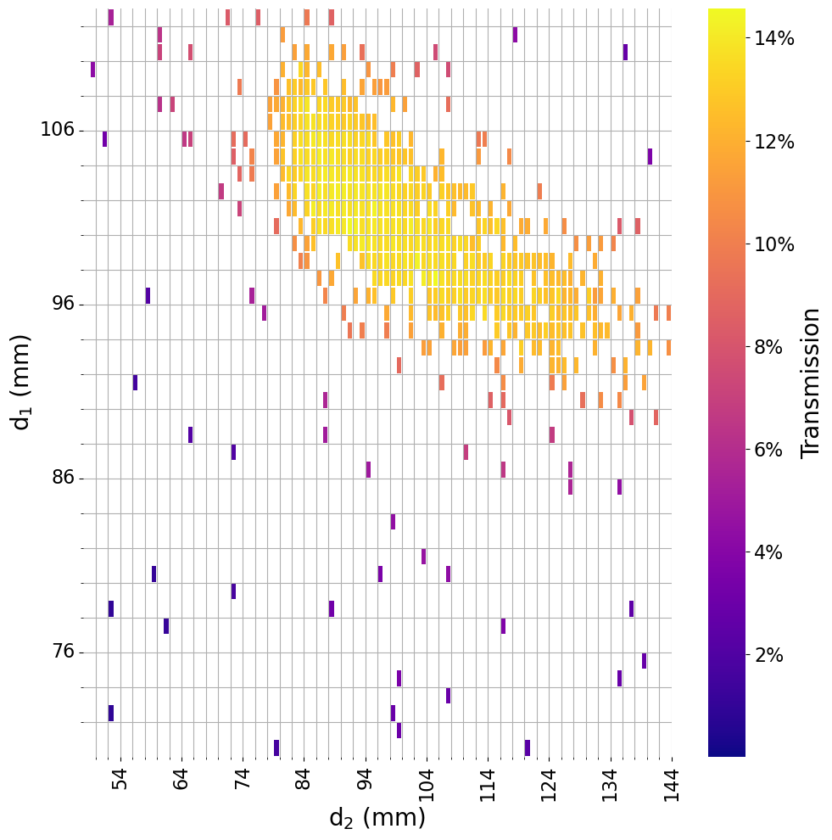
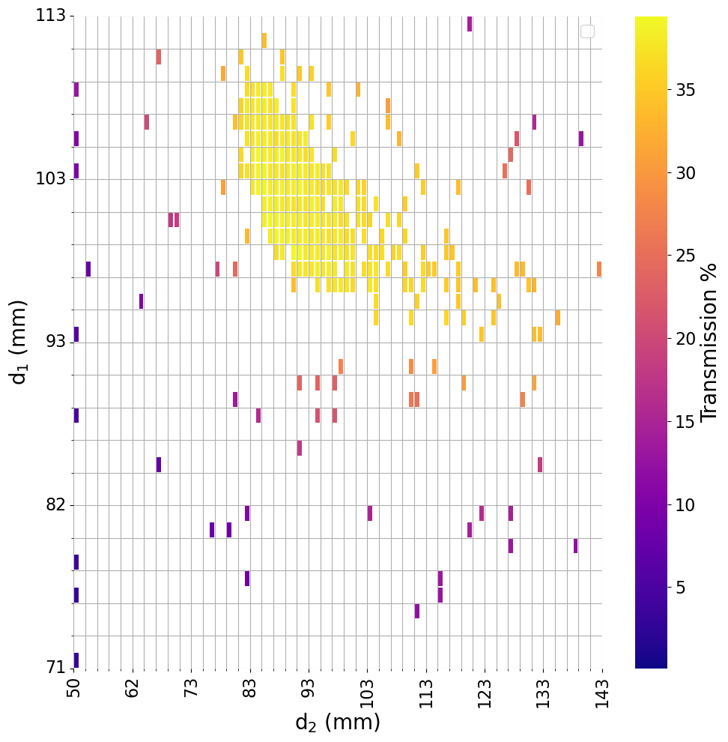
10MeV
Gauss
LsrDrvn

Slide 4
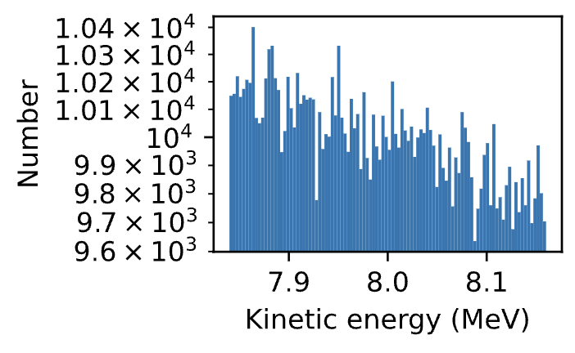
8MeV vs 10MeV
10MeV
8MeV

Slide 5
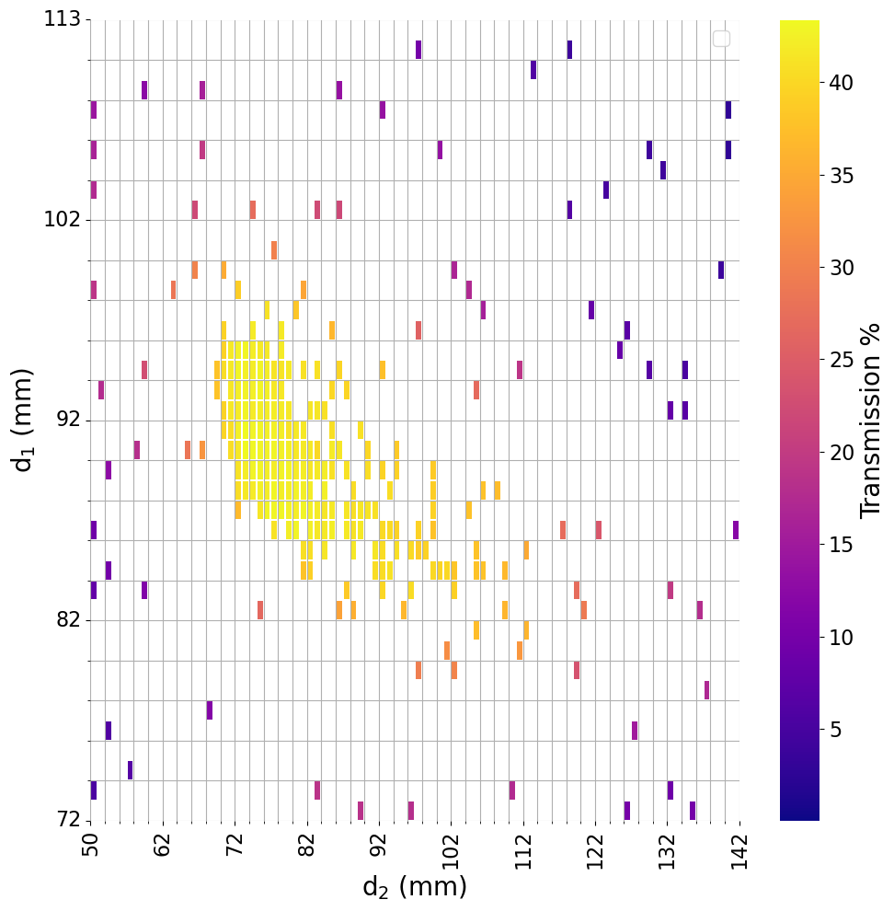
8MeV vs 10MeV
10MeV
8MeV

Slide 6
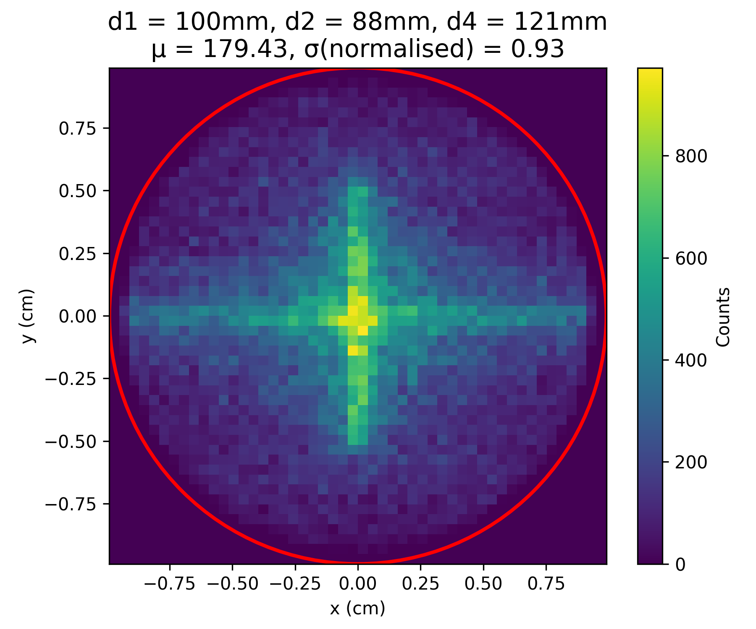
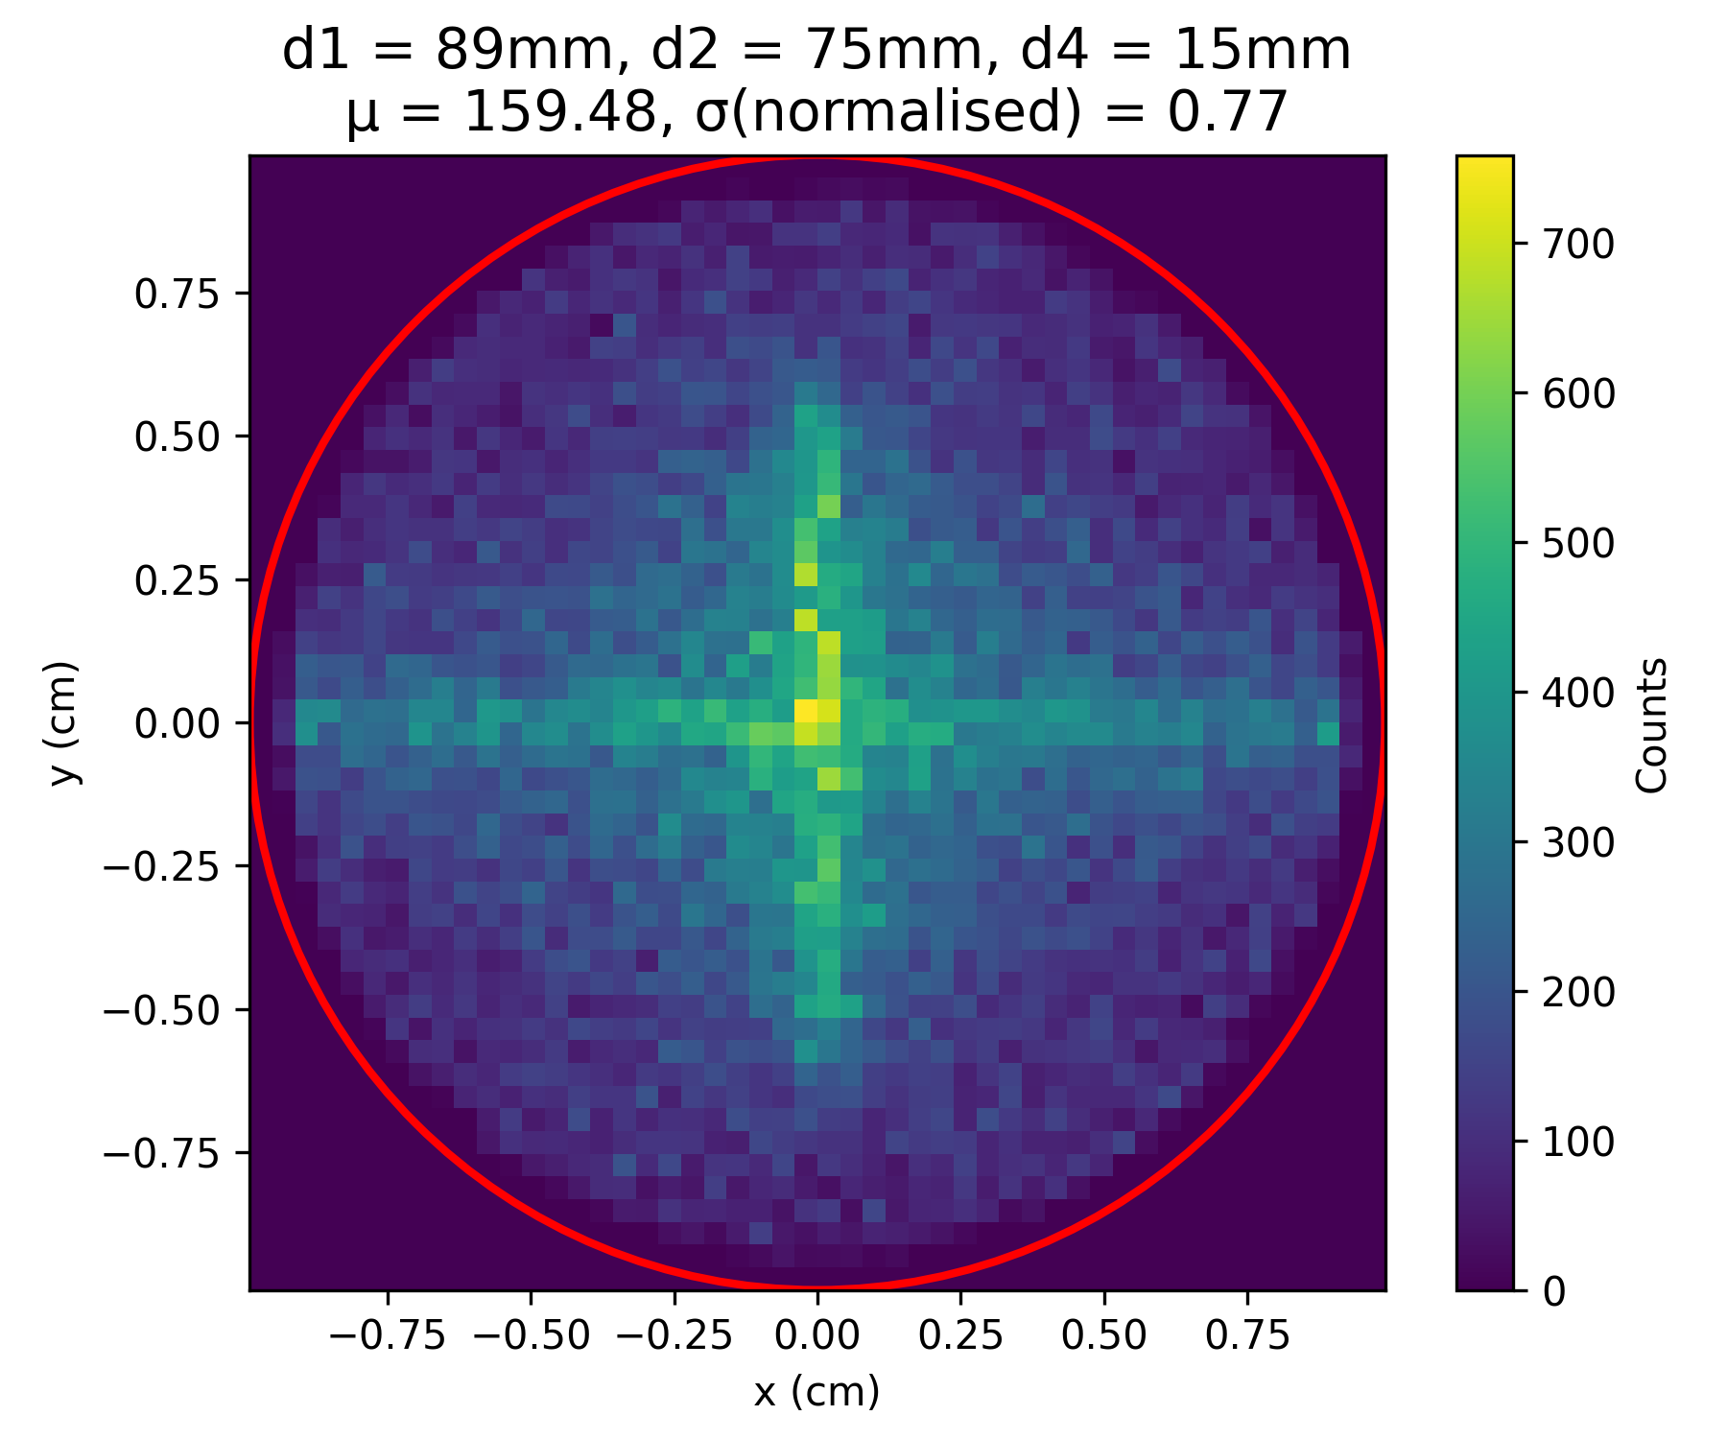
Comparison of Best Setups
10MeV
8MeV

Slide 7
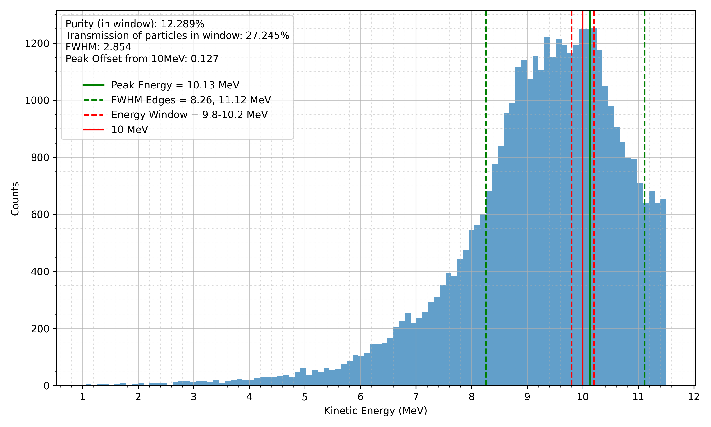
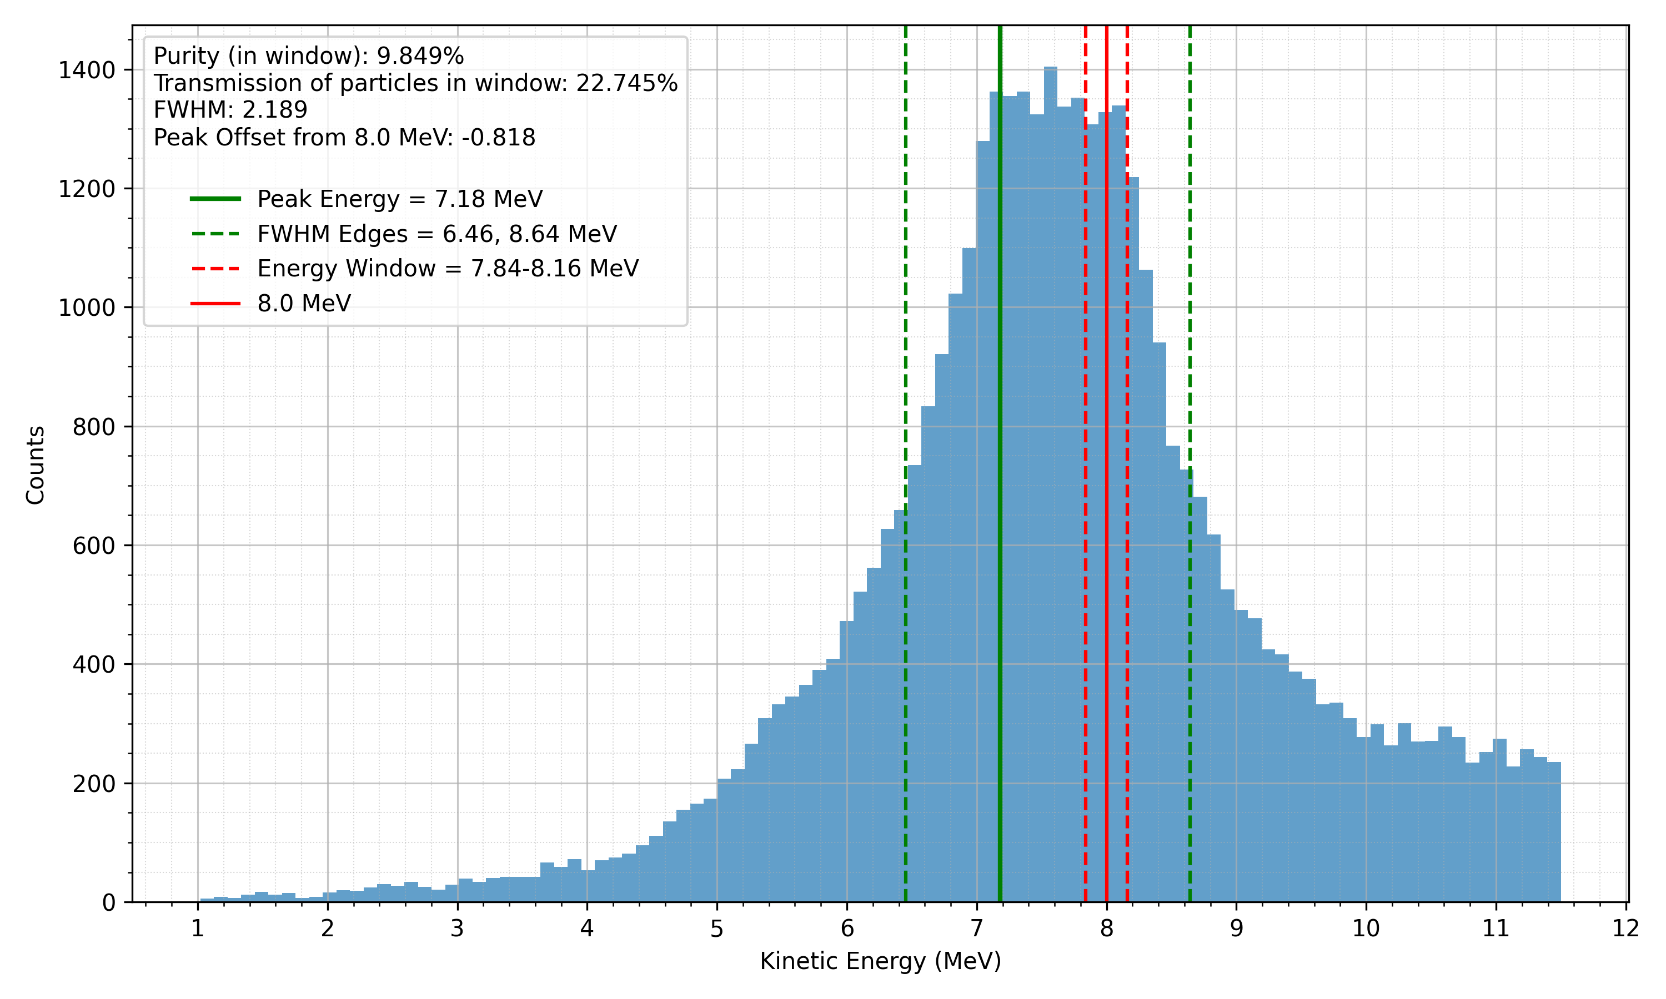
Comparison of Best Setups
10MeV
8MeV

Slide 8
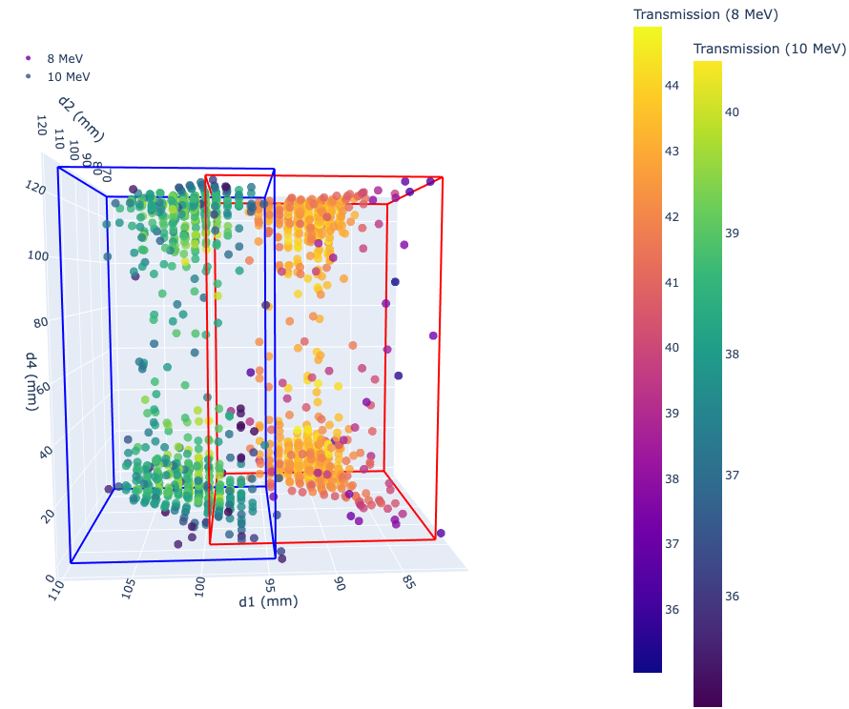
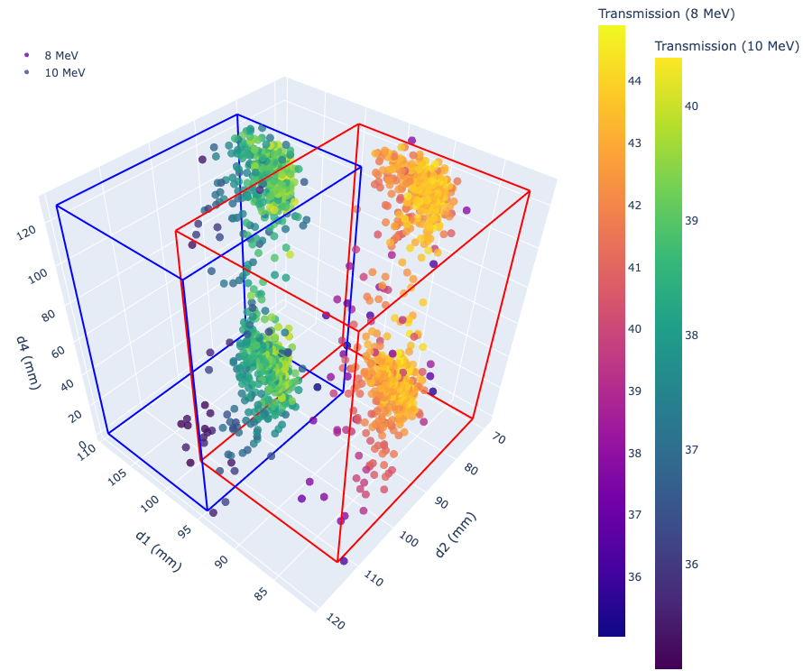
8MeV vs 10MeV

