Slide 1
Dose Calculations

Slide 2
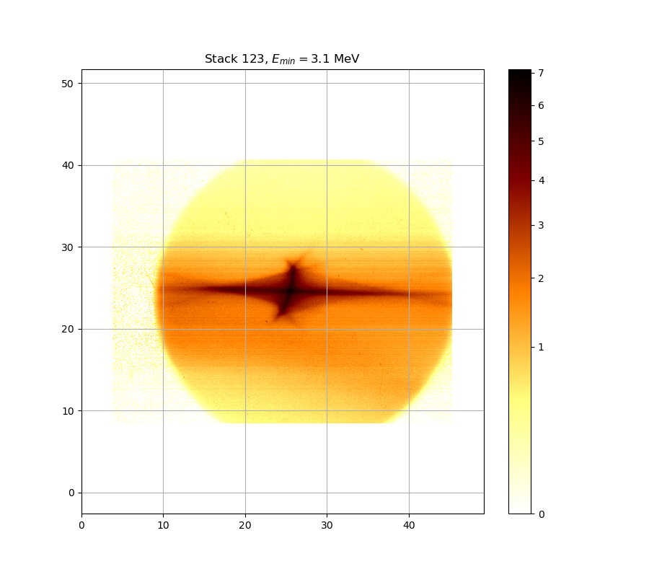
RCF Data – Layer 1

Slide 3
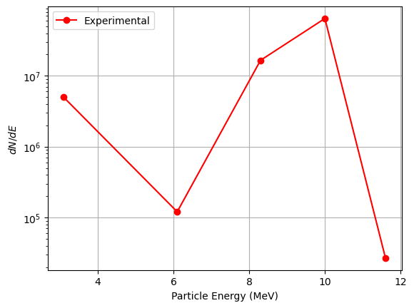

Experimental Spectrum

Slide 4
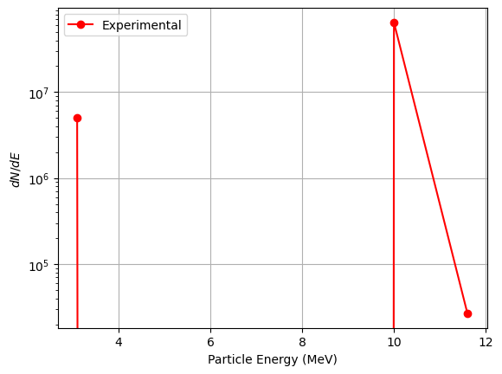
Experimental Spectrum
Fake but informative

Slide 5
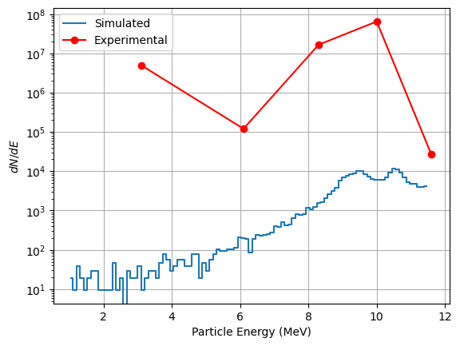
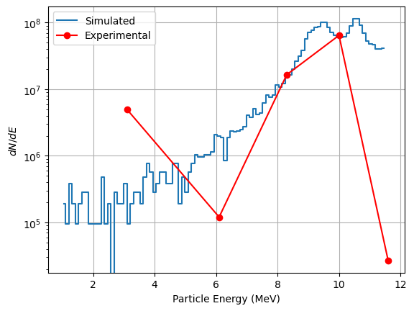
Matching with sim
Original
Scale factor of 10,000

Slide 6
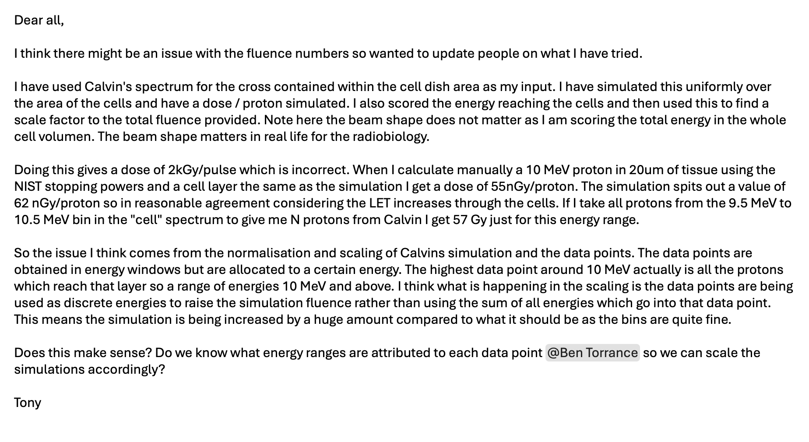
Tony’s Output

Slide 7
Sidenote:
Built a cell dish in Geant4 (including vac window)
Fed in phase space from LhARALinearOptics
Calculated mean dose and multiplied by 10,000
Got just under 1Gy

Slide 8
Next Steps
Just use the RCF dose:
  Can simulate a beam going into RCF and going into cells (/water) and find out the scaling factor difference in mean dose
  Requires Nick to share the calibration constants he used (or to calculate the mean)
Nick to try and get sensible proton numbers using his analysis code:
  Will have a better understanding of what the code does so can answer tony’s questions better
  Then give to Tony to calculate the dose

