Slide 1
Recap of Phase 2 Part 1

Slide 2
Optimisation varying, d1, d2, d3. d5 fixed as 15mm
Vacuum
Air
15
FQ (150T/m)
FQ (150 T/m)
Mylar (50um)
Gold Foil (10um)
20mm
40mm
20mm
d1
d2
d3
420mm
LsrDrvn Source
40mm
20mm
Beamline End

Slide 3
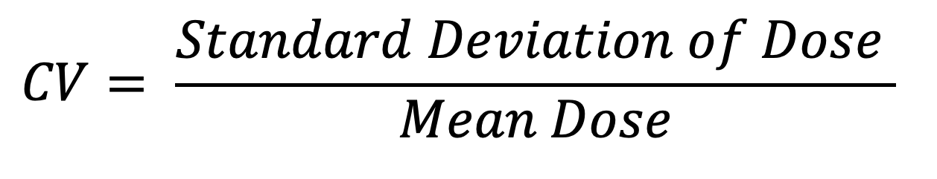
Coefficient of Variation (aka normalized standard deviation)
$$CV= \frac{Standard Deviation of Dose }{Mean Dose}$$

Slide 4
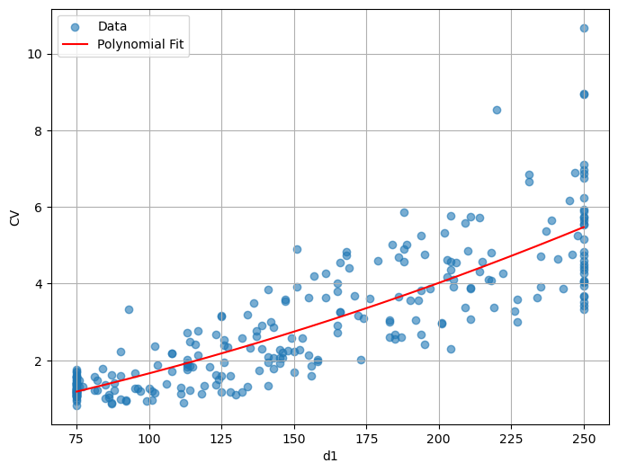
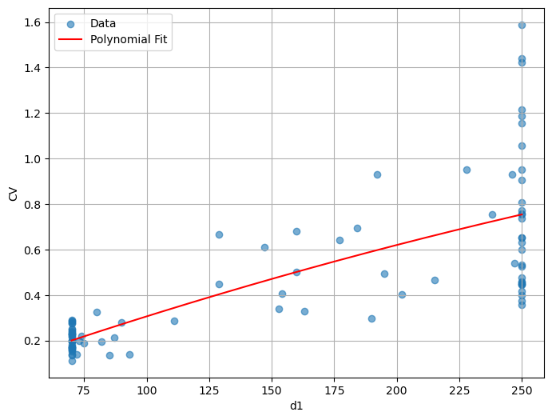
Effect of d1
Low Stats
High Stats

Slide 5
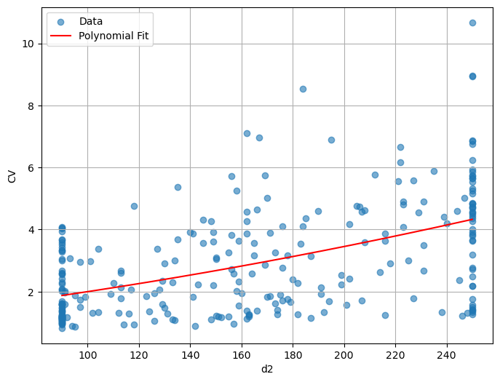
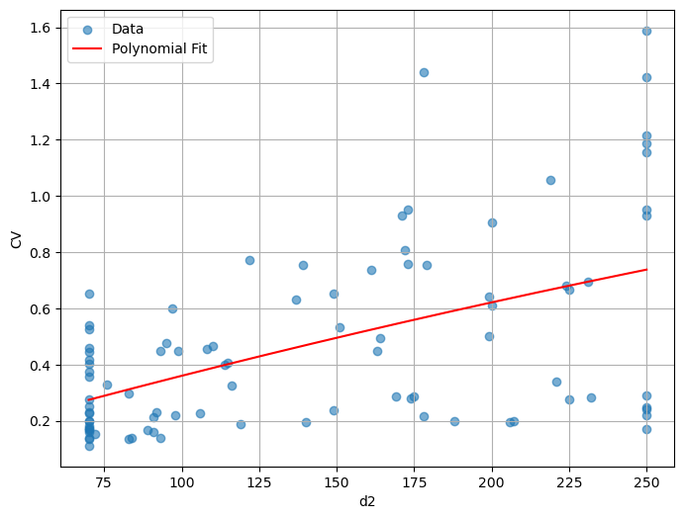
Effect of d2
Low Stats
High Stats

Slide 6
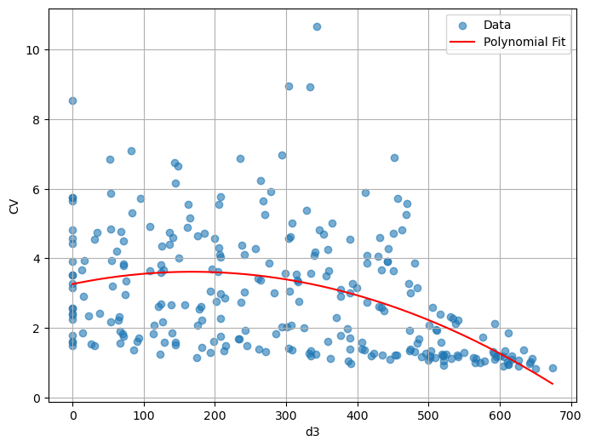
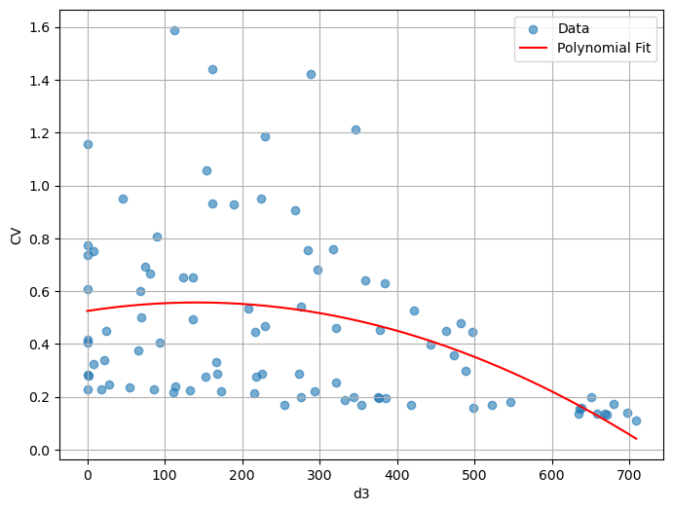
Effect of d3
Low Stats
High Stats

Slide 7
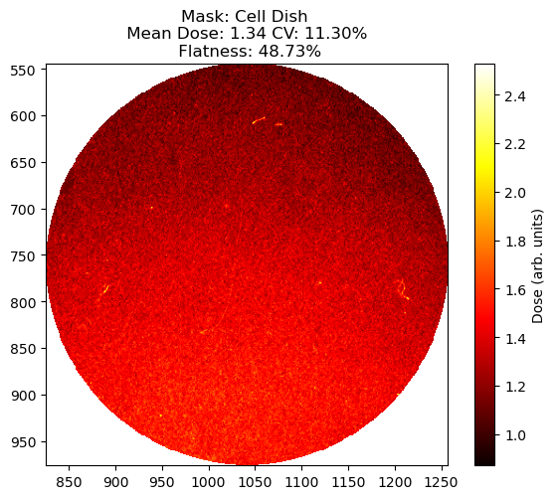
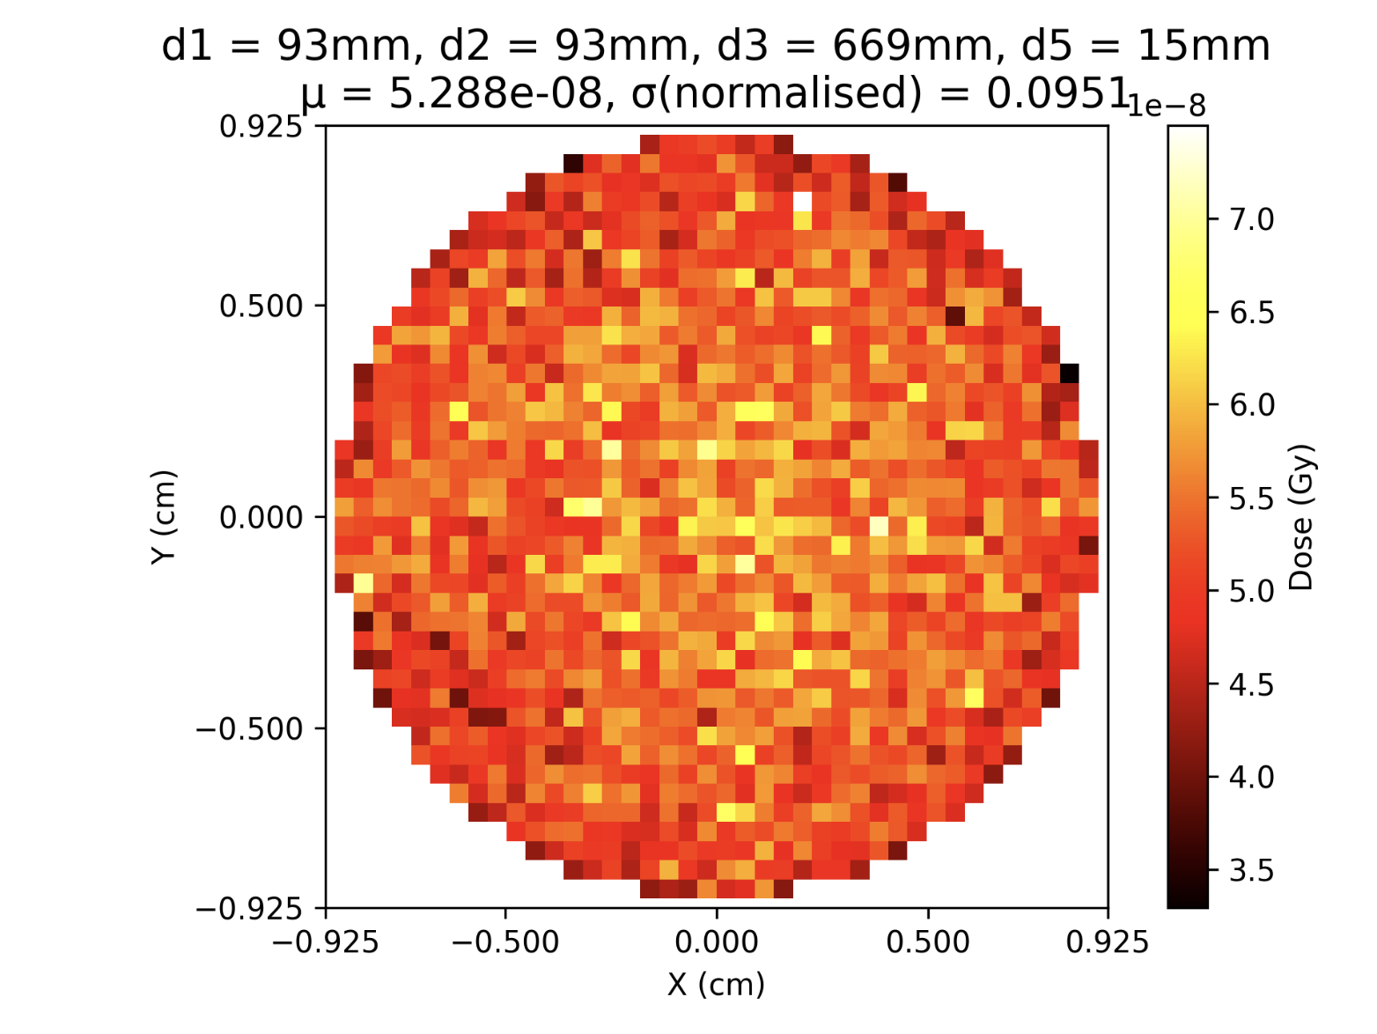
Gold (10um):

Slide 8
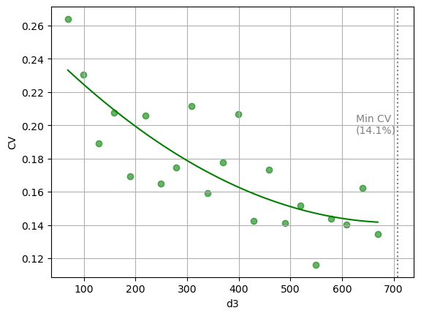
Gold (10um) d3 Scan:

Slide 9
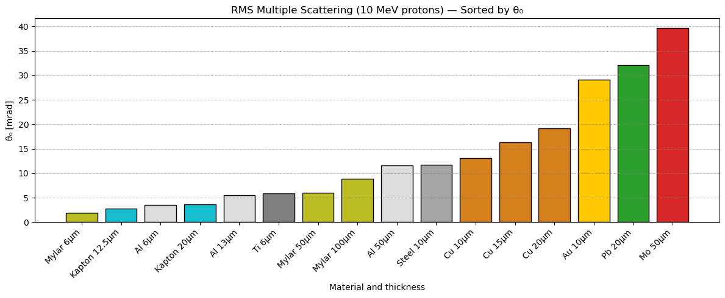
Scatterer Options

Slide 10
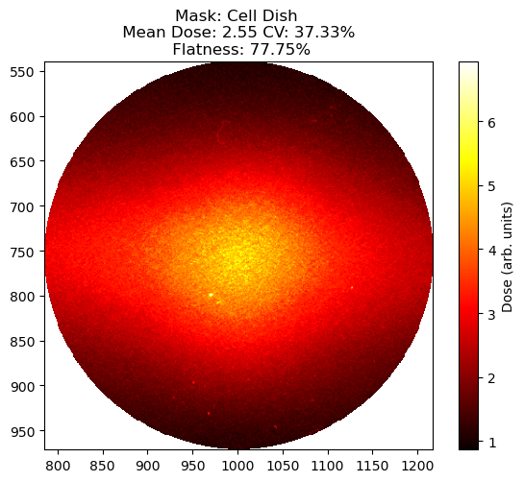
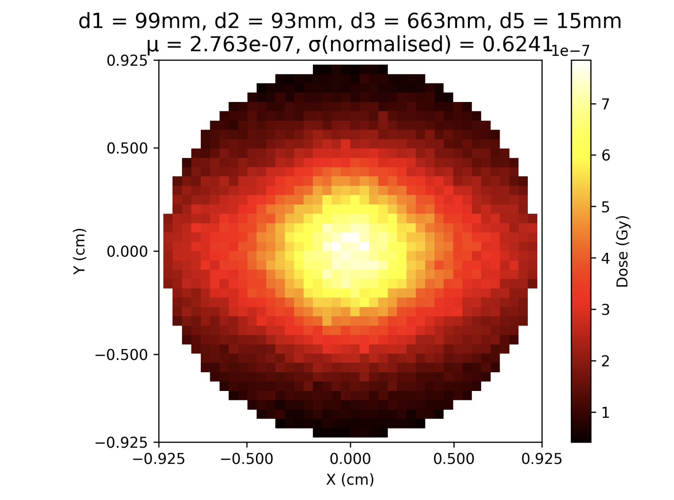
Al (6um):

Slide 11
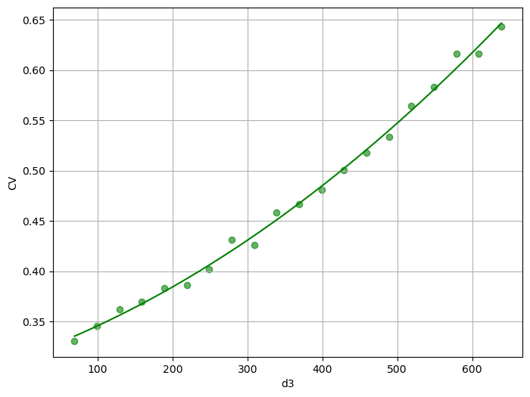
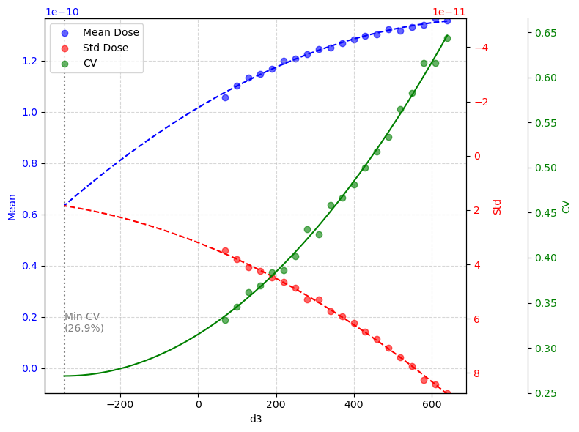
Al (6um) d3 Scan:

Slide 12
Scatterer Options

Slide 13
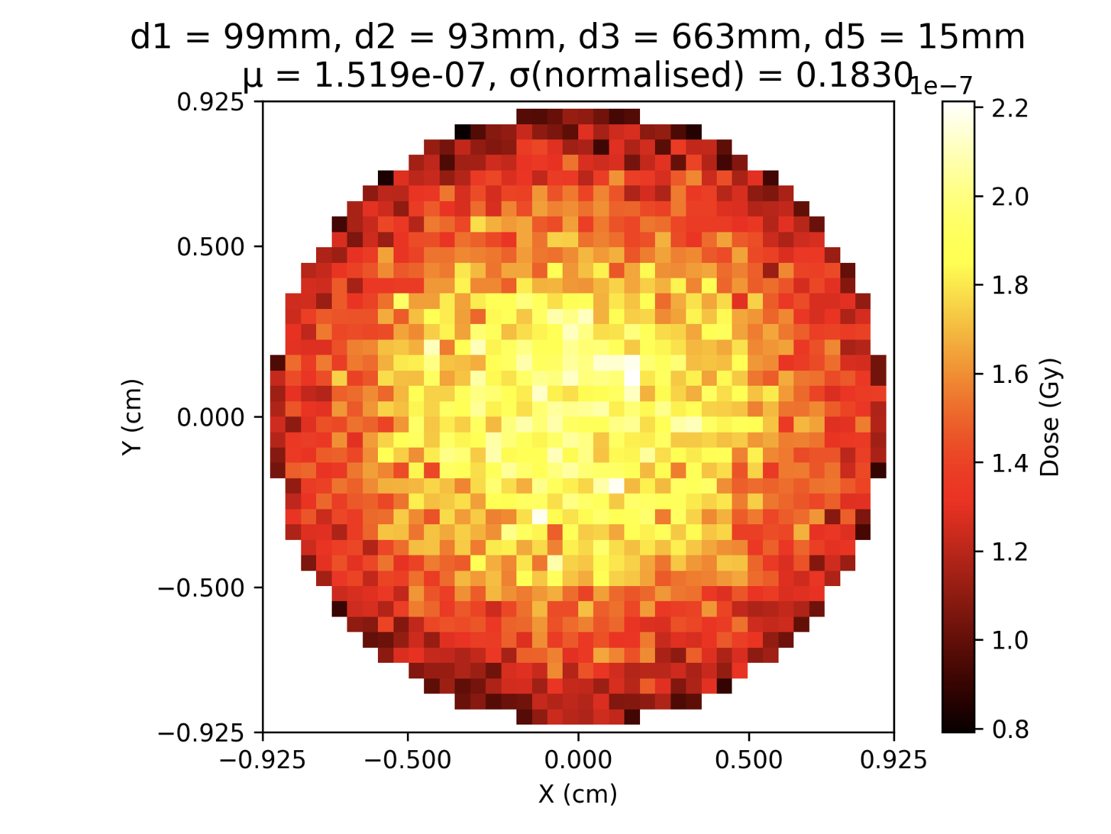
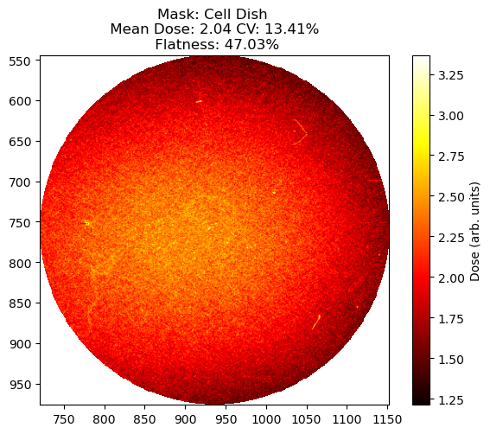
Cu (10um):

Slide 15
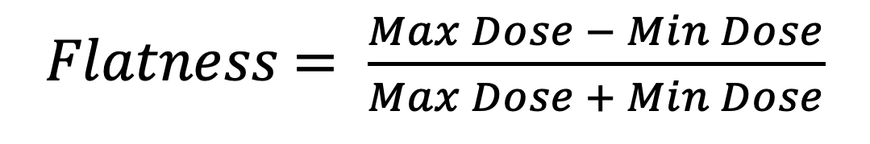
Cu (10um)
Tony’s Results:
$Flatness$ $= \frac{Max Dose − Min Dose}{Max Dose + Min Dose}$

Slide 16
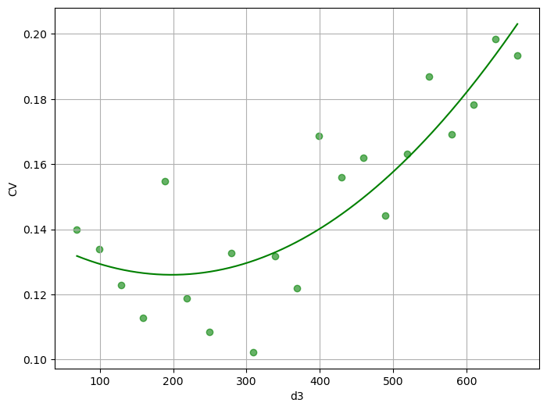
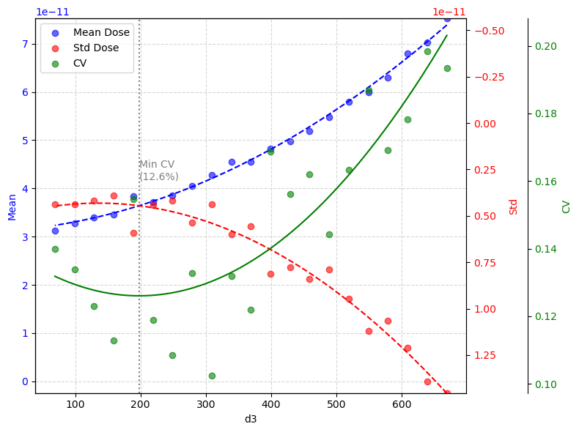
Cu (10um) d3 Scan:

Slide 17
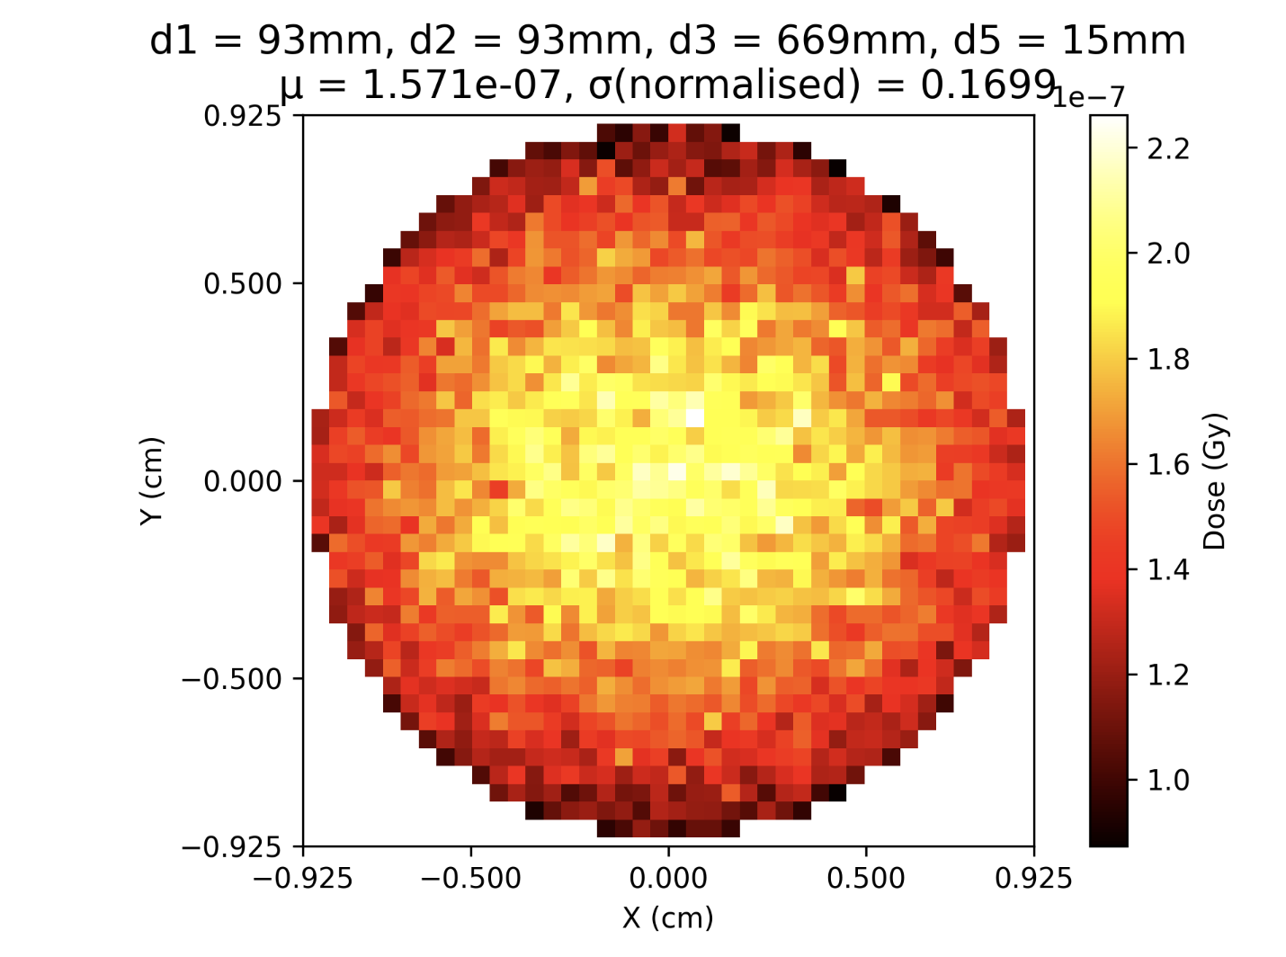
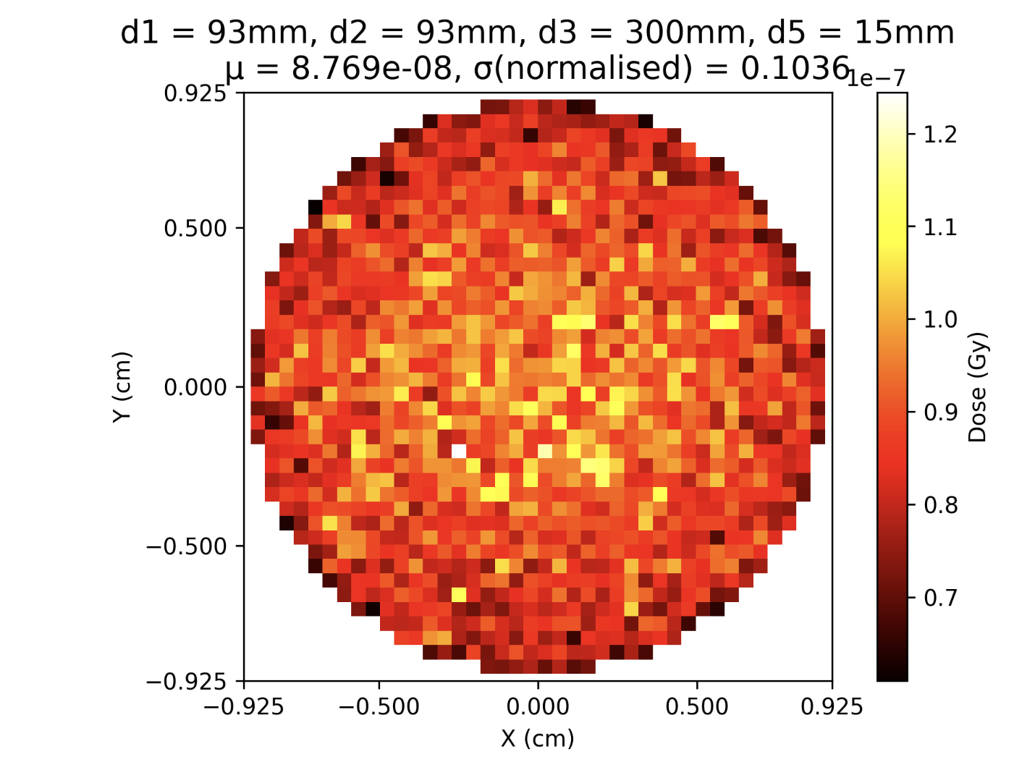
Cu (10um): Max d3 vs d3=300mm

Slide 18
Optimisation using Cu (10um)

Slide 19
Comparison between RCF Dose and Cell Dish Dose

