Slide 1
Early Analysis of RCF

Slide 2
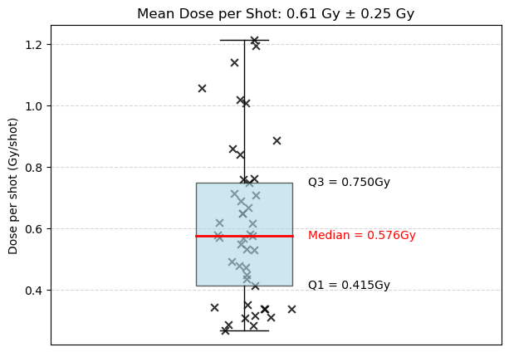
Calculated Dose per Shot

Slide 3
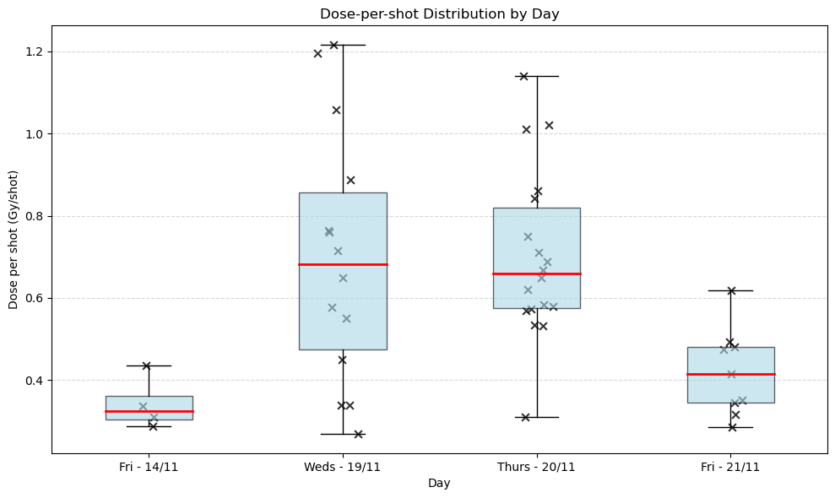
Source of variation: Day to day?

Slide 4
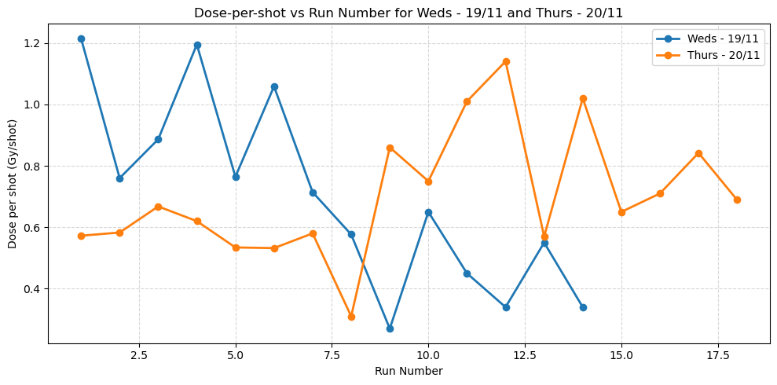
Source of variation: Number of shots in one day?

Slide 5
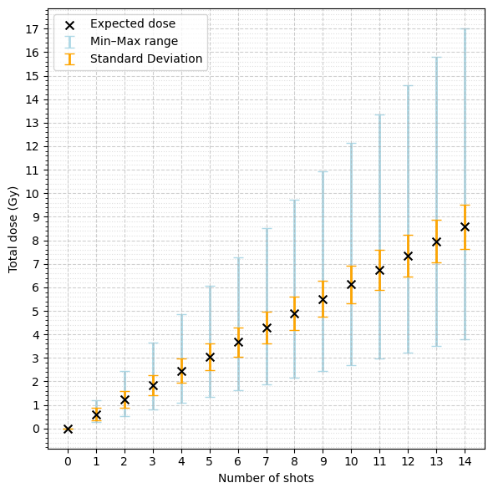
Estimating the Dose:
4, 7 and 14 Shots

Slide 6
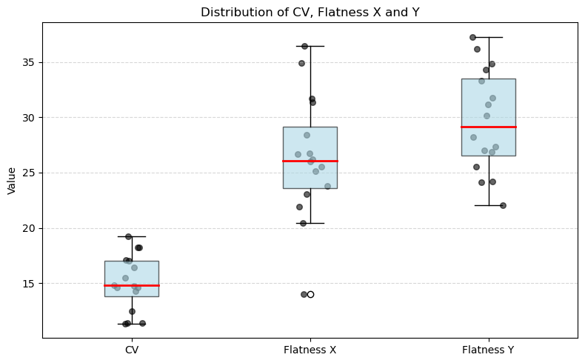

Uniformity

Slide 7
Rotation Issue

Slide 8
