Slide 1
Protons per Fibre

Slide 2
Set Up
Source
N1e5
LsrDrvn Energy Spectrum
Note: I believe we expect more like 1e9 particles at source and when I ran 1e5 the numbers appear to scale linearly.
Fibre
Polystyrene and diamater 250um
Grid of 48x42mm

Slide 3
Vacuum
Air
15mm
FQ (150T/m)
FQ (150 T/m)
d4
Mylar (50um)
air1
d1
d2
Copper (10um)
d3
40mm
20mm
20mm
93mm
93mm
669mm
420mm
LsrDrvn Source
40mm
20mm
Beamline End
D3 is probably the most likely place to position the fibre based on ease of implementation
SciFi Locations

Slide 4
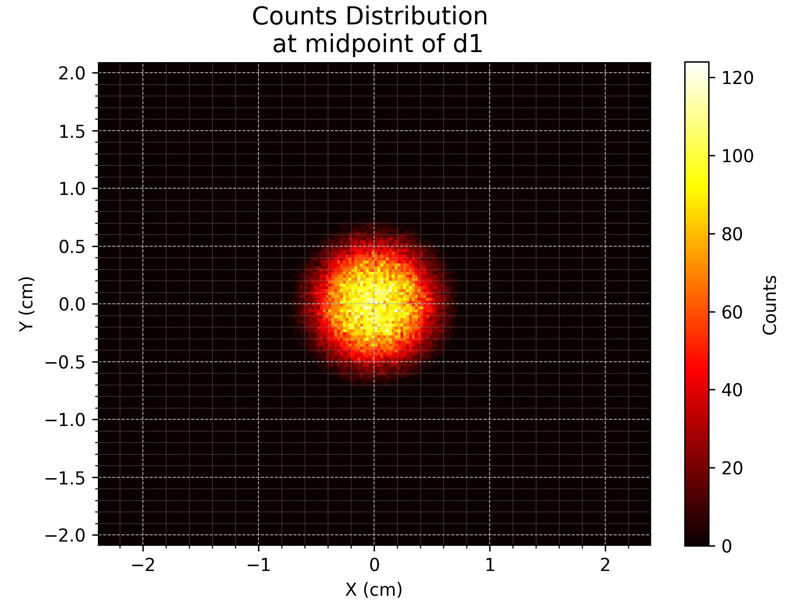
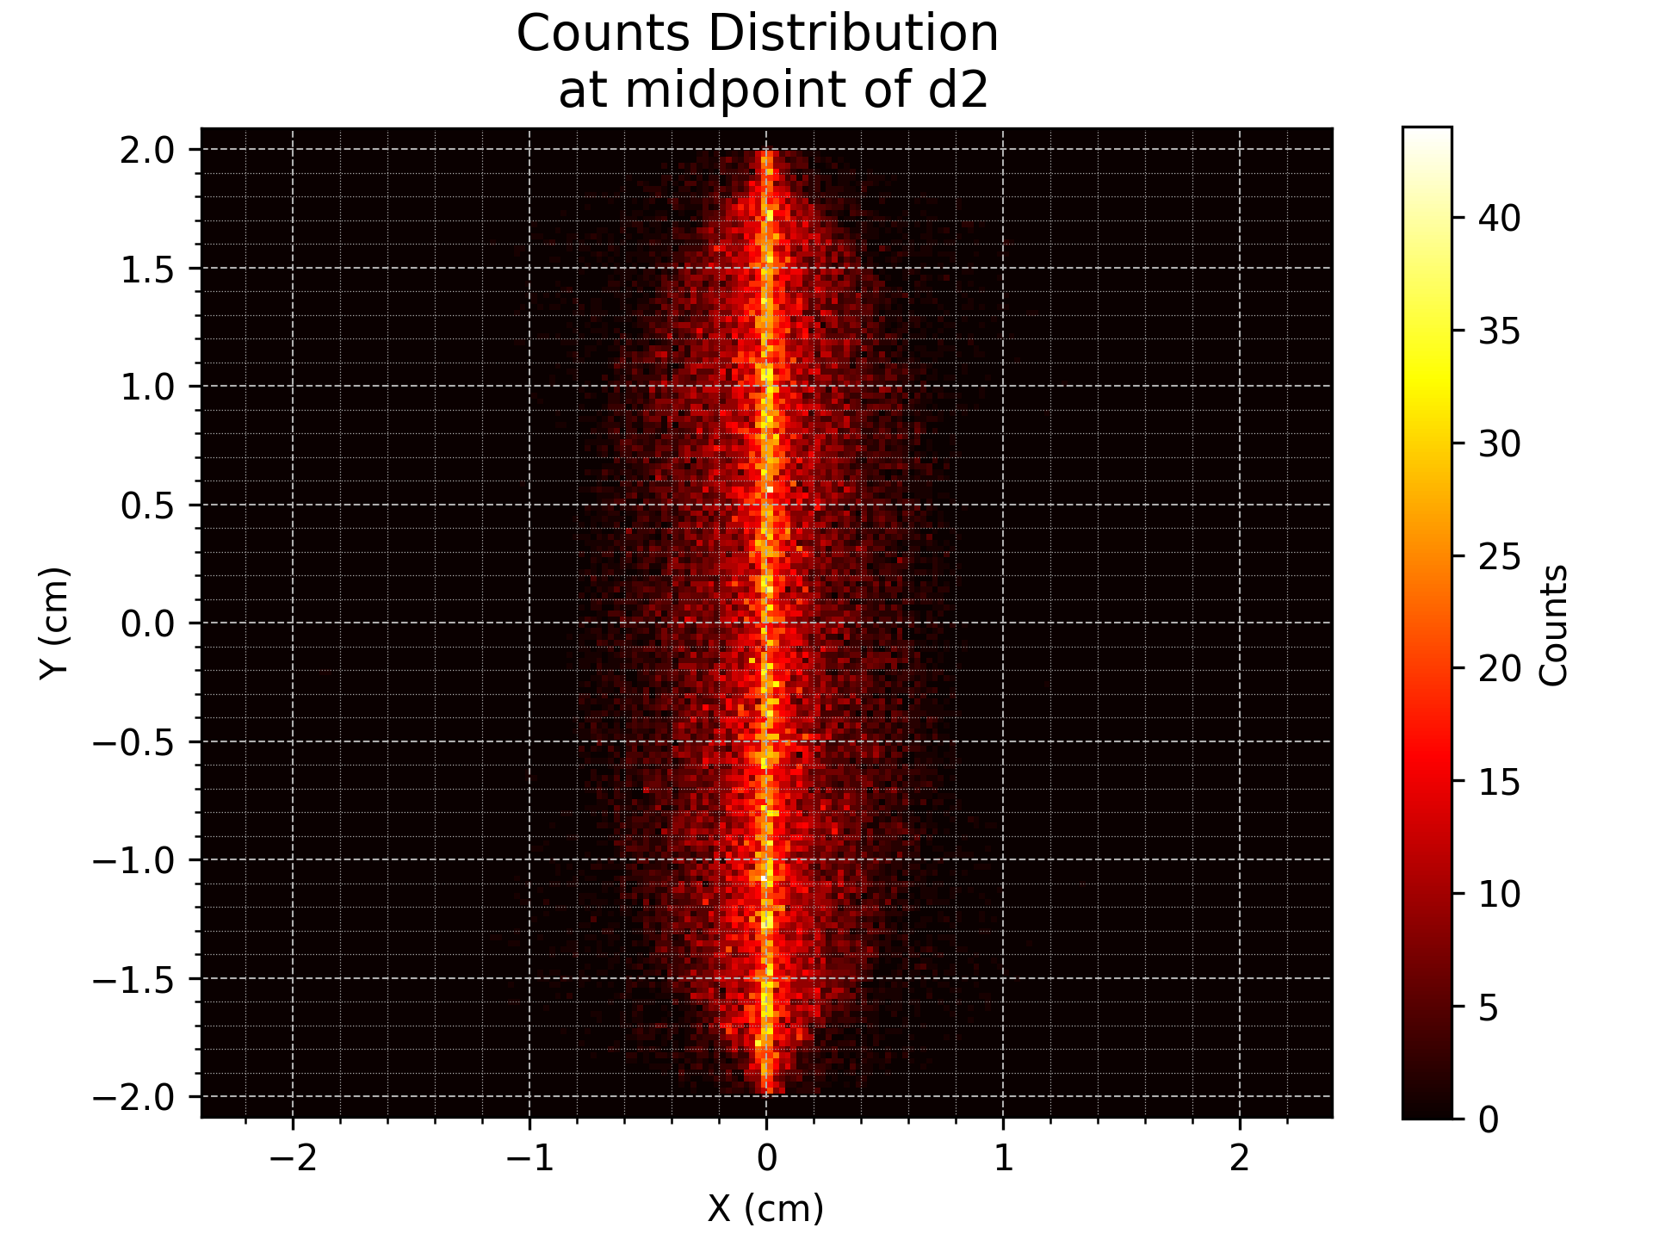
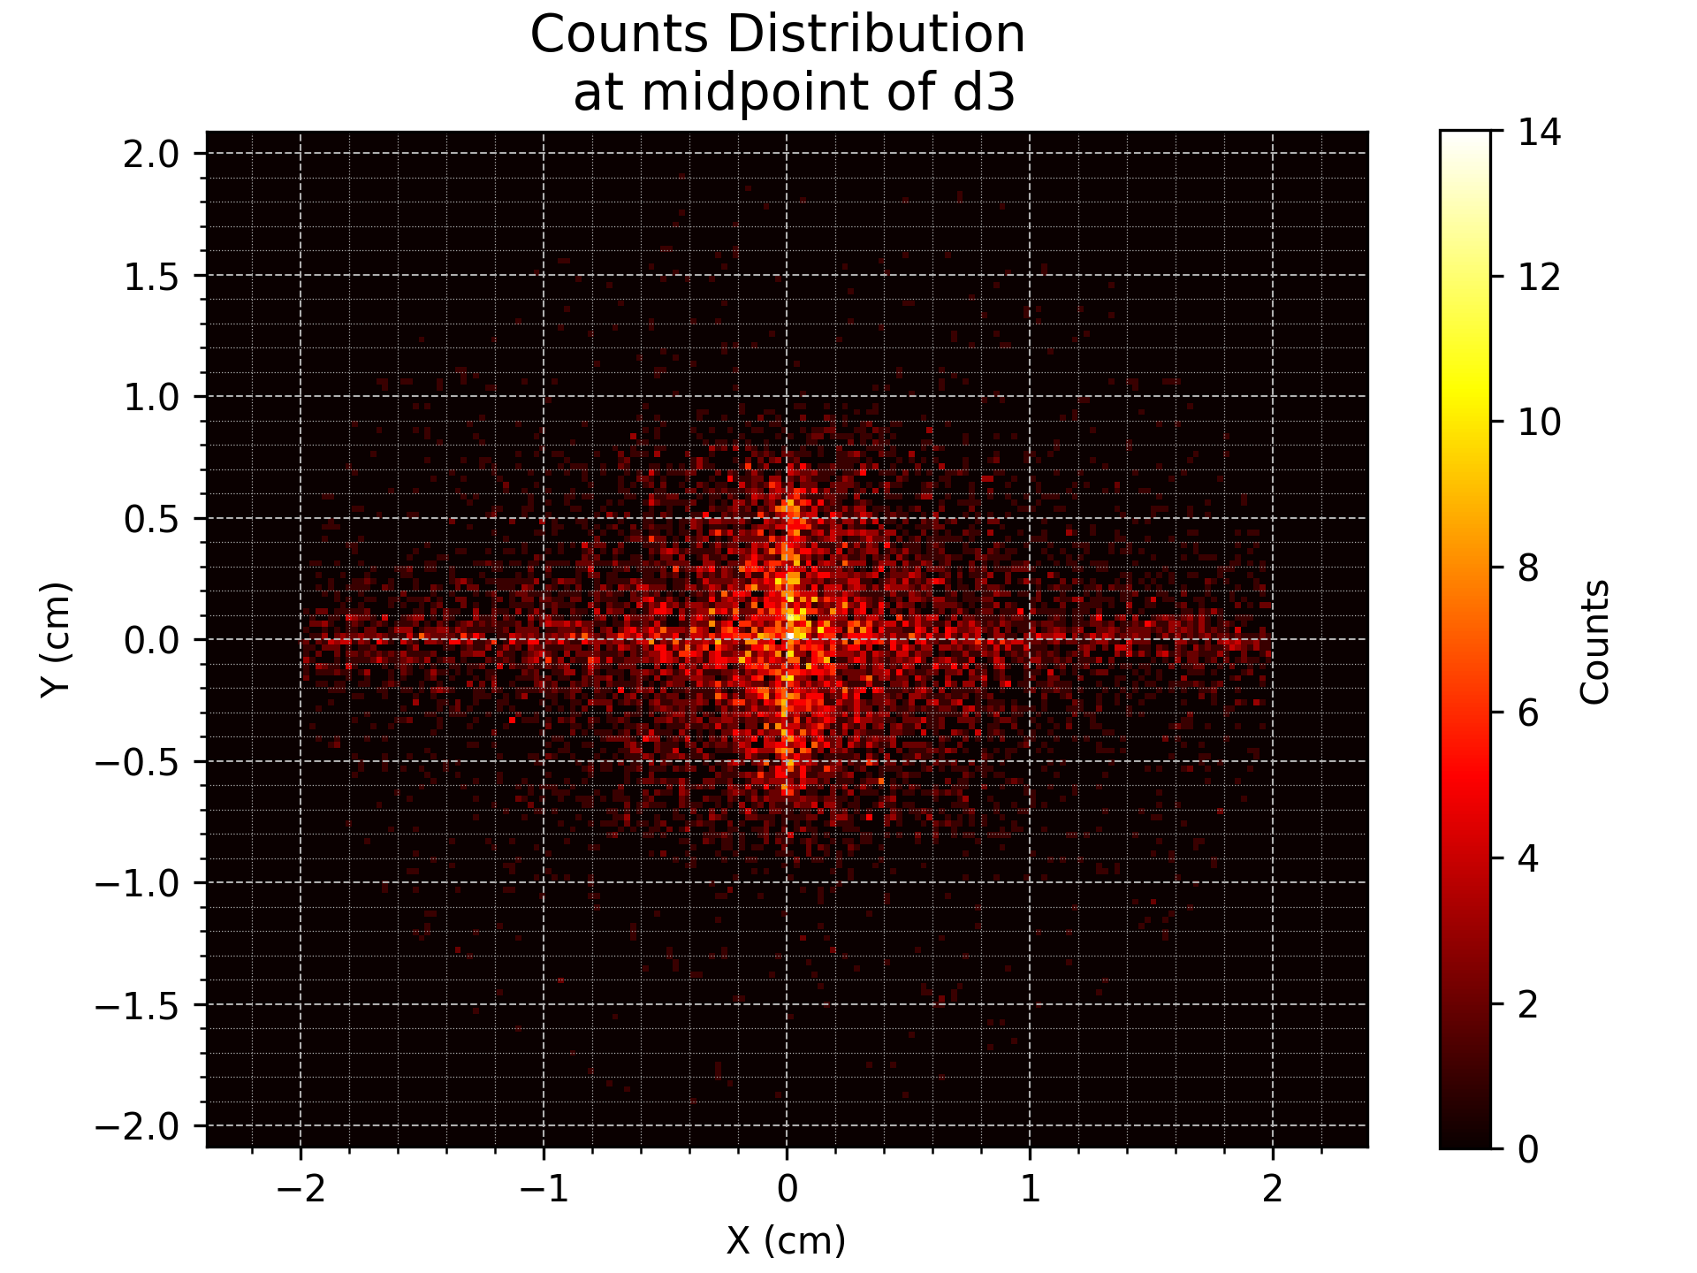

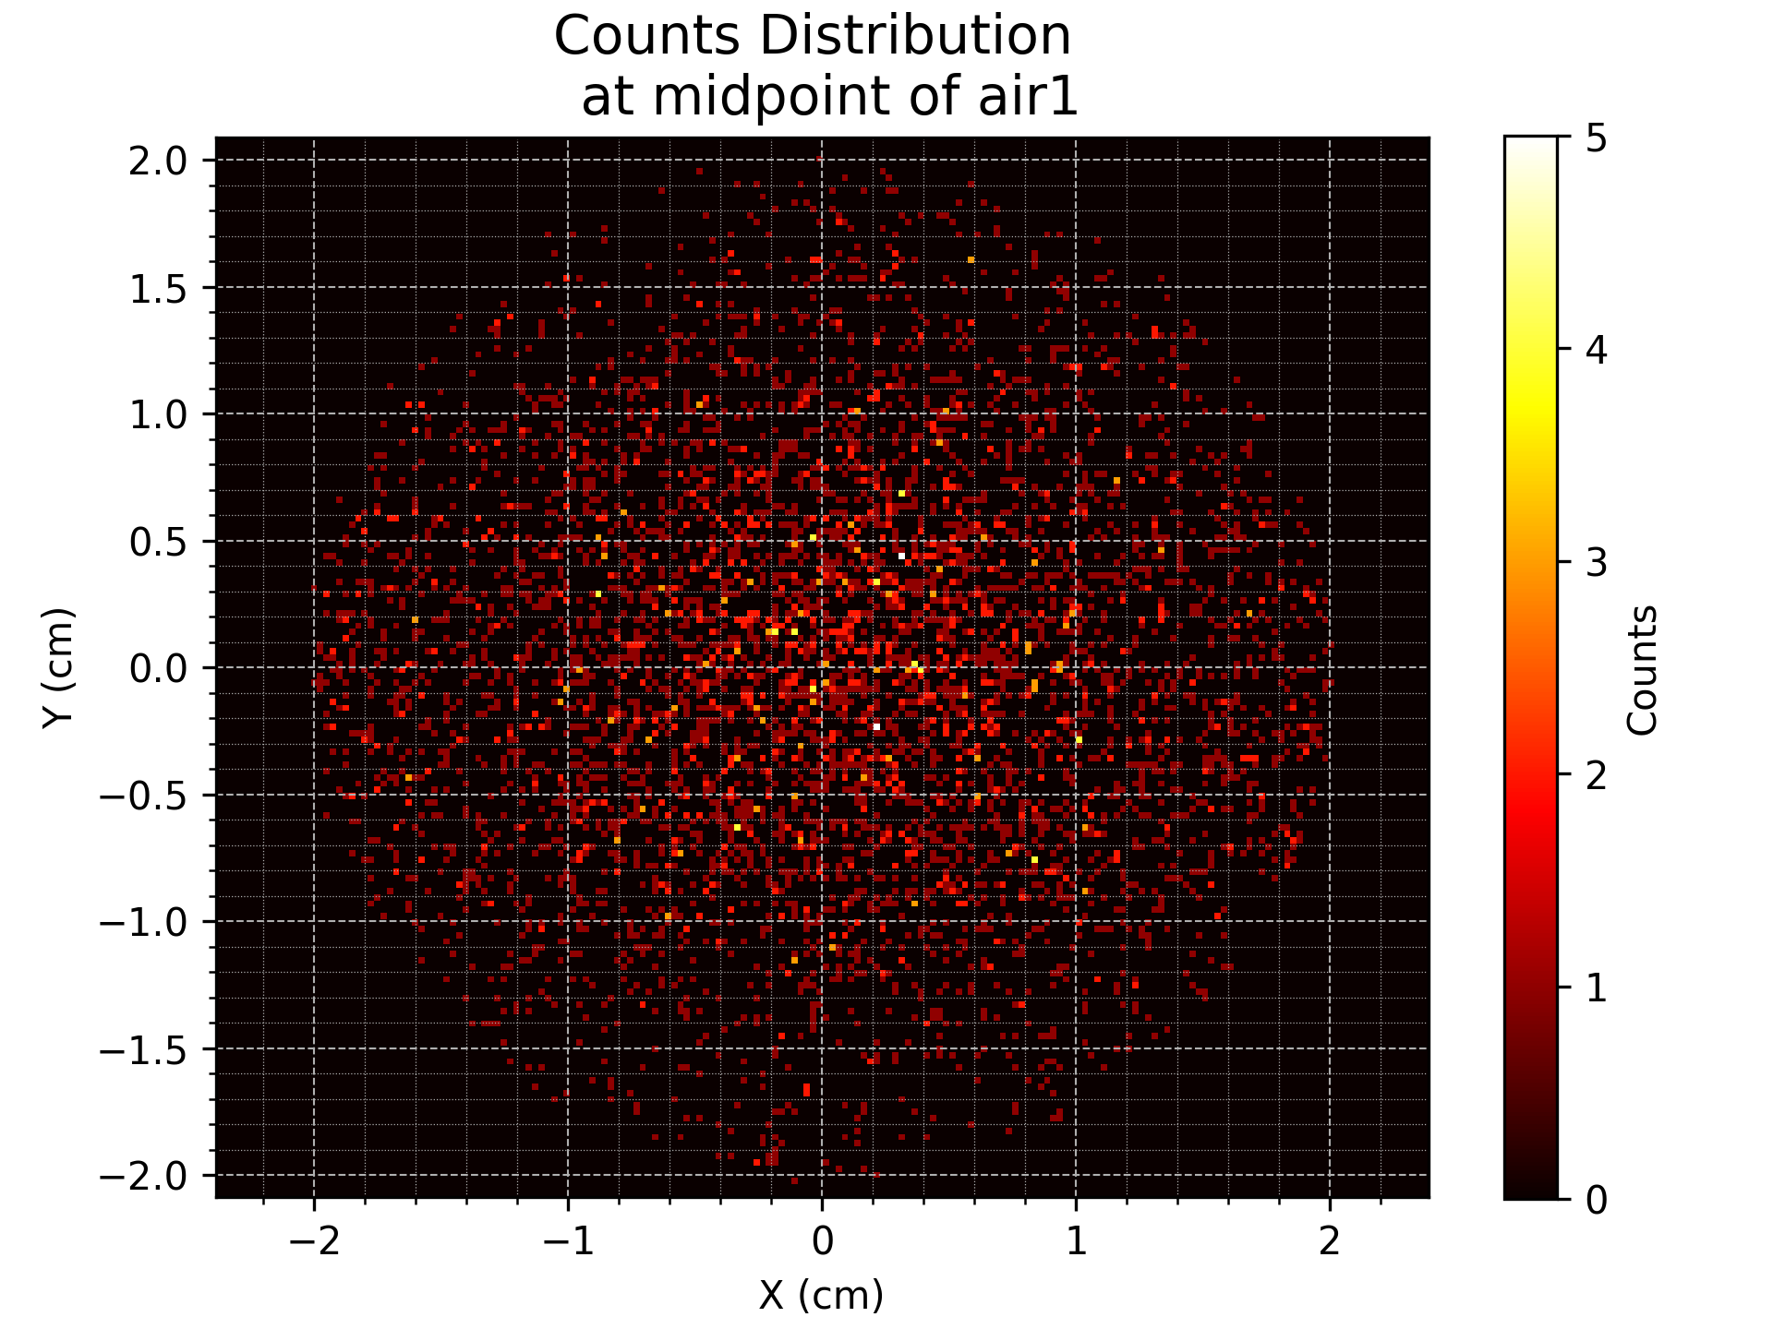
Profiles at Positions

Slide 5
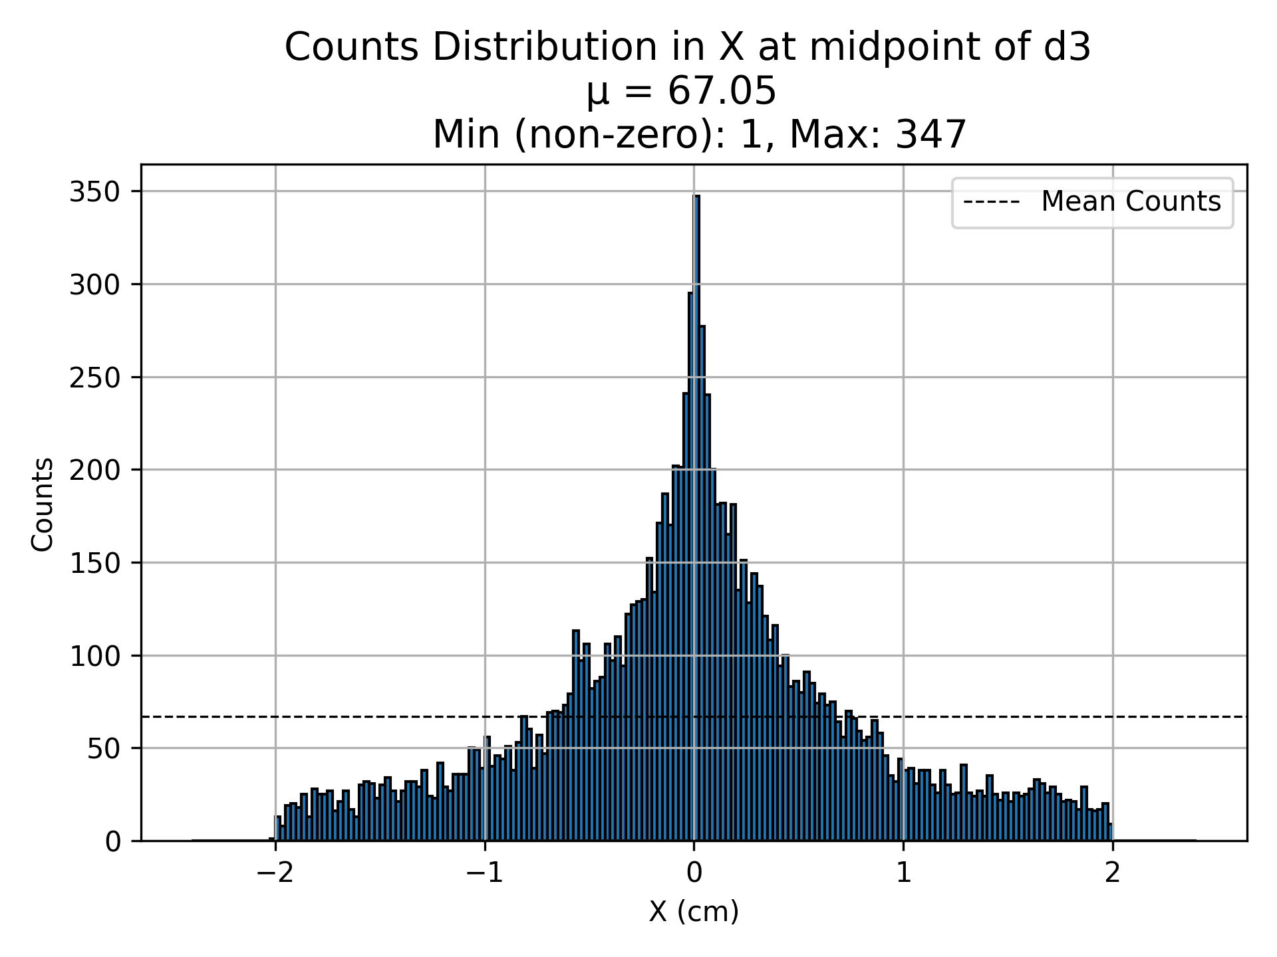
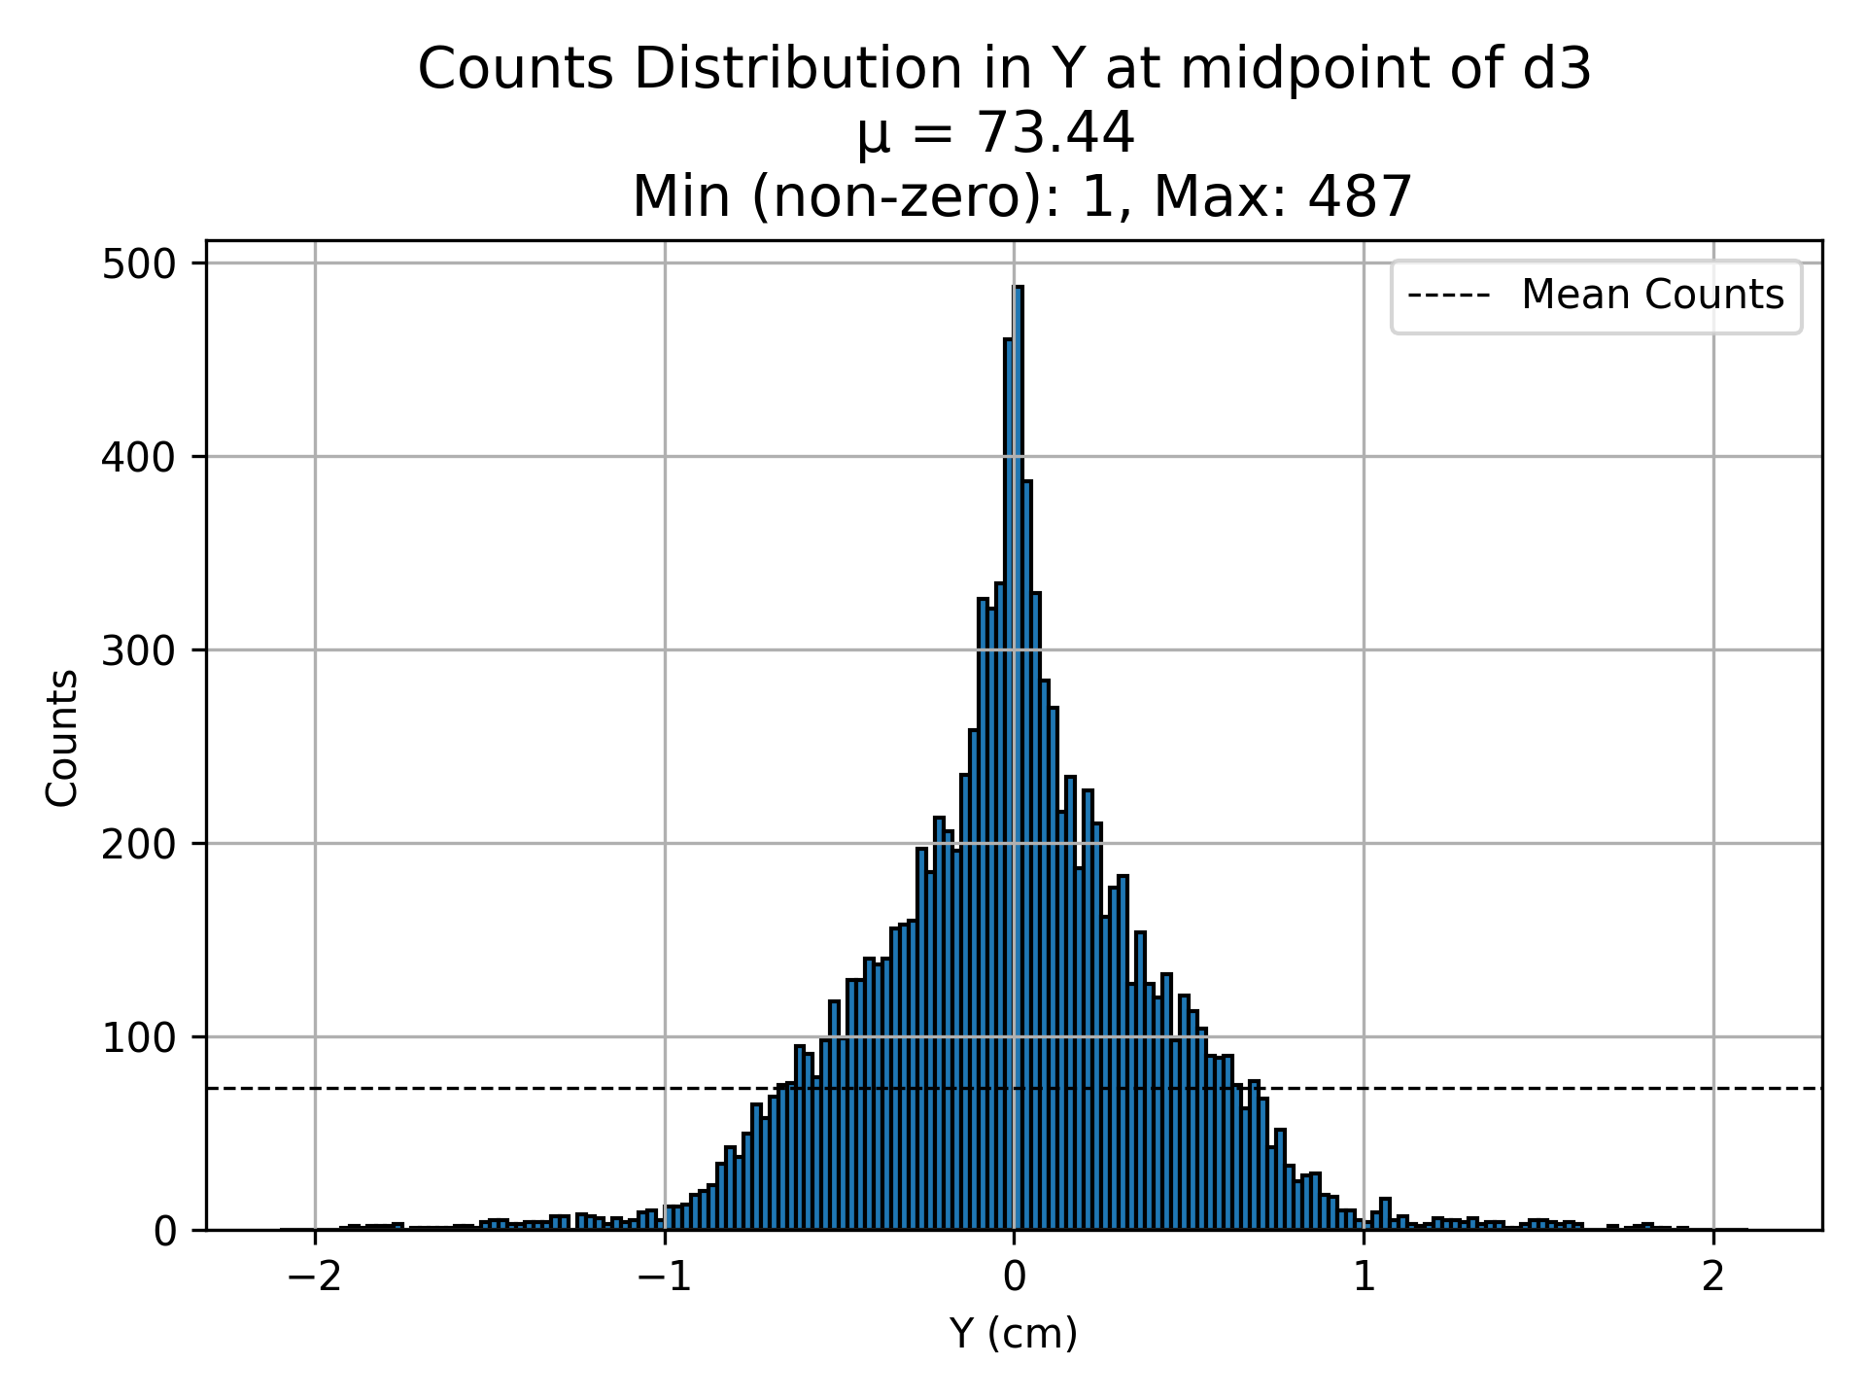
D3 (Counts)

Slide 6
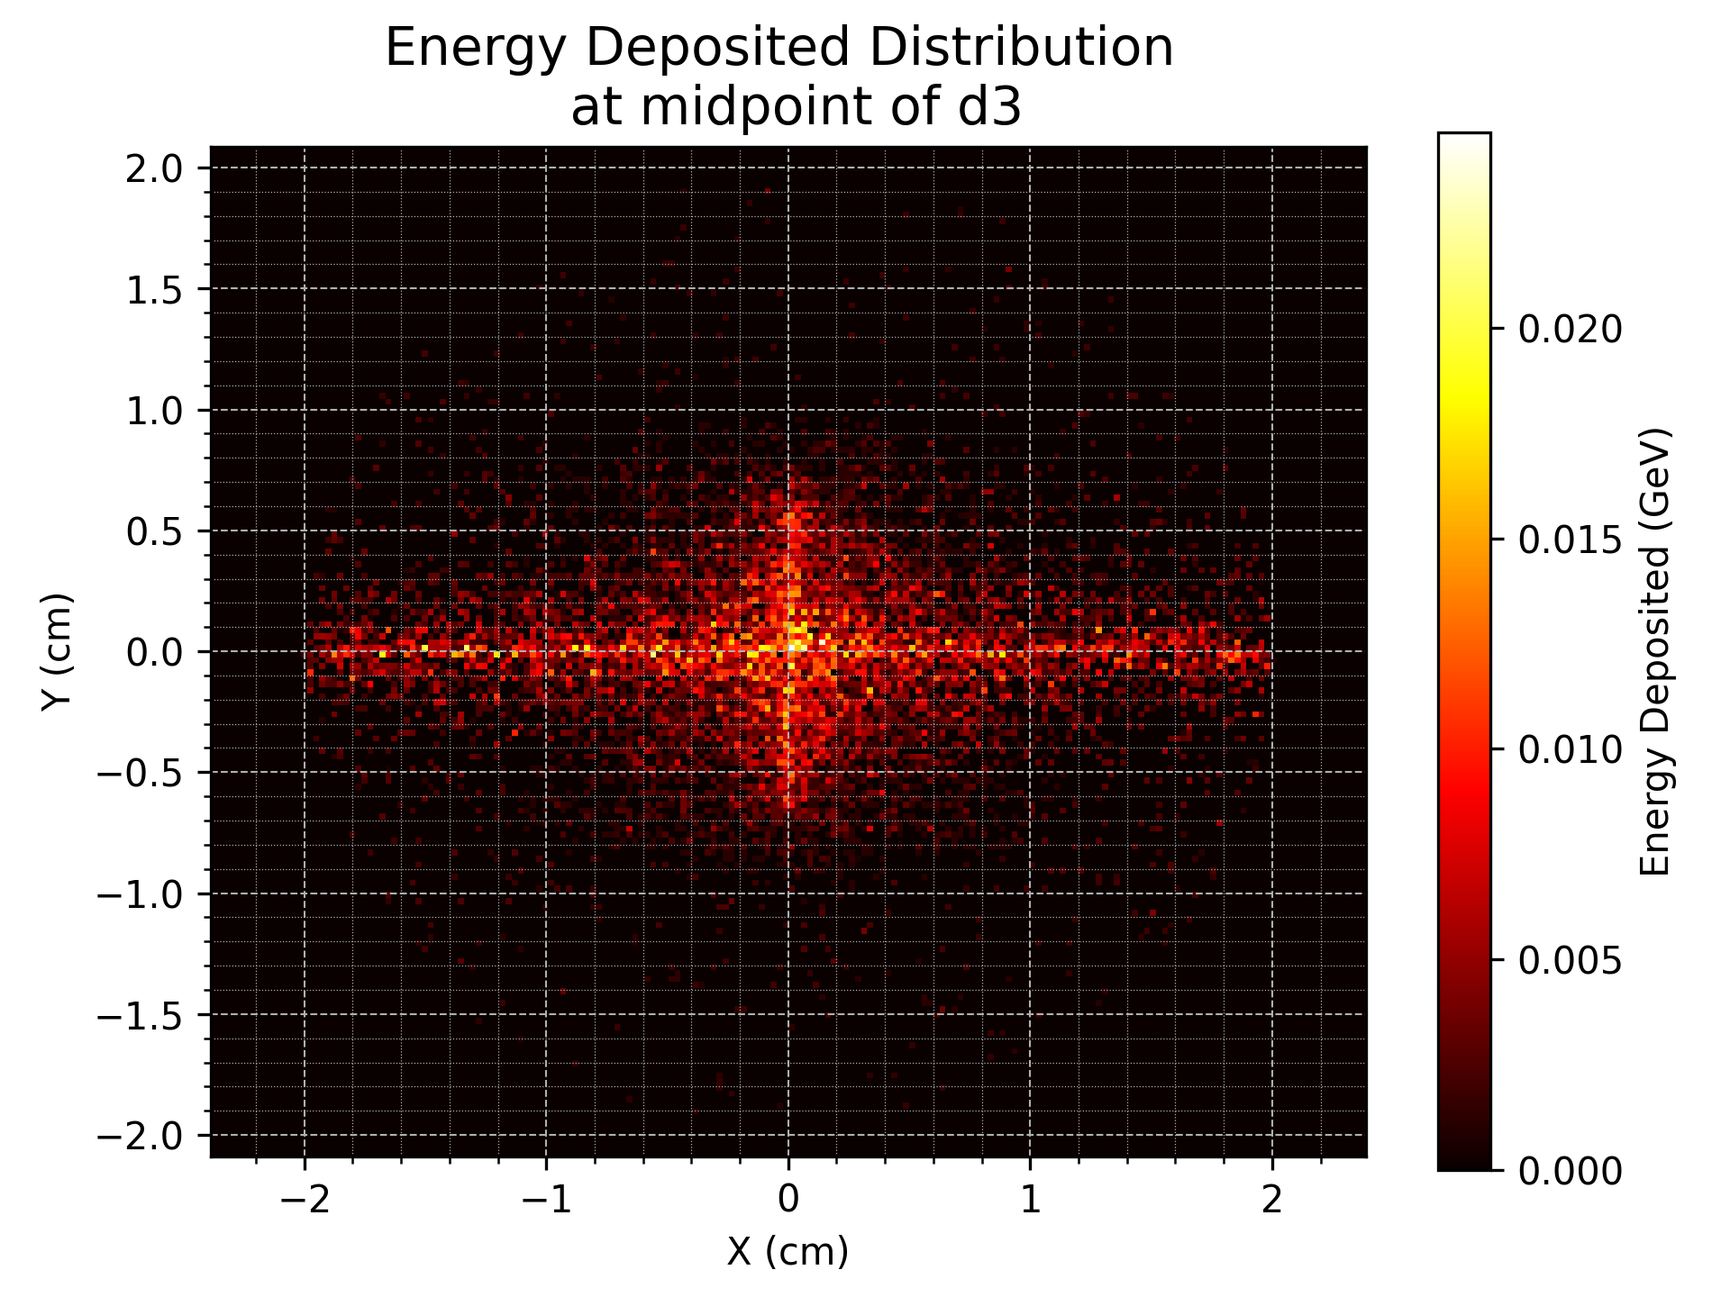

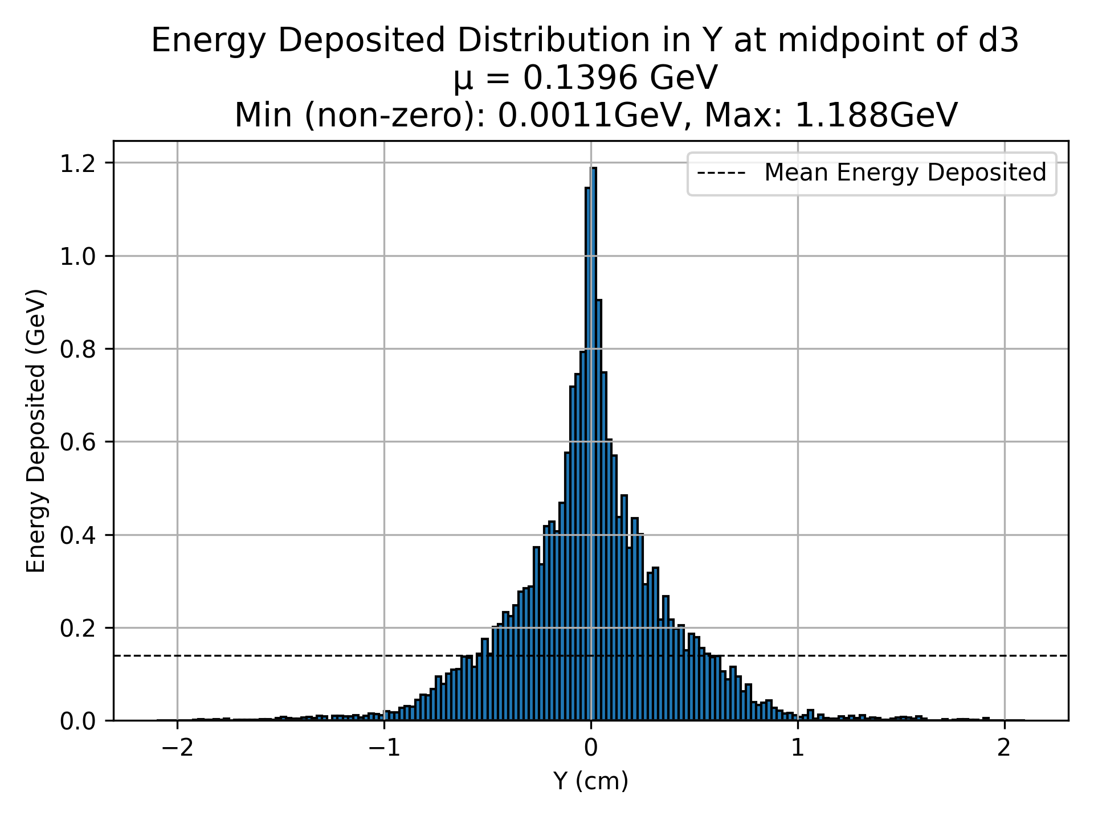
D3 (Energy Deposited)

Slide 7
Estimating Real Numbers
Position | Average Counts | Average Energy Deposited (GeV) | Scaled Energy
d1 | 1800 | 3.4 | 5mJ
d2 | 360 | 0.7 | 1mJ
d3 | 70 | 0.13 | 0.2mJ
d4 | 50 | 0.08 | 0.1mJ
air1 | 30 | 0.05 | 0.08mJ
Assuming the beam arrives over the course of 1ns then the power per fibre at d3 would be 200W
Seems high?

Slide 8
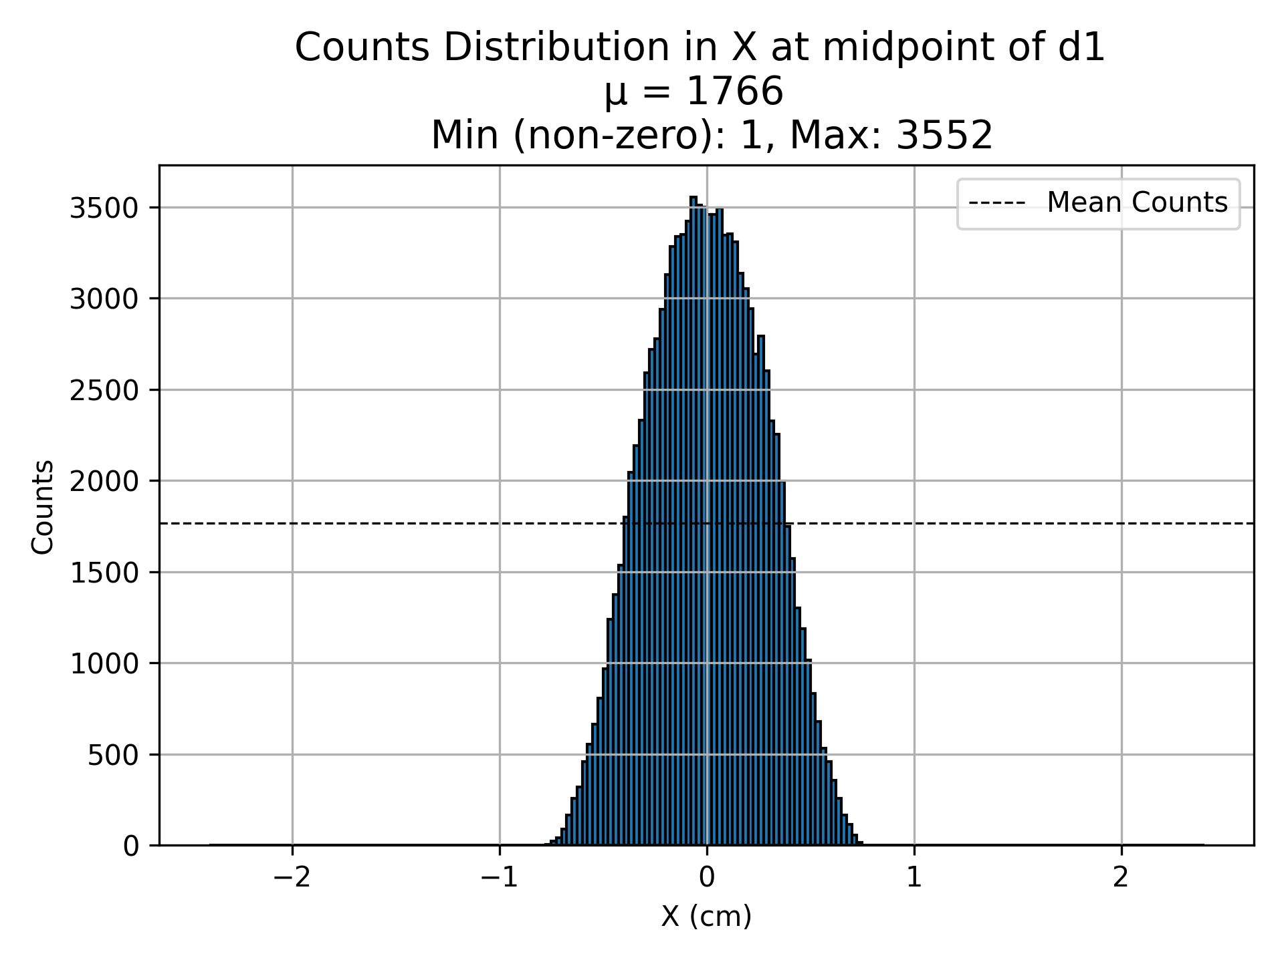

D1 (Counts)

Slide 9
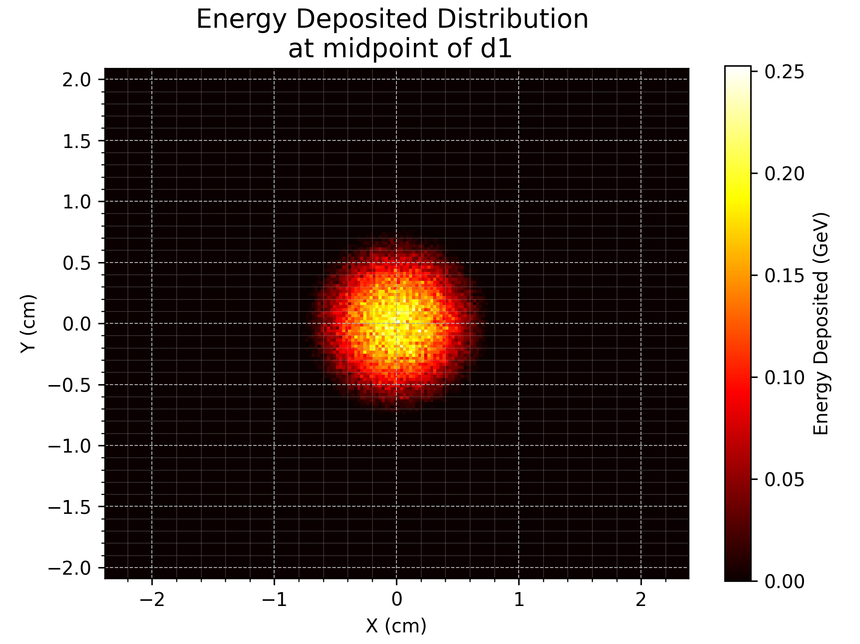
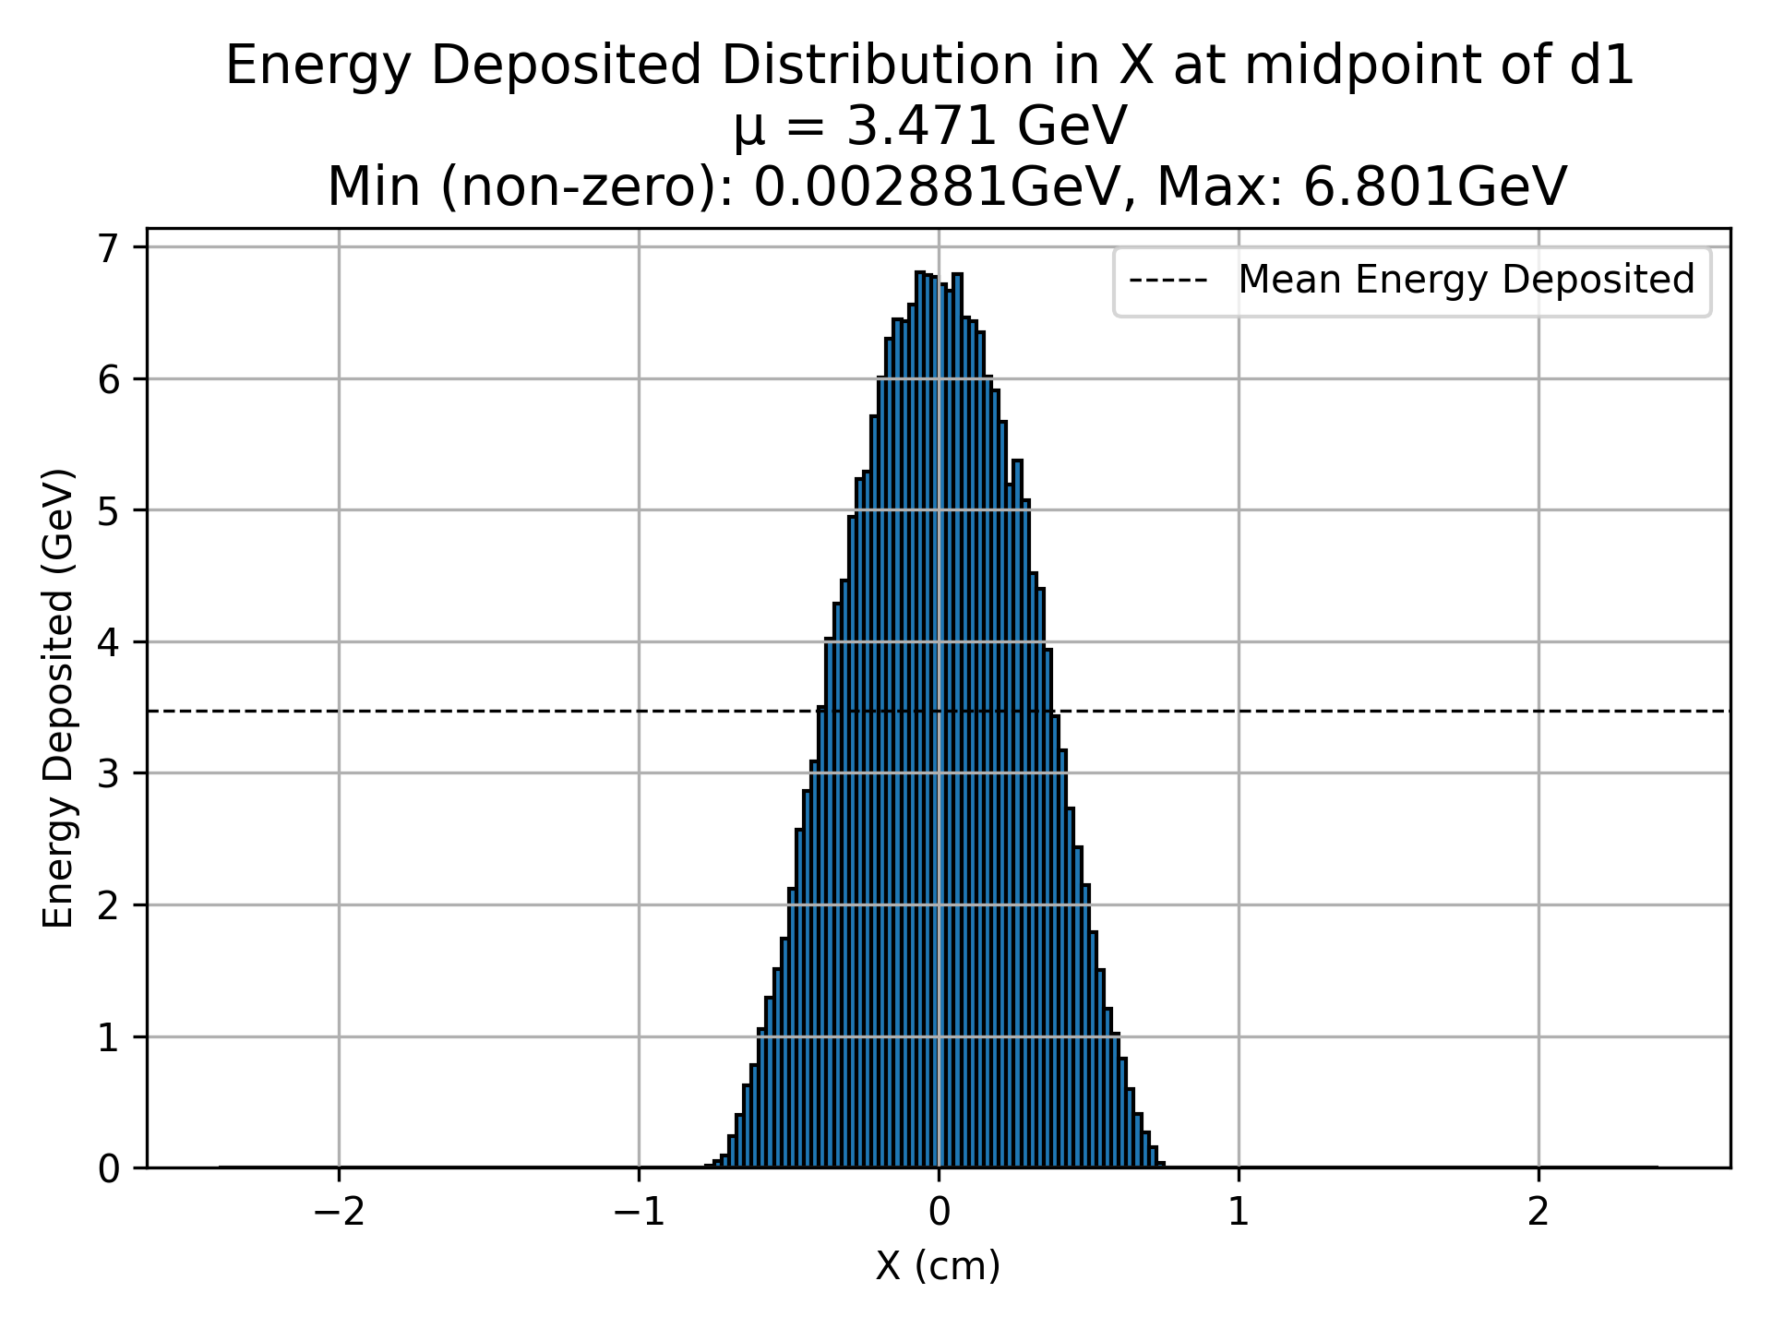
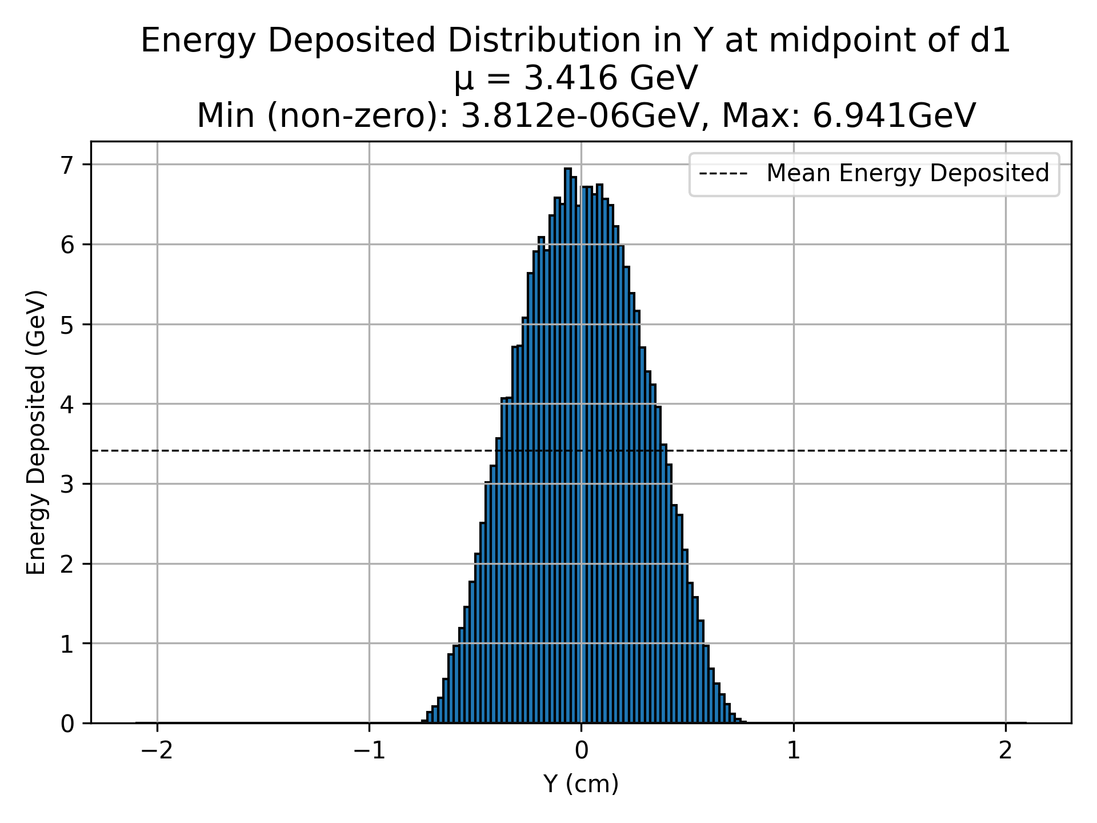
D1 (Energy Deposited)

Slide 10
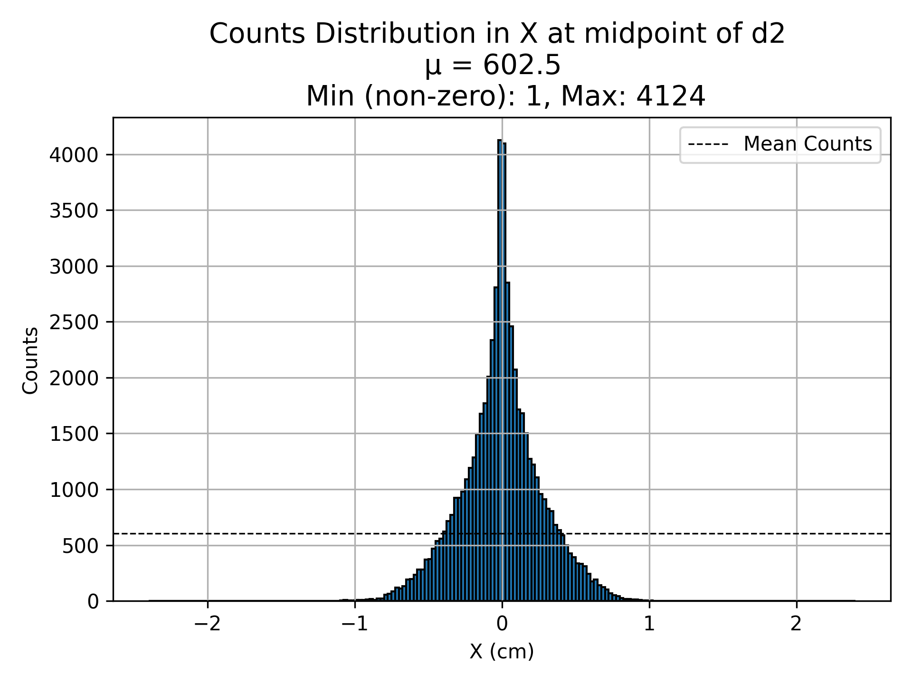
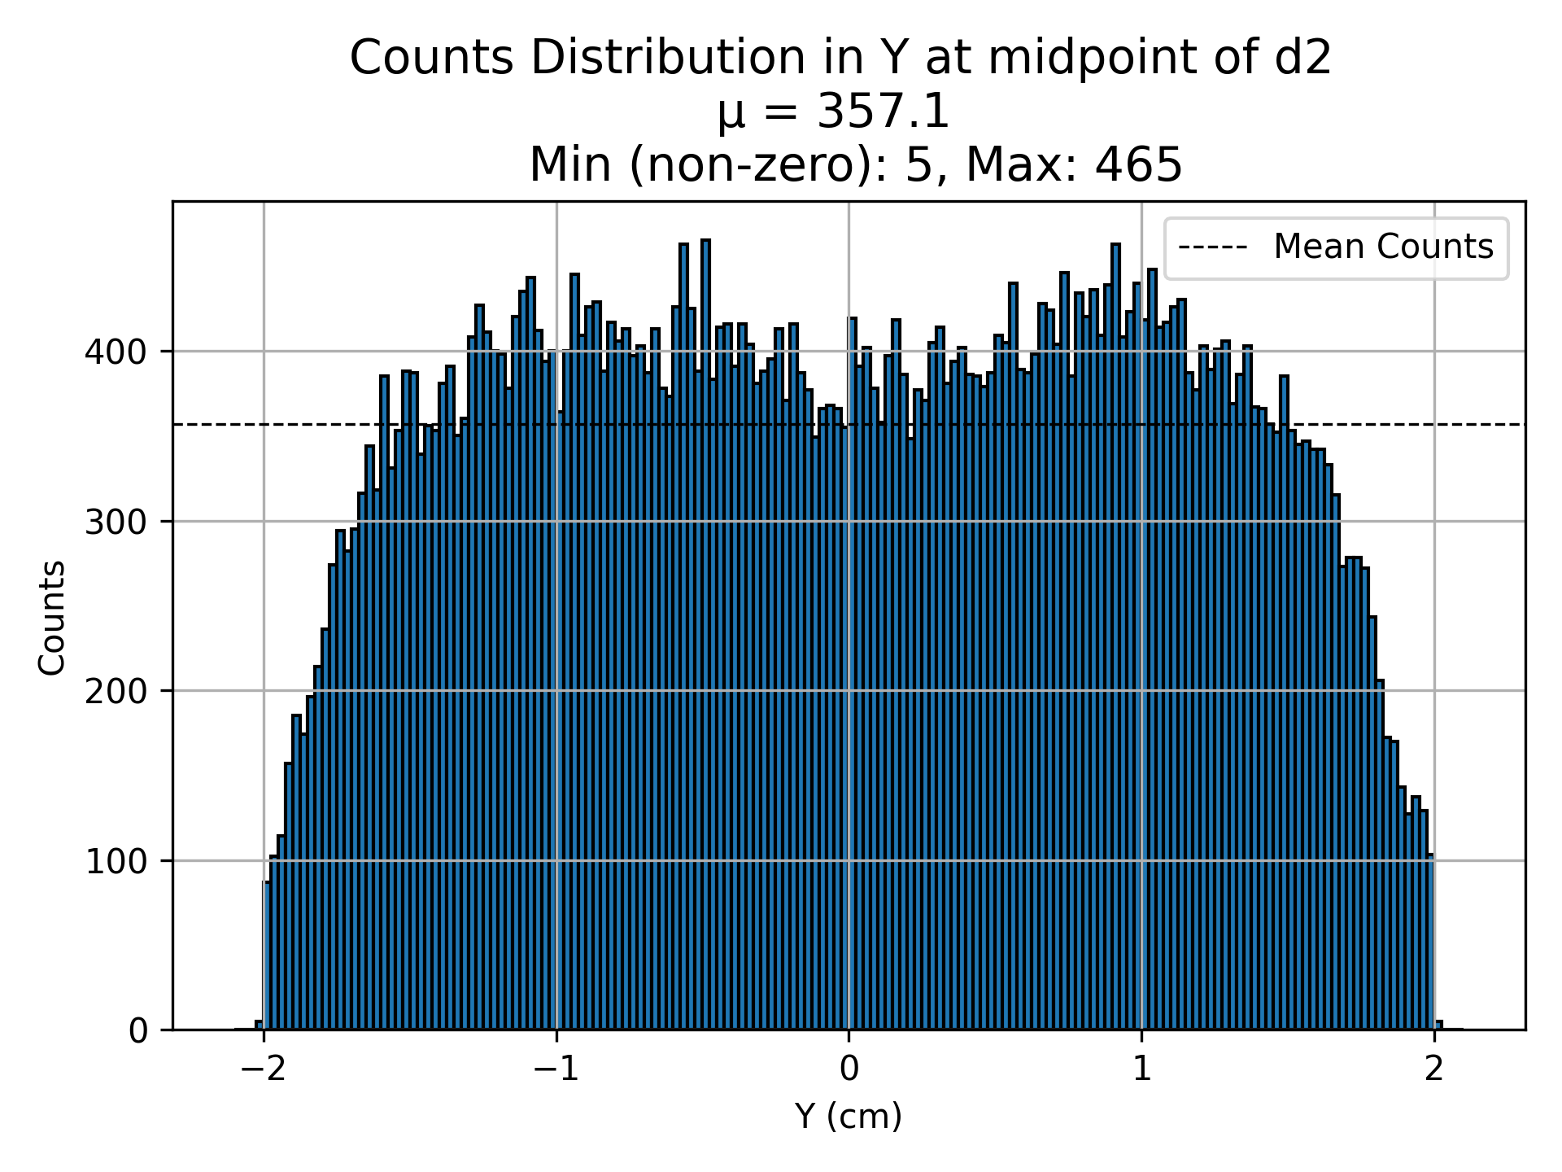
D2 (Counts)

Slide 11
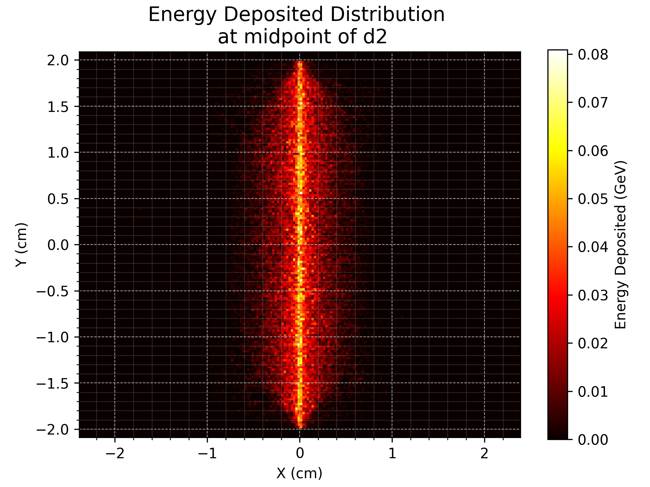
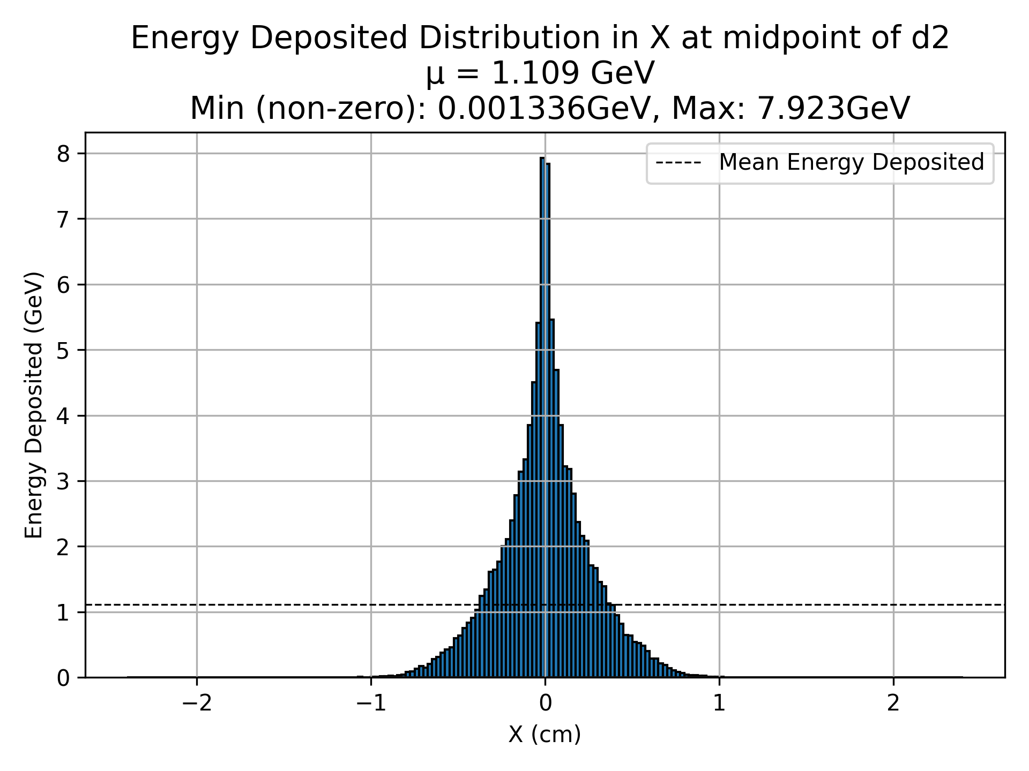
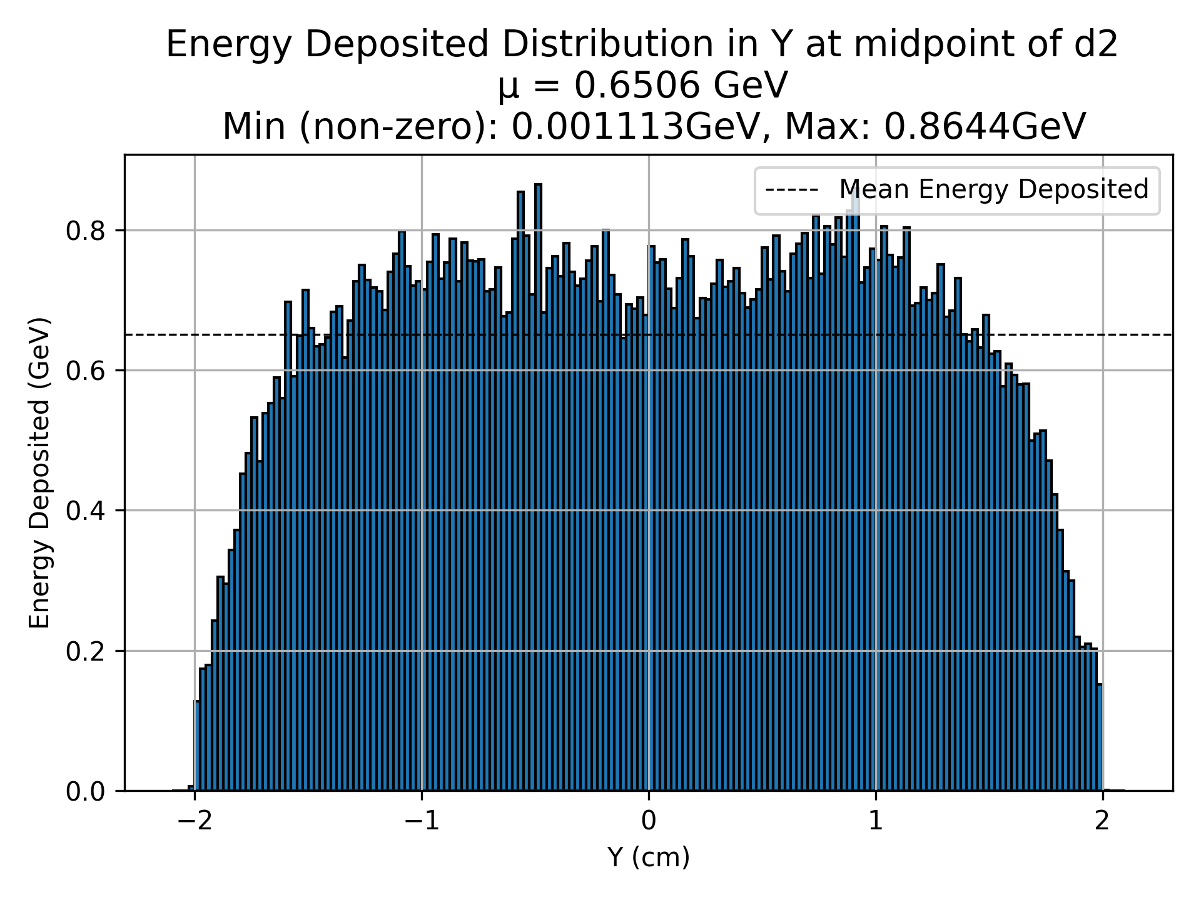
D2 (Energy Deposited)

Slide 12
D3 (Counts)

Slide 13
D3 (Energy Deposited)

Slide 14
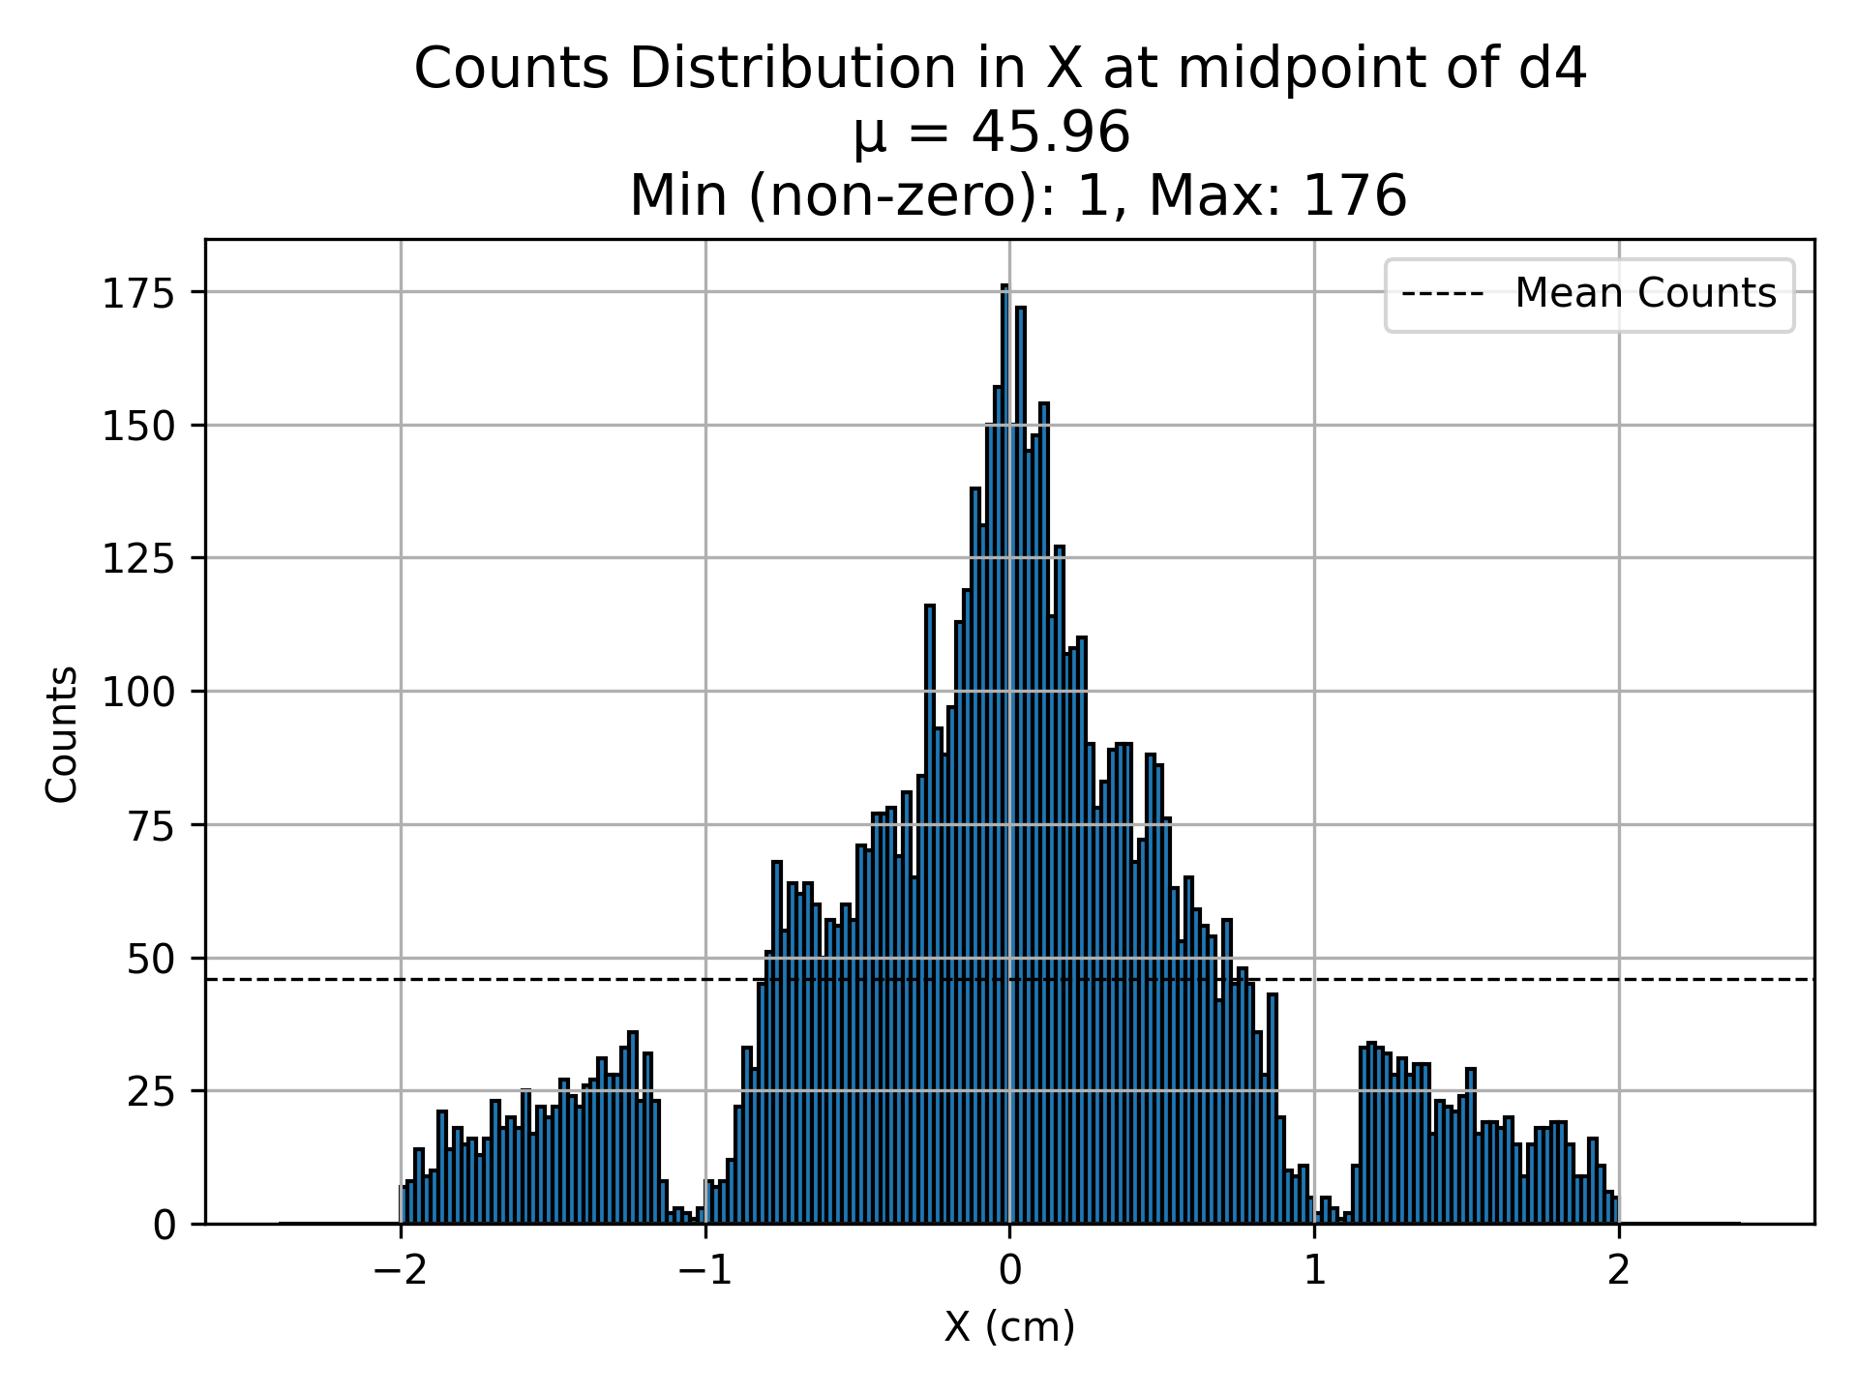
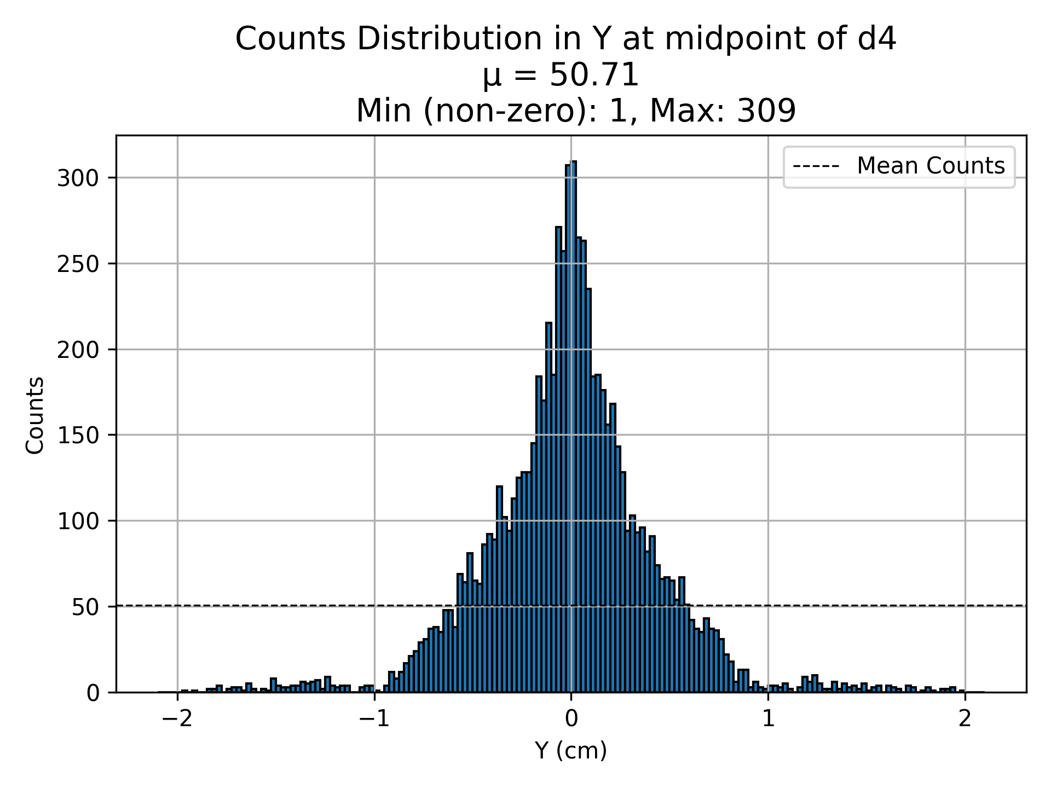
D4 (Counts)
Note: The strange cut-offs are due to the holder of the scatterer, which I have tried to highlight in pink. You can move the pink to see it.
Holder
Cu

Slide 15
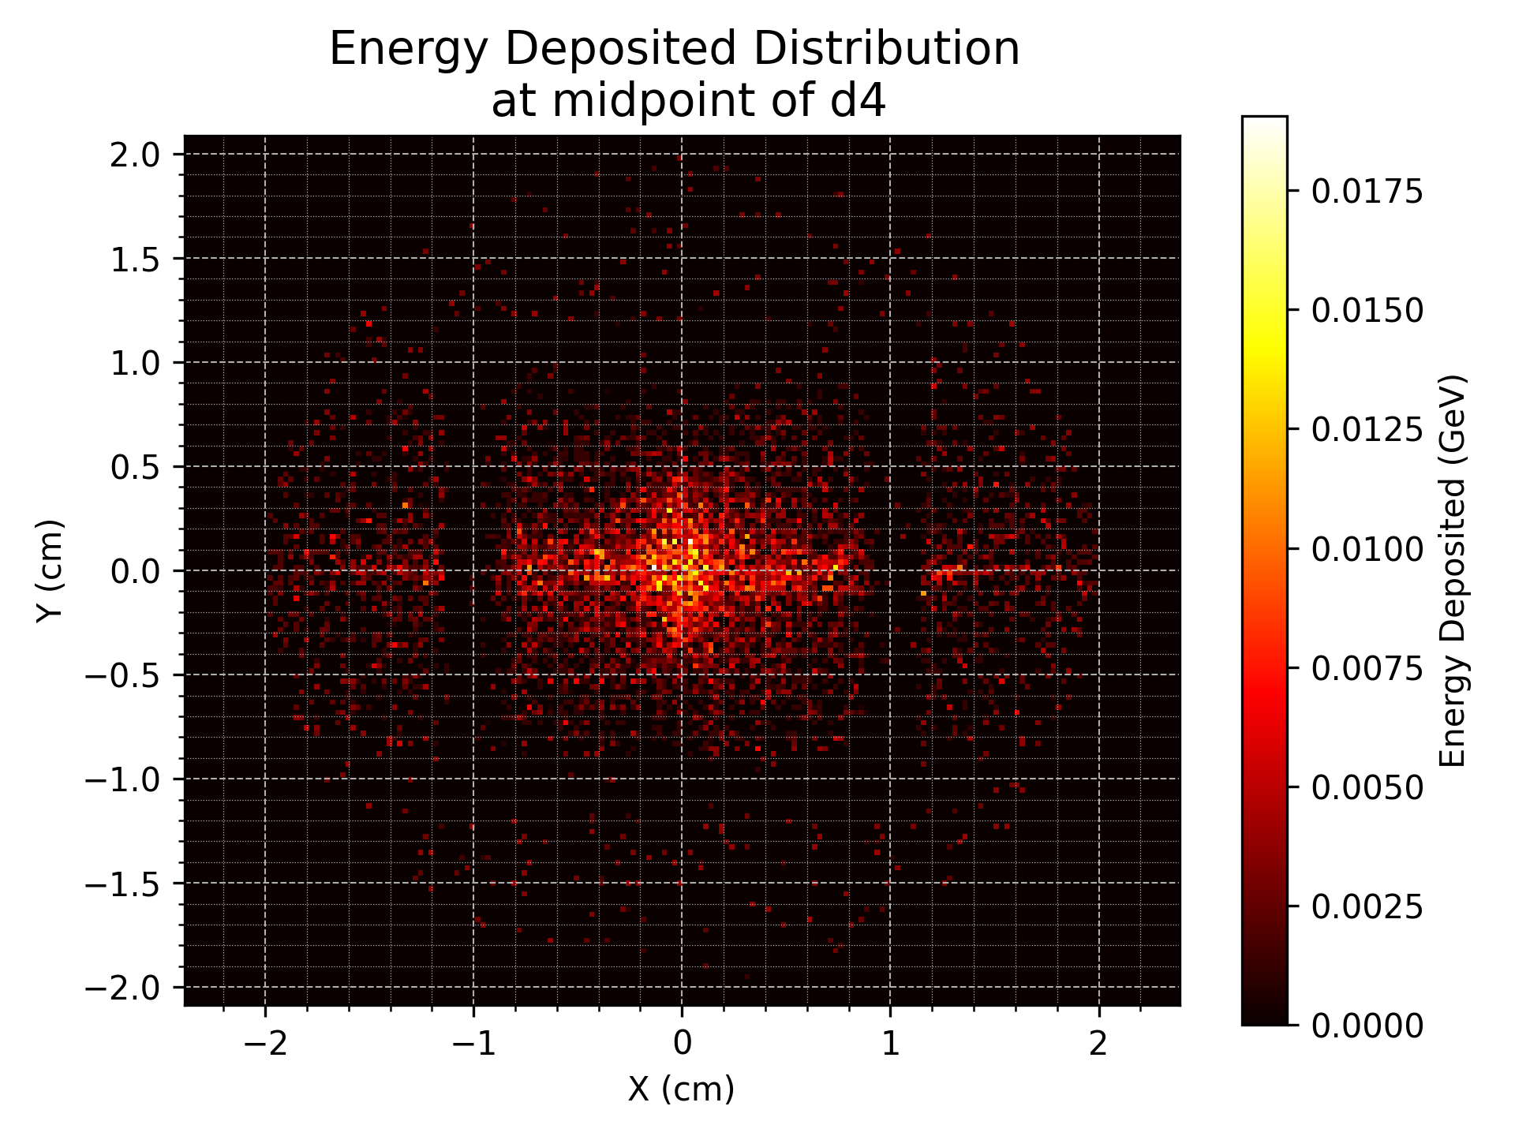
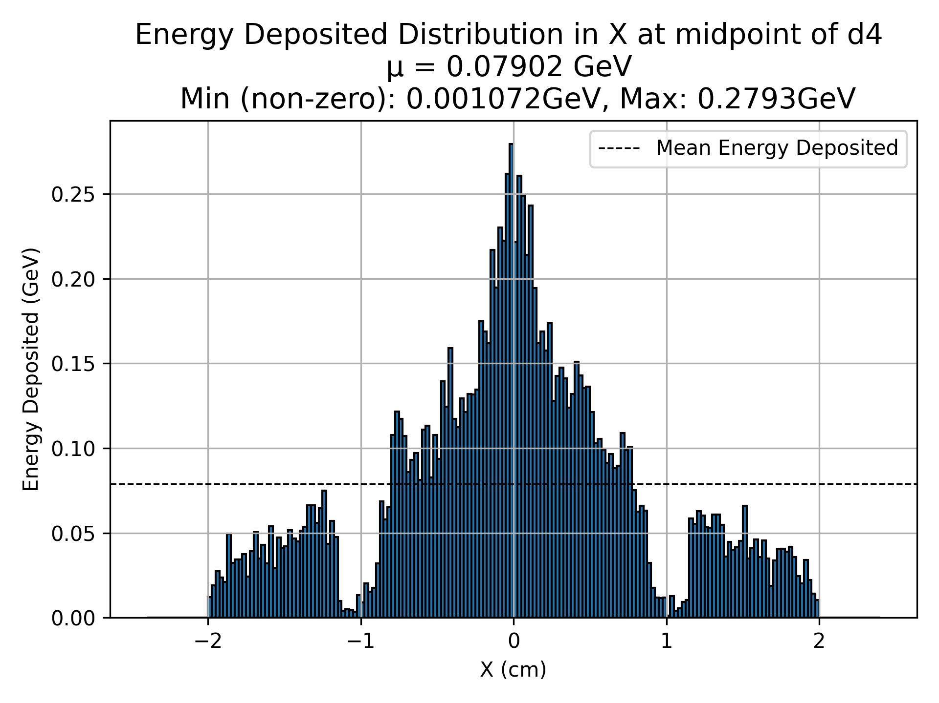
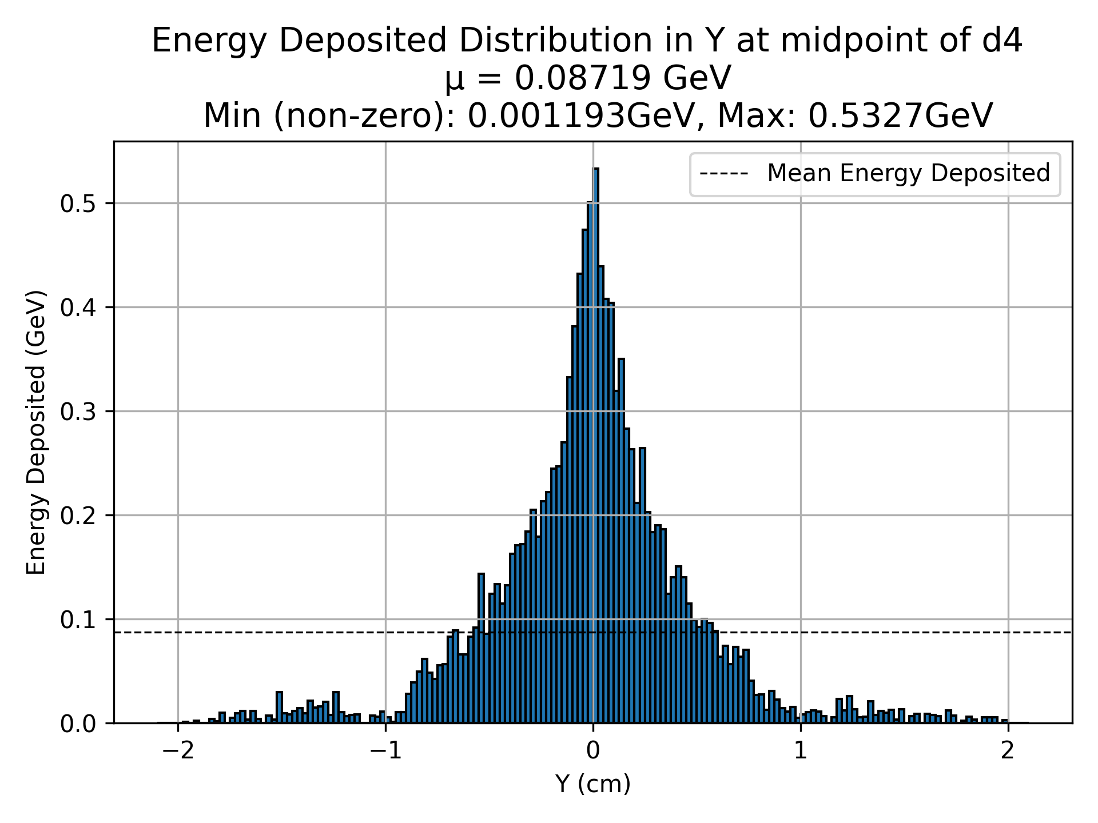
D4 (Energy Deposited)
Holder
Cu

Slide 16
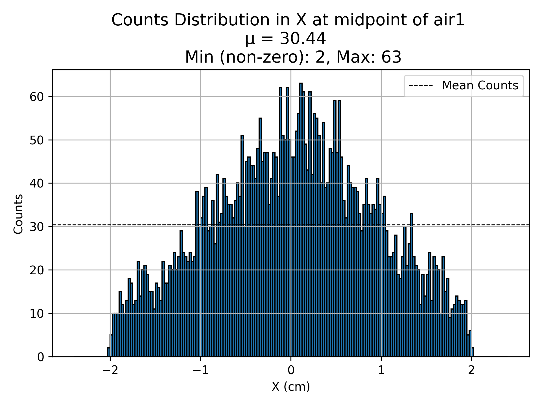
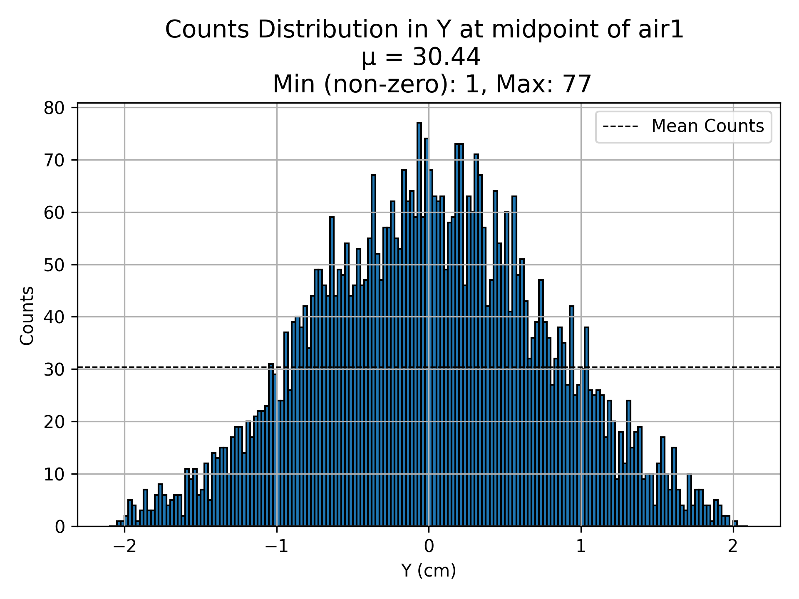
air1 (Counts)

Slide 17
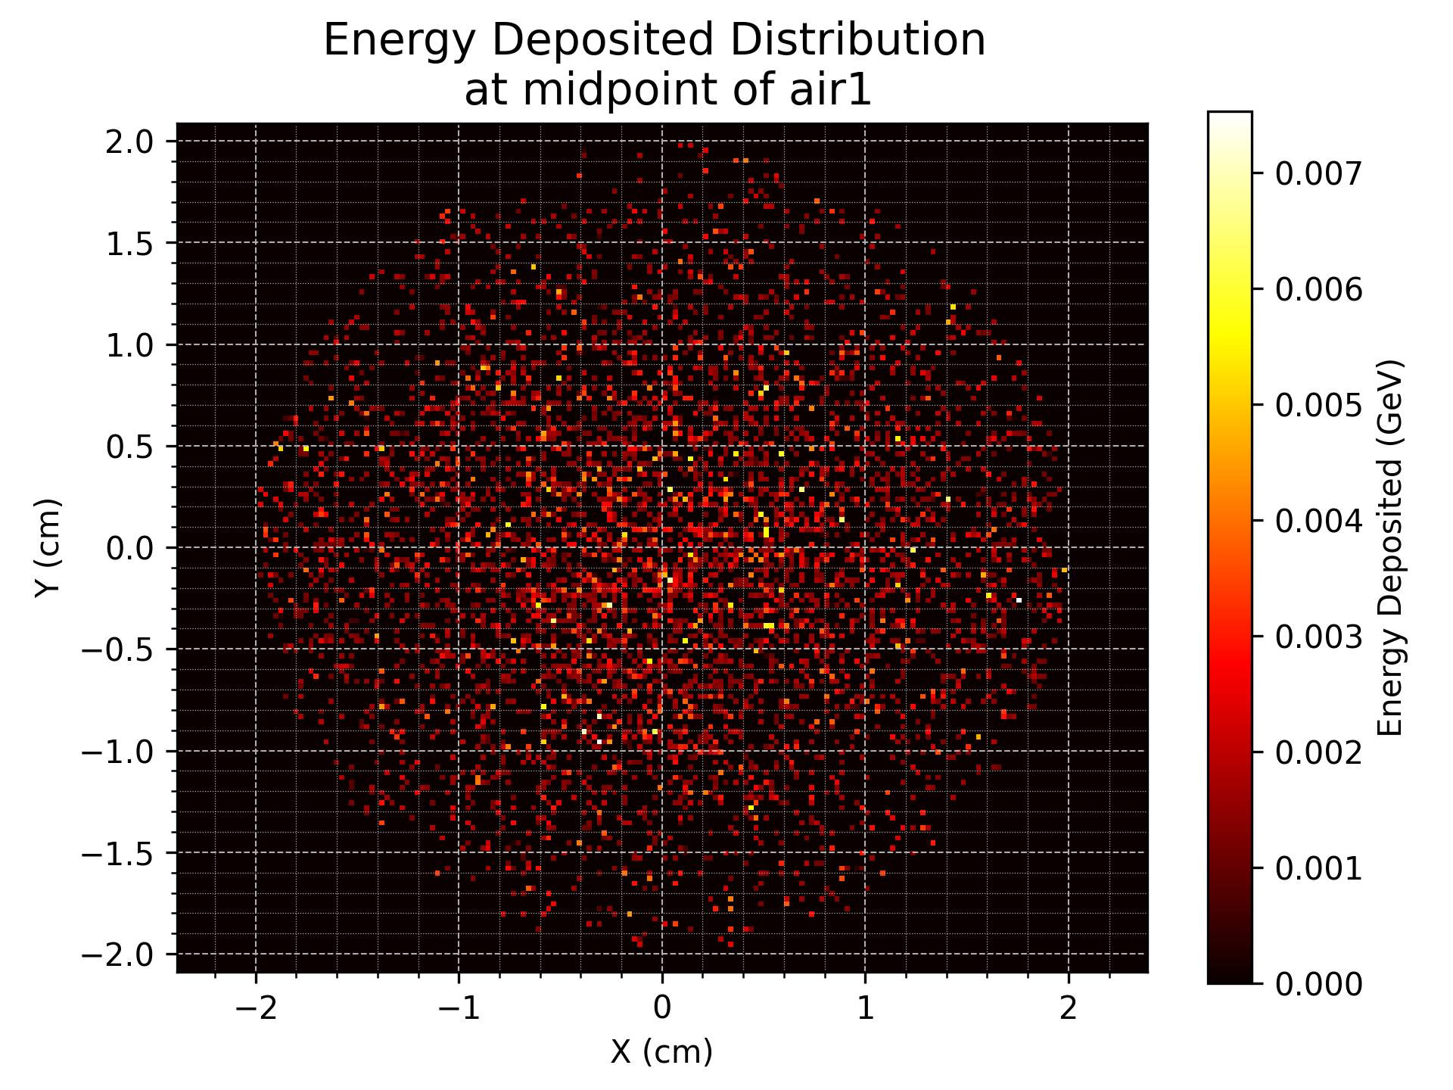
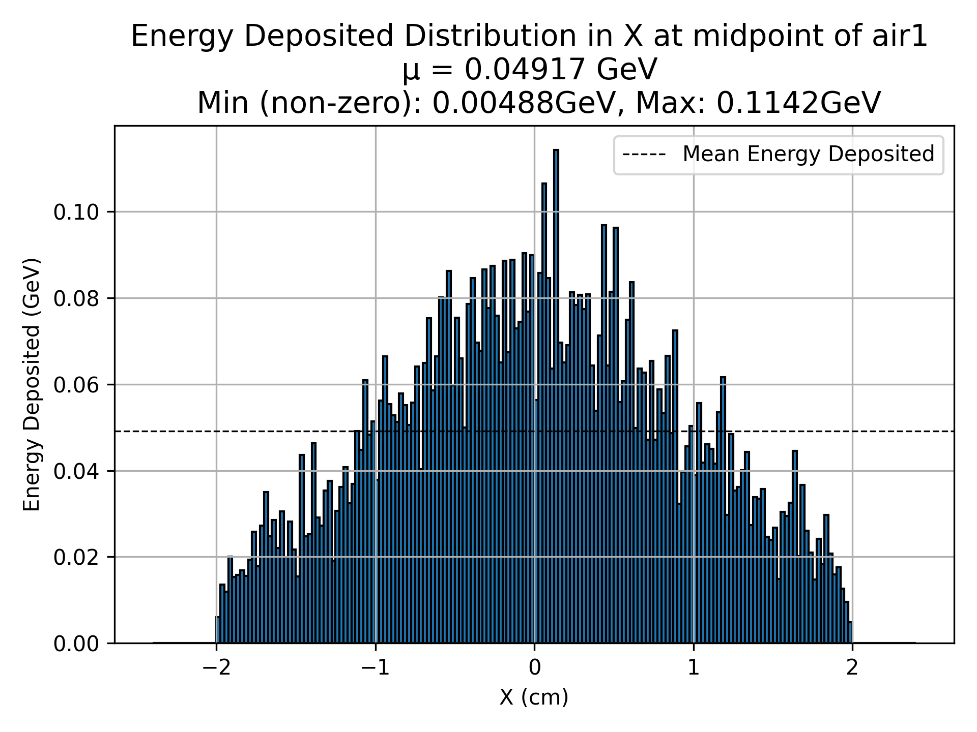

air1 (Energy Deposited)

