Slide 1
Dose and LET vs Energy

Slide 2
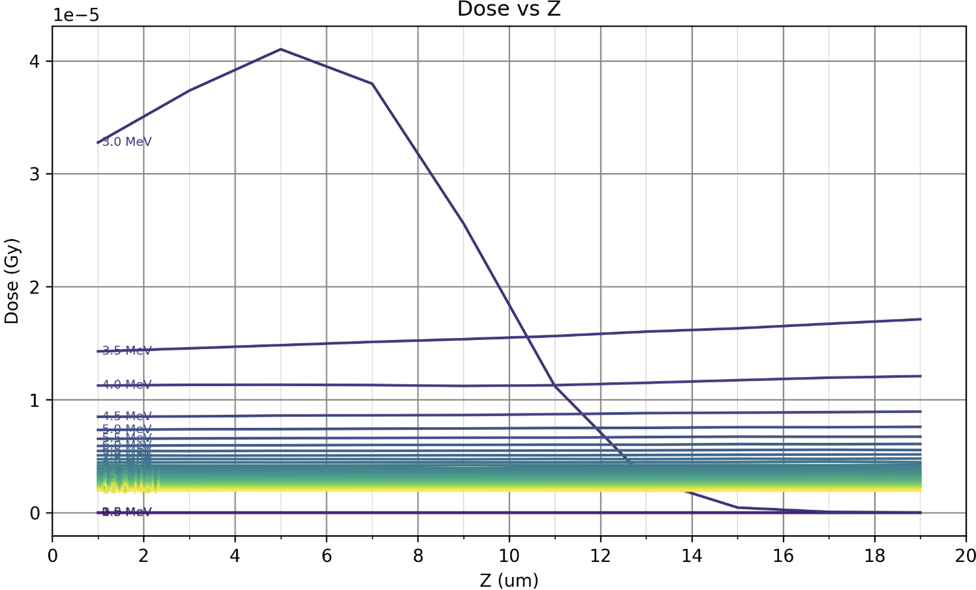
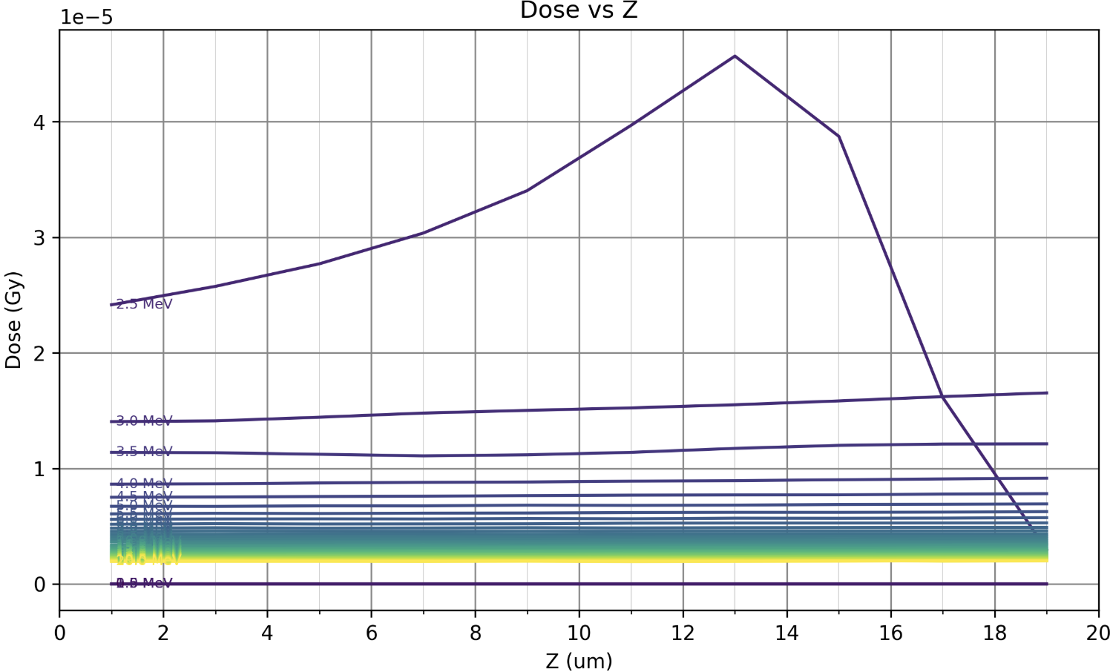
Dose Across the cell media (20um deep)
Full Beamline:
(Cu10um, Mylar window, Air, Mylar cover, Media (Cells))
No scatterer:
(Mylar window, Air, Mylar cover, Media (Cells))

Slide 3
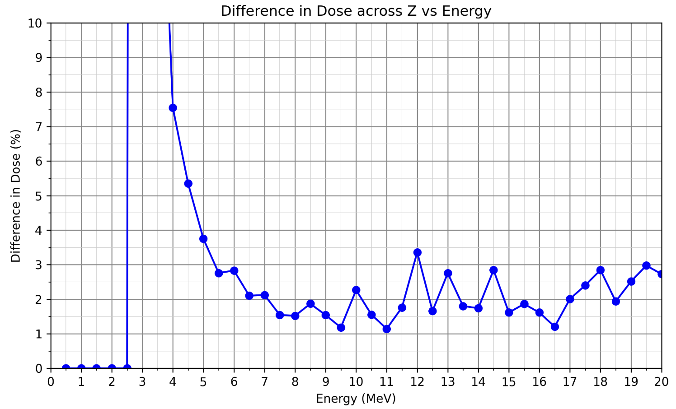
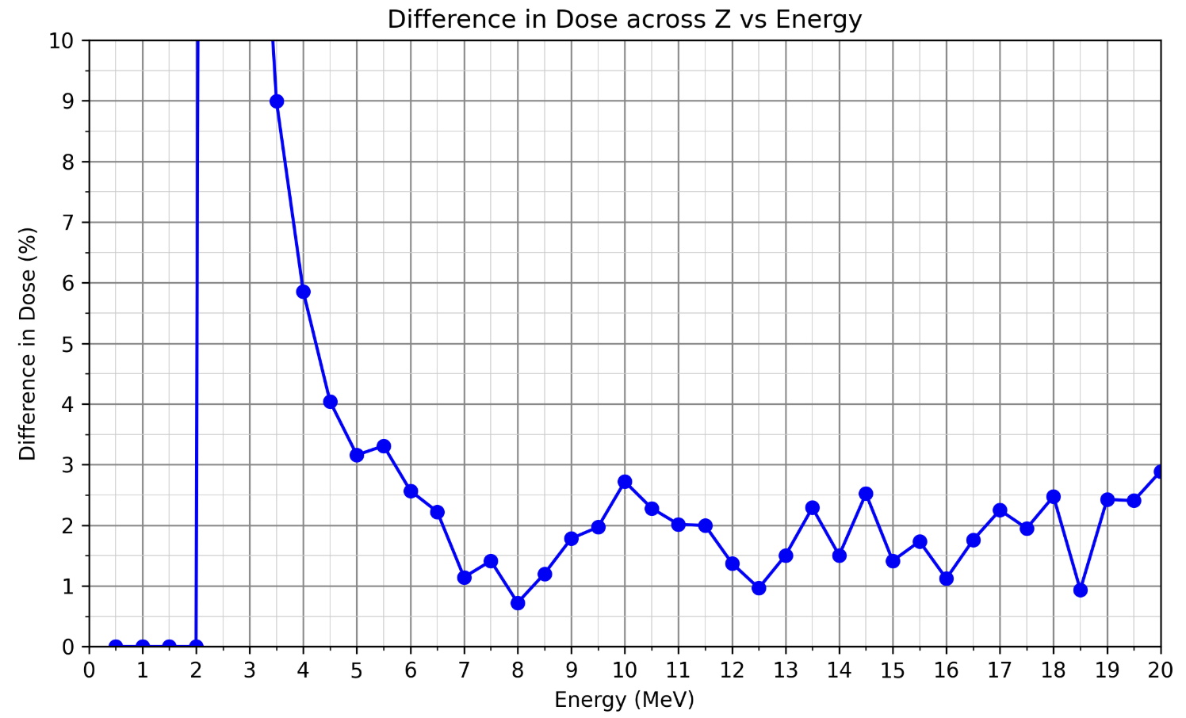
Dose difference across the cell media (20um deep) against Energy
Full Beamline:
(Cu10um, Mylar window, Air, Mylar cover, Media (Cells))
No scatterer:
(Mylar window, Air, Mylar cover, Media (Cells))

Slide 4
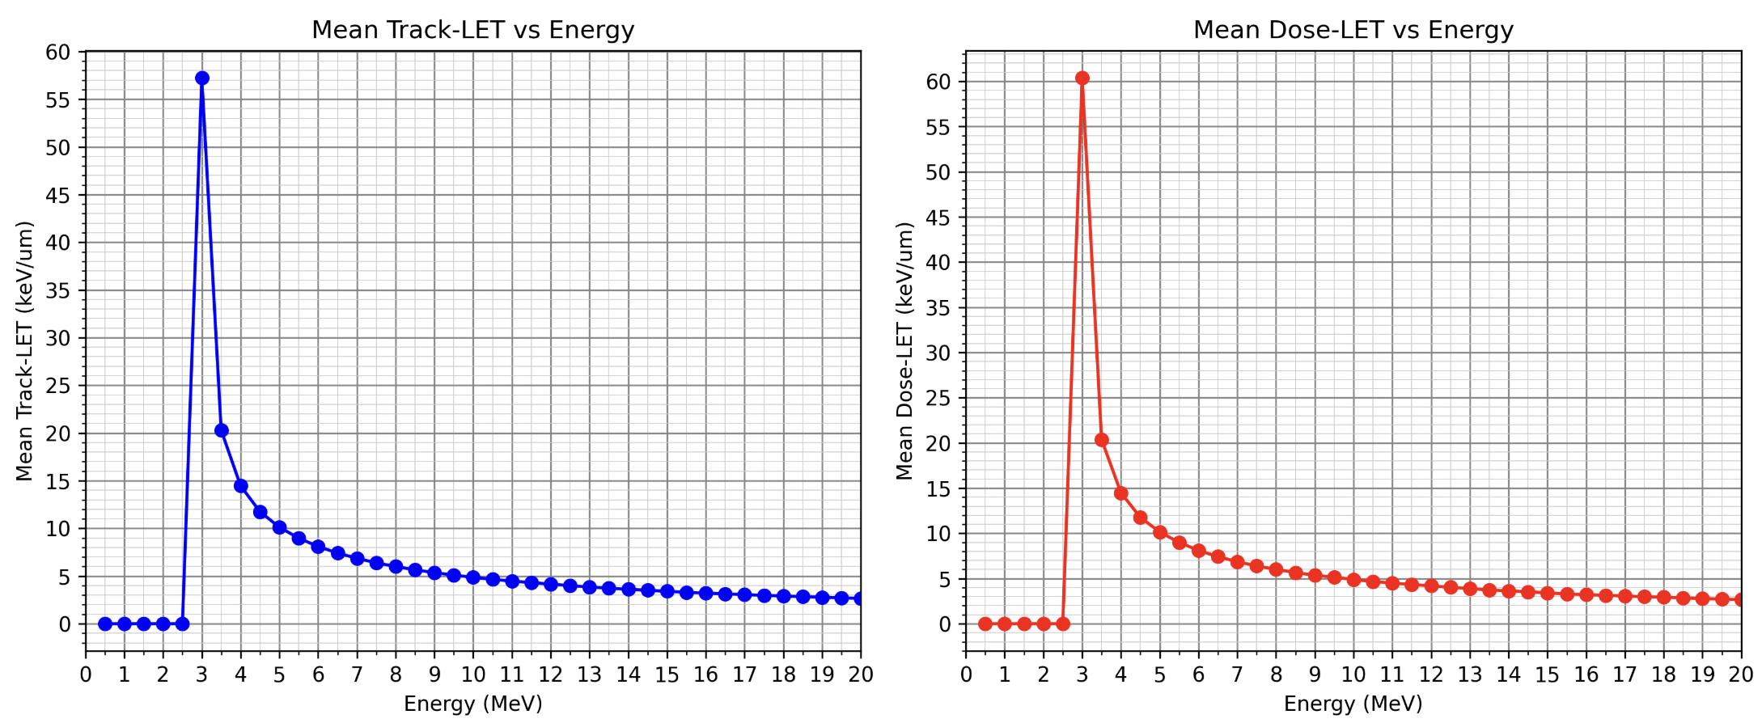
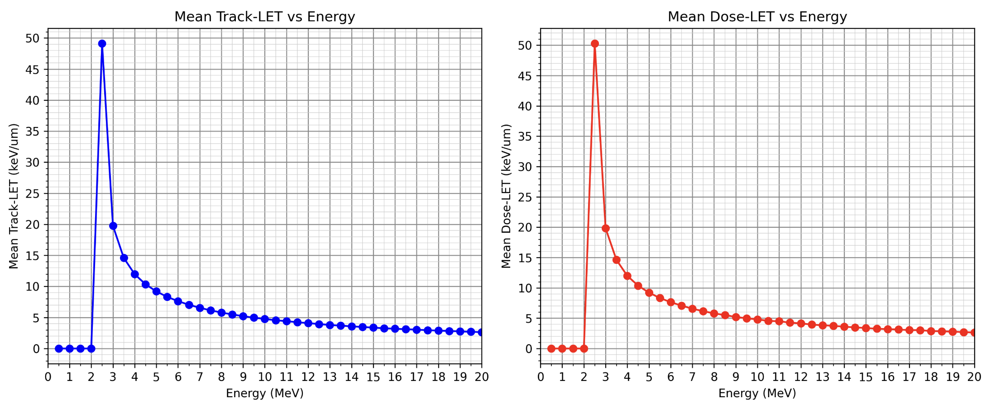
LET vs Energy
Full Beamline:
(Cu10um, Mylar window, Air, Mylar cover, Media (Cells))
No scatterer:
(Mylar window, Air, Mylar cover, Media (Cells))

Slide 5
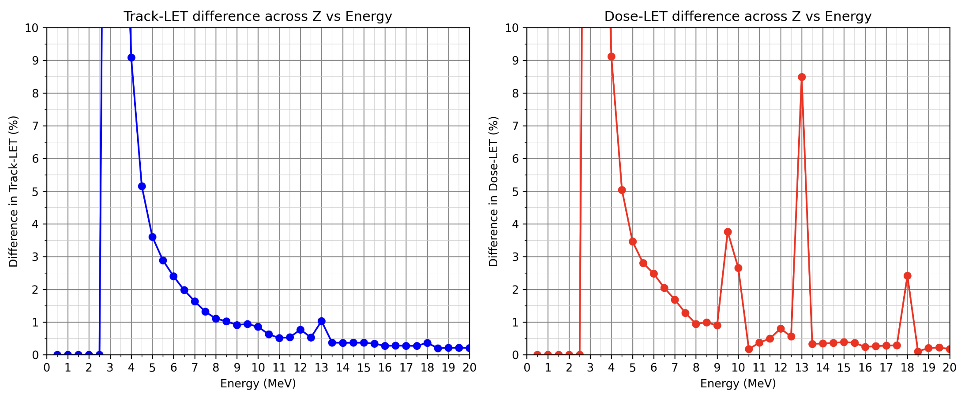
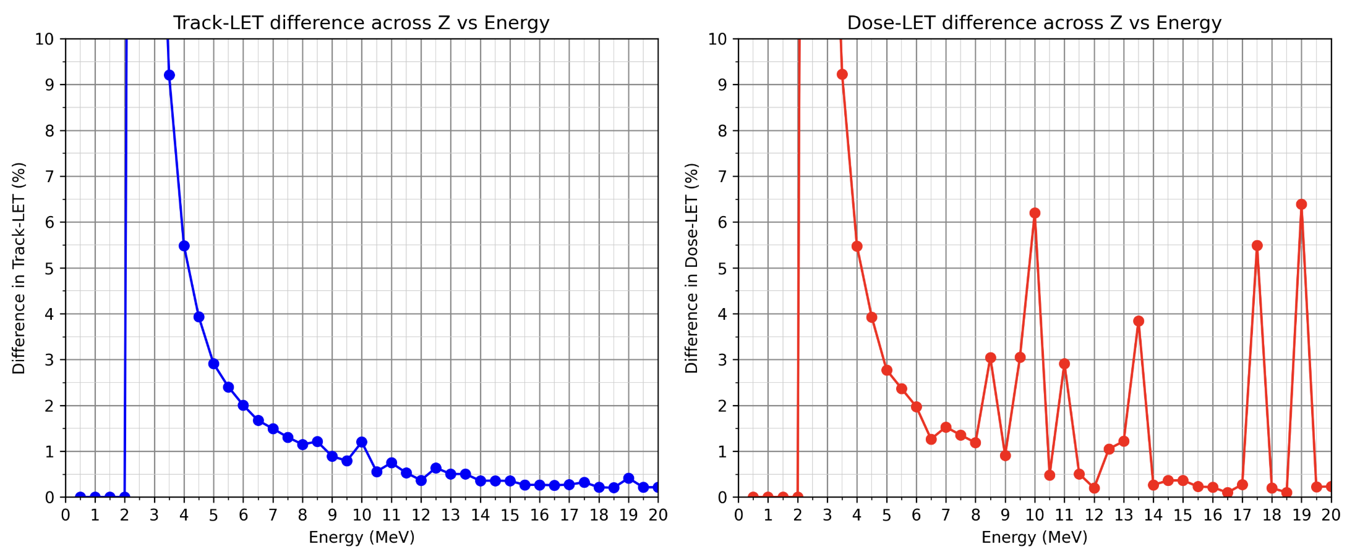
LET difference across the cell media (20um deep) against Energy
Full Beamline:
(Cu10um, Mylar window, Air, Mylar cover, Media (Cells))
No scatterer:
(Mylar window, Air, Mylar cover, Media (Cells))

Slide 6
Conclusions
Minimum Energy required to reach the cells is 3MeV with 10um Cu scatterer and 2.5MeV without the scatterer
The minimum energy to aim for should be 7MeV
Hard limit to avoid protons with an energy less than 5MeV. With a scatterer in place this should be more like 5.5MeV
Therefore limits of the energy distribution be a gaussian centred on 7MeV with a maximum standard deviation of 0.7MeV (This imagines no energy loss)
Based on pre-cells, 4MeV is the hard cut-off for protons before entering cells.

Slide 7
Additional Slides

Slide 8
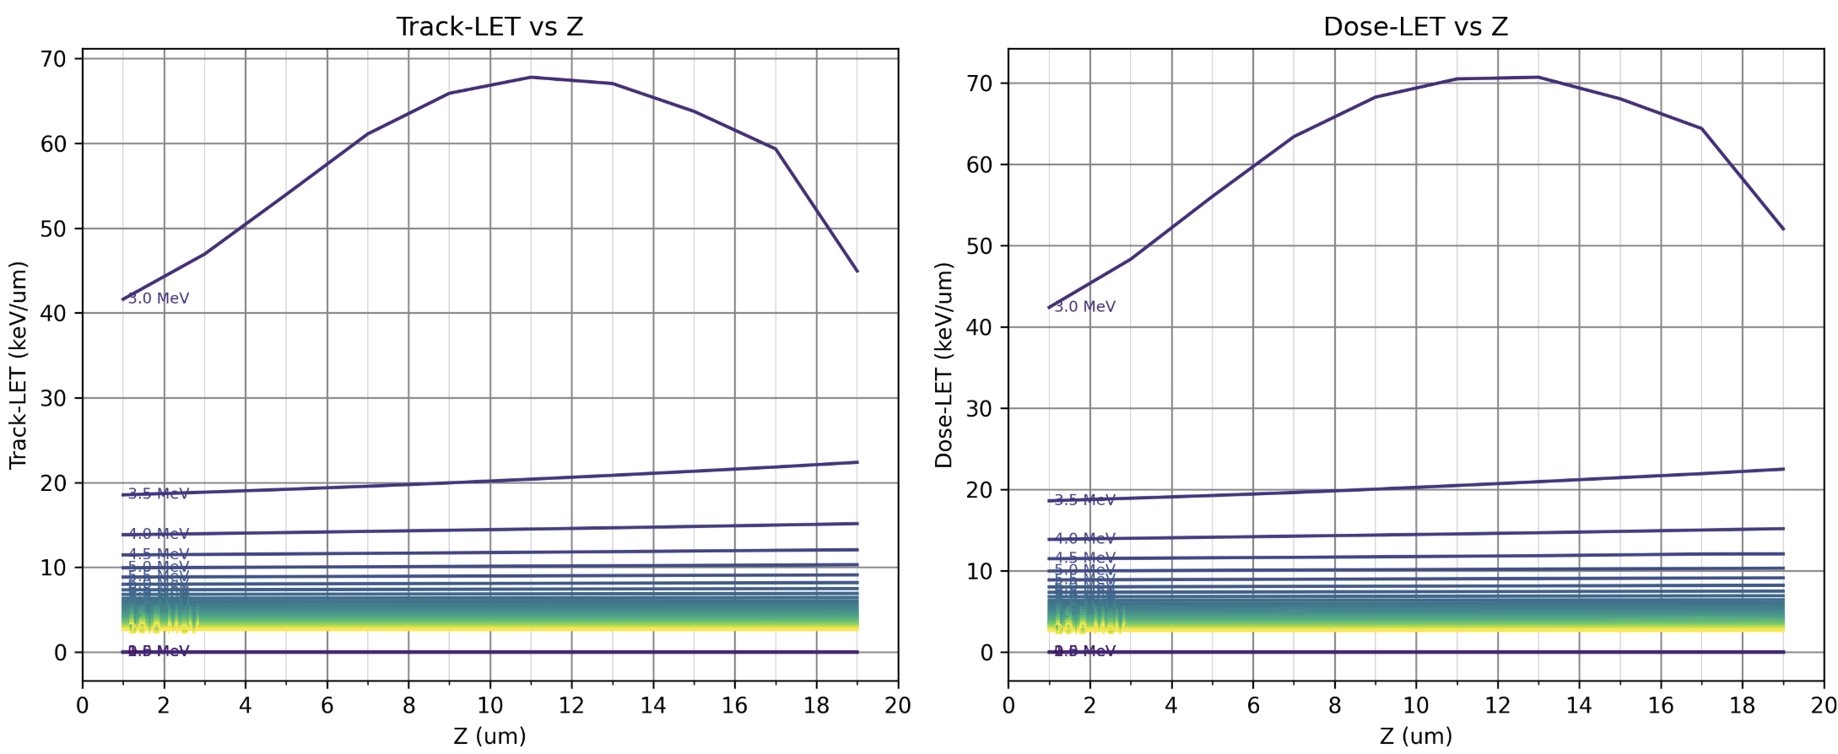
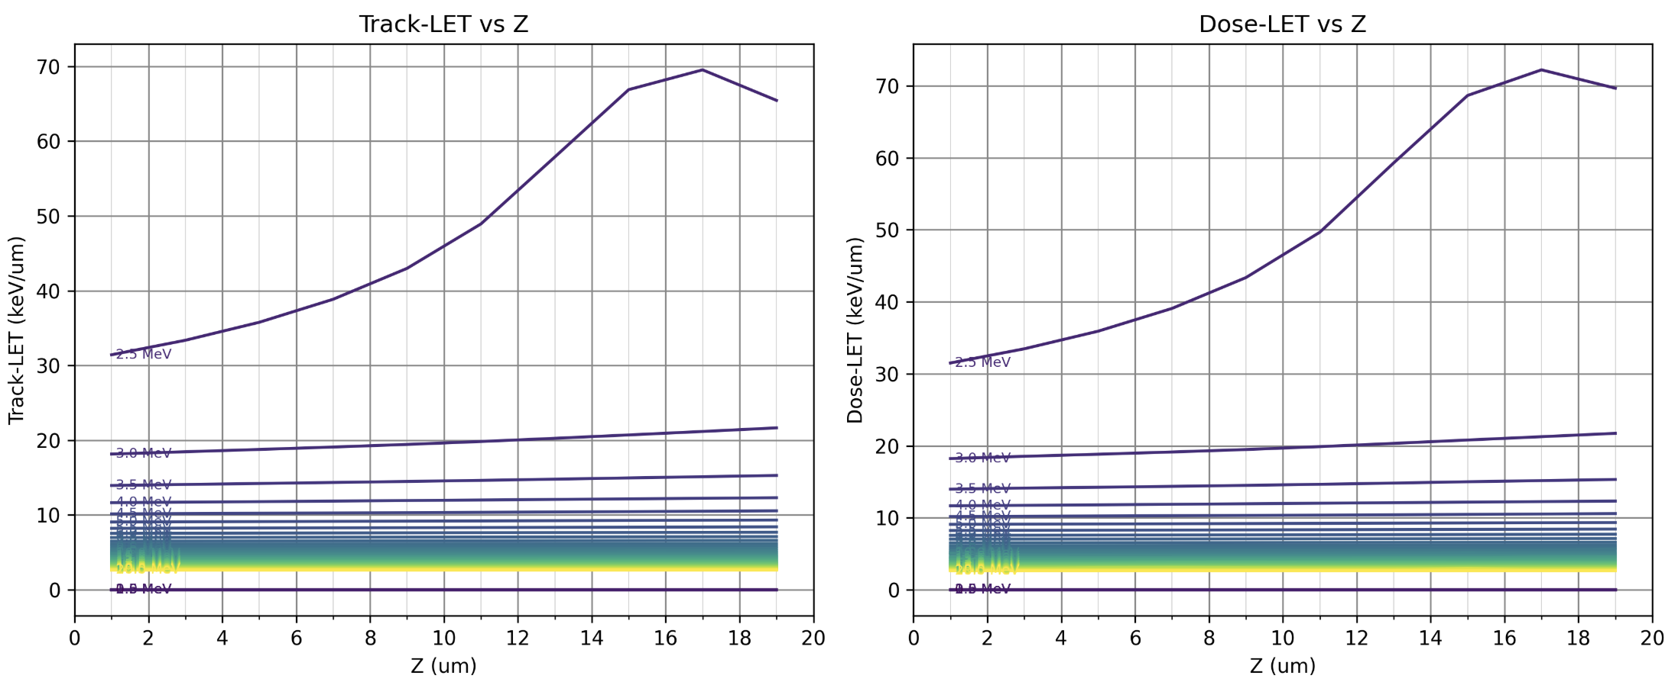
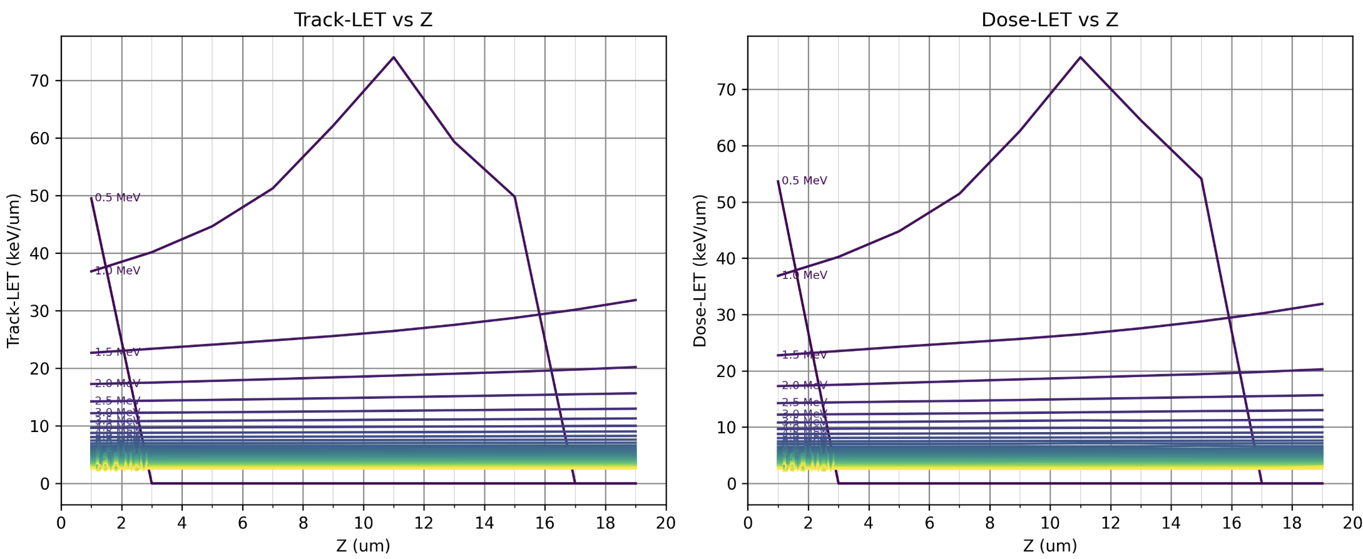
LET Across the cell media (20um deep)
Full Beamline:
(Cu10um, Mylar window, Air, Mylar cover, Media (Cells))
No scatterer:
(Mylar window, Air, Mylar cover, Media (Cells))
Pre Cells:
(Mylar cover, Media (Cells))

Slide 9
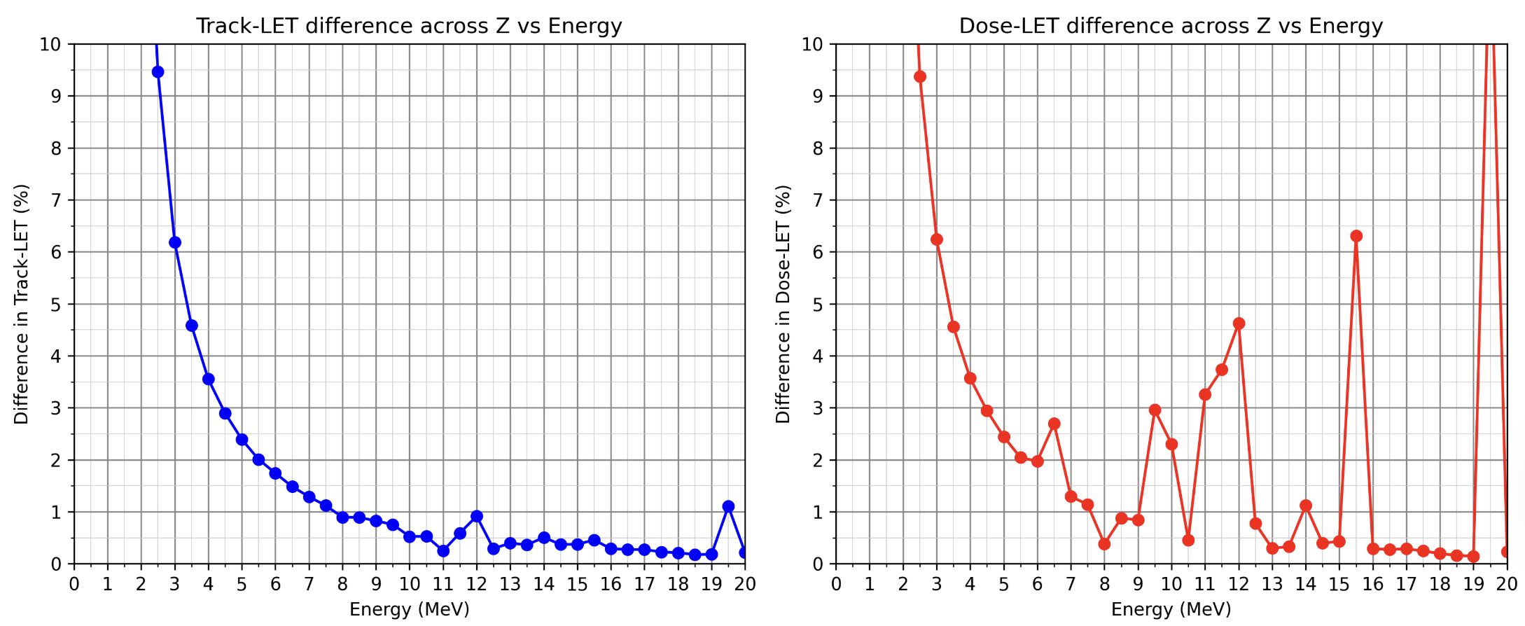
LET difference across the cell media (20um deep) against Energy
Full Beamline:
(Cu10um, Mylar window, Air, Mylar cover, Media (Cells))
No scatterer:
(Mylar window, Air, Mylar cover, Media (Cells))
Pre Cells:
(Mylar cover, Media (Cells))

Slide 10
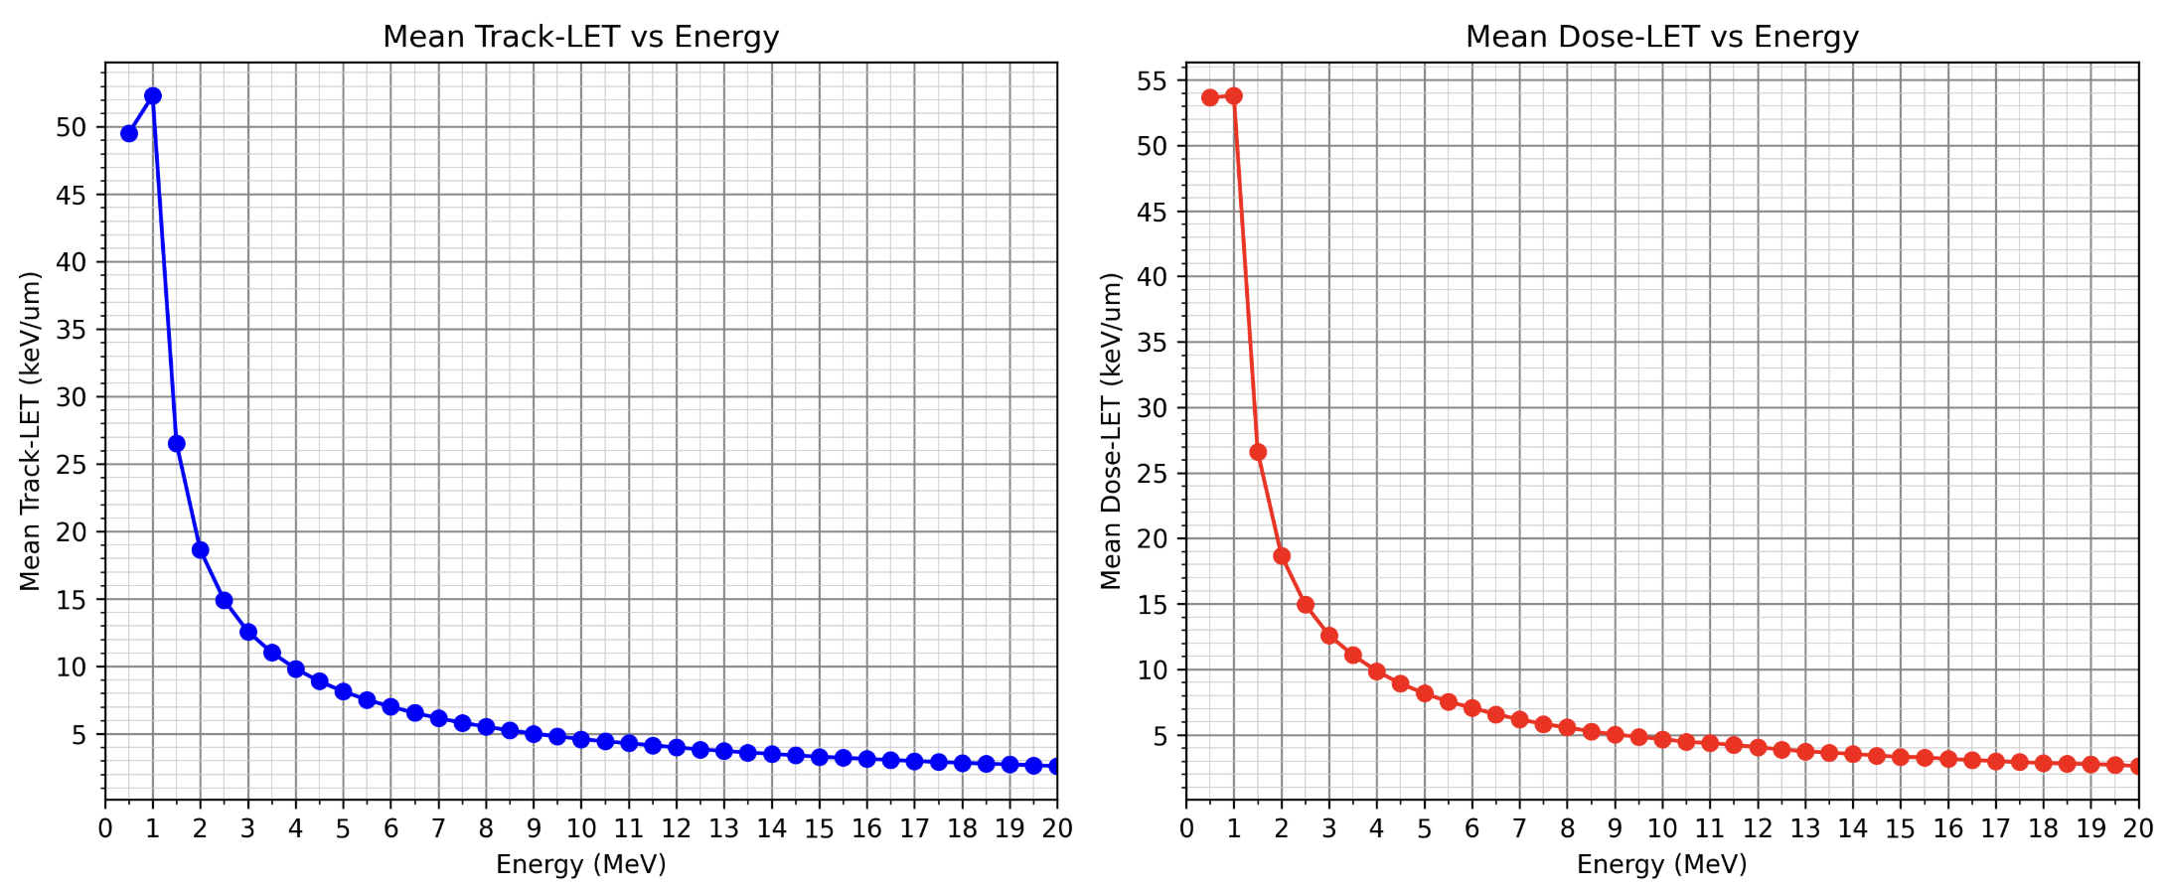
LET vs Energy
Full Beamline:
(Cu10um, Mylar window, Air, Mylar cover, Media (Cells))
No scatterer:
(Mylar window, Air, Mylar cover, Media (Cells))
Pre Cells:
(Mylar cover, Media (Cells))

Slide 11
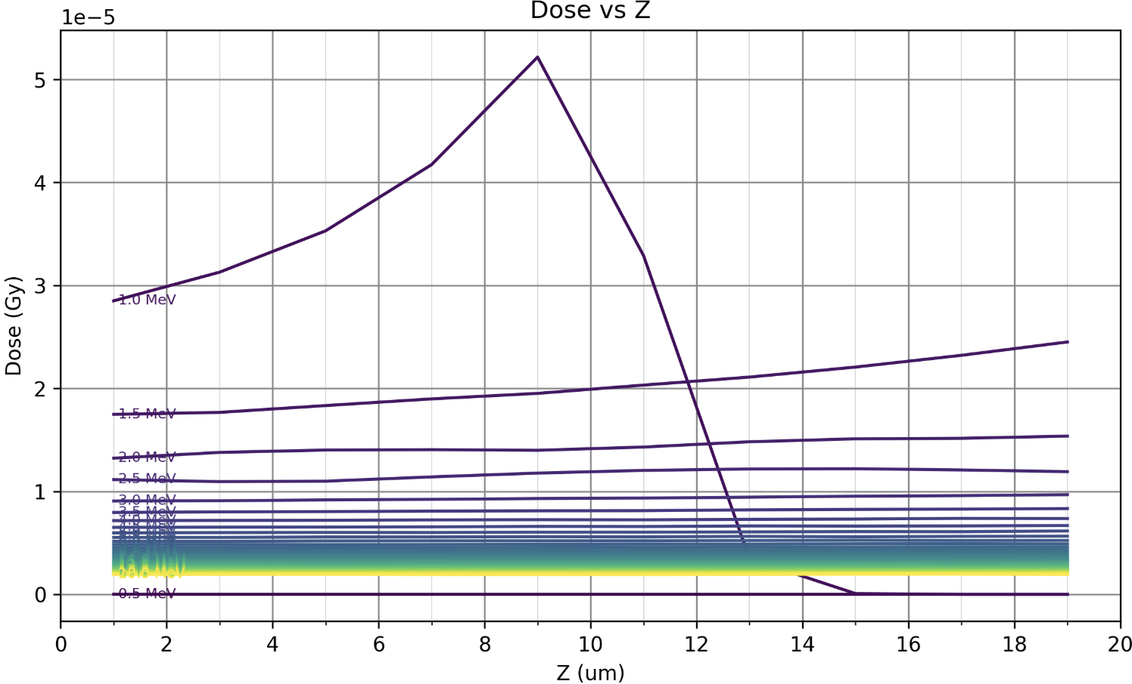
Dose Across the cell media (20um deep)
Full Beamline:
(Cu10um, Mylar window, Air, Mylar cover, Media (Cells))
No scatterer:
(Mylar window, Air, Mylar cover, Media (Cells))
Pre Cells:
(Mylar cover, Media (Cells))

Slide 12
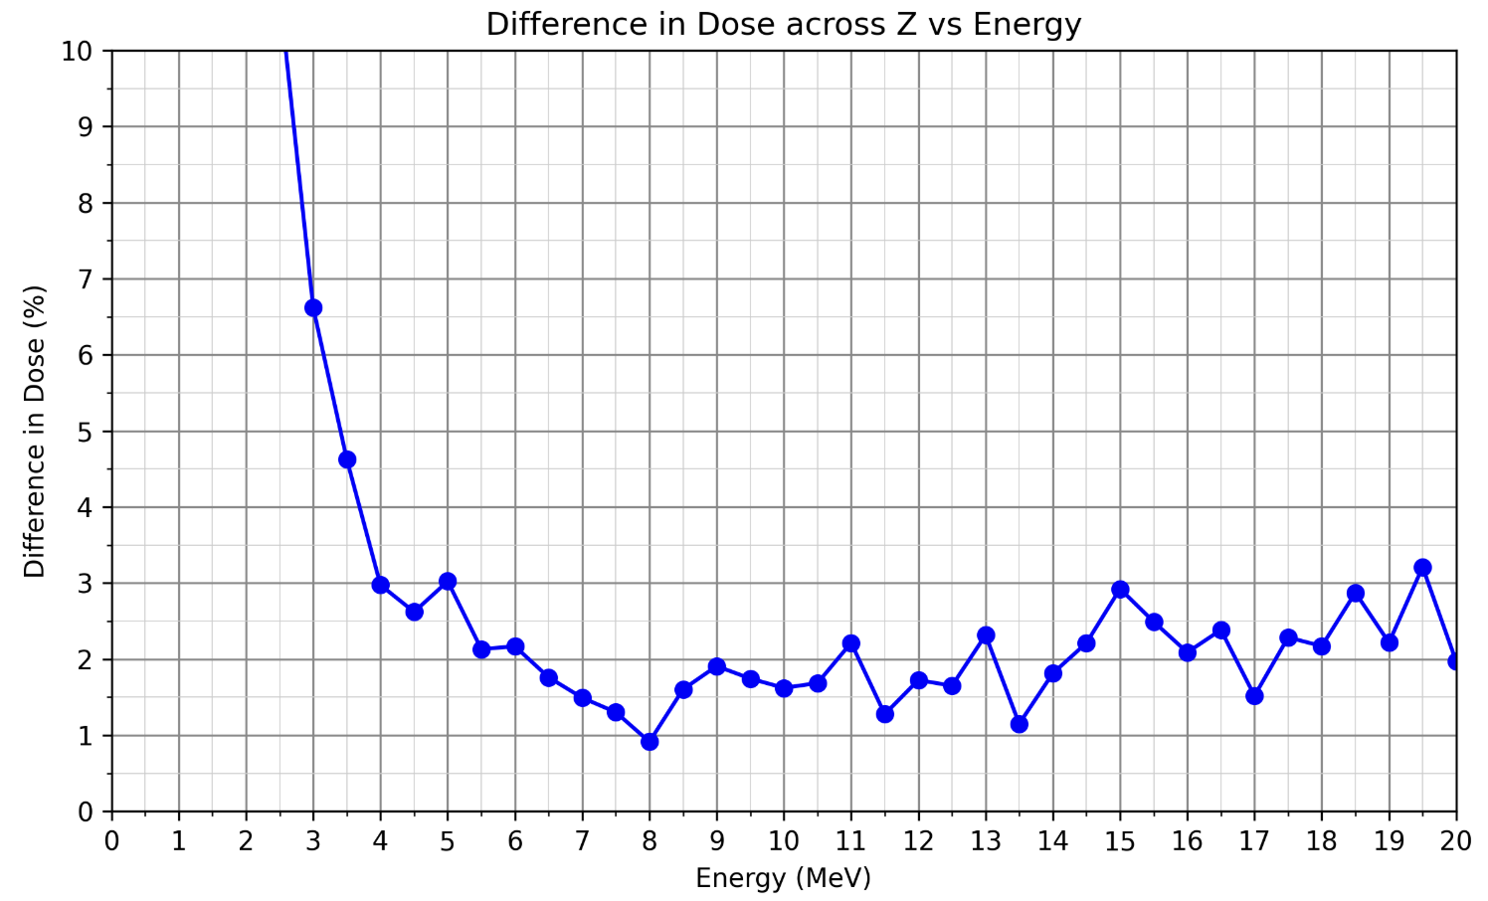
Dose difference across the cell media (20um deep) against Energy
Full Beamline:
(Cu10um, Mylar window, Air, Mylar cover, Media (Cells))
No scatterer:
(Mylar window, Air, Mylar cover, Media (Cells))
Pre Cells:
(Mylar cover, Media (Cells))

Slide 13
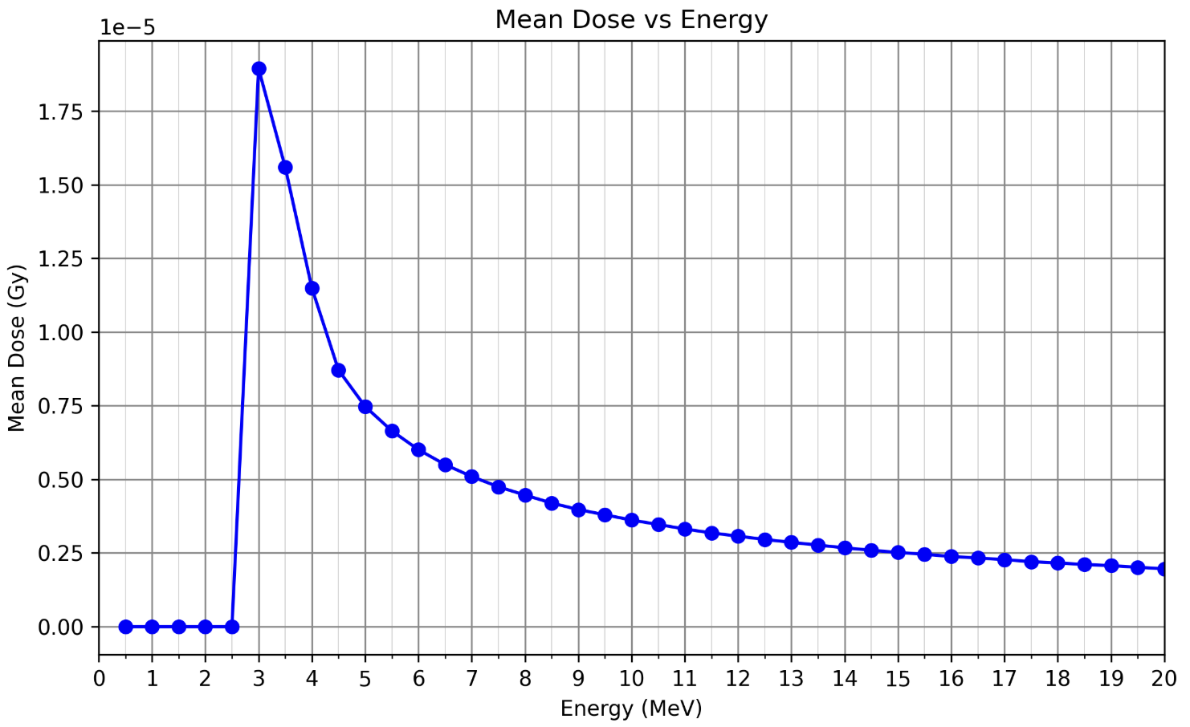
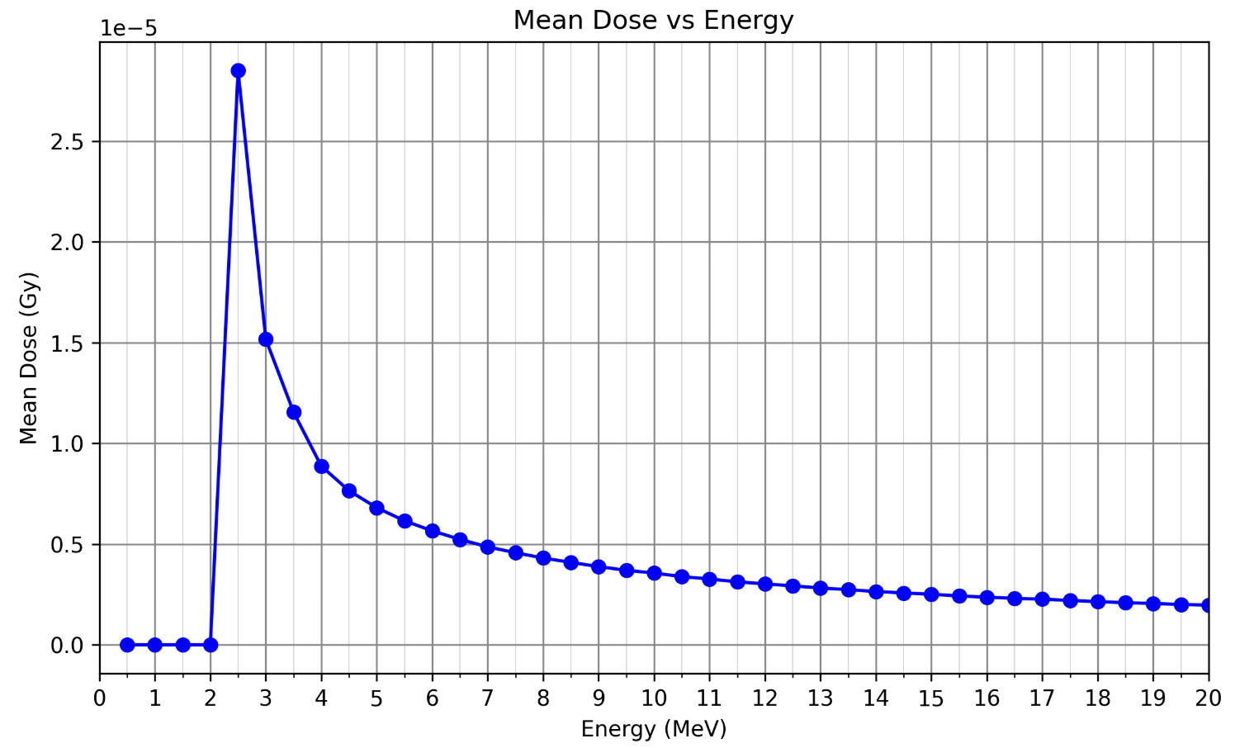
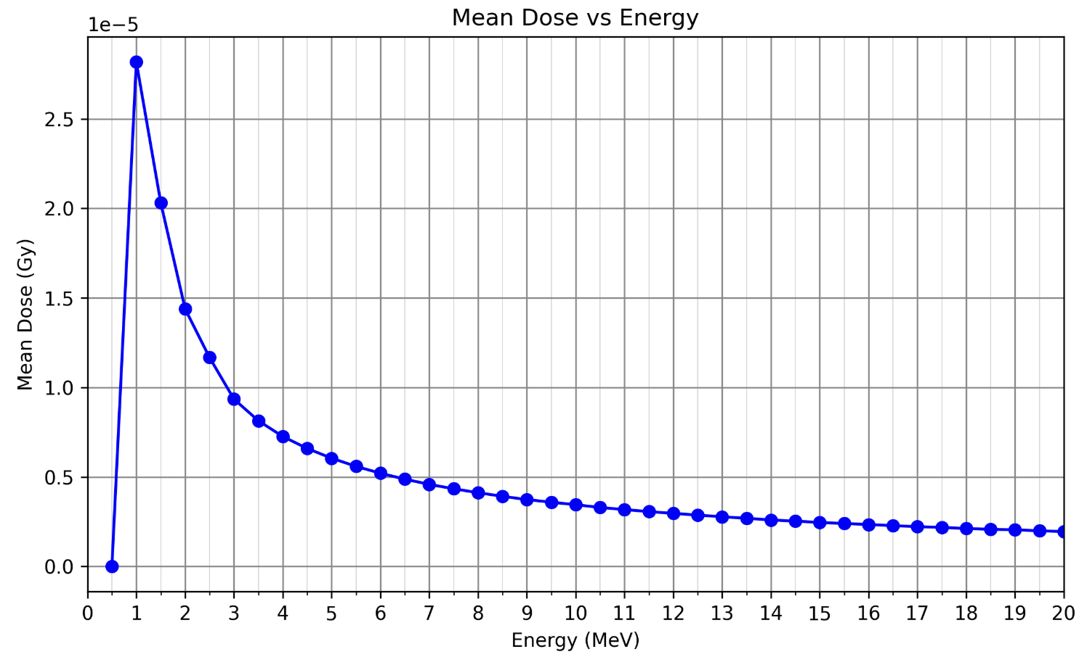
Dose against Energy
Full Beamline:
(Cu10um, Mylar window, Air, Mylar cover, Media (Cells))
No scatterer:
(Mylar window, Air, Mylar cover, Media (Cells))
Pre Cells:
(Mylar cover, Media (Cells))

