Slide 1
Radiobiology & the CCAP/LhARA

Slide 2

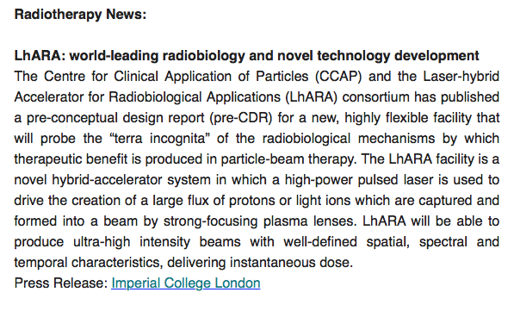
19th June 2020

Slide 3

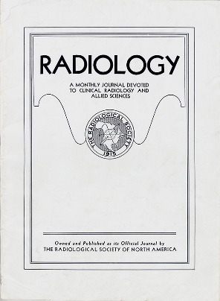
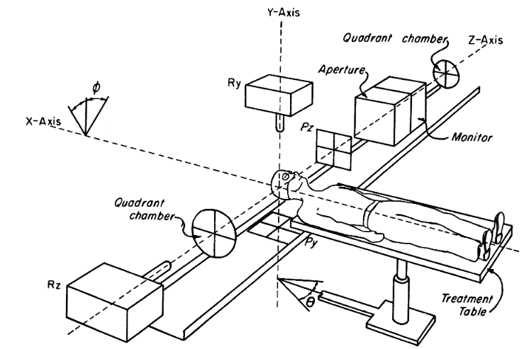

Novel accelerator techniques
System: image processing
fast feedback, control
1946
↓
1960
Fundamental
radiobiology
1970
1980
1990
2000
2010
2020
2030
2040
2050

Slide 4
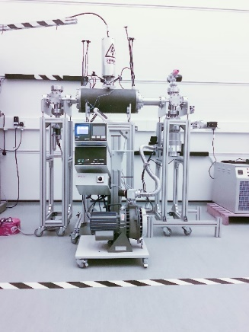
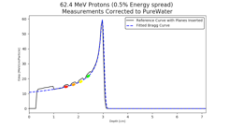
Novel accelerator techniques
System: image processing
fast feedback, control
Fundamental
radiobiology

Slide 6
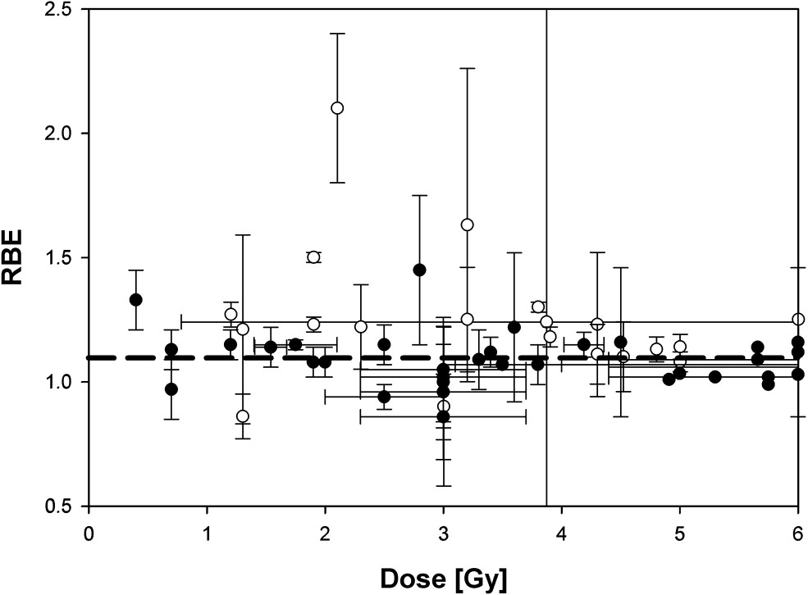
The case for fundamental radiobiology
Relative biological effectiveness:
  Defined relative to reference X-ray beam
  Known to depend on:
    Energy, ion species
    Dose & dose rate
    Tissue type
    Biological endpoint
Yet:
  p-treatment planning uses 1.1
  Effective values are used for C⁶⁺
Maximise the efficacy of PBT now & in the future:
  Require systematic programme to develop
  full understanding of radiobiology
Paganetti,
van Luijk
(2013)
SemRadOncol

Slide 7
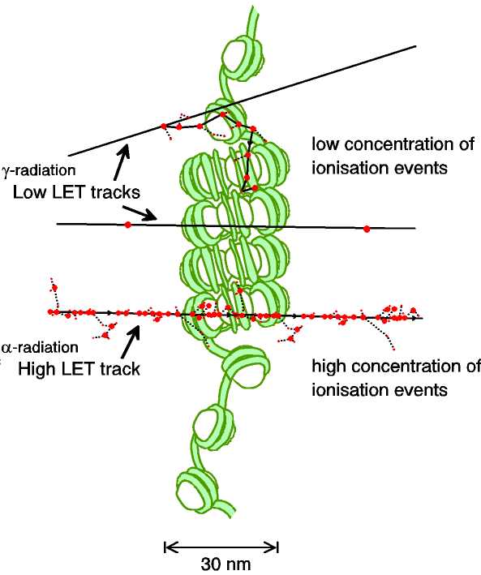
Biological impact ^{from the} physics of ionisation
Low-LET radiation:
  Repairable single/double
  strand breaks
High-LET radiation:
  Complex DNA lesions
    Multiple DNA pathways
    More difficult to repair
    Enhances cell death
Programmatic approach:
  Dynamic studies of impact of radiation
  Interpret with advanced computer models (e.g. G4DNA)

Slide 8
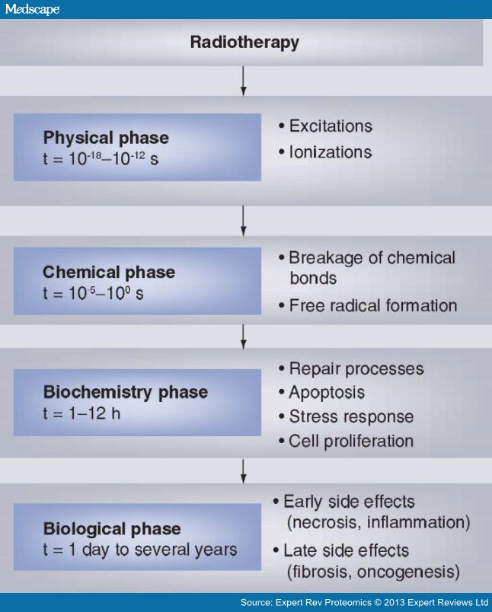
A complex, multi-facetted problem
Carter et al, and Parsons
(2018) IJROBP & (2019) IJROBP
Multidisciplinary approach essential
Time

Slide 9
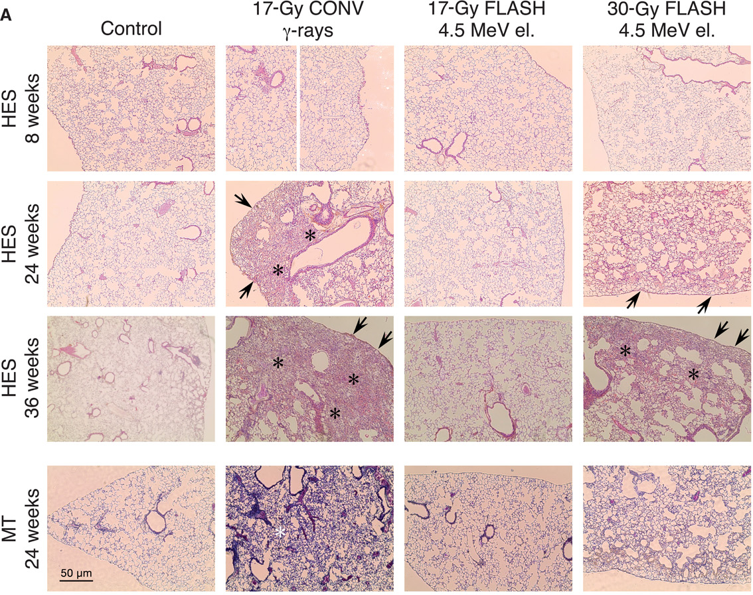
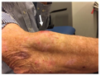
Radiobiology in new regimens
Worked example: FLASH
Conventional regime : ~2 Gy/min
FLASH regime : >40 Gy/s
Evidence of normal-tissue sparing while tumour-kill probability is maintained:
i.e. enhanced therapeutic window
Time line:
Initial reports: 2014 (e.g. Flauvadon et al, STM Jul 2014)
Confirmation in mini-pig & cat: 2018 (Clin. Cancer Research 2018)
First treatment 2019 (Bourhis et al, Rad.Onc. Oct 2019)

Slide 10
Radiobiology in new regimens
Prezado; 13Nov19
Worked example: micro beams
Conventional regime : > 1 cm diameter; homogeous
Microbeam regime : < 1 mm diameter; no dose between ‘doselets’
Remarkable increase of normal rat brain resistance.
[Dilmanian et al. 2006, Prezado et al., Rad. Research 2015]
Dose escalation in the tumour possible – larger tumor control prob.

Slide 11
Radiobiology in new regimens
Time
domain
Space
domain
The ideally
flexible beam facility
can deliver it all!
⇒ substantial
opportunity for a
step-change in
understanding!
Ion
species
Energy
In combination
and with chemo/immuno Therapies

Slide 12
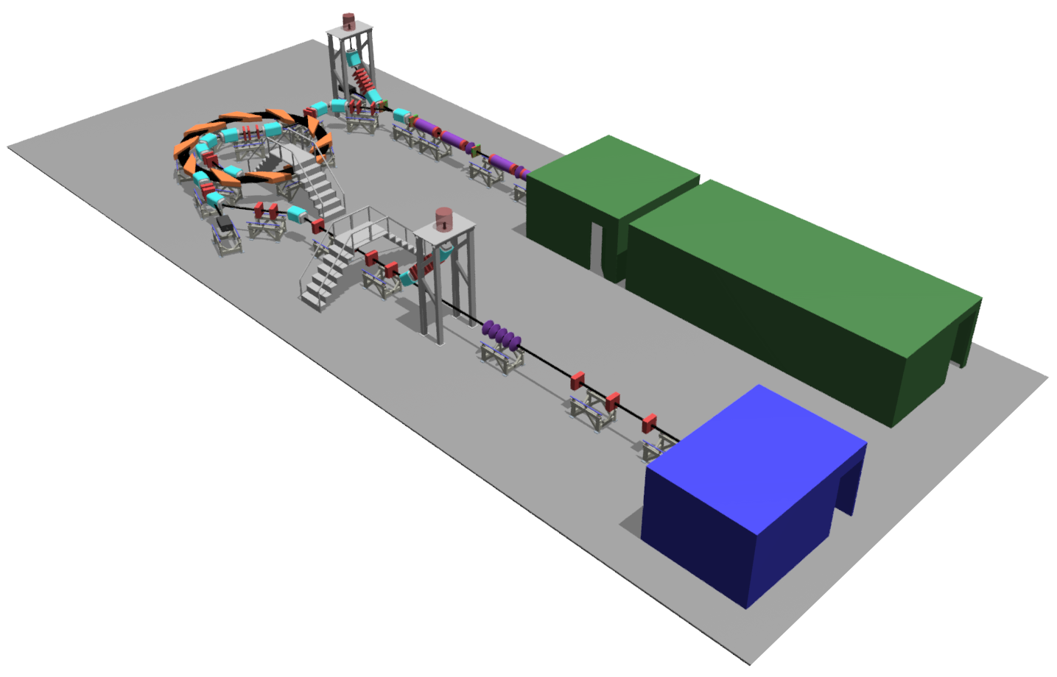
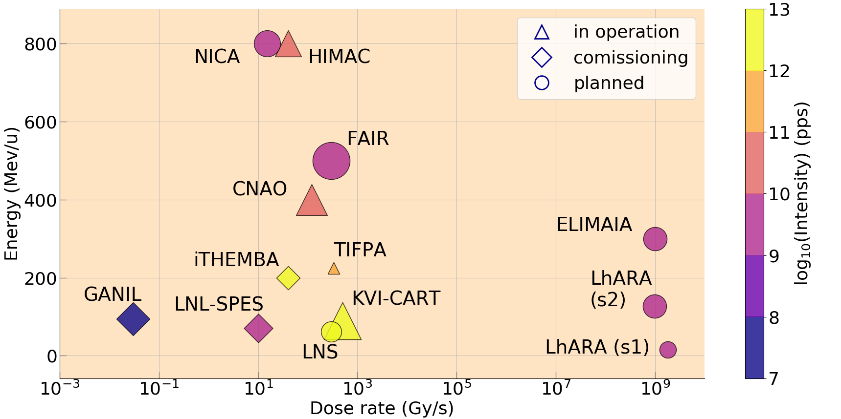
Laser-hybrid Accelerator for Radiobiological Applications
LhARA; a novel, hybrid, approach:
  High-flux, laser-driven proton/ion source:
    Overcome instantaneous dose-rate limitation
    Delivers protons or ions in very short pulses:
      Pulse length 10 – 40 ns
    Can provide arbitrary pulse structure
  Novel plasma-lens capture & focusing
  Fast, fixed-field post acceleration
⇒ compact, uniquely flexible facility
LhARA consortium

Slide 13
Our vision and our ambition
LhARA will be a uniquely-flexible, novel system that will:
Deliver a systematic and definitive radiobiology programme
Prove the feasibility of the laser-driven hybrid-accelerator approach
Lay the technological foundations for the transformation of PBT
  automated, patient-specific: implies online imaging & fast feedback and control

