Slide 1

Metabolism: how to evaluate metabolic changes after radiation therapy
Marc-Emmanuel Dumas
¹Head of Biomolecular Medicine, Dept of Metabolism, Digestion and Reproduction
& National Heart and Lung Institute, Imperial College London, UK
²CNRS UMR8199, European Genomic Institute for Diabetes, University of Lille, France
³McGill Genome Innovation Centre, McGill University, Montréal, Canada

Slide 2
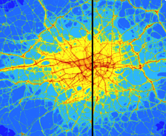
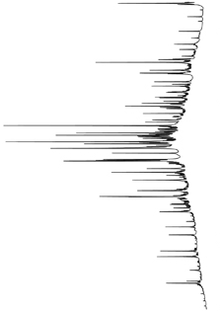
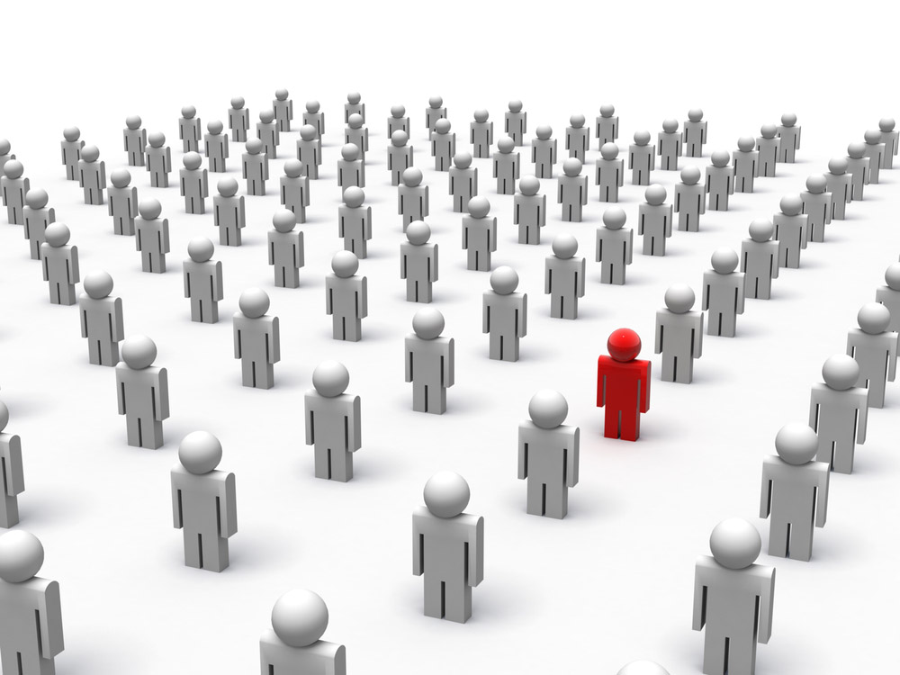
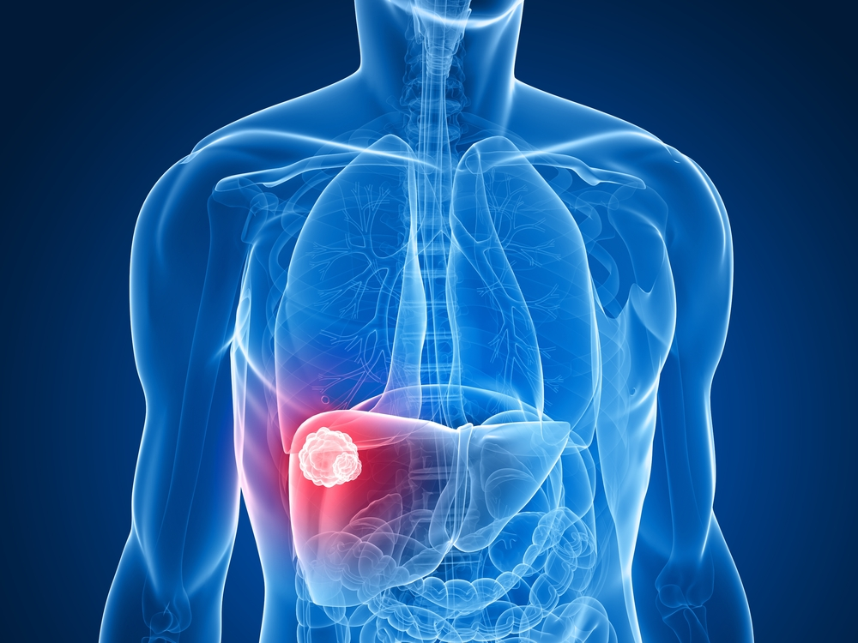
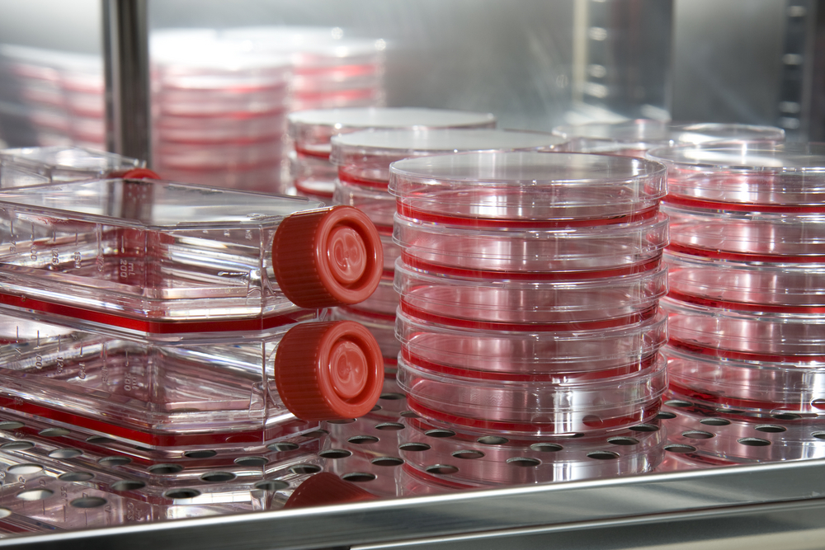
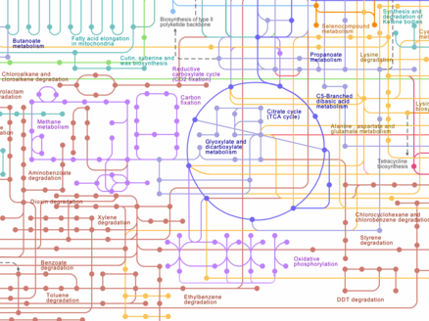
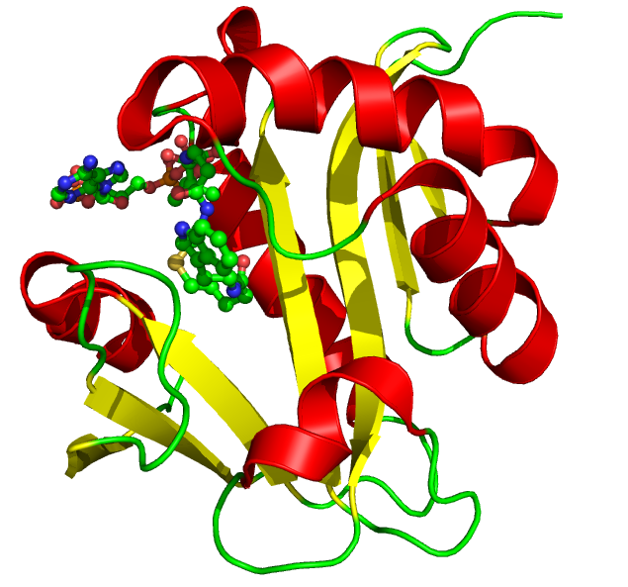

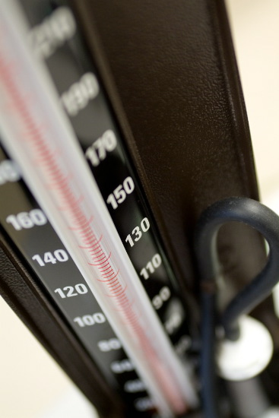
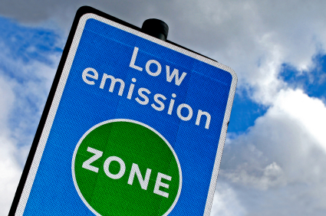
Biomarkers
Epidemiology
Molecular
Phenotyping
Biomarkers
Systems
Biology
Mechanistic
Insight
Linkage and Integration
Health
Policy & Action
Courtesy of Dr. Toby Athersuch

Slide 3
Biomarkers
Exposure
Internal Dose
Biologically Effective Dose
Early Biological Effect
Altered Structure / Function
Clinical Disease
Susceptibility
Key
Biomarker
Marker progression
Influence of individual susceptibility on progression
Adapted from: Committee on Biological Markers of the National Research Council. Biological markers in environmental health research. Environ. Health Perspect. 74: 3-9, 1987.
Courtesy of Dr. Toby Athersuch

Slide 4
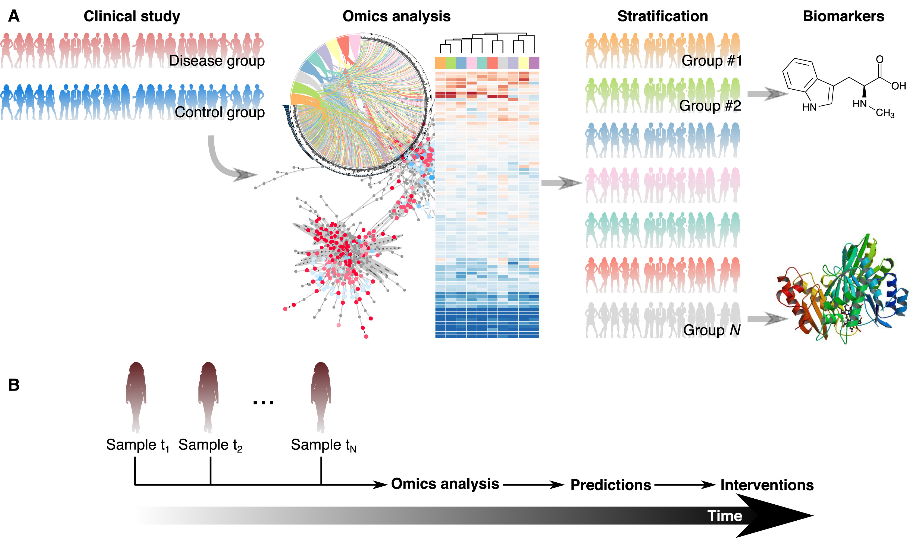
Systems biology of metabolism
Nielsen, Cell Metabolism 2017; 25(3): 572-579. https://doi.org/10.1016/j.cmet.2017.02.002

Slide 5
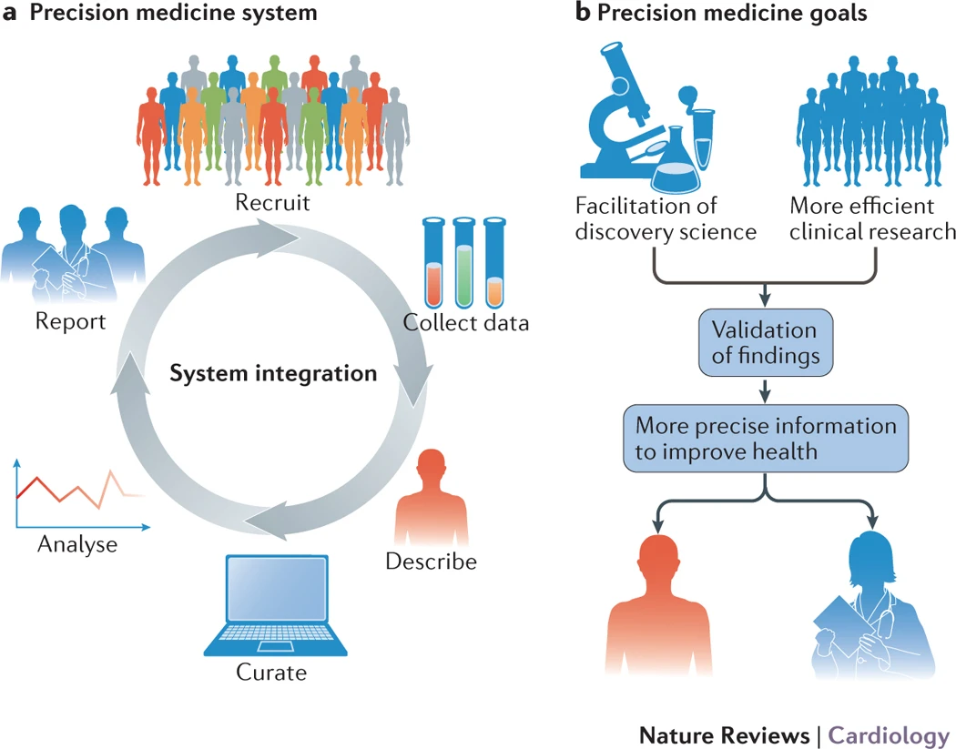
Precision Medicine
“Medical care designed to optimize efficiency or therapeutic benefit for particular groups of patients, especially by using genetic or molecular profiling.”
Oxford dictionary
Antman & Loscalzo, Nature Reviews Cardiology 2016; 13: 591-602. https://doi.org/10.1038/nrcardio.2016.101

Slide 6
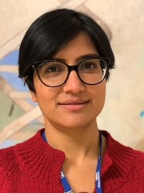
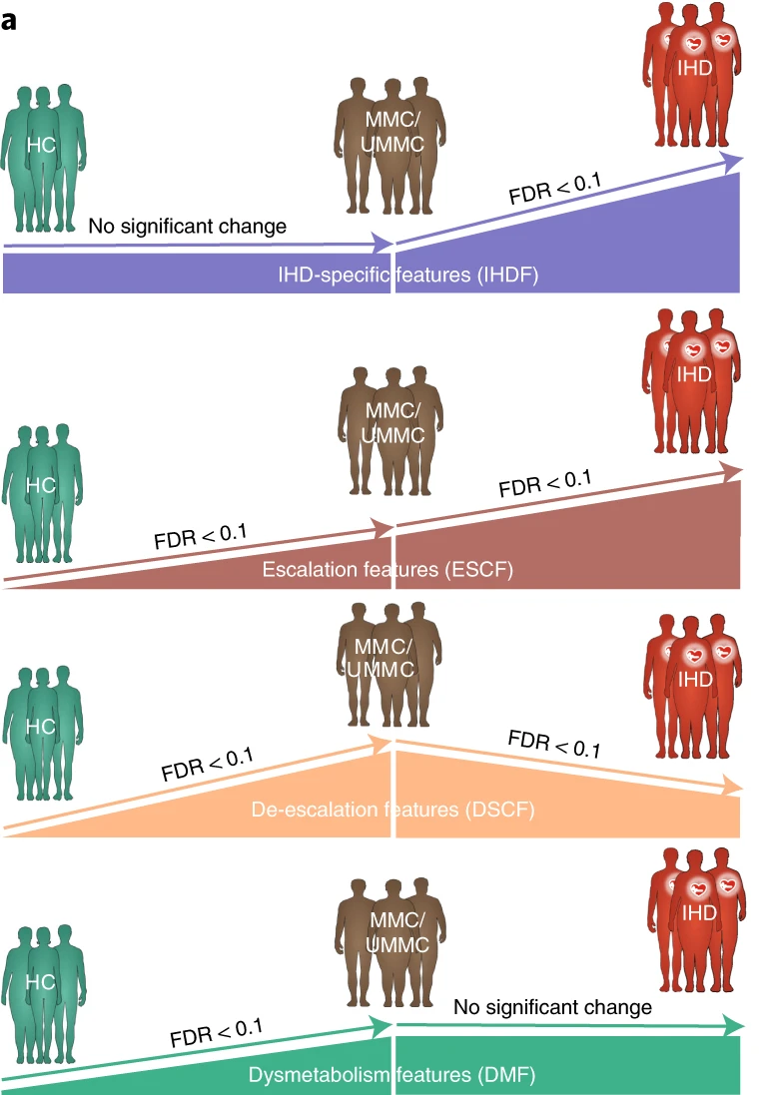
Drug Deconfounded Microbiome and Metabolome Signatures in
the Cardiometabolic Disease Spectrum
Fromentin, …, Chechi, …, & Dumas*, Ehrlich*, Pedersen*, Nature Medicine 2022; 28(2):303-314.

Slide 7
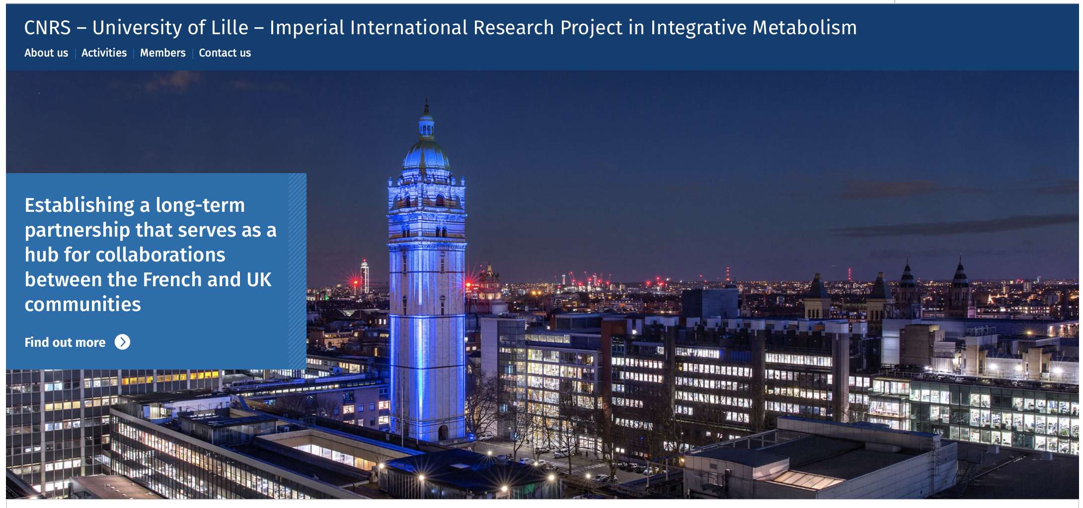
IRP in Integrative Metabolism between the University of Lille, Imperial & CNRS “Metabo-LIC”

Slide 8
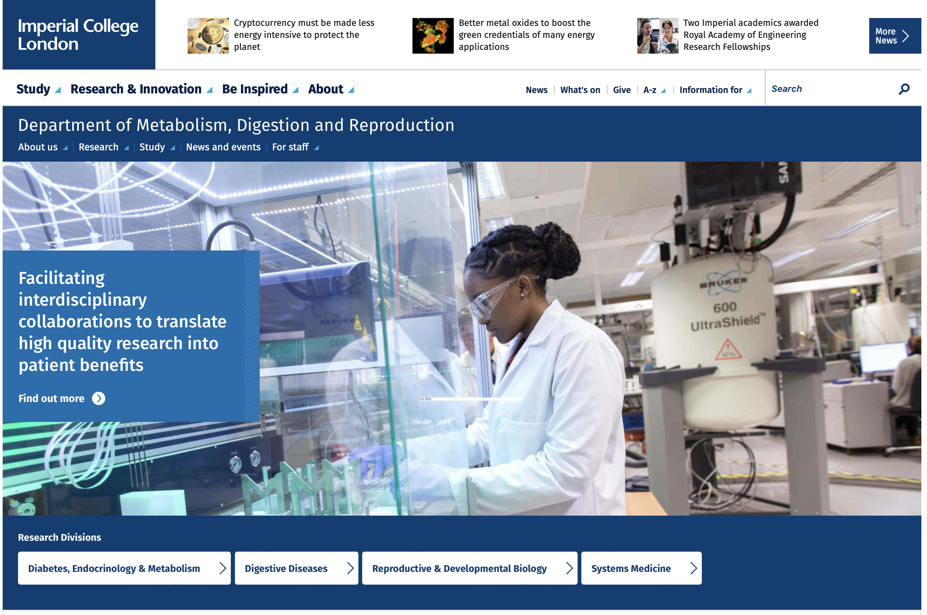

Partners in the IRP “Metabo-LIC”
Imperial: Dept of Metabolism, Digestion and Reproduction
Section of Biomolecular Medicine
Setion of Bioanalytical Chemistry
Section of Bioinformatics
Section of Genetics and BRC Genomics Unit
Sections of Cell Biology, Endocrinology, Hepatology & Gastroenterology
Microbiome, Diabetes and GPCR Networks
CNRS: UMR8199 and EGID
Team « functional epigenomics »
LiGAN-PM sequencing platform
IMPACT-PM metabolomic platform
Bioinformatics Team

Slide 9
IRP “Metabo-LIC”: Flagship projects, cross-cutting themes & ECR training

Slide 10
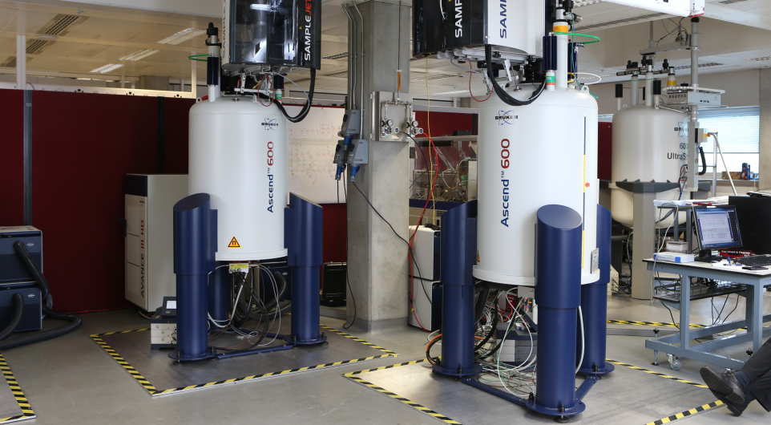
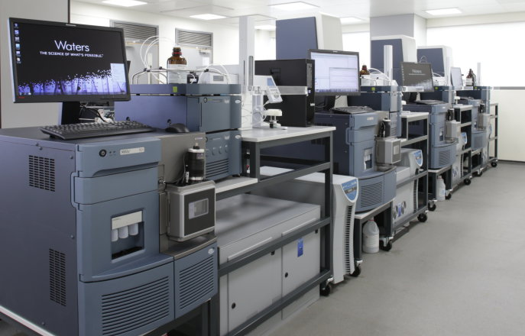
Analytical technologies for metabolomics
NMR Spectroscopy
Mass Spectrometry

Slide 11
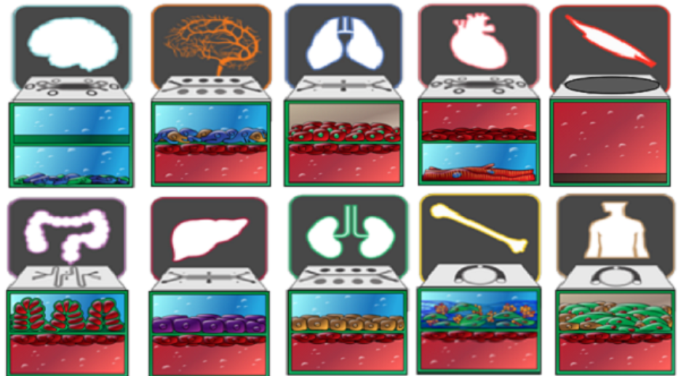
Modelling human organs
Inter-organ crosstalk
In vitro pharamcology
iPSC
Organoids
Organs-on-a-chip
Courtesy of Prof. Mark Thursz

Slide 12
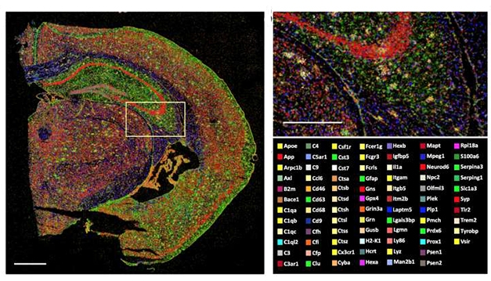
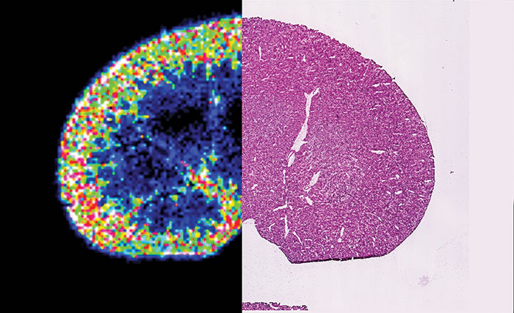
Spatial Biology: a “Google Earth” of Metabolism
Spatial Transcriptomics
Mass Spec Imaging

Slide 13
Metabolomics at the Clinic

Slide 14
Metabolomics of Patient Journey

Slide 15
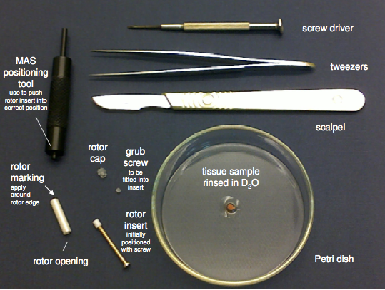
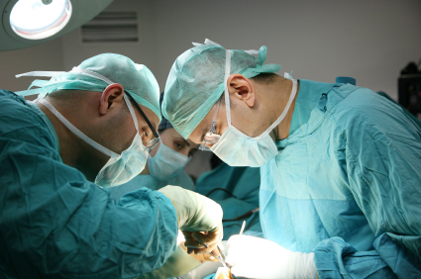
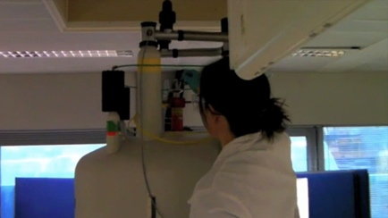
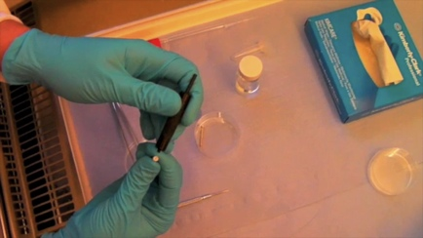
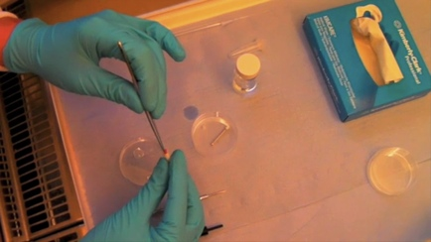
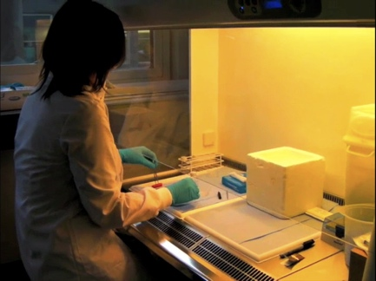
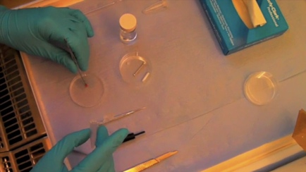
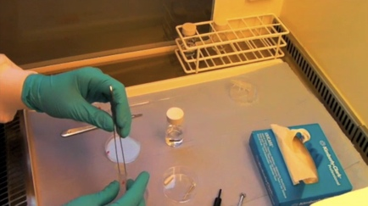
Generating ¹H NMR Metabolic Profiles – MAS NMR
Magic angle spinning (MAS) NMR

Slide 16
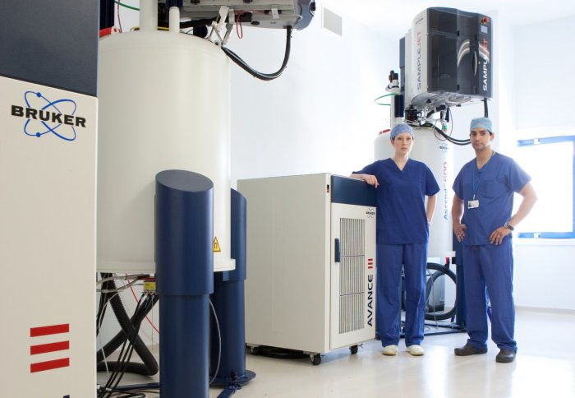
Real Time Intra-Operative Metabolic Profiling with HR-MAS NMR
MAS NMR Facilities at St Mary’s Hospital,
Imperial College London
Biopsies taken from surgical procedures are profiled simultaneously with traditional histological techniques
“New centre heralds age of precision medicine”
See: Jiménez B, Mirnezami R, Kinross J, Cloarec O, Keun HC, Holmes E, Goldin RD,Ziprin P, Darzi A, Nicholson JK. ¹H HR-MAS NMR spectroscopy of tumor-induced local metabolic "field-effects" enables colorectal cancer staging and prognostication.
J Proteome Res. 2013 Feb 1;12(2):959-68.

Slide 17
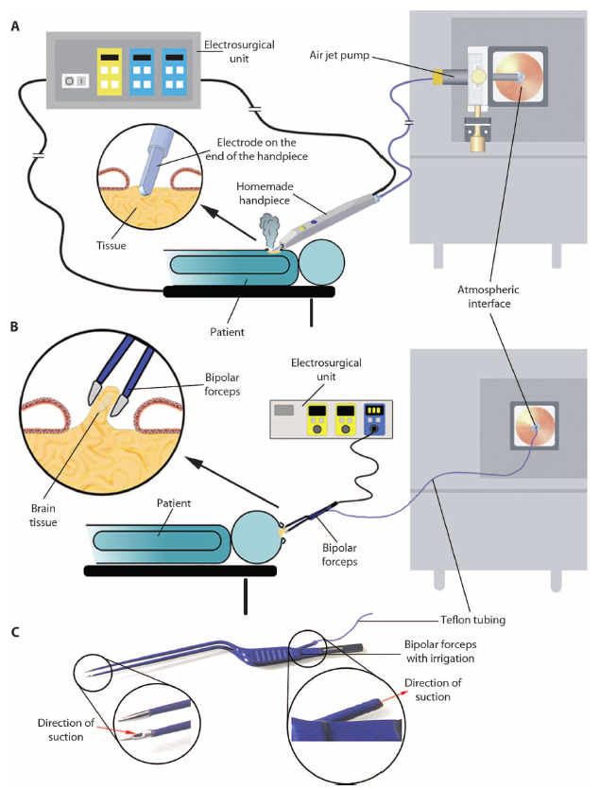
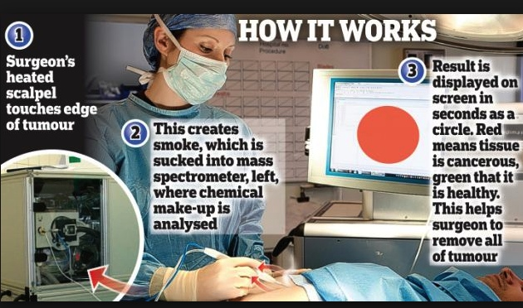
Sharp thinking - the intelligent knife (iKnife)
The iKnife sucks surgical smoke into a mass spectrometer, which then indicates whether the cut tissue is cancerous or healthy.
Balog et al, Sci Transl Med. 2013;5(194):194ra93.

Slide 18
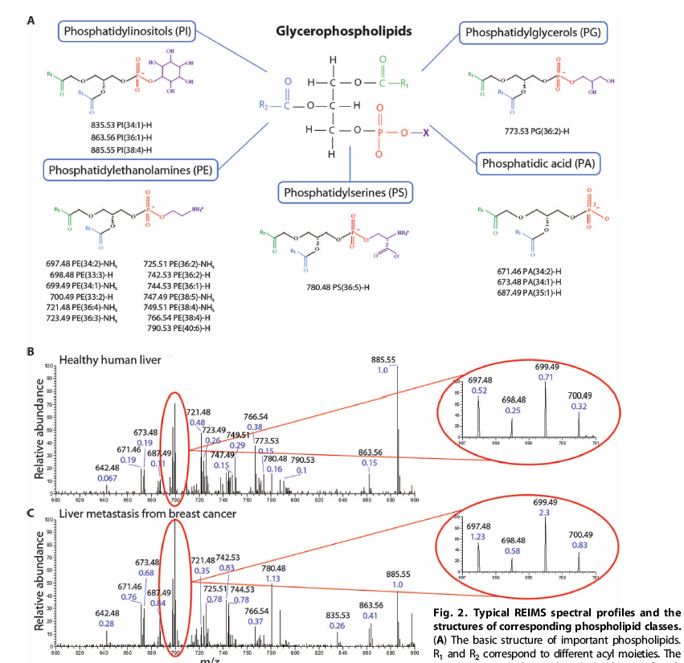
iKnife profiles the phospholipid complement of the tissue
Traditionally, have to remove and prepare the tissue sample/biopsy for mass spectrometry analysis
iKnife – real-time
Human healthy liver spectrum (B) and human liver metastasis spectrum (C)
The PL species in both tissues mostly overlap, however, the relative ratios of characteristic species were different.
Balog et al, Sci Transl Med. 2013;5(194):194ra93.

Slide 19
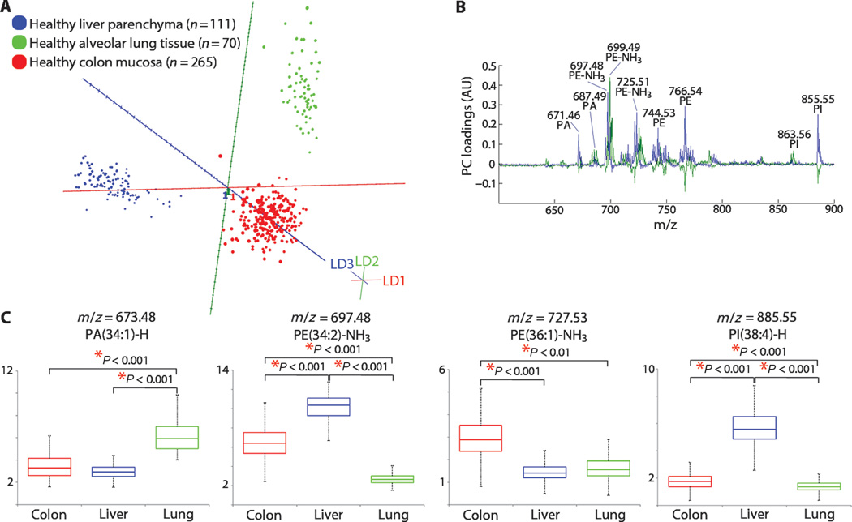
iKnife Analysis of Healthy and Cancer Tissue
Balog et al, Sci Transl Med. 2013;5(194):194ra93.

Slide 20
Zoom into Kidney specific profiles

Slide 21














Acknowledgements
Imperial College London
Kanta Chechi, Petros Andripokoulous, Michael Olanipekun, Angelos Manolias, Elliot Murphy, Julien Chilloux, Antonis Myridakis, Nadeen Habboub
Université catholique de Louvain, Brussels
Amandine Everard, Hubert Plovier, Patrice Cani
University of Rome
Marina Cardellini, Massimo Federici
University of Girona
Jèssica Latorre Luque, José Maria Moreno-Navarrete, Jose-Manuel Fernandez-Real
Nottingham Trent University
Fiona Newberry, Lesley Hoyles
Ottawa Heart Centre
David Smyth, Liyong Zhang, Peter Liu
University of Copenhagen
Trine Nielsen, Torben Hansen, Oluf Pedersen
VIB, Leuven
Sara Silva-Vieira, Gwen,Falony, Jeroen Raes
EMBL, Heidelberg
Peer Bork
U1283/UMR8199 EGID, Lille
Francesc Puig Castellví, Romina Pacheco Tapia, Inés Castro Dionicio Maxime Deslande, Mickaël Chevalier, Gustavo Monnerat Cahli, Amélie Bonnefond, Philippe Froguel
INSERM, Toulouse
Matteo Serino, Julie Charpentier, Christophe Heymes, Vincent Azalbert, Vincent Blasco-Baque, Frédéric Lopez, Remy Burcelin
INSERM, Paris
Fabienne Foufelle, Elodie Anthony, Fadila Rayah, Catherine Postic, François Brial, Dominique Gauguier
ICAN Institute, Paris
Jean-Michel Oppert, Daniel Zucker, Karine Clément
INRAE Jouy
Sebastien Fromentin, Emmanuelle Le Chatelier,
S. Dusko Ehrlich
University of Leipzig
Rima Chakaroun, Michael Stumvoll
Max Delbruck Centre, Berlin
Sofia Forslund, Jennifer Kirwan, Nicola Wilck, Tobias Pischon, Friedemann Paul

