Slide 1
Considerations
required irradiation parameters we need to know for our beamline optimization
  proton energy/LET
  dose application scheme: single pulse (~10⁸ – 10⁹ Gy/s) or accumulated (~Gy/min)
  irradiation volume: sample + holder thickness and sample diameter
  required homogeneity
  study design:
    # cell lines
    # dose points
    # repetitions per dose point
→ need to find optimal beamline settings based on these parameters

Slide 2

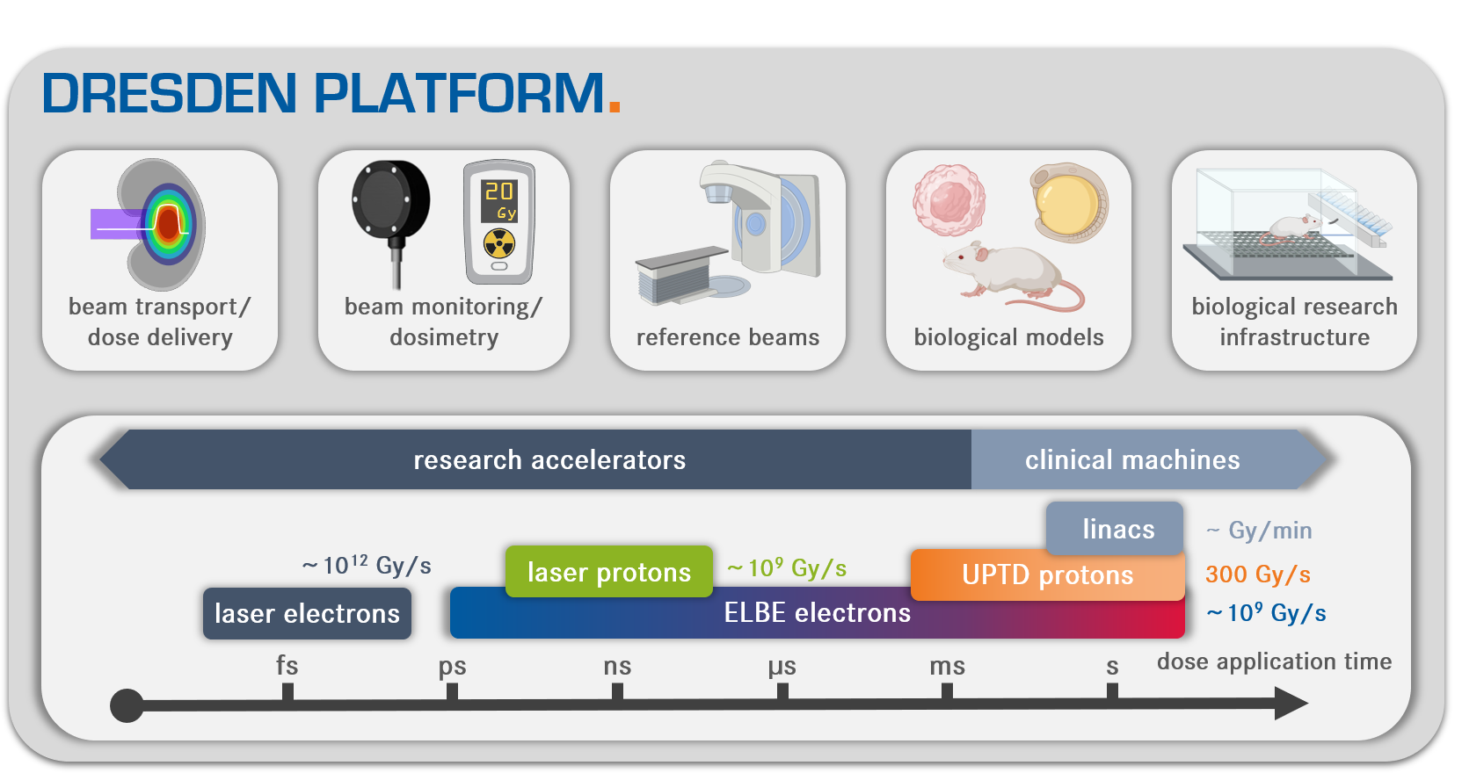
DRESDEN PLATFORM.
F. Kroll, et al. “Tumour irradiation in mice with a laser-accelerated proton beam”, Nature Physics 18, 316 (2022)
J. Jansen, et al. “Changes in Radical Levels as a Cause for the FLASH effect: Impact of beam structure para-meters at ultra-high dose rates on oxygen depletion in water”, Radiotherapy and Oncology 175, 193 (2022)
L. Karsch, et al. “Beam pulse structure and dose rate as determinants for the flash effect observed in zebrafish embryo”, Radiotherapy and Oncology 173, 49 (2022)
J. Jansen, et al. “Does FLASH deplete oxygen? Experimental evaluation for photons, protons, and carbon ions”, Medical Physics 48, 3982 (2021)
J. Pawelke, et al. “Electron dose rate and oxygen depletion protect zebrafish embryos from radiation damage”, Radiotherapy and Oncology 158, 7 (2021)
S. Brunner, et al. “Dose-dependent changes after proton and photon irradiation in a zebrafish model”, Anticancer Research 40, 6123 (2020)
E. Beyreuther, et al. “Feasibility of proton FLASH effect tested by zebrafish embryo irradiation”, Radiotherapy and Oncology 139, 46 (2019)
A research hub for ultra-high dose rate radiobiology
J. Metzkes-Ng, et al. “The DRESDEN PLATFORM – A research hub for ultra-high dose rate radiobiology”, to be submitted

Slide 3
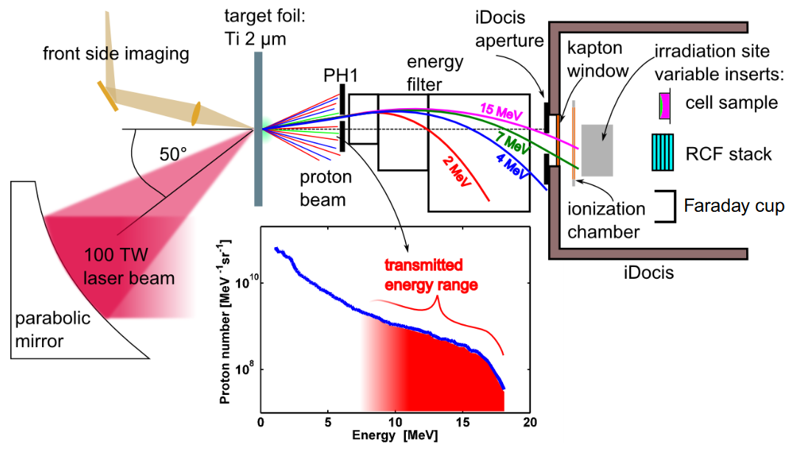
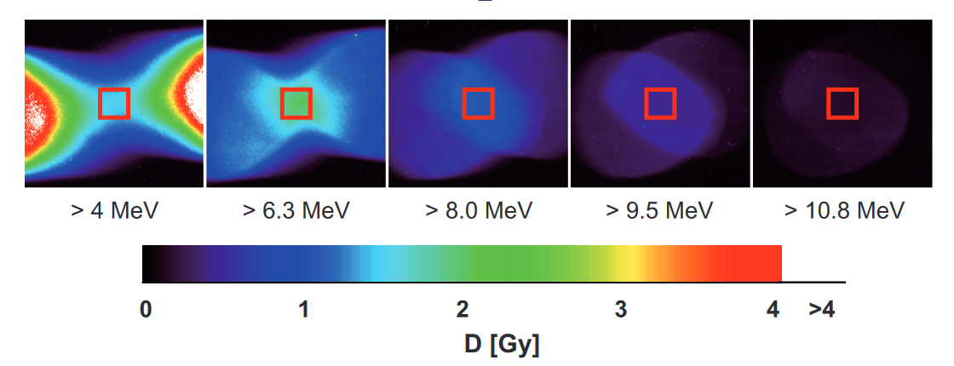
5 mm x 5 mm
S. D. Kraft et al 2010 New J Phys 12 085003
C. Richter et al 2011 Phys Med Biol 56 1529
K. Zeil et al 2013 Appl Phys B 110 437

Slide 4
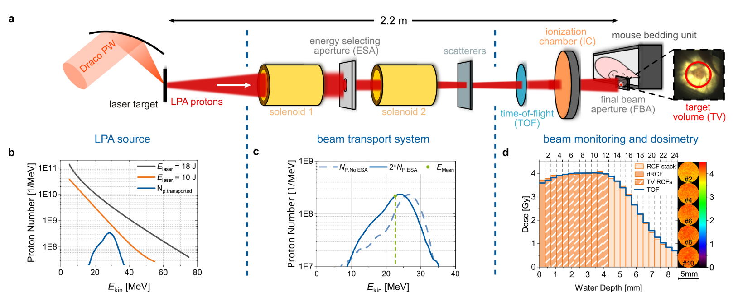
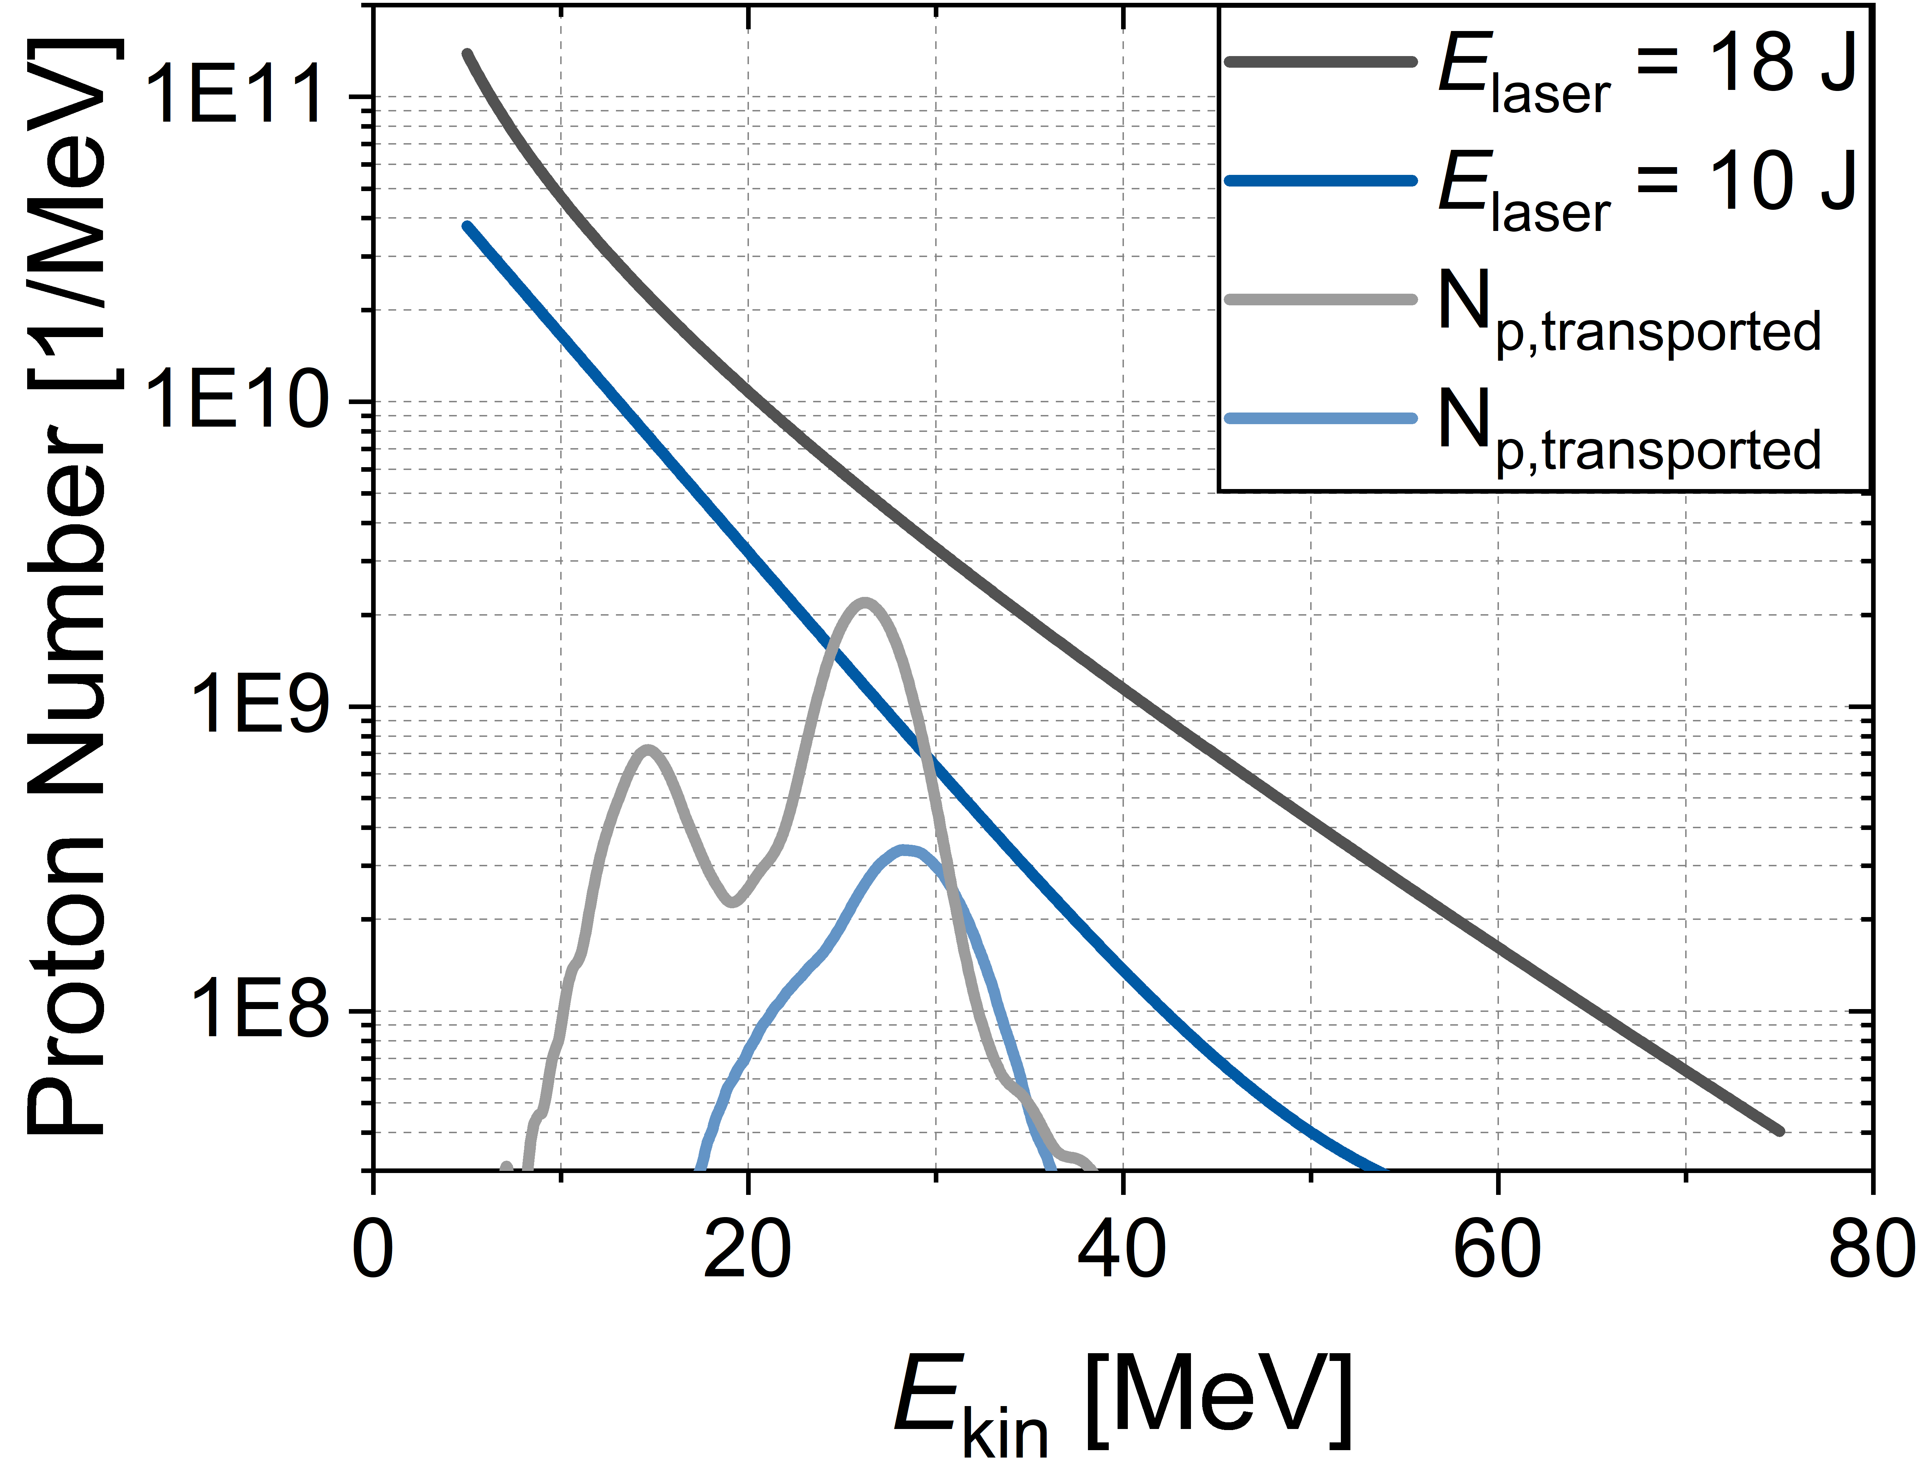
Draco PW & ALBUS-2S
Spectral beam monotoring and accelerator-readiness
F. Kroll et al., Nat Phys 18 (2022), 316
M. Reimold et al., HPLSE 11, e68 (2023)
Corvino et al., under review (miniSCIDOM)
F.-E. Brack et al. Sci Rep 10, 9118 (2020)
F. Kroll et al., Nat Phys 18, 316 (2022)
M. Reimold et al., Sci Rep 12, 21488 (2022)
M. Reimold et al., Phys Med Biol 68, 185009 (2023)

Slide 5
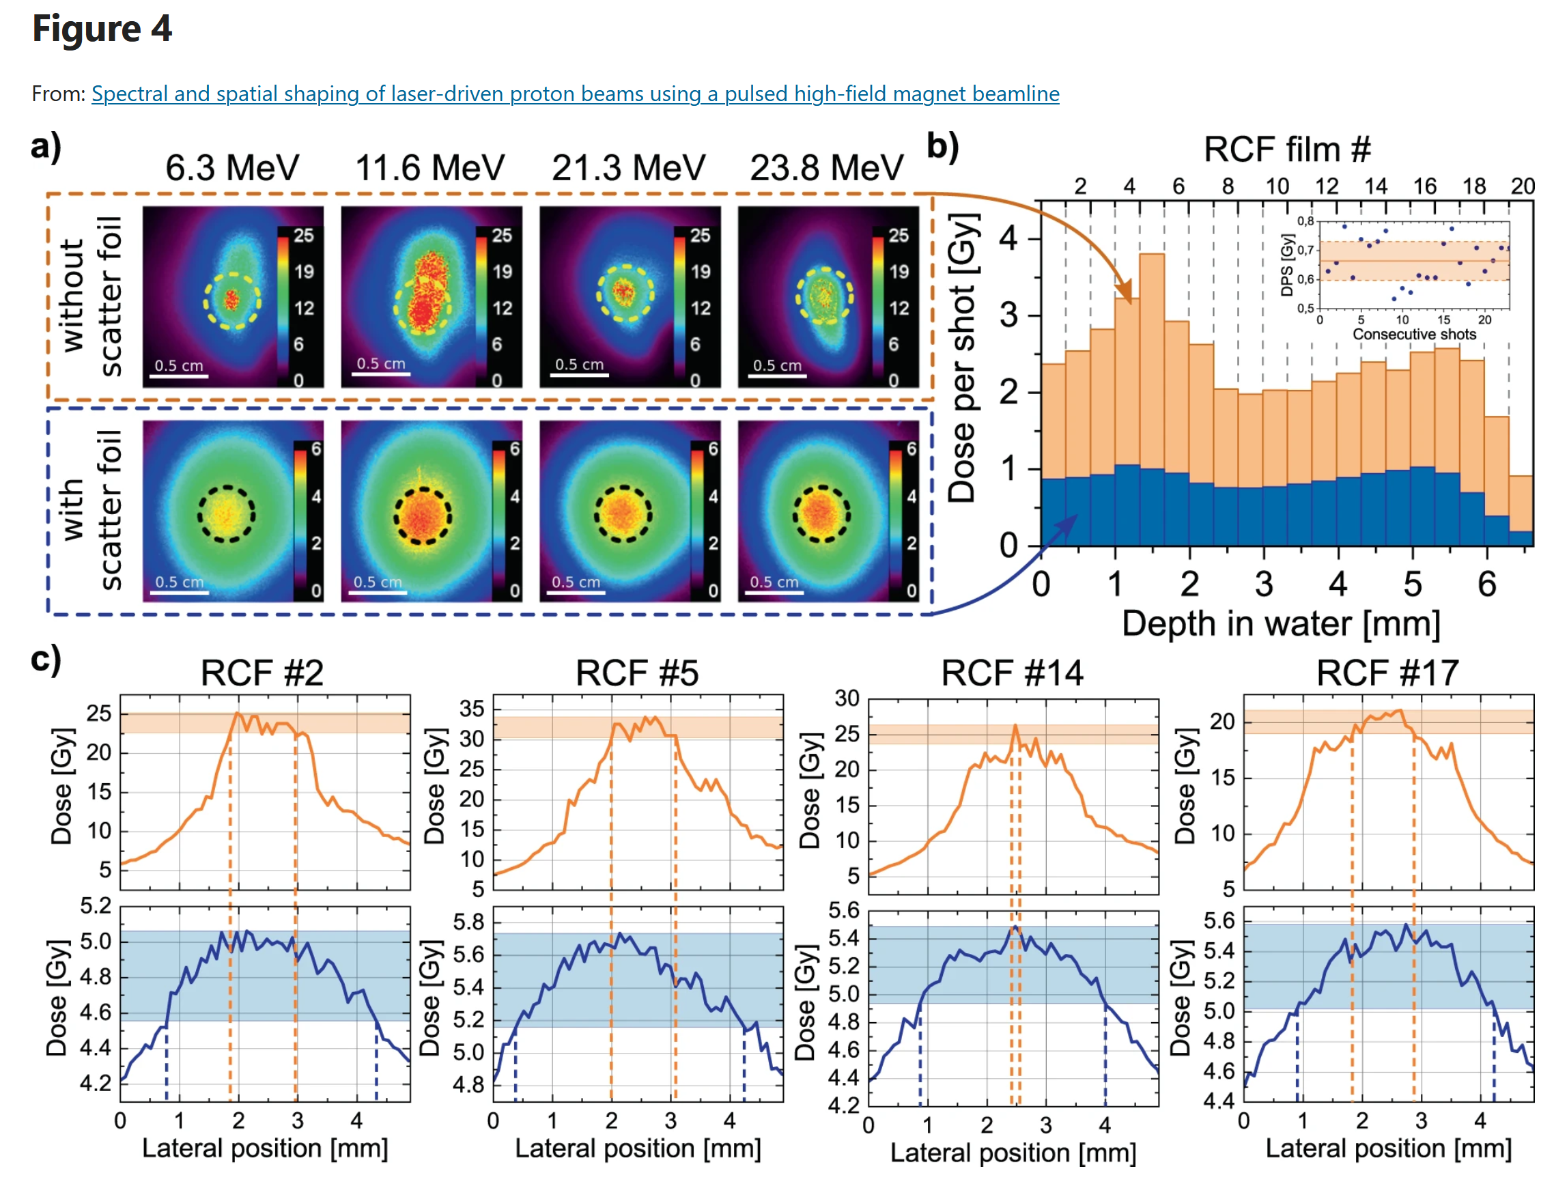
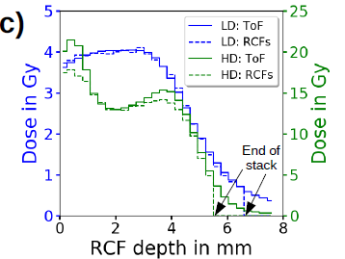
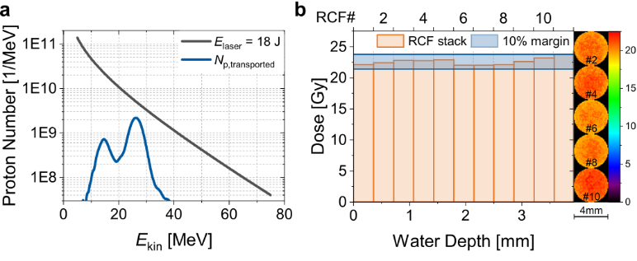

Slide 6
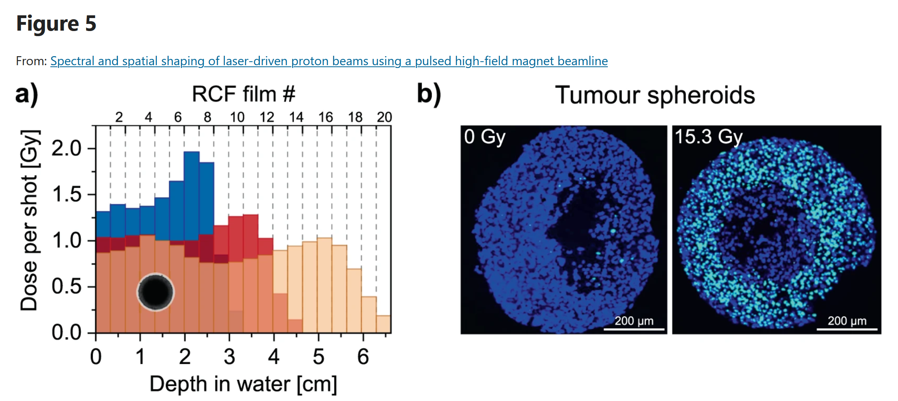

Slide 7
Draco PW & ALBUS-2S
Beam monitoring and dosimetry
F. Kroll et al., Nat Phys 18 (2022), 316
Irradiation
site
3D dose distribution in target volume (TV)
Single RCF
TV
volume dose
Transm.
IC
lateral homogeneity
depth homogeneity
TOF
p⁺

Slide 8
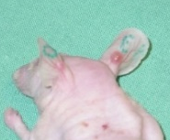
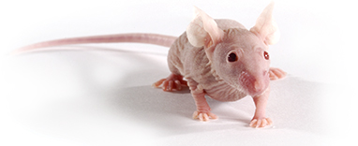
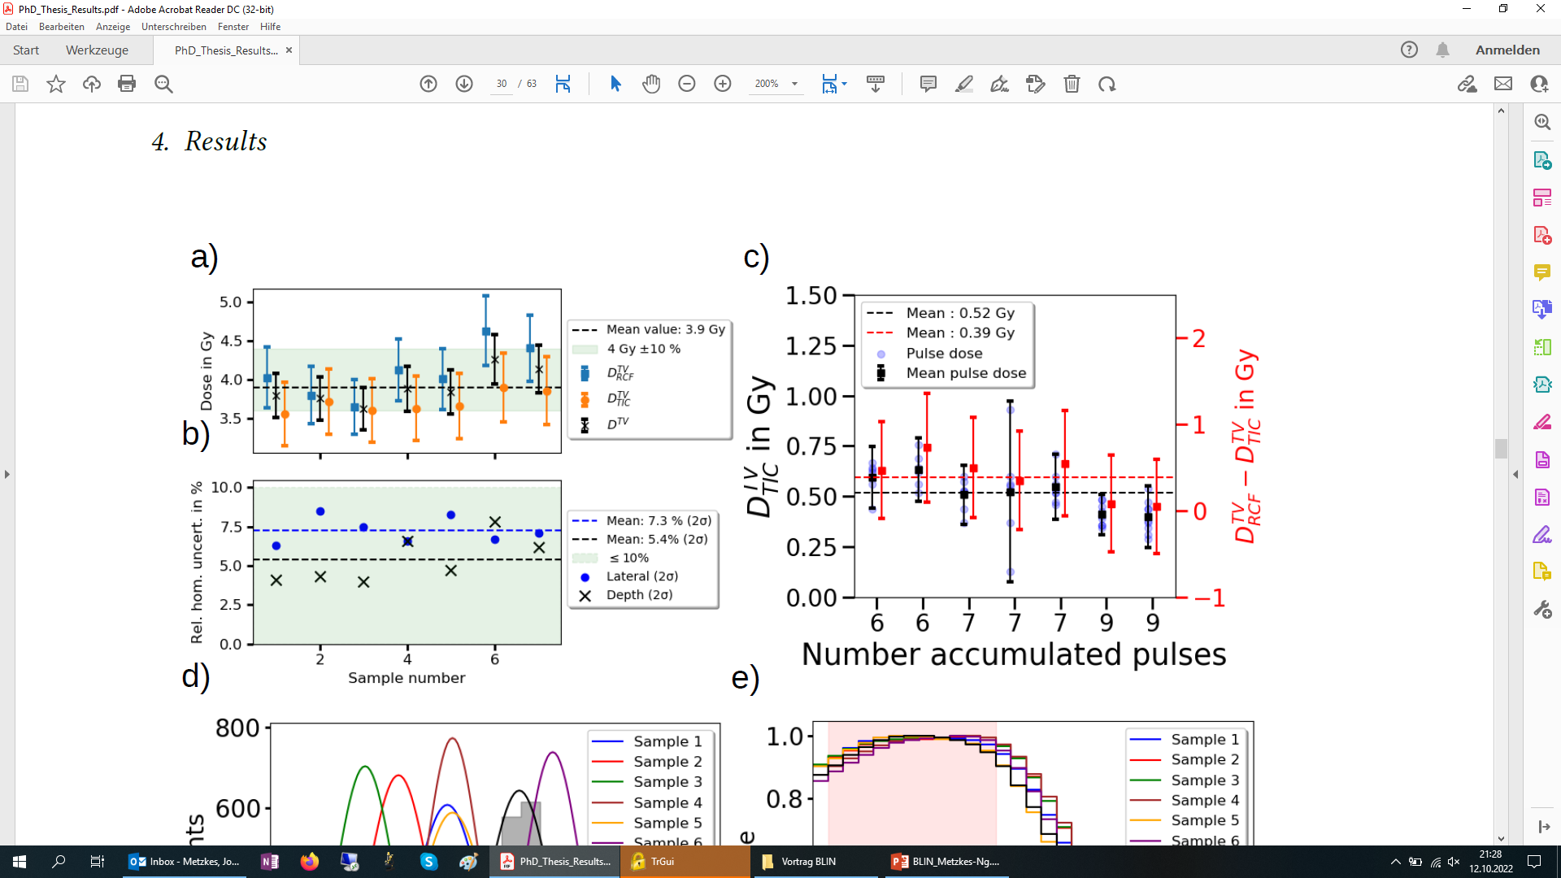
1st small animal pilot study with laser-driven proton pulses
Dosimetric results
criver.com
  ±7% (±2σ)
  agreement of independent dosimetric methods
  dose application and dosimetry concept with %-level accuracy for the full 3D dose distribution

